Slide 2
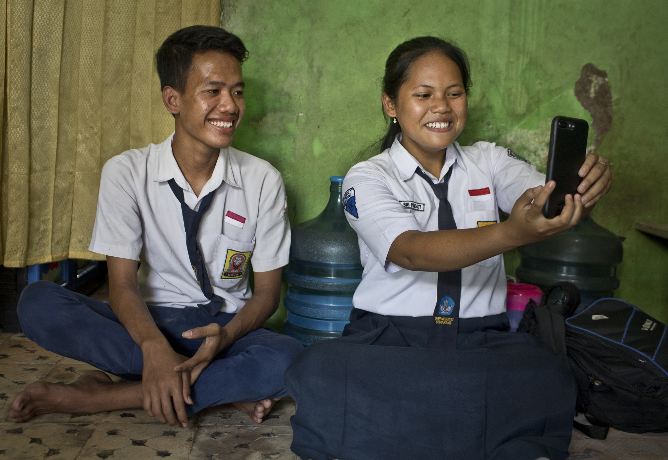
Everyone’s a hero
Article 19 Governments should ensure that children are properly cared for and protect them from violence, abuse and neglect.

Slide 3
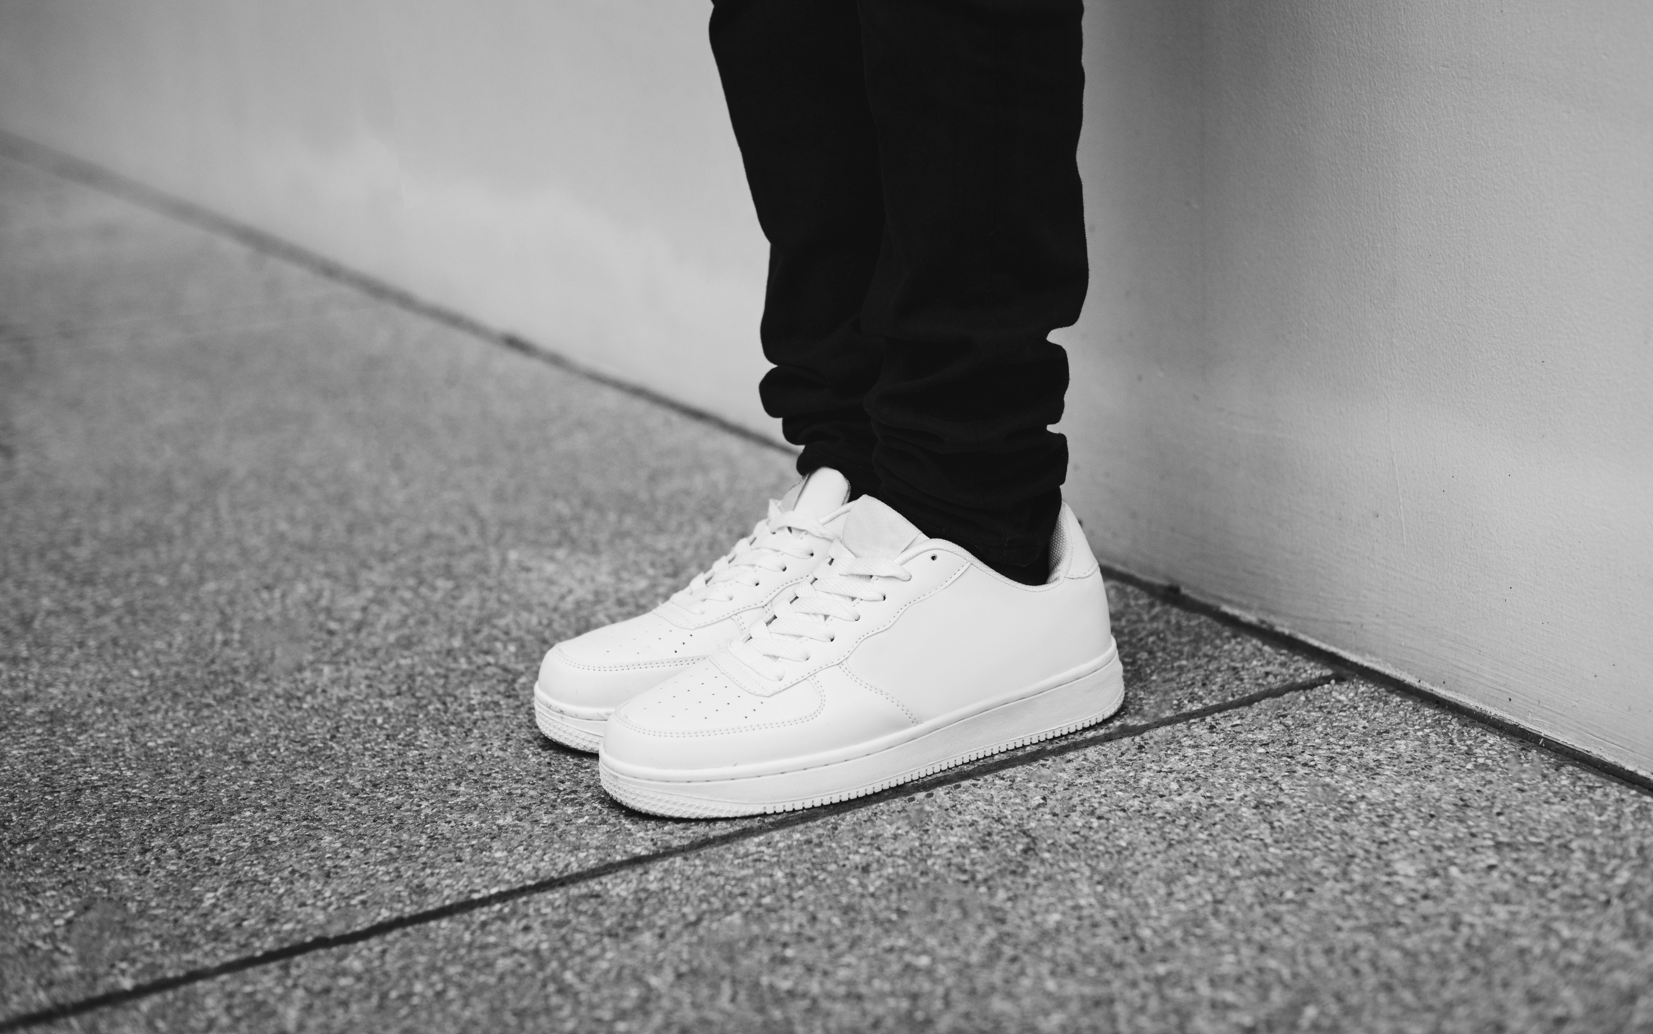
Question 1.
You are walking to school and a gang of bullies demand money or your trainers what would you do?
Fight them
Shout and try to run away
Give them what they want, and tell your teacher and parents
C. Give them what they want, and tell your teacher and parents

Slide 4
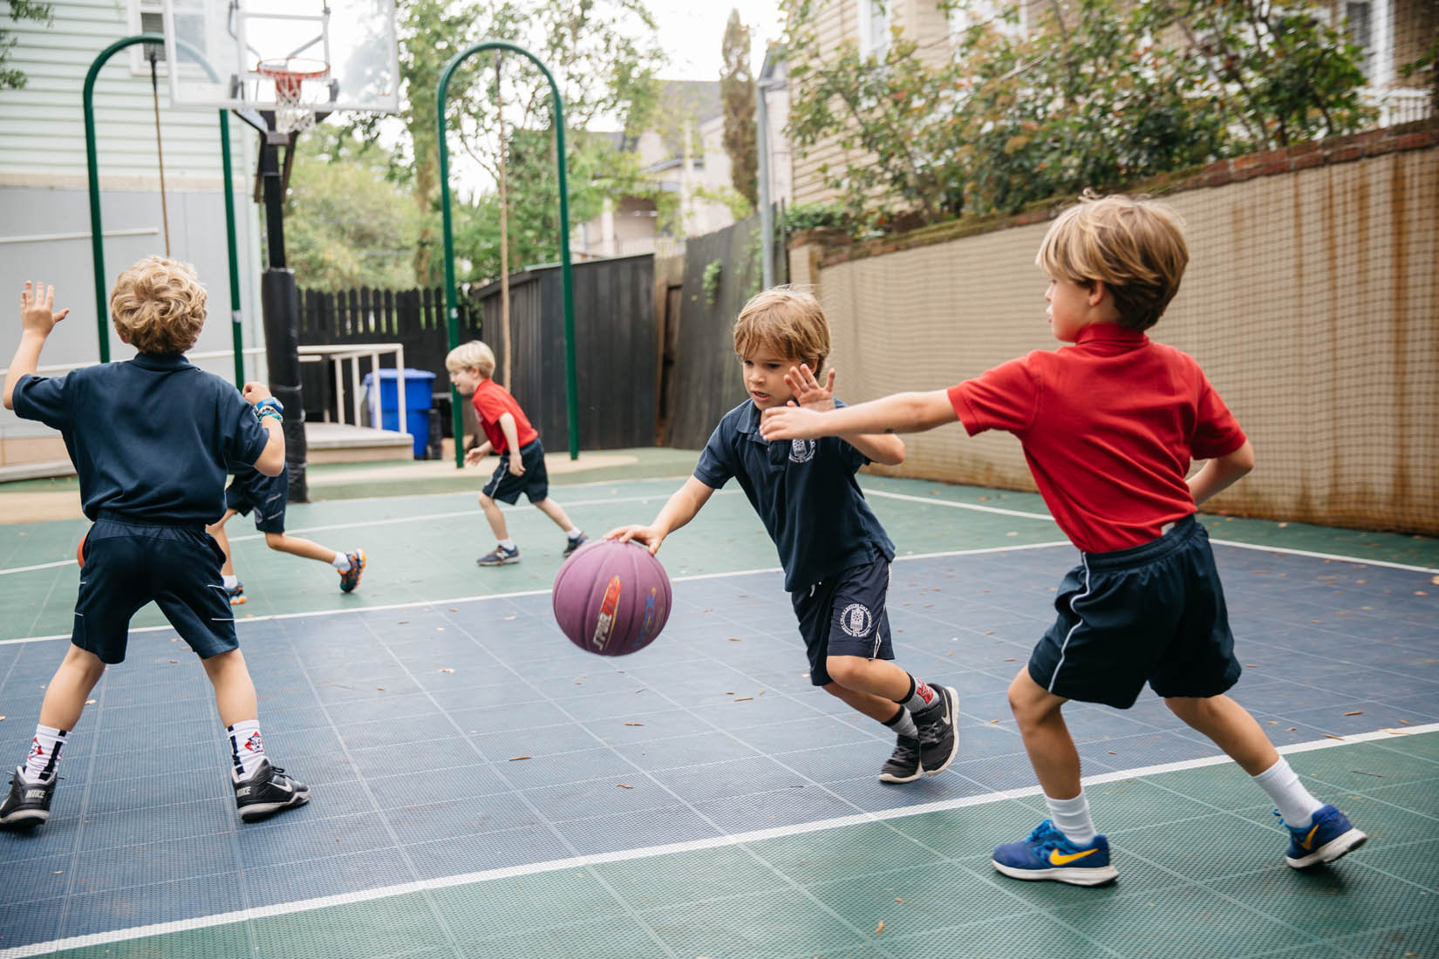
Question 2
You are on the school playground and someone accidentally trips you up. What should you do?
Hit the person hard
Give them a chance to apologise
Shout at them and tell the teacher they deliberately hurt you.
B. Give them a chance to apologise

Slide 5
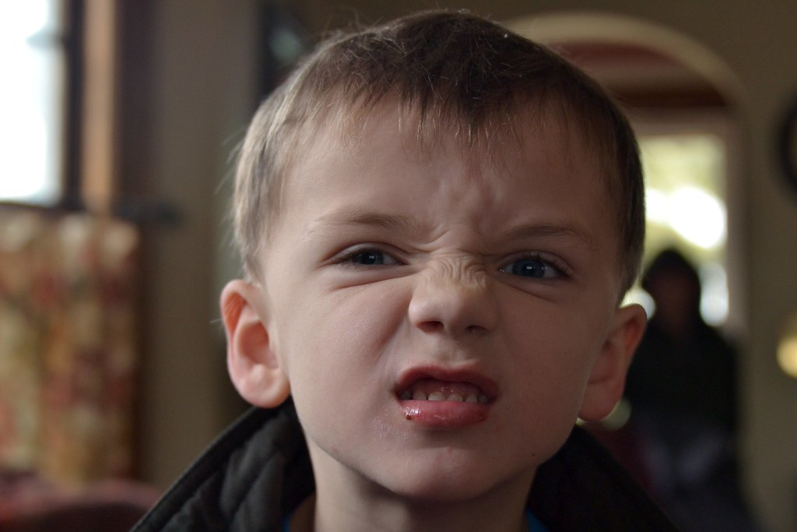
Question 3
Someone in your class is always making rude comments about you and says them loud enough for you and others to hear. It really upsets you. What do you do?
Get angry and punch the bully
Make nasty remarks back
Try not to react and tell the teacher or a trusted adult
C. Try not to react and tell the teacher or a trusted adult

Slide 6
Question 4.
You see someone being bullied. What should you do?
Get help or say ‘stop it please’ to the bully – but only if you won’t get hurt.
Ignore it, walk by and be thankful it isn’t you
Laugh at the bully’s victims in the hope that the bully won’t pick on you next time.
A. Get help or say ‘stop it please’ to the bully – but only if you won’t get hurt. Don’t be a bystander.

Slide 7
Fairness
Responsibility
Rights
Justice
Harmony
RESPECT

Slide 8
Bullying is wrong. We do not accept it at Stratford primary school

Slide 9
Recycle for funds
Collect items of clothing no longer needed and bring them in Friday
They will go to a company who recycle them
Be sustainable
Raise money for our school

Slide 10
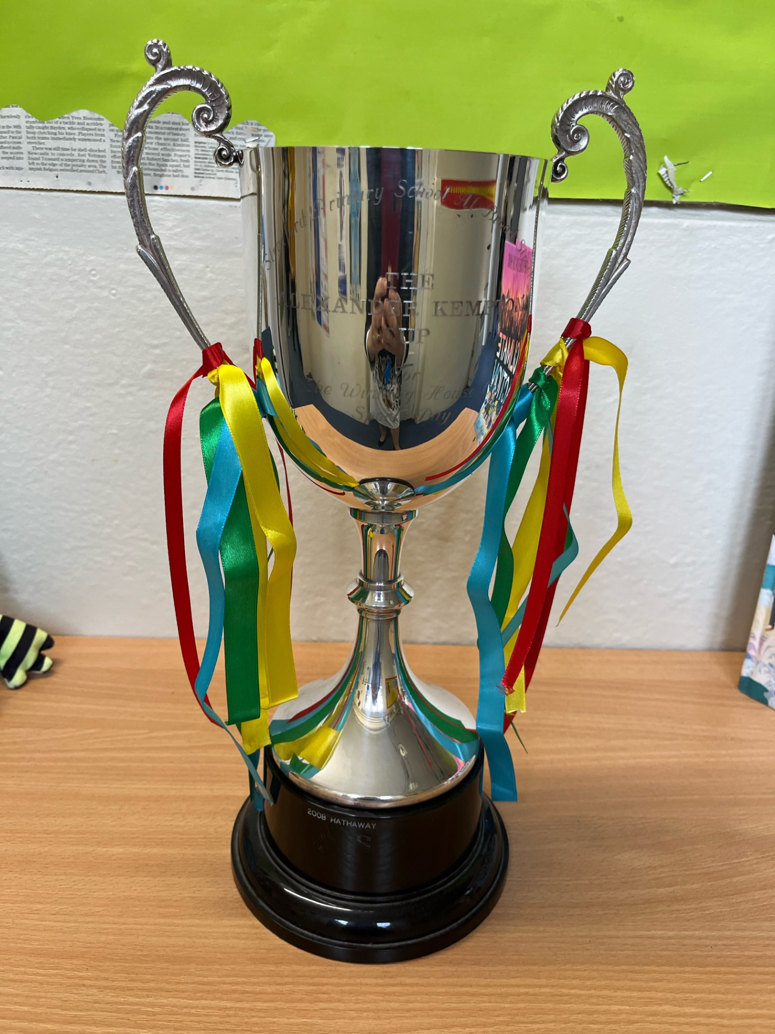
House Points
How many dojos did you have last week?
Did you know your dojos help your house team?
Work together
Each half term the winning house will get to choose a treat such as:
A movie afternoon or exclusive use of the paddock or a walk by the river or extra playtime or an afternoon of painting and art & craft.

Slide 11
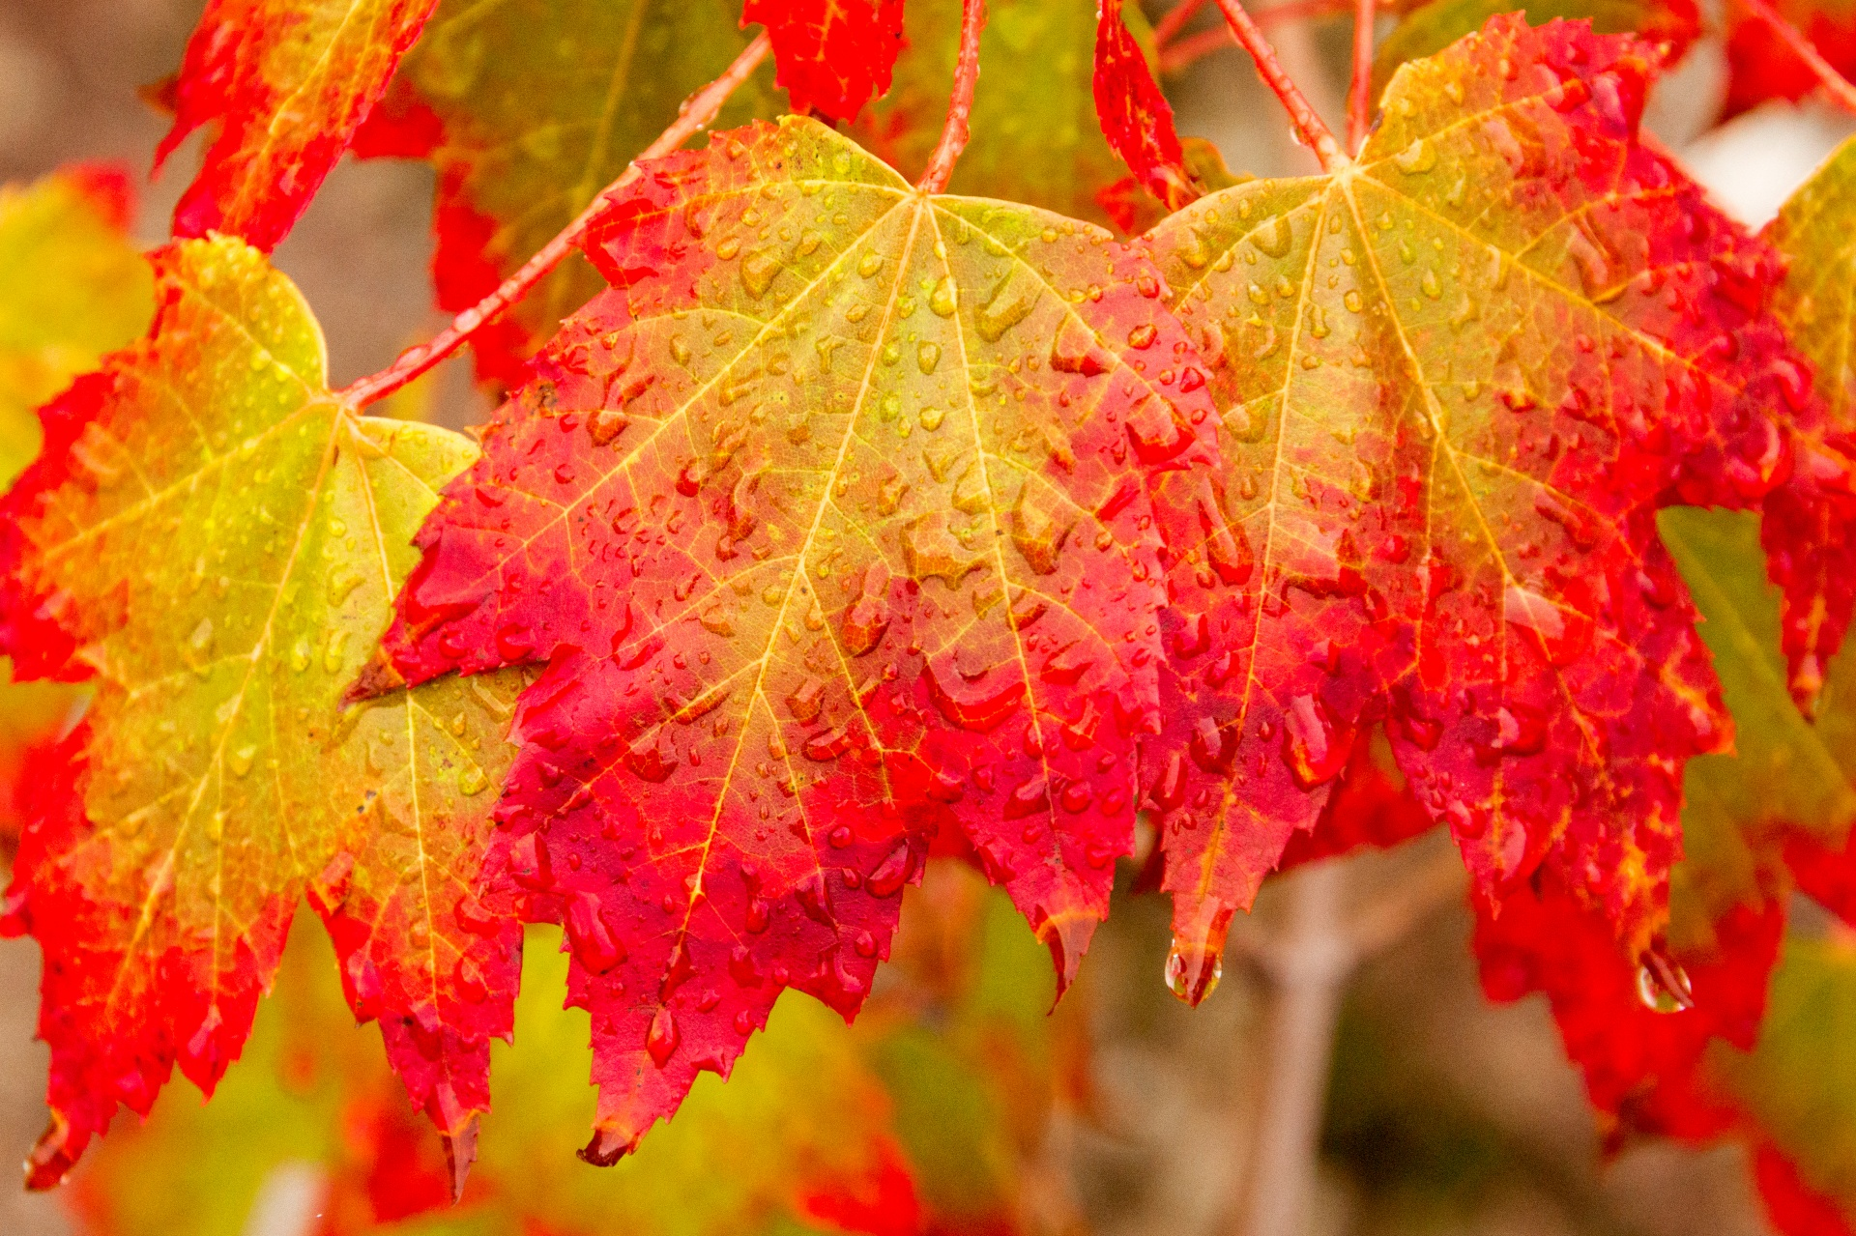
Let’s sing
Autumn leaves are falling down.

