Slide 1
Year Three
Welcome to
2023-24

Slide 2
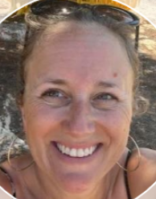
Year 3 Staff
Teacher
Mrs Slater
Support Staff
Mornings
Mrs Beesley
Afternoons
Mrs Buchanan

Slide 3
School starts at 8:45am. Children arrive at school, put their belongings in their lockers and settle down quietly to complete their early morning activities during registration time. They then move straight into morning lessons, which are the core subjects: English and Maths, as well as TTRS on the iPads and focused spelling sessions. The afternoons are dedicated to foundation subjects and many will be taught and enhanced by the theme for the half term – for example, Predator! in autumn 1. Please see the timetable for further details. Throughout the week, the children have daily handwriting practice and modelled reading.
A Typical Day in Year 3

Slide 4
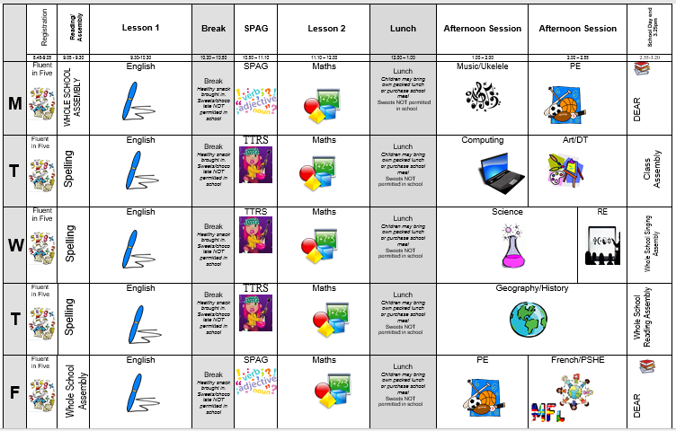
Class Timetable

Slide 5
PE and Outdoor Learning
Our PE lessons are on Monday and Friday. Children need to bring named PE kit on those days, including suitable footwear.
We will have lots of opportunities for outdoor learning this year, including trips to the Heart of England forest. You will be sent dates with plenty of notice – waterproofs and wellies/walking boots will be needed!
Please ensure every item is clearly named!

Slide 6
How we assess the children
Assessment in KS2 is carried out daily, using live marking and targeted questioning as the children are working. This is to ensure that feedback is immediate and children can respond immediately, ensuring the misconceptions are quickly addressed.
Throughout the year, children will take part in assessments in reading, writing and mathematics to inform us of next steps; gaps in learning etc. Alongside teacher judgements, we will then be able to target and support the learning.

Slide 7
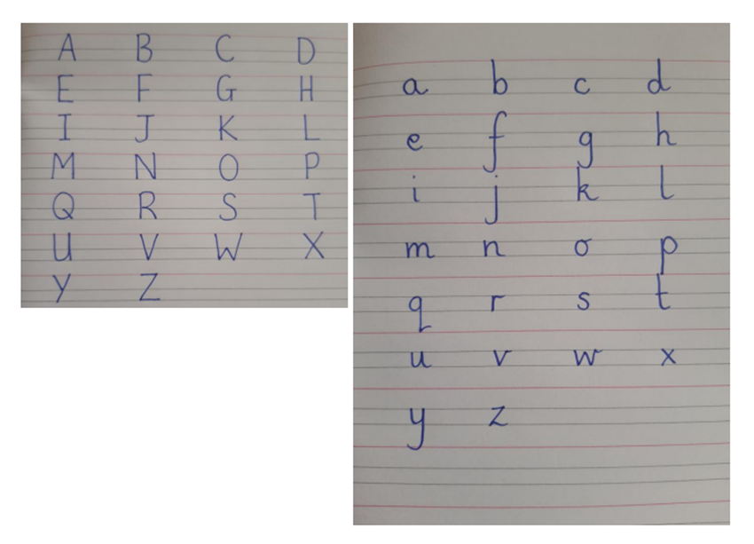
Homework
Reading- Please read with your child regularly, books and reading records need to be in school everyday! The children will be able to change their own books, however I will be keeping a close eye on how often they are changed and the suitability of their choices. I will send home targeted reading books where I feel this is appropriate.
Spelling - Daily practice in school. The children will have spelling every week for homework. These will go home on a Monday to be checked the following Monday.
Maths- TTRS three times a week in school. Homework will be set as per the spelling homework.

Slide 8
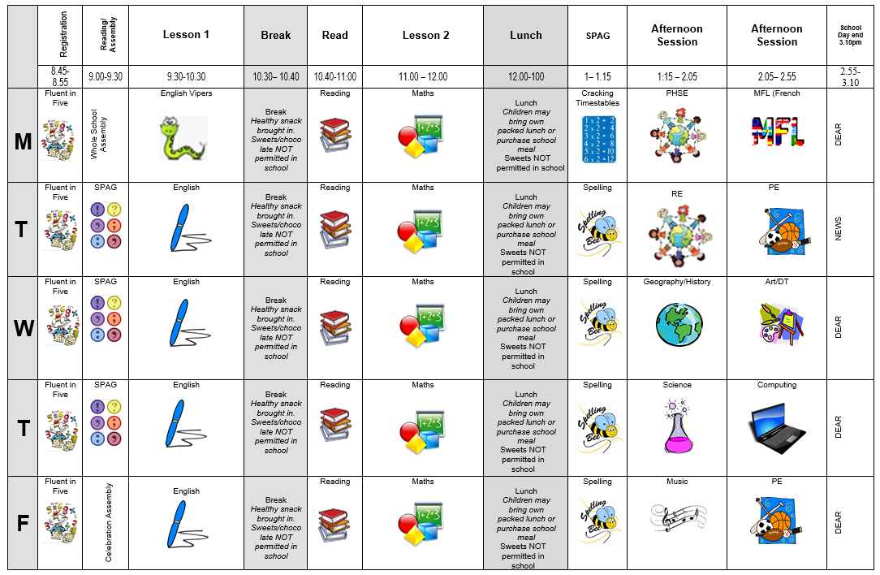
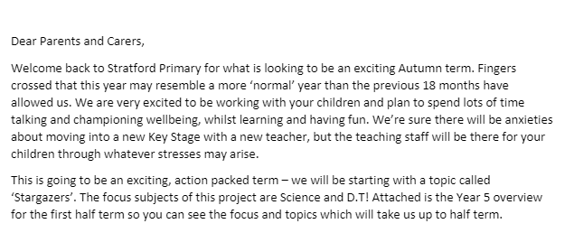
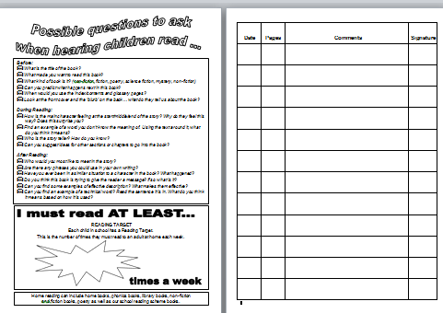
Communication
Timetable​
Parent letter
Weekly News Letter​
eSchools-home learning
Reading diary ​
Twitter- learning

Slide 9
Communication
We are always here to support and listen. You may come and talk to us at the end of the school day. If it is urgent, please email the school office. ​
​
If you have any minor inquiries, such as lost items/afterschool clubs, you can contact us via the school office. You can also use reading diaries to send messages. ​​
Important issues can be spoken about in person and appointments with teachers can either be done directly through teachers or via the school office.
​
​Serious injuries will be either a phone call home or a face-to-face chat. Minor injuries such as cuts and grazes will be communicated via accident forms which are given out at the end of the day.​​
.

Slide 10
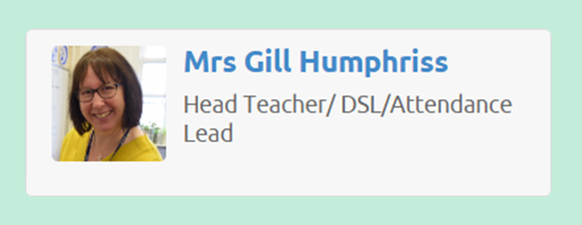
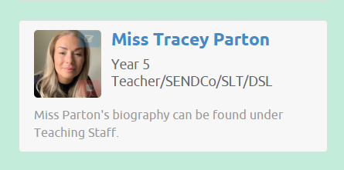
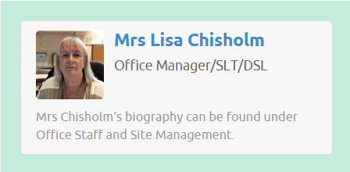
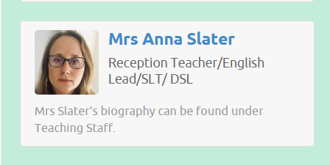
Additional Support/Concerns…
If you have any concerns about your child or need our support, you can directly come and talk to me after school. You may want to contact the school office and arrange a meeting in private.
The DSL team are always welcoming and can support you with your concerns.
You can email or phone - more contact information is available on the website.​
​

Slide 11
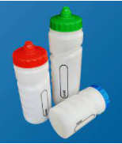
Expectations
Behaviour – high expectations, in class, in the playground, moving around school, on educational visits, when visitors are in and during after school clubs.
School uniform / PE kit / Lost Property – LABEL!
Presentation, in school and when completing work.
Encourage independence – children to inform when they need a book changed, need to hand in a letter, bring sheets and uniform home, hand homework in.
Named water bottle needs to be in school every day.
Phone or email the school office of your child is absent.

Slide 12
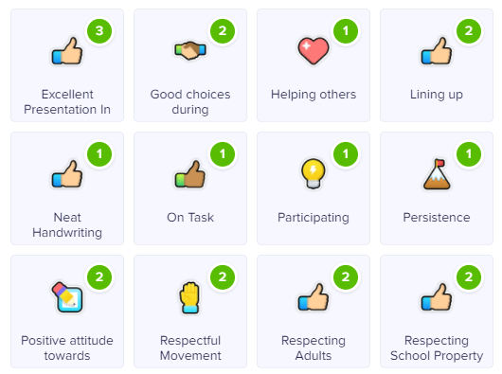
Celebrating Success…
Well-being Warrior in celebration assembly
Topic Sharing Events/Writer of the month
Looking at the website and Twitter
Stickers, Dojo points, House Points, and ‘WoW’ board

Slide 13
AOB…
​
Healthy snacks for break and in lunches
Clearly label: uniforms, coats, shoes and bags
Toileting!
​
PE is on a Monday and Friday - Please send them to school with PE kits
​
Following us on Twitter ​
​
RESPECT – the one school rule ​
​

