Slide 1

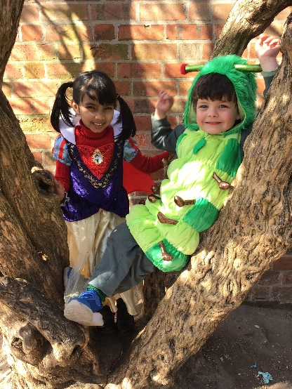
Welcome to Stratford Primary!
A guide to starting Reception

Slide 2
Welcome
Brief intro to Stratford Primary School
EYFS (Early Years Foundation Stage)
In the Classroom
Support from Home
Preparing for School

Slide 3

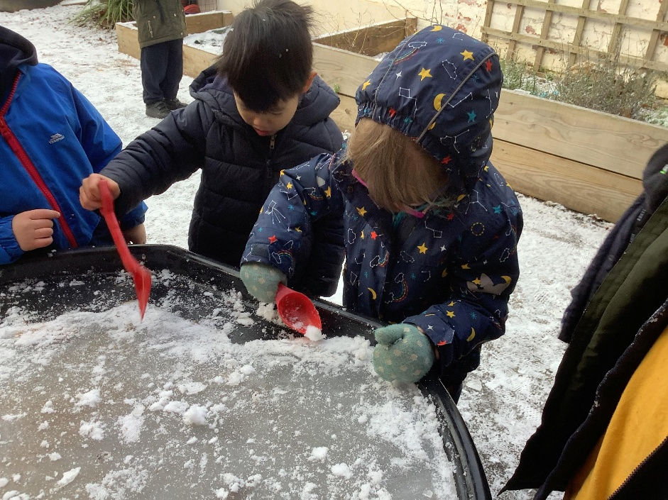
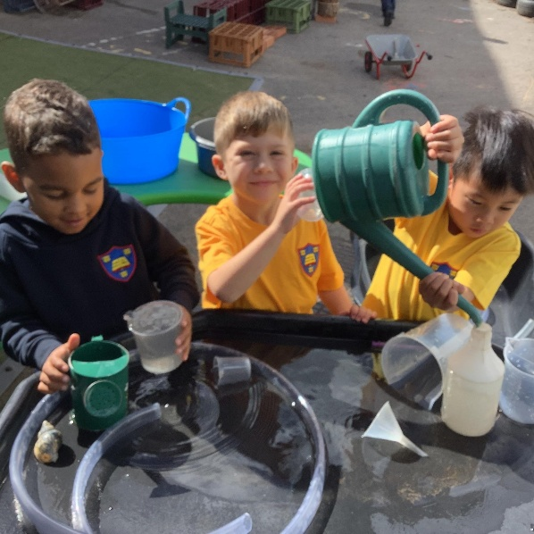
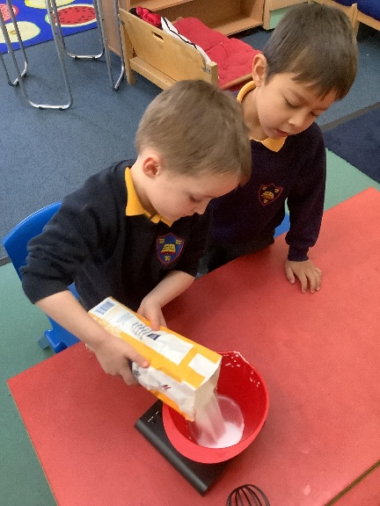
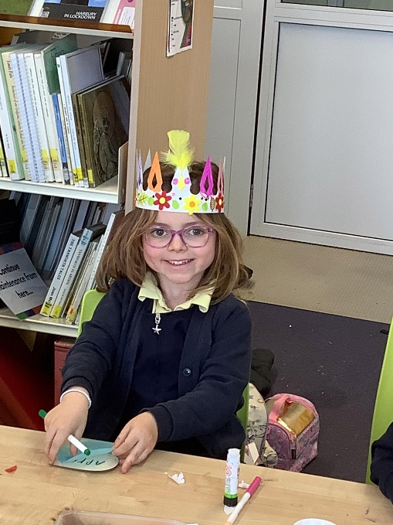
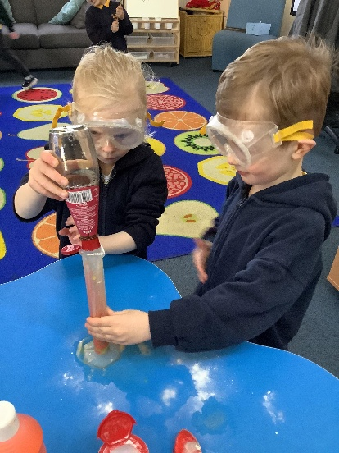
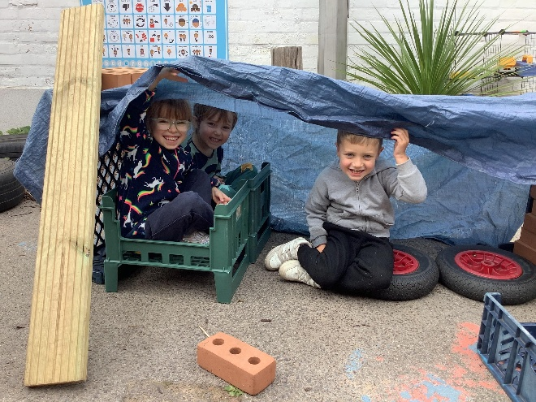
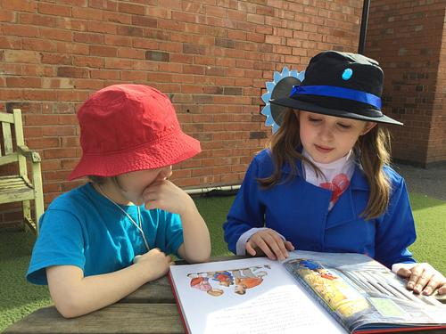
Stratford Primary School – established 1823
Our vision – To create a happy place, where children and adults learn and flourish in a creative, rewarding atmosphere and are given as many opportunities & experiences to increase their life chances and careers.

Slide 4
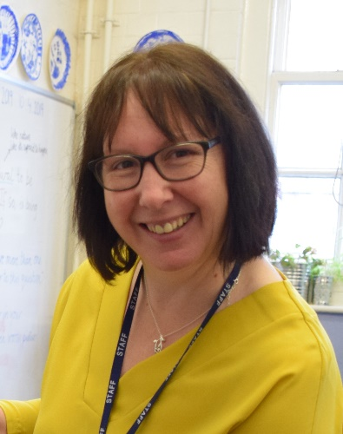
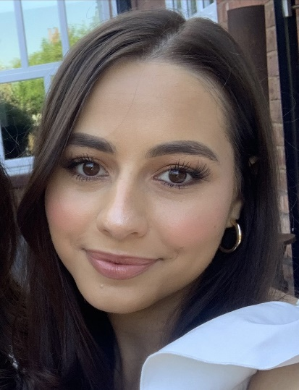
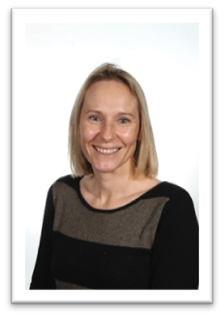
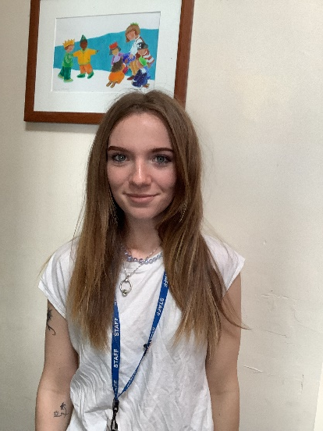
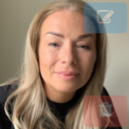
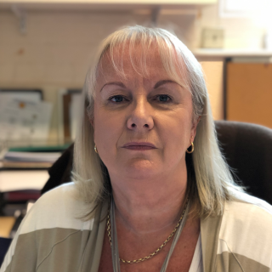
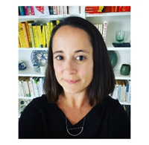
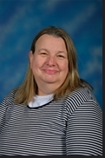
Meet some our key staff
Mrs Humphriss
Head Teacher
Lead DSL
Miss Hitchens
Class Teacher
Mrs Banks
Teaching Assistant
Miss Buchanan
Teaching Assistant
Ms Parton Assistant Head and SENDCo
Mrs Dale - Office
Mrs Chisholm – SBM - Office
Ms Chapleo
SLT

Slide 5

The EYFS (Early Years Foundation Stage)

Slide 6

7 areas of learning
Communication and Language
• Physical development
• Personal, Social and Emotional Development
• Literacy
• Mathematics
• Understanding the world
• Expressive arts and design

Slide 7


EYFS profile and assessment

Slide 8
What should your child be able to do by the end of EYFS academically
By the end of the Reception year the goal is for your child to:
• Read simple sentences without help
• Write in sentences without help
• Order, recognise and write numbers 0-20
• Add and subtract with simple numbers
• Double and halve and share amounts equally
Regular attendance is crucial in order to help support children achieve this.

Slide 9
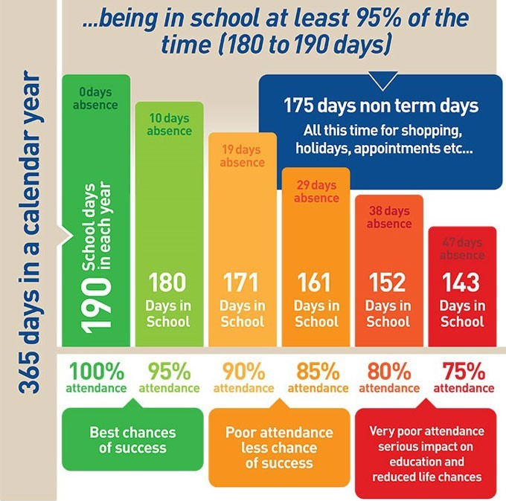
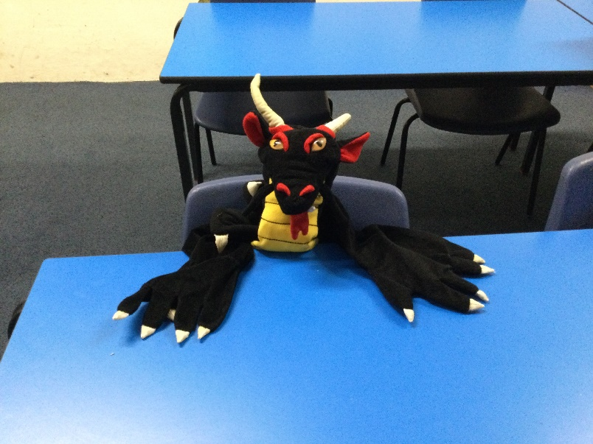
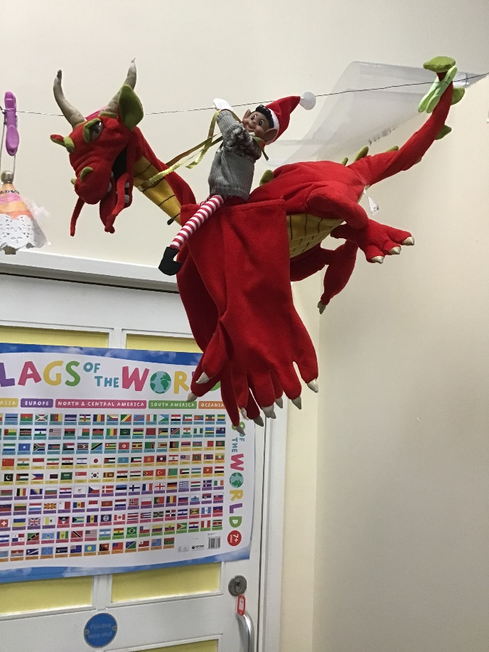
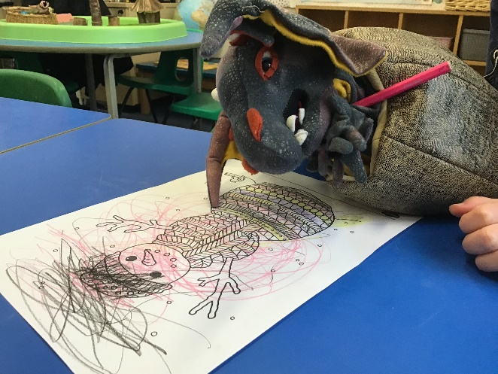
Attendance

Slide 10

In the classroom

Slide 11

School Day Timings
Our Reception children will start full time on Thursday 4th September.
Our school gates open at 8.40am. You can walk your child round to the Reception to begin with and help your child enter the building. The gates close at 8.55am. If you are late then you must go to the school office and sign your child in.
Lunchtime is 12 – 1pm
The school day ends at 3.20pm. The gates will open at 3.15pm to give you time to walk round to the playground. Please wait around the edge and wait for Miss Hitchens to release your child to you.

Slide 12
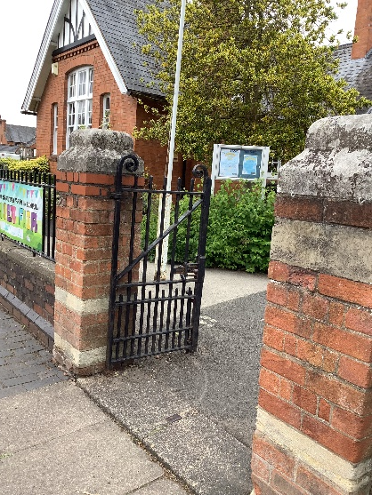
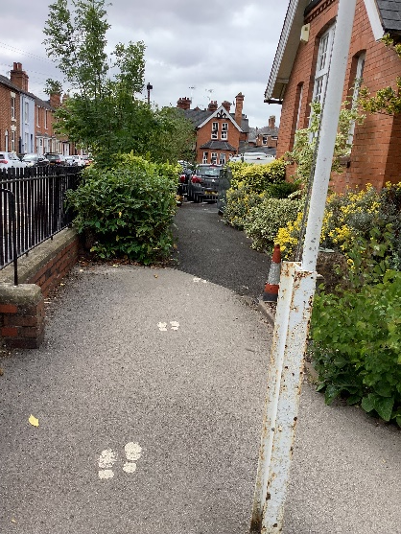
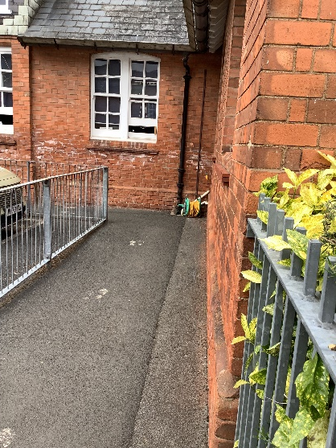
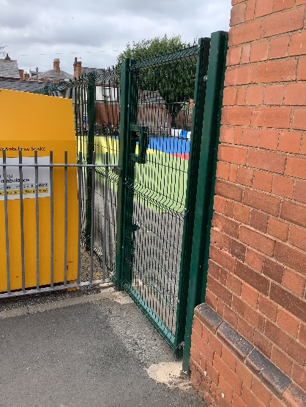
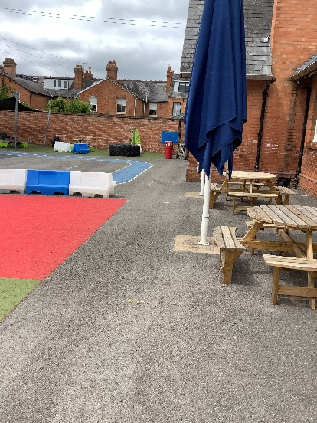
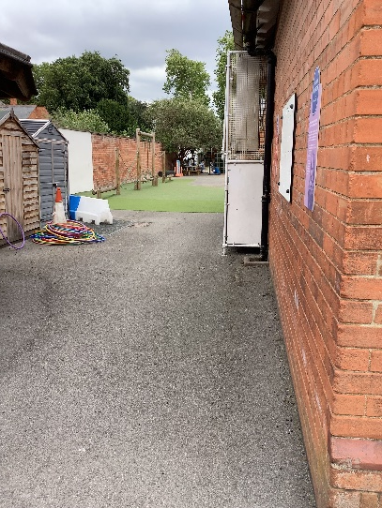
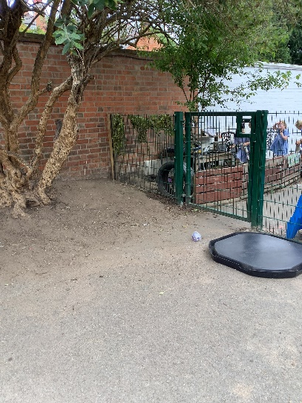
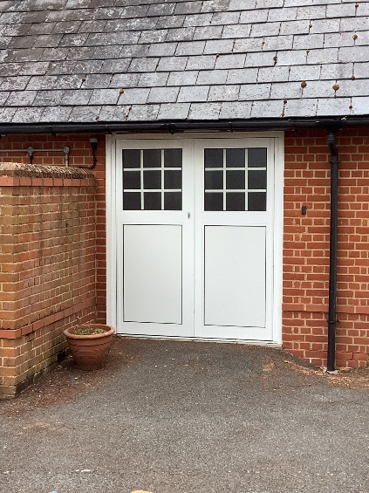
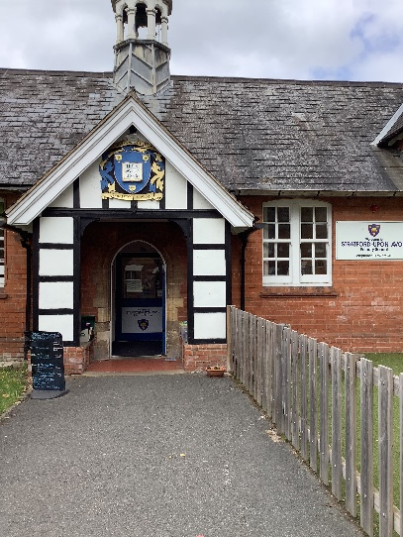
Where to go…
Enter through here
Walk along here
Go round the corner
Wait here – until it opens
Walk along here
This is the hall door for assemblies and Fitt4kids
Keep walking along here
This is the gate to Reception
This is where the school office is

Slide 13


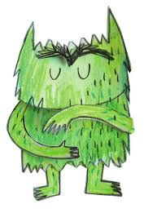


Colour Monster
Angry
Sad
Calm
Muddled

Slide 14

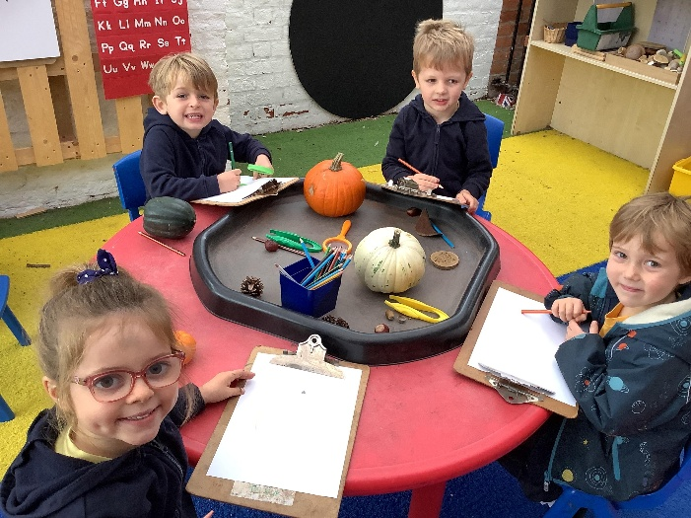
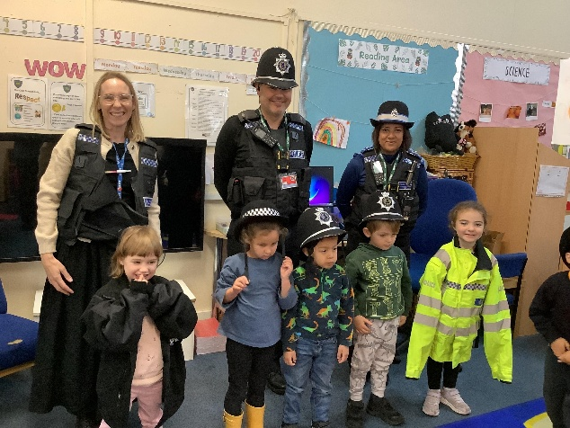
Daily Teaching
Each day there will be a mixture of:
 Exploration and Play 
Whole Class Work (number rhymes and songs, counting, games, listening to stories, learning and talking about number facts, watching shared writing)
 Taught Group Work (working with other children and a teacher)
 Independent Group Work (working with other children alone)
To begin with your child will bring home books to sit and read with you. Phonics teaching will not start straight away. We want to immerse children in songs, rhymes, stories and poems. Learning from others and hearing words read out loud develops a life long love of reading.

Slide 15

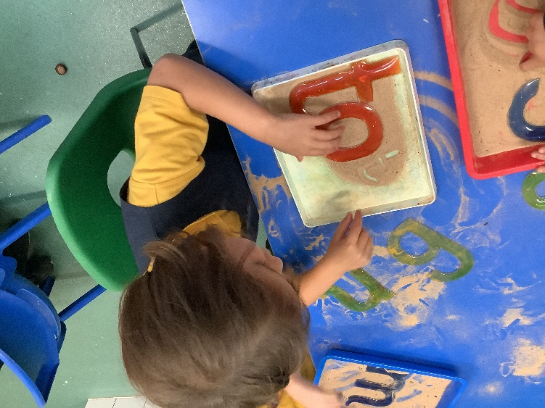
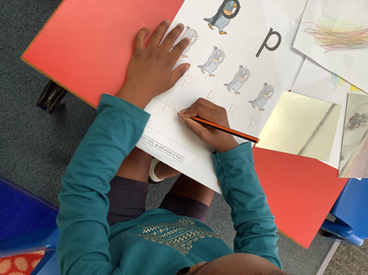
Phonics and Writing
We follow Little Wandle phonics schemehttps://www.littlewandlelettersandsounds.org.uk/
The pace of learning the phonetic sounds that enable a child to read are fast.
In the Autumn Term the children will learn the name of the letter, the sound it makes and how to write it. 
We teach the children how to write in a variety of ways – they learn to form the letters correctly. Please don’t teach them to join or write in capitals.

Slide 16

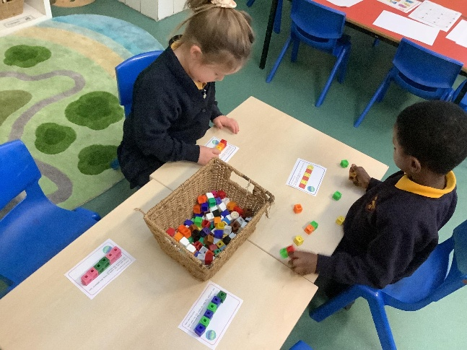
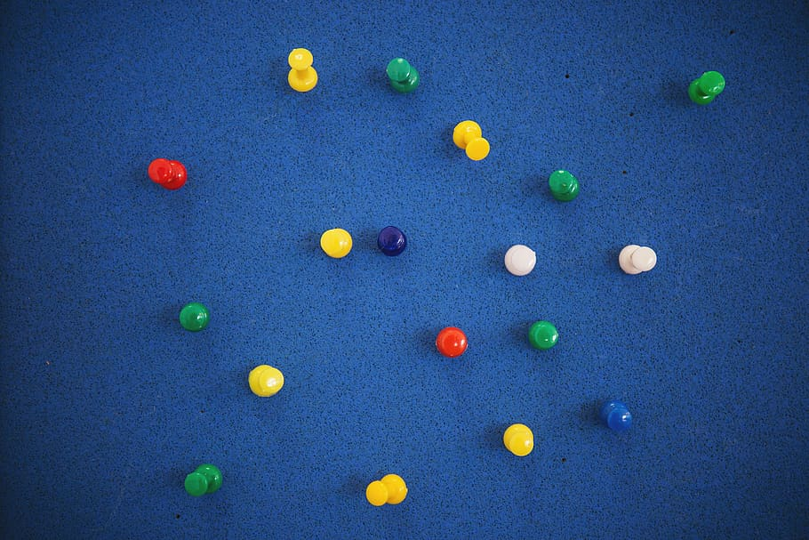
Number work
By the end of the year the children have to be confident with numbers to 20.
This does not mean just being able to count to 20, but understanding number thoroughly, e.g. that the number 8 is the same as double 4, or 5 +3, or 2+6, or 1+7 etc.
The children will learn how to add, subtract, divide (“share”), halve and double over the year.
You may hear the word ‘subitise’. Basically this means ‘It's the ability to look at a small number of objects and instantly recognise how many objects there are without needing to count.’

Slide 17
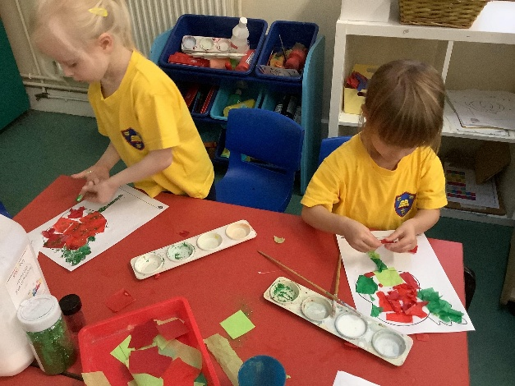
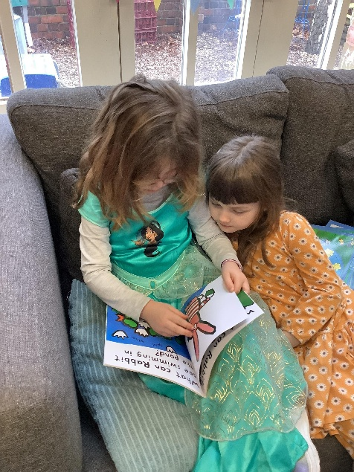
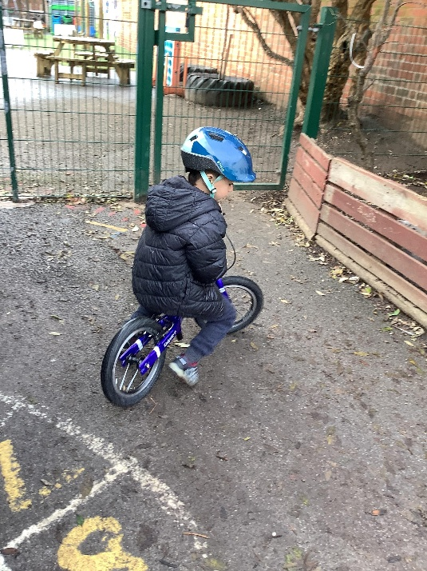
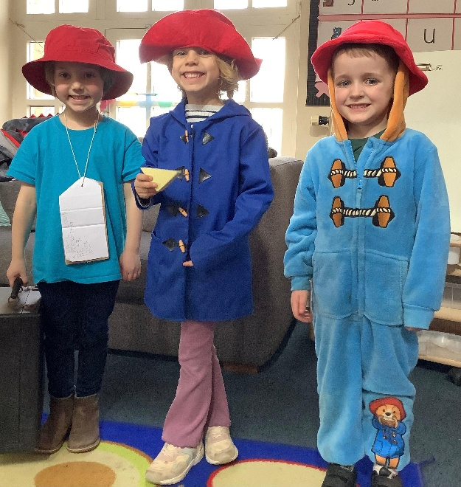
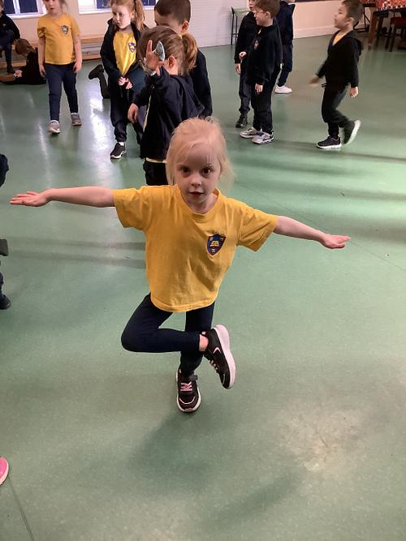
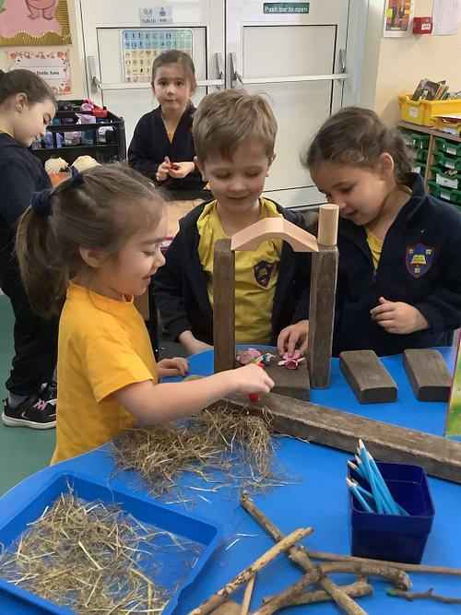
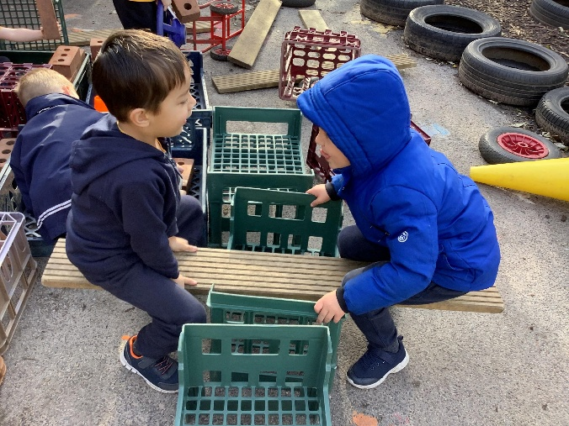
Continuous provision
Exploring
Talking
Problem Solving
Creativity
Learning
Playing

Slide 18
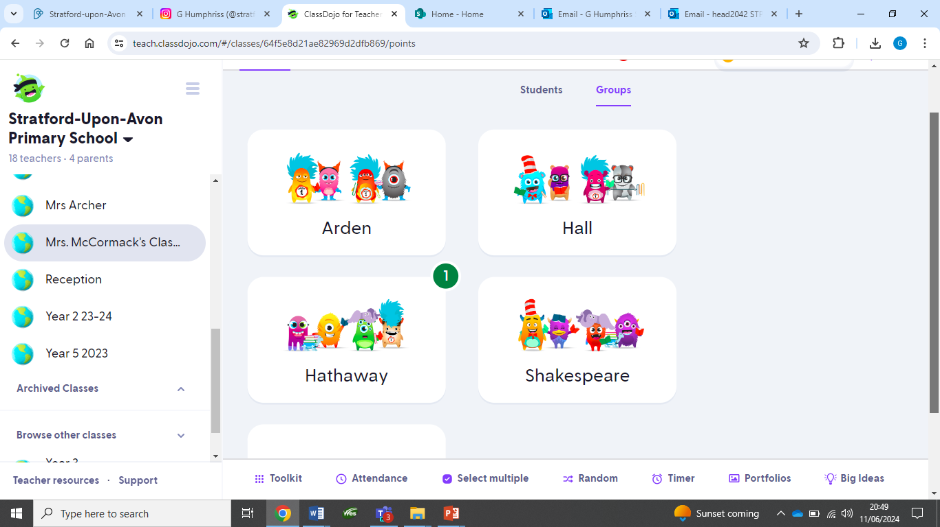
Communication – Class Dojo/Houses

Slide 19
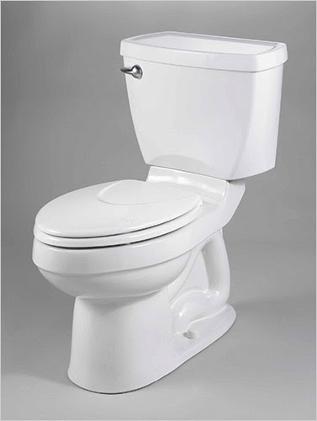

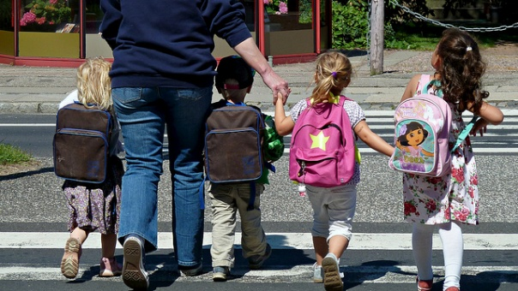
How you can support your child and school…
Get them to practise putting on their school uniform, including PE kits, shoes and coats. This forms part of the ELG and means we can focus on teaching and learning.
Get them to use the toilet independently
Teach them to wash their hands
Carry their own bags and manage their personal belongings
Sit and listen to short stories or simple instructions
Take turns and play co-operatively with other children
Talk about their own feelings and ask for help
Introduce them to the green gate and leaving you!
Support and reinforce our expectations of excellent behaviour. RESPECT
Tidying up and helping at home.
Be on time!

Slide 20
Buddies

Slide 21

Preparing for school

Slide 22
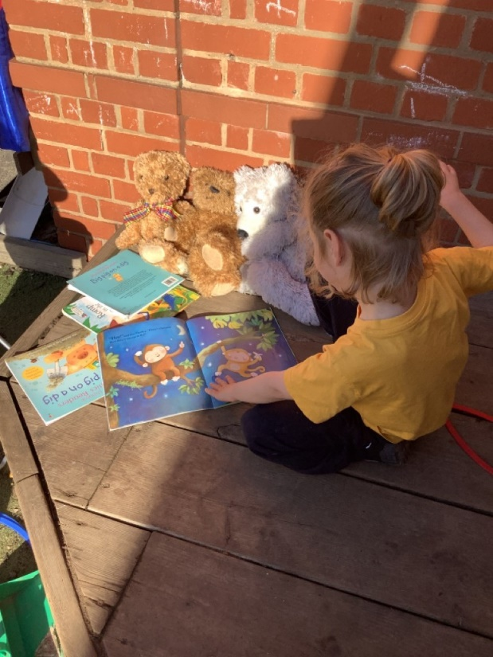
Book Bags and Uniform
All children require a bookbag to carry Reading Records, School Letters and work etc. to and from school and home.
Please name the book bag. Some parents like to attach a key-ring or decoration so that their child can immediately identify their own book bag.
Book bags must be brought to school every single day.
Please check them at home daily for any school letters or messages and to check Reading Records.
We use the following suppliers: Alcester School Shop, Earth Uniform and Orchard clothing
Please name every part of uniform in permanent marker or use labels.

Slide 23

Water bottles, PE kits, Forest School
The school has water fountains but all children are encouraged to bring in a NAMED water bottle which can be taken home each day to be refilled.
There should only be water in the water bottle not squash please.
Reception will be starting PE lessons straight away
Please ensure every part of the PE kit is named in permanent marker or with a name label as the whole class will be getting changed in close proximity at the same time! We will write names into any unnamed kit or jumpers that we find.
PE Kits can be kept in school on your child’s peg and will be sent home every half term to be washed.
Children go to the paddock weekly – they will need a bag of warm clothes which it doesn’t matter if they get dirty and wellies. We have puddle suits to wear.

Slide 24

Food and Drink in School
Reception children all get free fruit – you do not need to provide snacks. We give them fruit throughout the day. Apples, bananas, carrots, tomatoes, raisins etc.
Milk is free for your child up until they are 5 but you can register for them to continue having milk after this but you will need to pay for this.
Please note we are a nut free school due to serious allergies. Please check everything you put in a packed lunch.

Slide 25
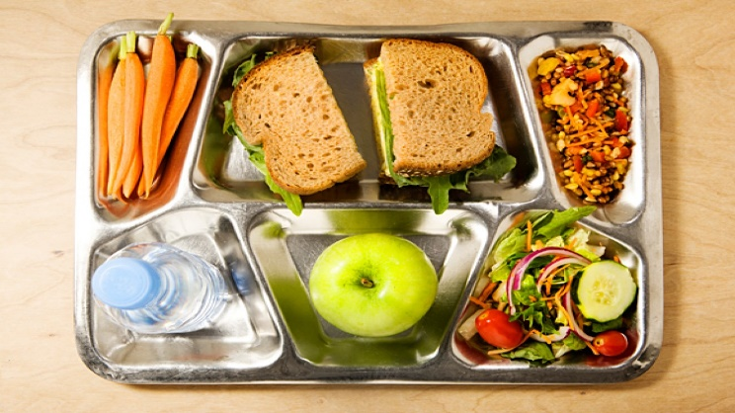
Lunchtime
All children eat their meals in the Hall and sit with their peers when eating.
Children can choose to bring a packed lunch or book a hot or cold school meal.
All Key Stage 1 children are eligible to receive a free school meal. Our School Meal provider is Class Caterer. Meals can be booked/managed online. Paid for through Arborpay
Miss Hitchens and her team will stay with the children at the start of lunch to support them and ensure that they are having a go
Please spend time teaching your child how to use their knife and fork
We encourage children to try the food and will let you know if they are not eating. (We have cereal and toast in school if children are still hungry)

Slide 26
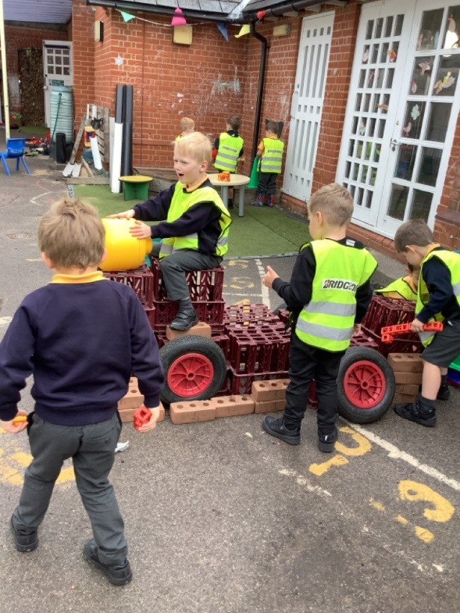
Transition into school
We are already starting to connect with nurseries to gain as much information as we can about your child
If your child has a sibling in school we are assuming that we already have a good relationship with you and know your children so are not offering a home visit unless you feel it is vital.
All other families who are new to our school we are planning to visit you in your home to get to know your child even more and see them in an environment where they are comfortable. It is a very useful opportunity for you to share any concerns that you may have about your child starting school, as well as give you and your child the chance to meet the staff they will be with each day in school.

Slide 27

Our top tips….
Name EVERYTHING in permanent marker with your child’s name and class. Biro washes off very quickly. Coats, hats, gloves, PE bag, PE kits, plimsolls, JUMPERS, school shirts, trousers. Alternatively you can buy iron-on or even better stick-on name labels online.
Check that your child’s winter coat has a zip that is easy to do up. Some zips are impossible for the child to do themselves! Practise putting on and doing up coats, it is really helpful as it develops children's sense of independence.
When choosing school shoes, ones with Velcro instead of shoelaces are helpful for younger children. Shoes need to be sensible, flat, black shoes – no sandals or open-toed shoes please.
Help your child feel comfortable and able to go to the loo themselves. Encourage them to be independent and able to look after themselves. If they can’t undo their trousers put them in joggers.
Your child is now joining a class of 30 children; they will have good days and bad days…this is normal. Help them to understand if they do not like something that another child says or does to use ‘Stop it please..with the behaviour they want to stop.’ How to share.

Slide 28
Other things you can do to help…
Lots of counting, both reciting and counting objects accurately.
Learning to recognise numbers.
Lots of drawing, colouring, Playdoh and Lego to help build up hand strength.
Lots of talking; promoting communication by discussing what you do over the summer etc.
Spend time with other people so they get used to being without you
READ, READ, READ
Sing lots of nursery rhymes
Role play

Slide 29
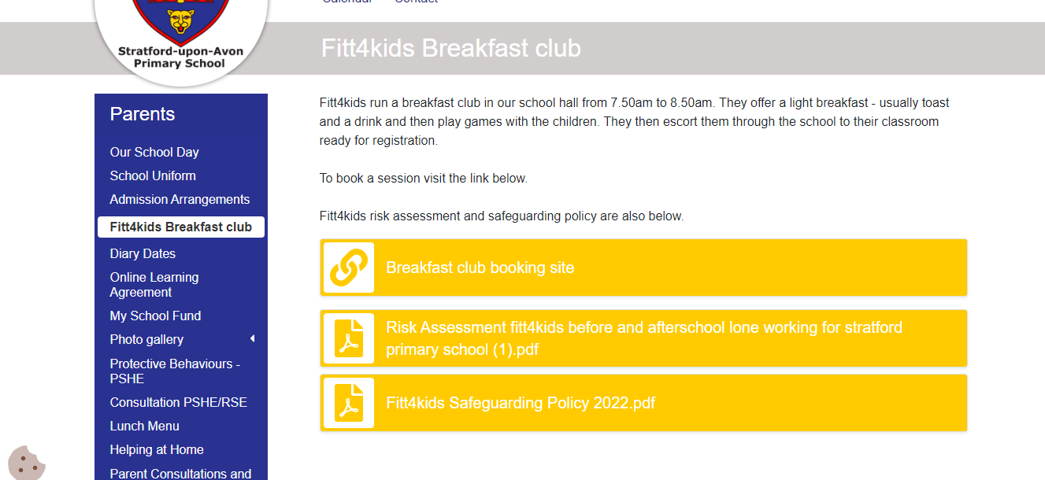
Breakfast club and Wraparound care
We offer breakfast club every day from 8am. You can book this through our website. An after school club also runs 3.30pm to 6pm. We also offer a range of other clubs e.g. multi-sports, art…

Slide 30

Communication and Paperwork
Please make sure all paperwork is completed and given to school office by 8th July 2026
Ensure we have multiple contact numbers and up-to-date emergency phone numbers.
If there is any change to normal pick up then please let the office know and provide a password
Letters in book bags!
Weekly newsletter
Parent workshops, meet the teacher and topic sharing.
Telephone us
If you need to speak with Miss Hitchens or Mrs Banks catch them on the door, a note can go in book bags or a phone call to the office. We will get in touch as soon as we are able to organise an appointment.

Slide 31

An introduction to our website www.stratfordprimary.co.uk

Slide 32


We have- Instagram - stratforduponavonprimary

Slide 33

Some other things…
Community Academies Trust
Governors – School Standards Committee
Friends of Stratford Primary School
Celebration Assembly – Fridays – by invite only
Remembrance trail, Christmas play, Shakespeare trail
Church – Christmas, Easter and End of Year
Parent consultations – November and March
Parking, one-way system.
Not sure – just ask!
New Head Teacher – January 2027

Slide 34






Books to help with transition

Slide 35

Finally!!
GET EXCITED!
Look forward to starting school and all the fun times ahead!

