Slide 1
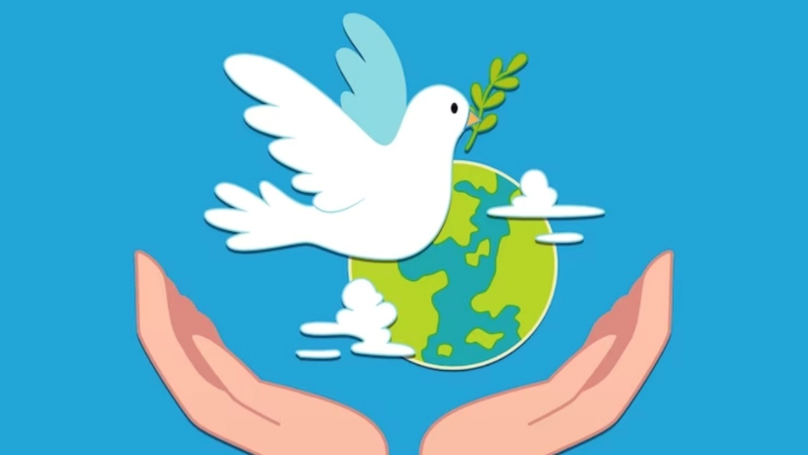
Respect
Resilience
Responsibility

Slide 2

What does peace mean?

Slide 3

International day of peace
Act now for a peaceful world

Slide 4

Peace
Walk the path of peace, my friend
Walk the path of peace
No need to fight,
No need to shout,
Walk the path of peace.
When things feel wrong and not right, my friend,
When things feel wrong and not right,
Peacefully show, the way to go,
When things feel wrong and not right.
.

Slide 5


Peace
Let’s walk the path of peace my friend.
Let’s show what’s right and not wrong,
In friendship, let’s walk hand in hand
And peacefully we’ll be strong.

Slide 6
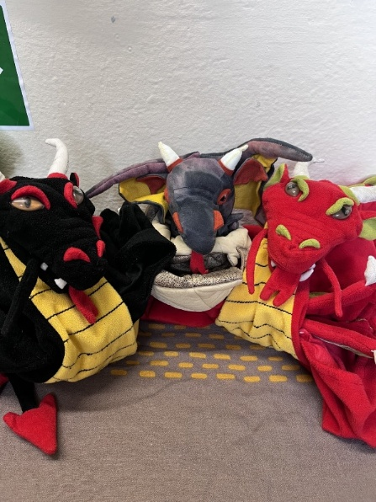

Attendance – week 4 29th Sep – 3rd Oct
Dragons go to Y4, Y3 and Y6
Reception 96.3%↓
Year One 96.3%↓
Year Two 97.3%↓
Year Three 97.6%↑
Year Four 99.7%↑
Year Five 96.6%↓
Year Six 97.6%↑
Whole School 97.3%↑

Slide 7

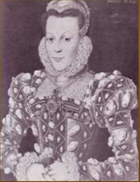
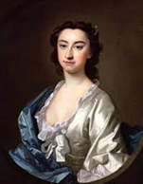
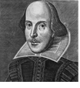
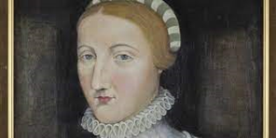
House Points
Arden
1051
Shakespeare
1090
Winners
Hall
1144
Hathaway
1120

Slide 8

Make me a channel of your peace

