Slide 2
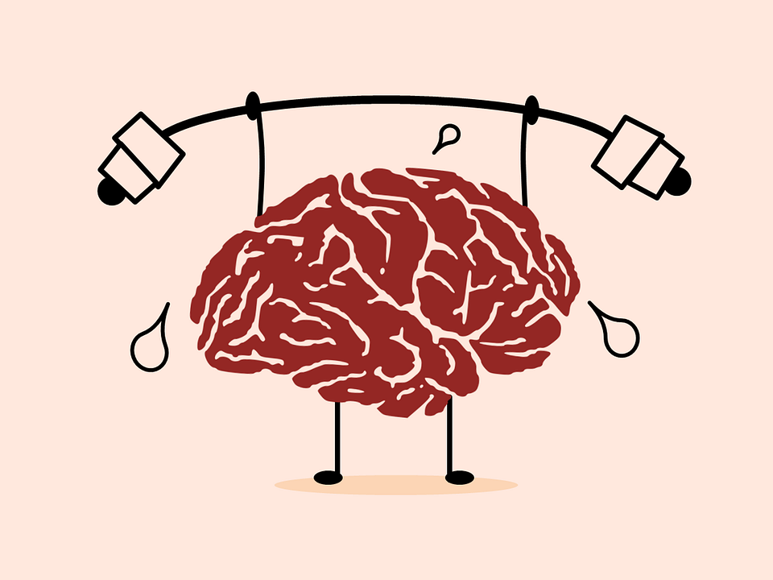
Mental Health what is it?
Emotions and how we feel inside
It affects how we think
It decides how we cope with difficult things
It decides how we see ourselves
It decides how we cope with life
It is our general well-being which is awesome

Slide 3
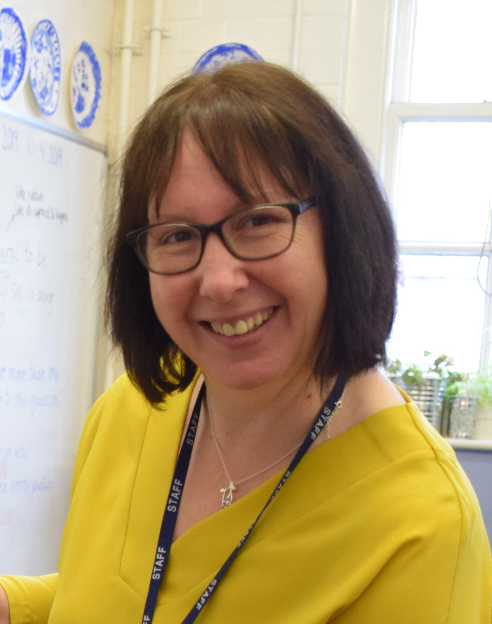
Senior Mental Health First Aider
Mental Health Action Plan
Trust Mental Health Offer
Curriculum
Mental Health interventions
Access to a wide range of services
Engage with our families
Staff training
Pupil leadership
Promote staff well-being
Promote mental health days

Slide 4
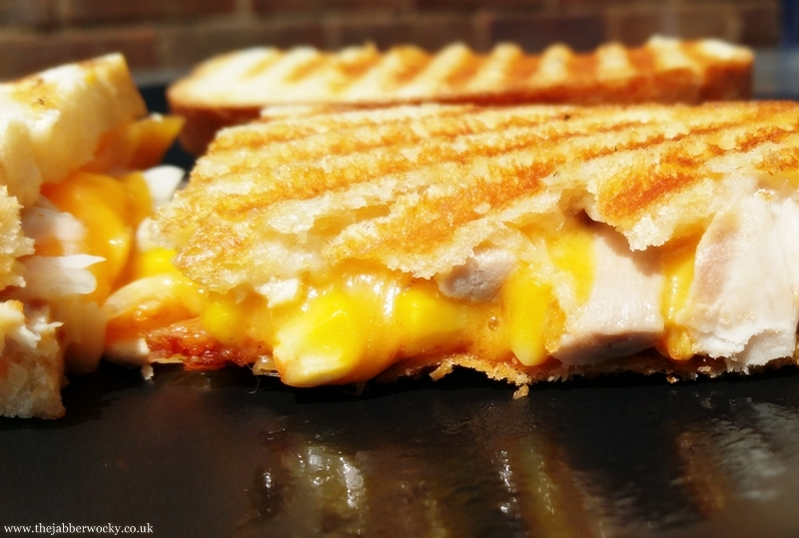
Our Happy Hormones
So let’s just imagine that you have made a toastie (or your favourite meal) and before you eat it – YOU feel it is important to take a photo and upload it to social media for everybody to see it! You then sit back and wait for the ‘LIKES’ to roll in.
Take a moment… ask yourself… Each time you post a photo of something, Are you really wanting the reader to see that photo in particular OR are you seeking acceptance and approval from others.

Slide 5
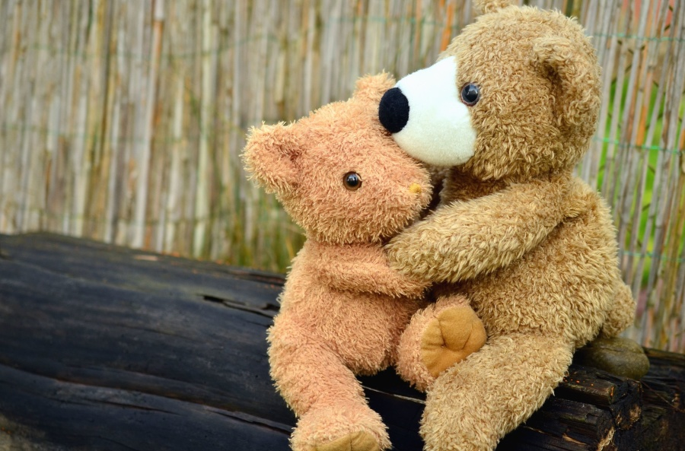
DOPAMINE
These likes release a chemical in your body. It makes us feel popular and happy!
However… it can also be addictive
How would you feel if no likes come through?
Seek your happiness in other ways – Hugs, smiles and acts of kindness release a better chemical called
OXYTOCIN
3

Slide 6
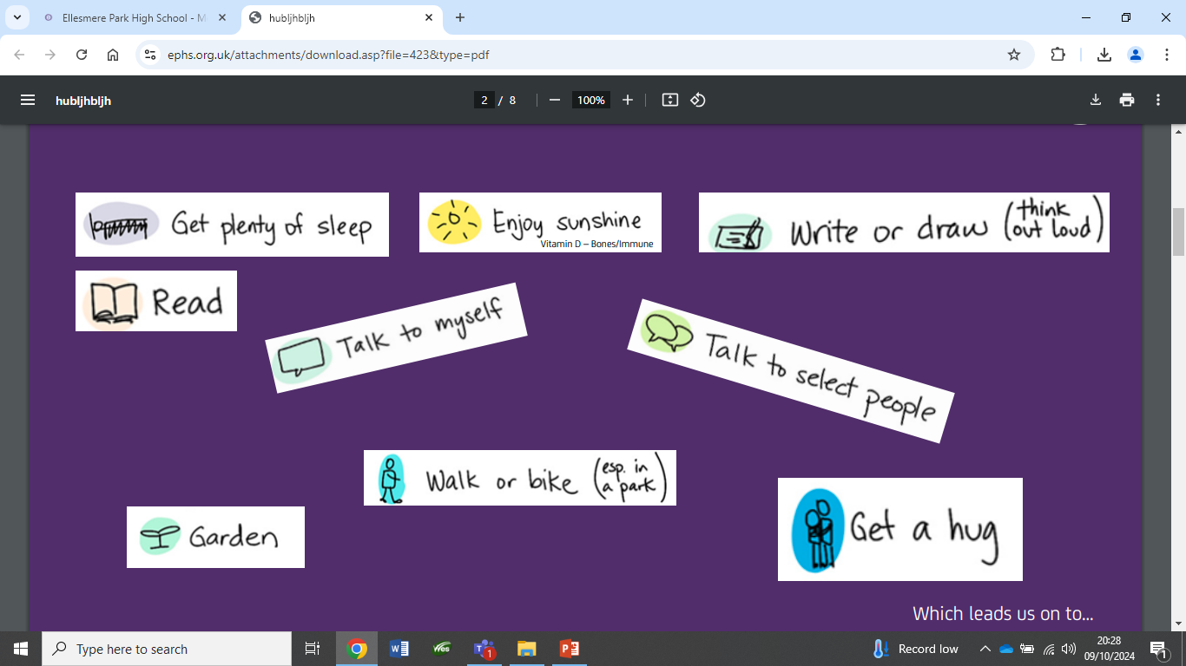

Slide 7
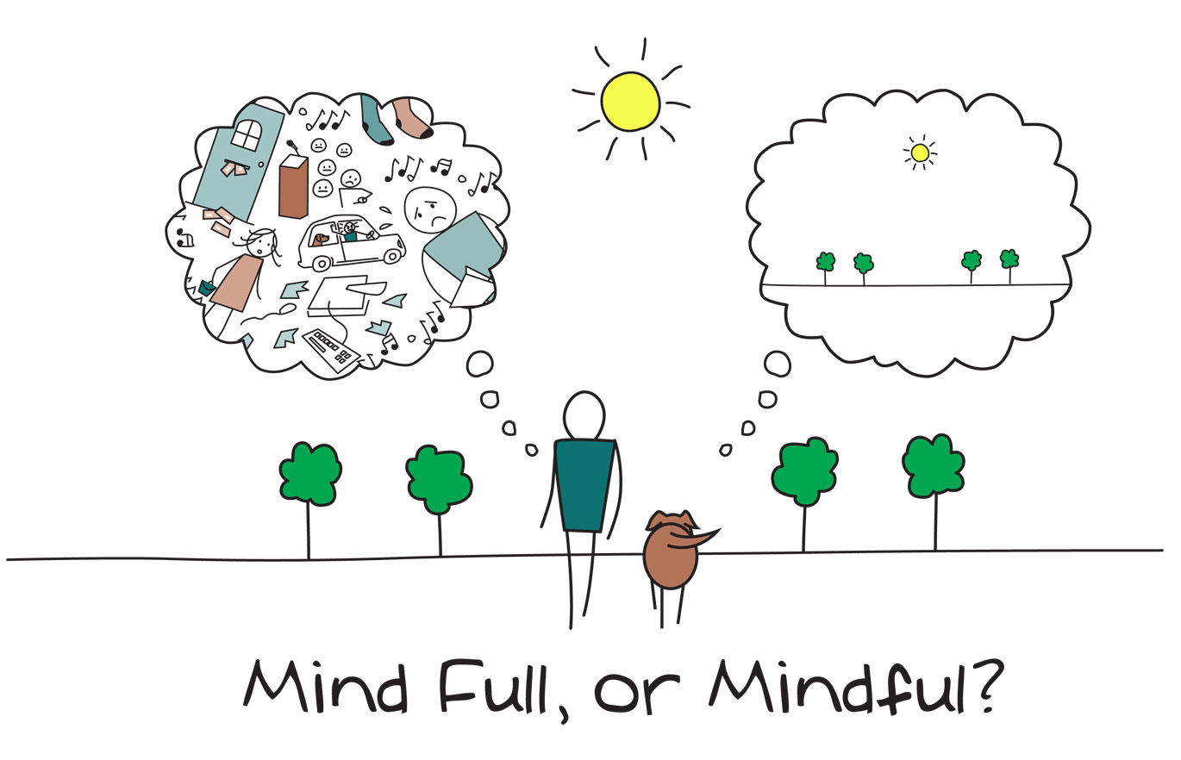
MINDFULNESS
Pay more attention to the present and what is around us – listening to your own thoughts and feelings, and to the world around you – can improve your mental health.
Notice the everyday
Try something new
Name thoughts and feelings
Feel your breathing.
Brain dump
4
Notes:
Delivery tips
After reading the slide, ask the following questions:
Demi lived in a diverse community growing up. What does ‘diverse’ mean? (Different types of people)
What does ‘community’ mean? (A group of people living in the same place or having something in common); What do you think makes a good community?
Look at the picture – why do you think Demi enjoyed where she grew up?

Slide 8
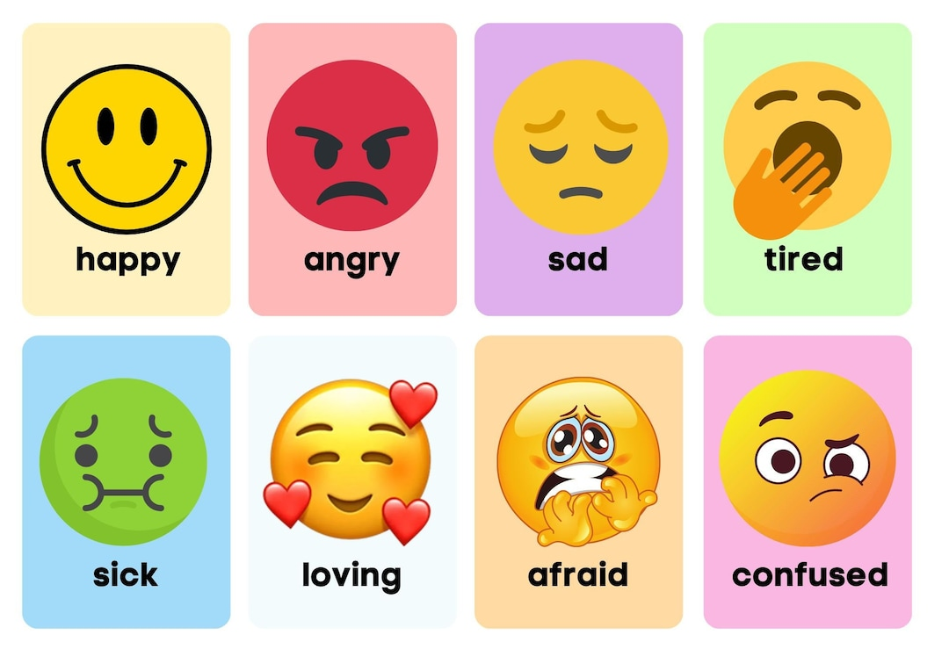
What does good mental health look like?
5
Notes:
Delivery tips After reading the slide, ask the following questions:
What is a role model? (A person you admire and look up to, a person you want to be like); Can you name someone who is a role model for you? Why?
How do you think having her Nan and her teacher as role models helped Demi in her career?
Look at the picture – how do you think Demi’s Nan felt about Demi’s achievements?

Slide 9
Things you can do for your child
Make sure they eat well – fresh food rather than processed foods.
Give them space
Listen to what they are saying
Don’t speak for them
Encourage them to focus on 3 positive things each day
Put worries in the worry jar
Make time to talk
Be a role model
Get outside – nature helps
Do things together
Learn mindfulness
Encourage them to seek a happy space in their mind
Try some of the things on the next page

Slide 10
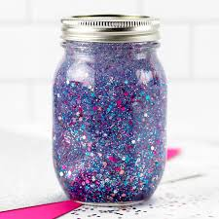
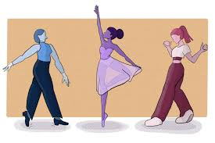
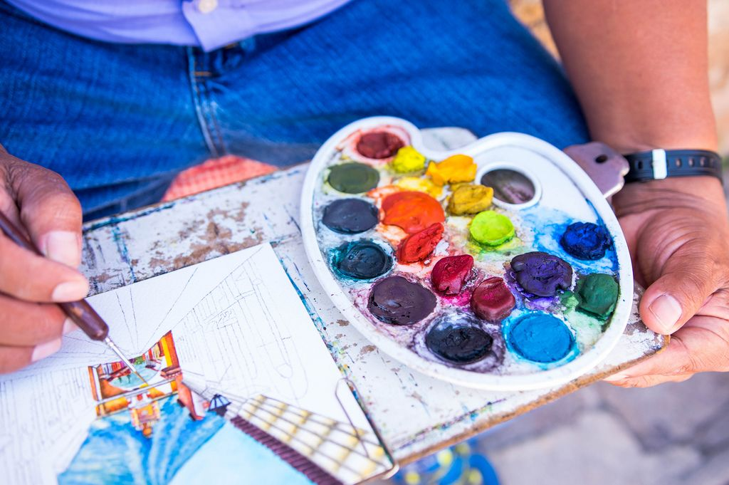
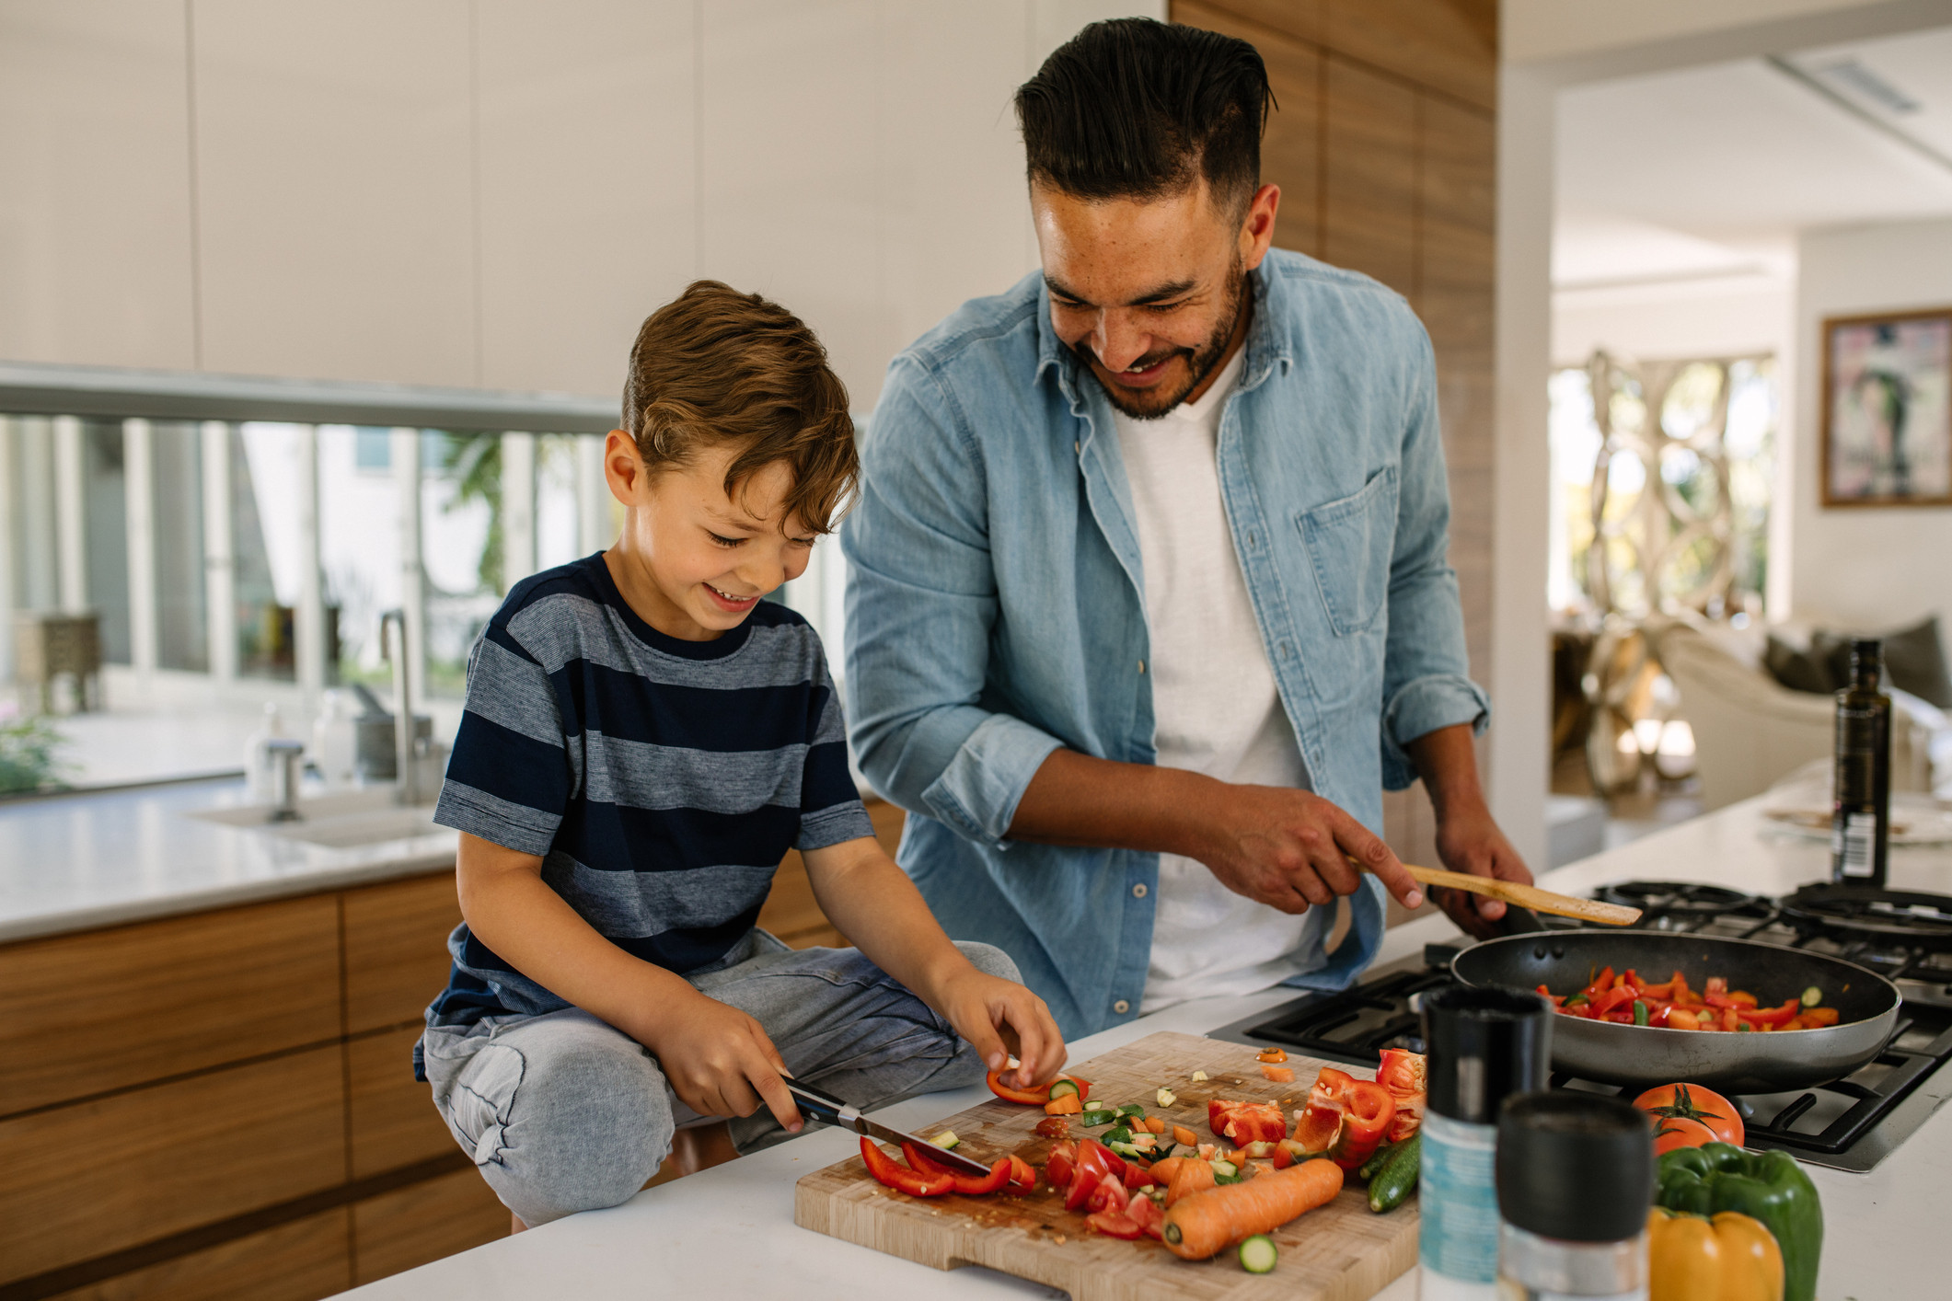
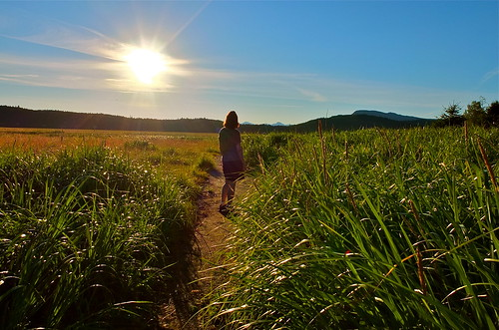

Slide 11
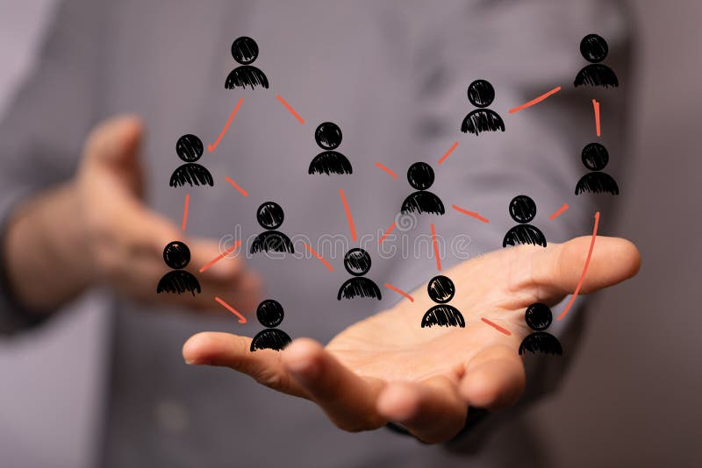
6
Notes:
Delivery tips After reading the slide, ask the following questions:
What is racism? (When someone is treated differently or unfairly because of their skin colour or where they are from)
How do you think Demi may have felt when she was called a racist name?
Why do you think the player who said the racist thing to Demi cried when they were punished?
Why was it important that Demi told an adult about what happened?

Slide 12
Resources to support
Young Minds - https://www.youngminds.org.uk/
Place 2 Be - https://www.place2be.org.uk/
Reading well - https://readingagency.org.uk/get-reading/our-programmes-and-campaigns/reading-well/reading-well-for-children/
Mind - https://cwmind.org.uk/
RISE - https://cwrise.com/

Slide 13
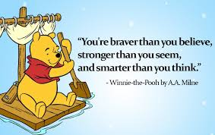
7
Notes:
Delivery tips After reading the slide, ask the following questions:
How do you think Demi felt when she didn’t make the World Cup team in 2015?
Resilience is when something difficult happens but you keep going anyway. Can you think of a time when you have been resilient?
Why do you think Demi enjoys working with so many different types of people?
Look at the picture – how do you think Demi felt when she played for Manchester City for the first time?

