Slide 1
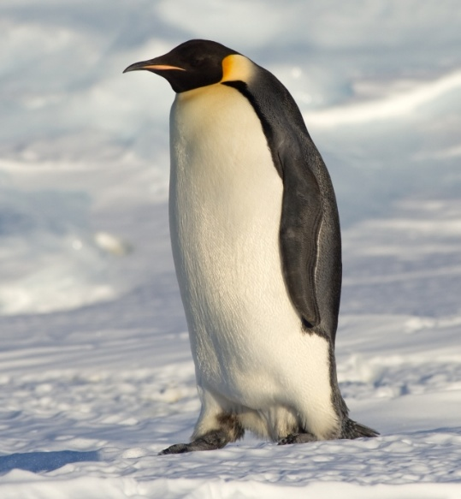
Have you ever had a penguin come to tea?
Take a look at me a penguin you will see.
Penguins Attention, (Stand to attention)
Penguins Begin ! (Salute and be ready for action)
Right Arm ( Slap right arm on leg)
Left Arm (Slap left arm on leg)
Right Leg (Lift right leg)
Left Leg (Lift Left leg)
Nod your head (Nod head)
Stick out your tongue (Stick out tongue!)
Sit Down

Slide 2
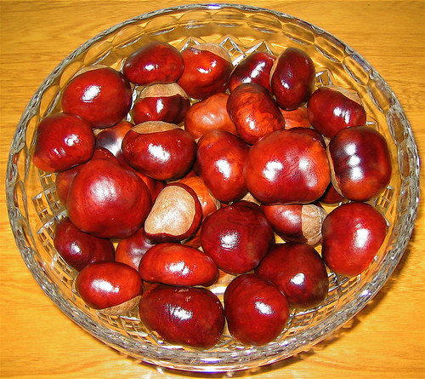
Conkers, we’re collecting conkers

Slide 3

Conkers
Chorus: Conkers, I’m collecting conkers,
I’m trying hard to find the biggest and the best
Conkers, lots of lovely conkers,
I want a conker that is better than the rest! (Repeat)
Verse: Under the chestnut tree, there waits for me,
A sight so marvellous to behold,
Amidst the autumn leaves, it gleams for me,
A conker, beautiful and bold!
(Repeat the chorus)

Slide 4
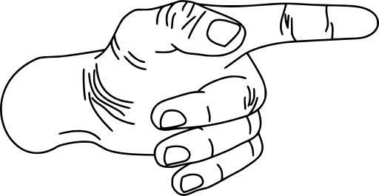
Verse 1
One finger, one thumb, keep moving.
One finger, one thumb, keep moving.
One finger, one thumb, keep moving.
We’ll all be merry and bright!
Verse 2
One finger, one thumb, one arm, one leg, keep moving.
One finger, one thumb, one arm, one leg, keep moving.
One finger, one thumb, one arm, one leg, keep moving.
We’ll all be merry and bright!
Verse 3
One finger, one thumb, one arm, one leg, one nod of the head, keep moving.
One finger, one thumb, one arm, one leg, one nod of the head, keep moving.
One finger, one thumb, one arm, one leg, one nod of the head, keep moving.
We’ll all be merry and bright!

Slide 5
Verse 4
One finger, one thumb, one arm, one leg, one nod of the head, stand up, sit down, keep moving.
One finger, one thumb, one arm, one leg, one nod of the head, stand up, sit down, keep moving.
One finger, one thumb, one arm, one leg, one nod of the head, stand up, sit down, keep moving.
We’ll all be merry and bright!
Verse 5
One finger, one thumb, one arm, one leg, one nod of the head, stand up, sit down, and turn around, keep moving.
One finger, one thumb, one arm, one leg, one nod of the head, stand up, sit down, and turn around, keep moving.
One finger, one thumb, one arm, one leg, one nod of the head, stand up, sit down, and turn around, keep moving.
We’ll all be merry and bright!

Slide 6
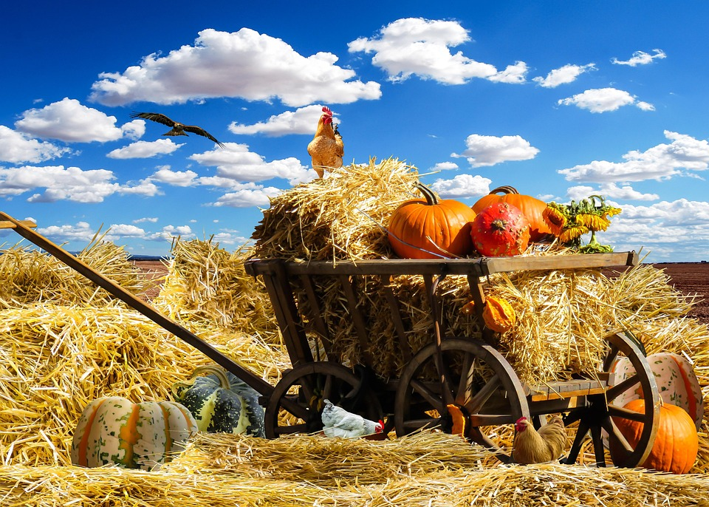
Harvest Song
Verse 1: There is a farmer who stands in his fields,
And he sees all the work to be done.
He has been watching for many a month,
He’s been waiting for this day to come.
Chorus:
There’s a song to sing as the harvest comes in,
To the One who gives sunshine and rain.
Let us all join in with a thank-offering
For the harvest that’s gathered again.

Slide 7
2: There was a time when the fields were prepared,
And the good soil was carefully ploughed.
Then came the day for the farmer to sow
And the seeds were all scattered around.
Chorus
There’s a song to sing as the harvest comes in,
To the One who gives sunshine and rain.
Let us all join in with a thank-offering
For the harvest that’s gathered again
3.There was a time for the farmer to wait
As the seeds slowly grew out of sight.
Then came the day when the first shoots appeared,
And the farmer was filled with delight.

Slide 8
Chorus
There’s a song to sing as the harvest comes in,
To the One who gives sunshine and rain.
Let us all join in with a thank-offering
For the harvest that’s gathered again
4.Now is the time when the crops are full grown,
And the farmer must gather them in.
He’ll need some help ’cause there’s lots to be done,
And it’s hard to know where to begin.
Chorus
There’s a song to sing as the harvest comes in,
To the One who gives sunshine and rain.
Let us all join in with a thank-offering
For the harvest that’s gathered again
Repeat the chorus.

Slide 9

Wheels on the Bus
The wheels on the bus go round and round,
Round and round, round and round,
The wheels on the bus go round and round,
All through the town.
(Roll hands over each other)
The doors on the bus go open and shut,
Open and shut, open and shut,
The doors on the bus go open and shut,
All through the town.
(Hold palms forward and turn hands out and in)
The money on the bus goes clink, clink, clink...
(“Twinkle” or flutter fingers of both hands like coins falling)

Slide 10
The driver on the bus says, “Please move back”...
(Make “move to the rear” gesture)
The windows on the bus go open and shut...
(Move hands up, then down—or however the windows on the buses in your community move)
The horn on the bus goes beep, beep, beep...
(Pretend to beep the horn on each word “beep”)
The children on the bus go bump, bump, bump...
(Bounce up and down as if on bumpy ride)
The daddy on the bus tips his hat...
(Tip hat)
The baby on the bus goes “Wah, wah, wah”...
(Pretend to cry like baby, wiping tears with fists)
The mother on the bus goes “Shh, shh, shh”...
(Put index finger to lips)

Slide 11
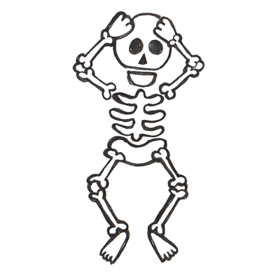
Dem Bones
Dem bones, dem bones, dem dry bones,
Dem bones, dem bones, dem dry bones,
Dem bones, dem bones, dem dry bones,
Now shake dem skeleton bones!
The toe bone's connected to the foot bone,
The foot bone's connected to the ankle bone,
The ankle bone's connected to the leg bone,
Now shake dem skeleton bones!

Slide 12
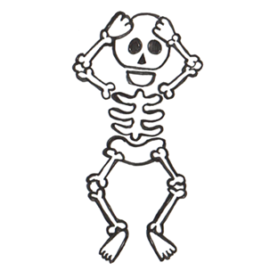
The leg bone's connected to the knee bone,
The knee bone's connected to the thigh bone,
The thigh bone's connected to the hip bone,
Now shake dem skeleton bones!
Dem bones, dem bones, dem dry bones,
Dem bones, dem bones, dem dry bones,
Dem bones, dem bones, dem dry bones,
Now shake dem skeleton bones!

Slide 13
The hip bone's connected to the back bone
The back bone's connected to the neck bone,
The neck bone's connected to the head bone,
Now shake dem skeleton bones!
The finger bone's connected to the hand bone,
The hand bone's connected to the arm bone,
The arm bone's connected to the shoulder bone,
Now shake dem skeleton bones!
Dem bones, dem bones gonna walk around
Dem bones, dem bones, gonna walk around
Dem bones, dem bones, gonna walk around
Now shake dem skeleton bones!

Slide 14
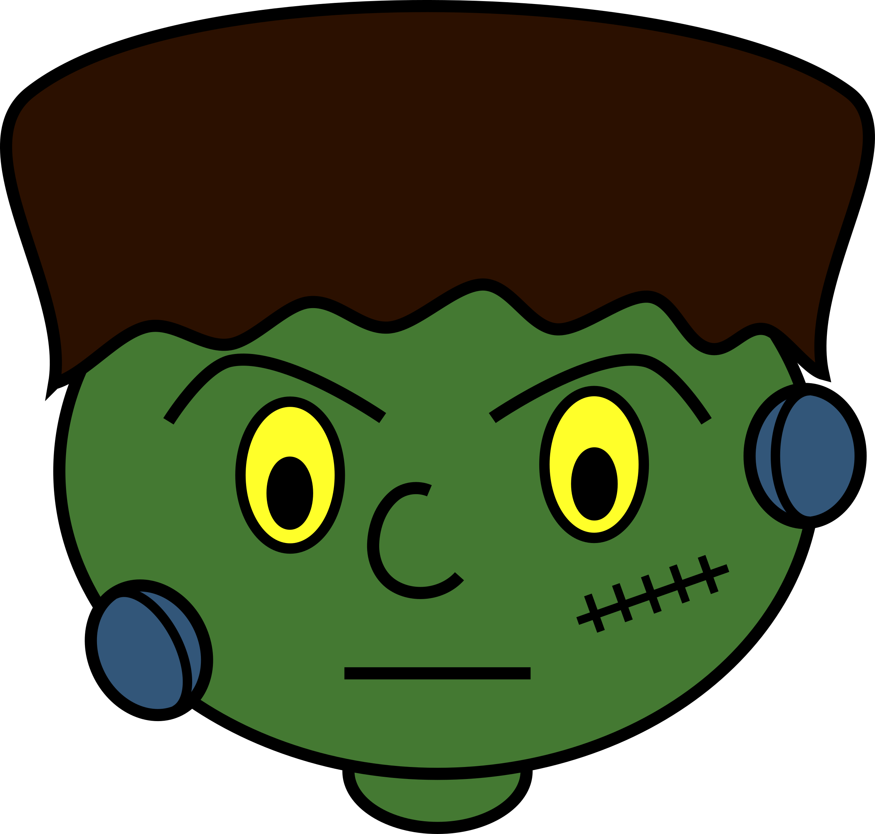
Monster Mash
I was working in the lab, late one night
When my eyes beheld an eerie sight
For my monster from his slab, began to rise
And suddenly to my surprise
, he did the monster mash
(The monster mash), it was a graveyard smash
(He did the mash), it caught on in a flash
(He did the mash), he did the monster mash
from my laboratory in the castle east
(Wa-ooh) to the master bedroom where the vampires feast
(Wa-wa-ooh) the ghouls all came from their humble abodes
(Wa-ooh) to get a jolt from my electrodes

Slide 15
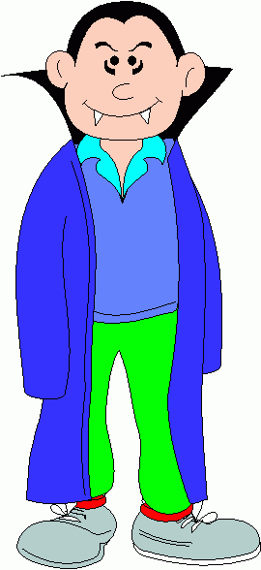
they did the monster mash
(The monster mash), it was a graveyard smash
(They did the mash), it caught on in a flash
(They did the mash), they did the monster mash
the zombies were having fun
(Ta-da-shoop, wa-ooh) the party had just begun
(Ta-da-shoop, wa-ooh) the guests included Wolfman
(Ta-da-shoop, wa-ooh) Dracula, and his son
the scene was rockin', all were digging the sounds
(Wa-ooh) Igor on chains, backed by his baying hounds
(Wa-wa-ooh) the coffin-bangers were about to arrive
(Wa-ooh) with their vocal group, The Crypt-Kicker Five

Slide 16
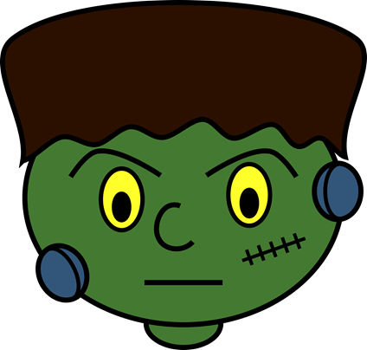
they did the monster mash
(The monster mash), it was a graveyard smash
(They played the mash), it caught on in a flash
(They played the mash), they played the monster mash
out from his coffin', Drac's voice did ring
(Wa-ooh) seems he was troubled by just one thing
(Wa-wa-ooh) he opened the lid and shook his fist and said
(Wa-ooh) "Whatever happened to my Transylvania Twist?
, it's now the monster mash
(The monster mash), and it's a graveyard smash
(It's now the mash), it's caught on in a flash
(It's now the mash), it's now the monster mash

Slide 17

now everything's cool, Drac's a part of the band
(Wa-ooh) and my Monster Mash is the hit of the land
(Wa-wa-ooh) for you, the living, this mash was meant too
(Wa-ooh) when you get to my door, tell them Boris sent you
, then you can monster mash
(The monster mash) and do my graveyard smash
(Then you can mash), you'll catch on in a flash
(Then you can mash), then you can monster mash
mash good
(Monster mash, wa-ooh) easy, Igor, you impetuous young boy
(Monster mash, wa-ooh) mash good
(Monster mash, wa-ooh)
(Monster mash, wa-ooh)
(Monster mash, wa-ooh)
(Monster mash, wa-ooh)
(Monster mash, wa-ooh)

Slide 18

Frere Jacques
Frere Jacques, Frere Jacques
Dormez Vous, Dormez Vous
Sonnez les Matines, Sonnez les Matines
Ding dang dong, Ding dang dong
Brother John, Brother John
Are you sleeping? Are you sleeping?
Morning bells are ringing, Morning bells are ringing
Ding dang dong, Ding dang dong

Slide 19

Christmas
Christmas, Christmas
Secrets everywhere,
Christmas, Christmas,
Carols in the air.
Christmas, Christmas,
Starshine in the sky,
Everyone is waiting with a twinkle in their eye.

Slide 20
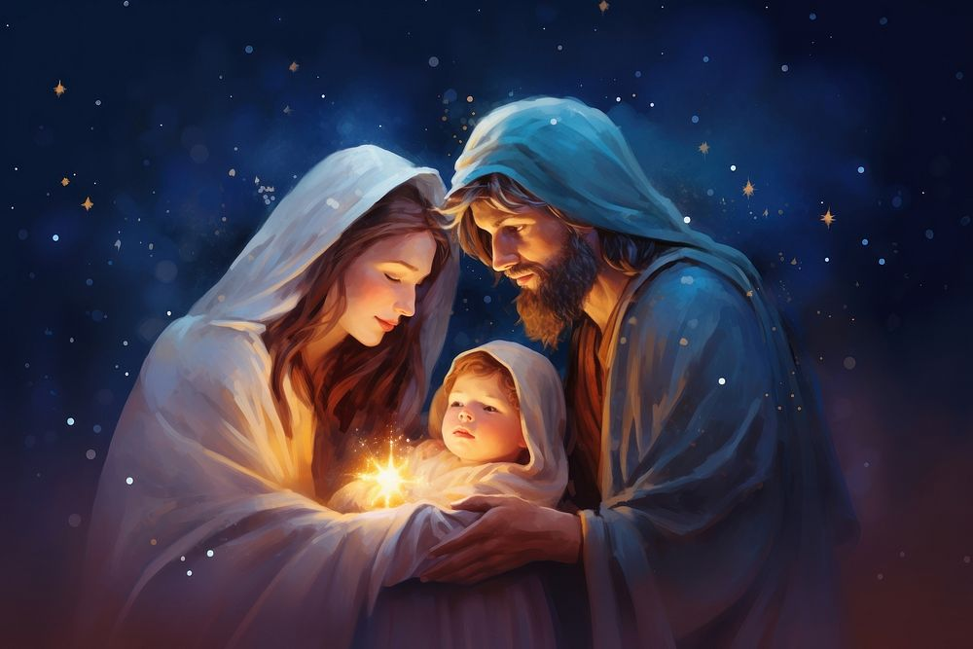
Christmas, Christmas
Christmas day has come.
Christmas, Christmas,
Gifts for everyone.
Christmas, Christmas,
Sing it out with joy,
We celebrate the birthday of a special baby boy.

