Slide 1
Wednesday 16th November 2022

Slide 2
Notes:
Slide 1
This week we are taking part in Road Safety Week 2022
Road Safety Week is a big road safety campaign and it happens every year.
We’re going to be talking about road safety all week and this is important because we all use roads and it’s important to talk about what we need to make sure our journeys are safe.
A note about sensitivity
Discussions about road safety should be approached with care. If you are aware that a pupil has been affected by a road crash, either directly or indirectly, please talk to them and their parent or carer before involving them in any Road Safety Week activities. Please take individual needs into consideration when planning your activities and carry out risk assessments where required. The road safety animation explains that sometimes people get badly hurt in crashes and sometimes people die.
Move to next slide

Slide 3
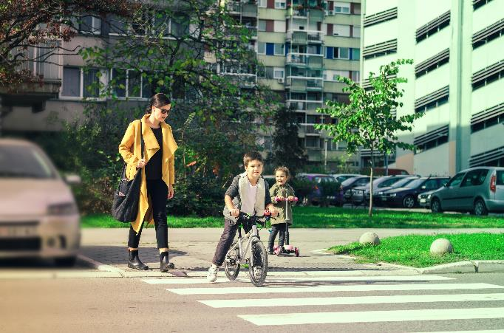
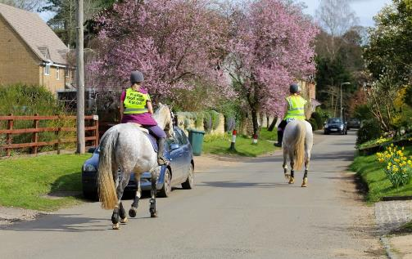
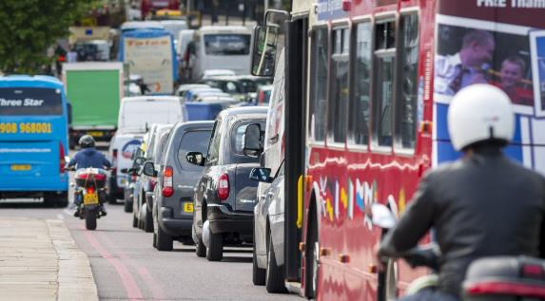
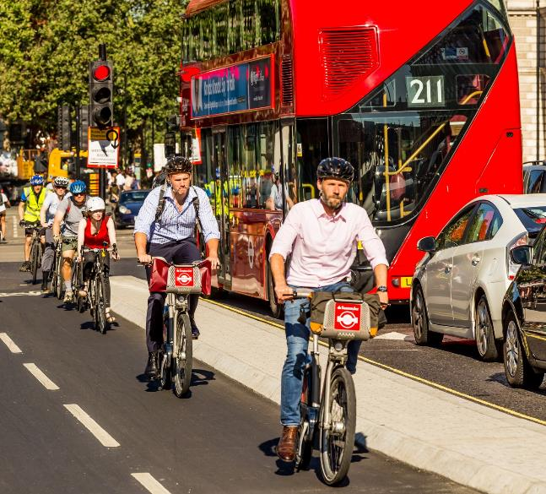
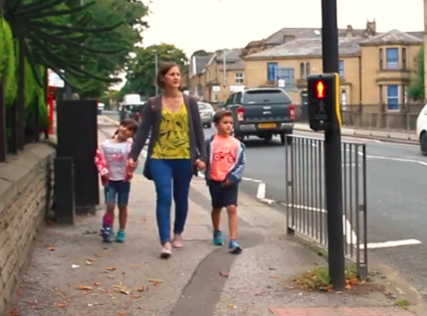
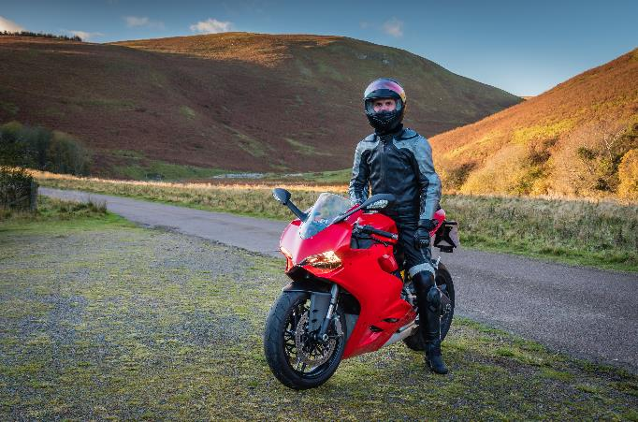
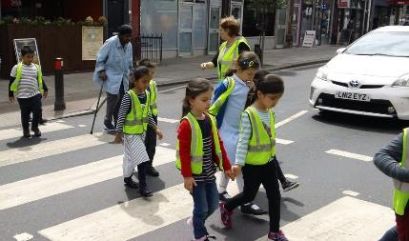
Notes:
Slide 3
So we’re going to have a think about how do we use roads? Who can tell me how they’ve used a road today. How did you get to school this morning?
Suggestions could include:
Walk
Cycle
Scoot
As a car passenger
As a bus or tram passenger
And can you think of any other people we share our roads with?
Suggestions could include:
People who walk – pedestrians
People who ride – bicycles, motorbikes, horses and scooters
People who use wheelchairs or mobility scooters
People who drive for work – buses, trams, ambulances, lorry drivers, van drivers
People who ride for work – food delivery, police
Children in pushchairs
Move to next slide

Slide 4
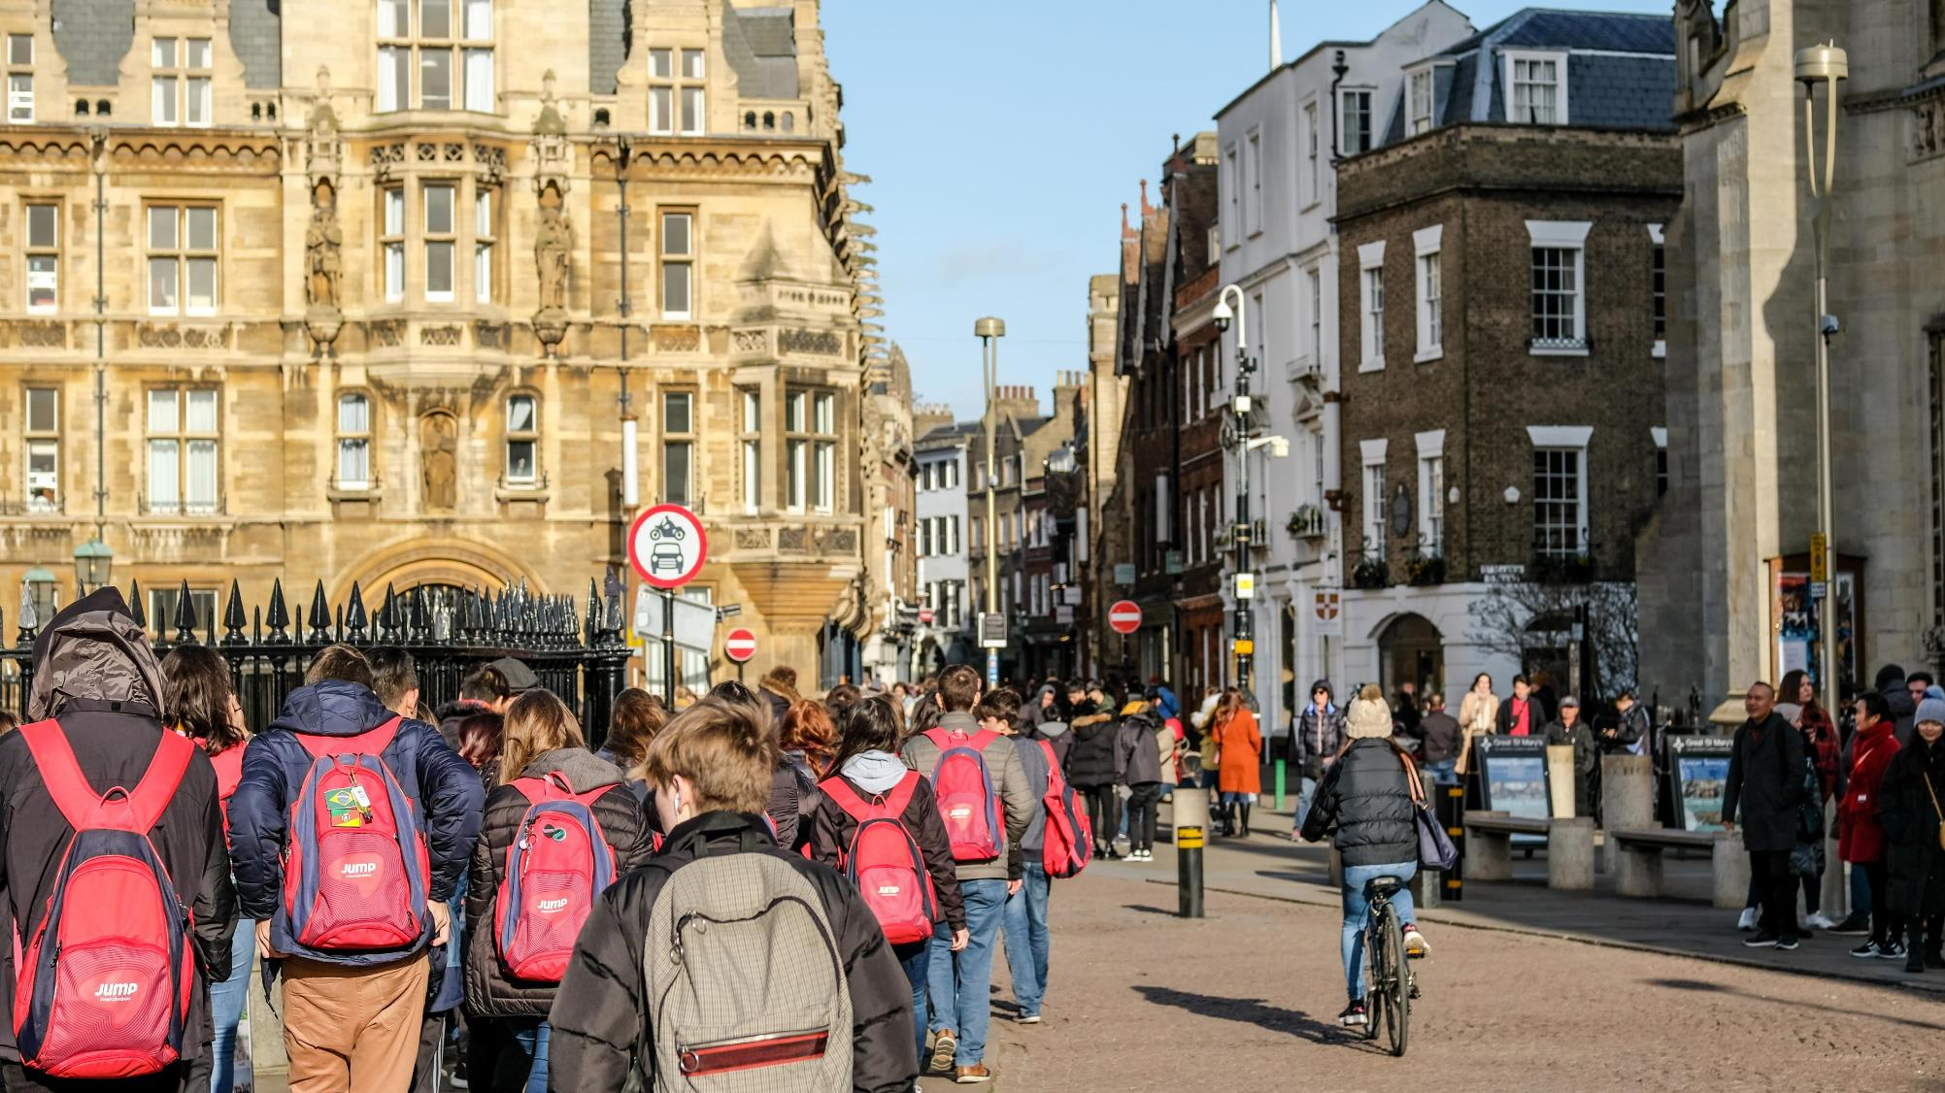
Notes:
Slide 4
We know that we share our roads with lots of different people and vehicles
Here you can see a street that shows a road with no traffic.
It’s busy but it’s a safe space for people to walk and cycle. There are safe footpaths and a cycle path just for bicycles.
Move to next slide

Slide 5
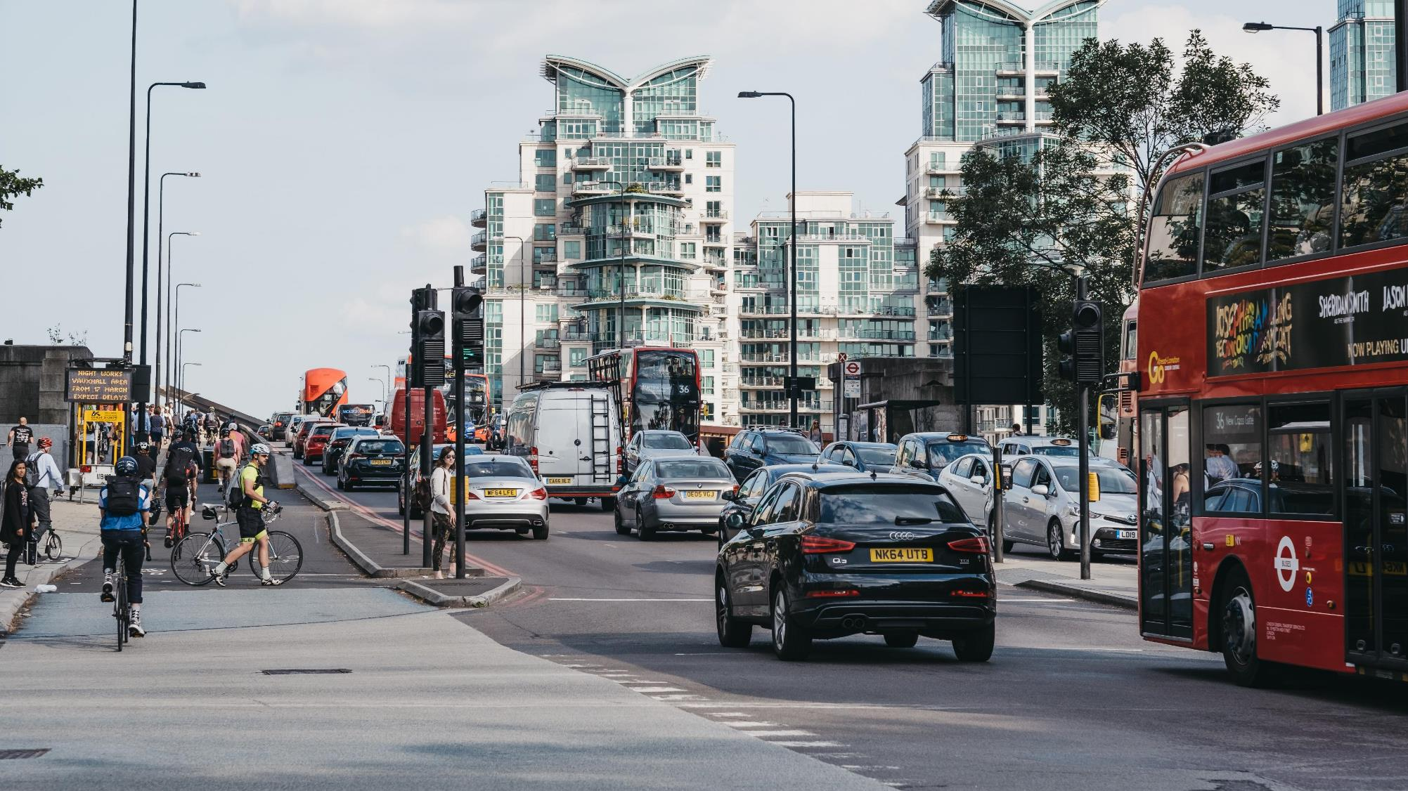
Notes:
Slide 5
Who do we share our roads with?
Here you can see a different street where people travelling in lots of different ways have to share the road space.
There are people walking, cycling, cars, vans and buses.
This one is really busy too, but there is a separate place for people to walk and cycle, and there’s a safe place to cross the road.
Because we all have to share roads, it’s really important that everyone understands how to use roads safely to keep us all safe
Move to next slide

Slide 6
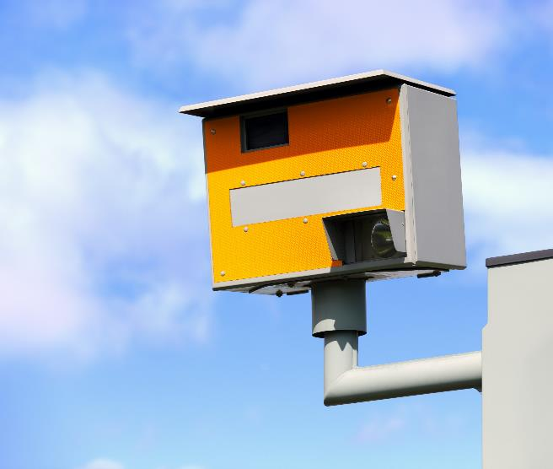
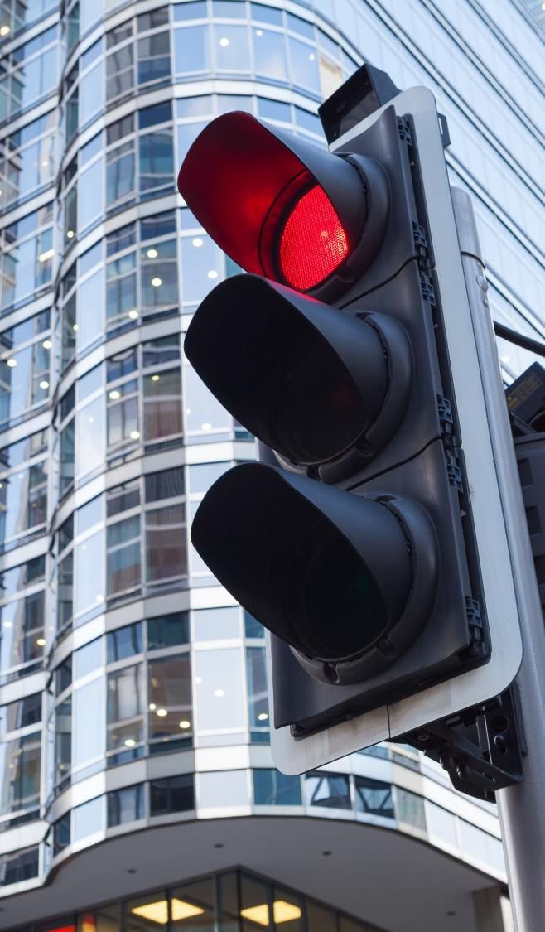
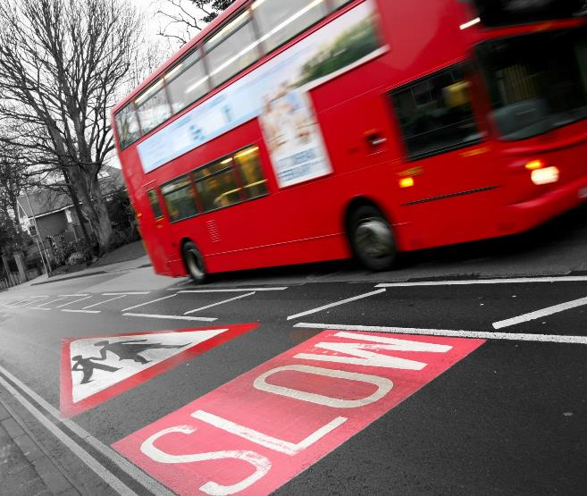
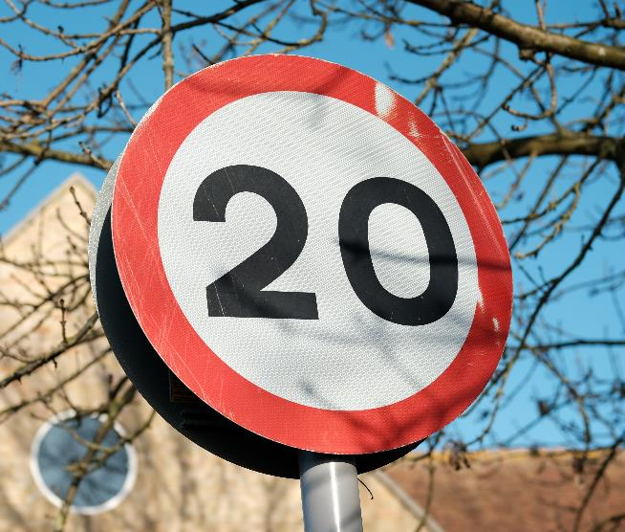
Notes:
Slide 6
There are rules we all need to follow when we use roads
Can you think of any rules?
Drive slowly near our school
Only cross the road when the green man shows
Stop when we see a red traffic light
No parking outside school
These rules are important to keep us safe.
Why do you think this is important?
Traffic is heavy and hard
If it hits us it can hurt us very badly
Our bodies are soft and get hurt easily
Big vehicles and fast traffic can cause the most harm.
The new rules will help protect the people who need it most.
The rules say that the people who are most likely to be harmed in a crash need the most protection.
This includes pedestrians, cyclists, horse riders and motorcyclists. Children, older adults and disabled people are most at risk.
People who drive vehicles that cause the most harm need to take the greatest care to reduce the danger to others.
This means drivers of big vehicles like lorries and buses, vans and minibuses, and drivers of cars and taxis and motorbikes.
Cyclists and horse riders need to reduce danger to people who walk.
And everyone needs to use roads safely to protect themself and others.
We’re now going to show you how this works with a bit of help from [nominate class representatives or teachers to come to the front to show different types of road users]
Use whatever props you have available or big labels to represent someone who is:
Walking
Riding a scooter
Riding a bicycle
Riding a horse
Riding a motorbike
Driving a car
Driving a bus
Driving a lorry
Ask pupils who is most likely to do most harm:
Person driving a car
Person driving a bus
Person driving a lorry
Ask pupils who needs most protection:
Person walking
Person riding a bicycle
Person riding a horse
Person riding a motorbike
Ask pupils to arrange the road users in order to show who is most at risk and needs most protection, and who is most likely to cause harm and needs to take the greatest responsibility.
People who drive vehicles, especially big vehicles need to make sure they drive safely to protect people who walk and cycle and ride horses.
Move to next slide

Slide 7
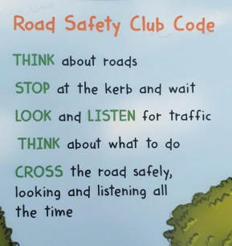
Let’s recap the
Warwickshire Safe and Active Travel
Road Safety Code:
Notes:
Let’s recap the Warwickshire Safe and Active road safety code

Slide 8
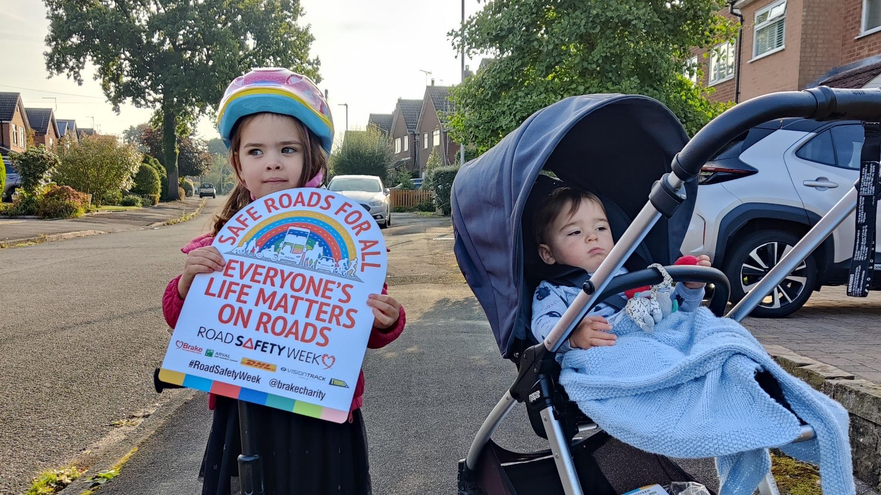
Notes:
Slide 7
Everyone can shout out for Safe Roads for All
Remember we’re taking part in Road Safety Week and talking about road safety.
We’re thinking about who we share our roads with and how we can use roads safely.
Our grown ups can help us too.
Say to younger children that they should always hold hands with a grown-up when walking near roads. They should use safe footpaths away from traffic and always cross roads at safe places with a grown up. When riding their bikes, they should ride their bike with a grown up on a safe path away from traffic and wear a helmet to protect their head if they fall off. They should always sit in a special car seat to protect them when travelling by car.
Remind older children that we all share a responsibility to use roads safely, and this includes people who walk, scoot and ride, as well as people who drive. Say that they shouldn’t use their phone when walking near roads/crossing roads and they should play in safe places away from traffic. Children can talk to their parents or carers and remind them to drive at safe speeds, especially in areas where people live, work and play; to never use their phone while driving; and to always wear a seat belt.
At the end of this assembly, I would like you to think about making a pledge… what is a pledge? It is a bit like a promise. You are going to make a pledge for how you are going to use the roads safely. For example, I pledge to wear reflective clothing when I walk to and from school each day or you might park safely, further away from school and walk to school every morning.

Slide 9
