Slide 1
Meet the Teacher- Year 6
Mrs McCormack, Mrs Bean, Mrs Mingins and Mrs Fade

Slide 2
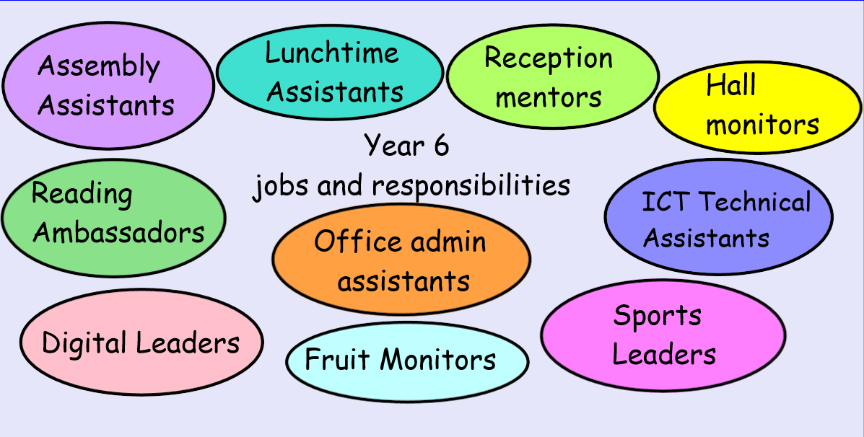
Year 6… the best year!
Year 6 is a busy but hopefully an extremely enjoyable and fulfilling year for the children at Stratford Primary.
As well as being mindful of the demands of SATs, it is about preparing the children for the transition to secondary school. We will encourage the pupils to be more self-reliant and self-sufficient and to take on more of the responsibility for their own learning and progress.
The children will also be encouraged to take on roles of monitoring and support duties with younger pupils and take on responsibilities both in the classroom and around the school as ‘top of the school’.

Slide 3
A Typical Day in Year 6…
Doors open at 8:40am. A typical day in Year 6 is fast paced and action packed!
Children arrive at school, put their belongings away in their lockers and settle down quietly to complete their early morning activities during registration time – Fluent in Five and Colour Monster. They then move straight into morning lessons, which are the core subjects: English (reading, writing and SPAG) and Maths.
Lunch – often filled with jobs!
The afternoon consists of Theme-based learning through the foundation subjects, for example Art, Science, Computing, Geography, History, French etc. The day will end with assemblies and/or a whole class story.
Throughout the week, the children have daily reading opportunities. The main teaching of reading takes place through the whole class reader, which allows the children to become immersed in a quality text, and to develop their reading skills, such as inference and understanding of vocabulary .

Slide 4
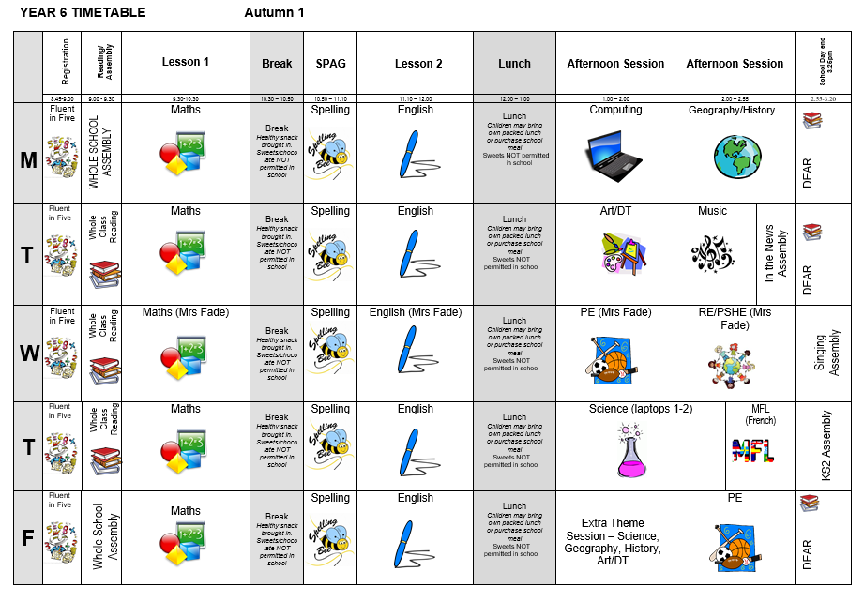
Year 6 Timetable…

Slide 5
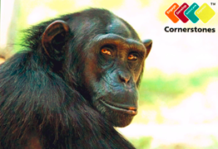
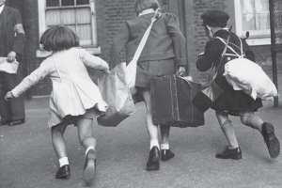
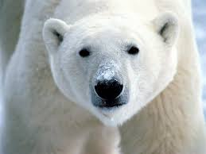
Our Creative Learning Themes…
Islands of Evolution
Britain at War
Frozen Kingdom
Hola Mexico
Gallery Rebels

Slide 6
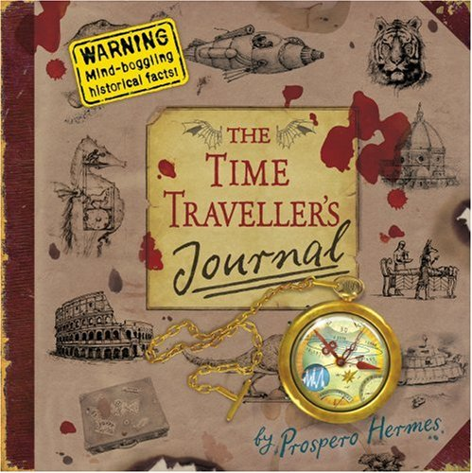
Key Texts…
Islands of Evolution
Britain at War
Frozen Kingdom
Hola Mexico
Gallery Rebels

Slide 7
Trips and visitors …
This year, we have tried to think of how we can further enhance the curriculum and the children’s learning through trips and experiences at as low a cost as possible, especially as we have the costly residential in July.
Here are the planned/potential experiences for the year …
WWI soldier visit – Tuesday 12th November in school – cost approx. £15
KS2 Theatre visit – December – date and cost TBC
Survival Day in the Paddock – March – no cost
Graffiti Workshop – June – cost TBC but subsidised by FOSP
Manor Adventure – Monday 7th to Friday 11th July 2025 – cost £550

Slide 8
How we assess the children…
Assessment in KS2 is carried out daily, using a range of strategies, such as quick quizzes, 5-a-day questions, live marking and targeted questioning. This is to ensure that teachers can keep a close track on children’s learning and understanding, so that children can respond to feedback and to ensure that any misconceptions are quickly addressed.
Throughout the year, children will also take part in more formal assessments in reading, writing and maths to help us judge attainment and understanding; to inform us of next steps; and to help identify any gaps in learning, so we can put interventions in place.
In May (dates will be shared later), the children will sit the statutory KS2 National Curriculum assessments, in Reading, GPS and Maths. They will receive results which state their raw score and whether they have met the Expected Standard for the end of Year 6. Writing is based on teacher assessment.

Slide 9
Home Learning…
As Year 6, the children will be expected to complete English and Maths homework each week. English will comprise of spelling and reading; Maths will comprise of Times Tables Rock Stars and after Christmas, a class work consolidation task.
We strongly encourage home reading in order to support the skills the children are developing in class and, most importantly, for enjoyment, and we expect the children to have a book that they are reading both in school and at home regularly. We will keep a record of these in their Reading Journals (in school).
Spellings will be taught weekly and practised during daily sessions in school. The children will be expected to practise these daily at home in their green spelling book. These will be set on a Wednesday and tested the following Wednesday.
In Maths, the children will be given KIRFs (Key Instant Recall Facts) for the half term. These will outline the facts that the children are required to know and give ideas and strategies for practising these. This half term, the focus is on times tables and knowing the multiplication and corresponding division facts for all tables up to 12 x 12. They will also be set 20 minutes of Times Table Rock Stars practice per week.

Slide 10
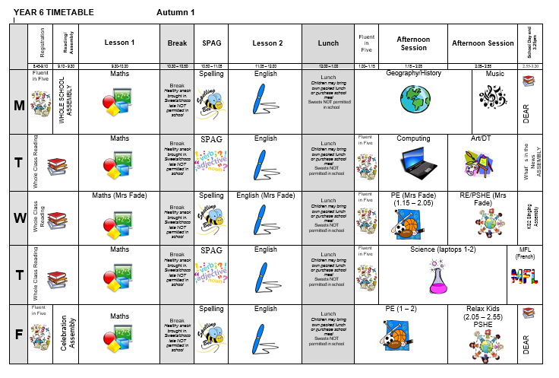
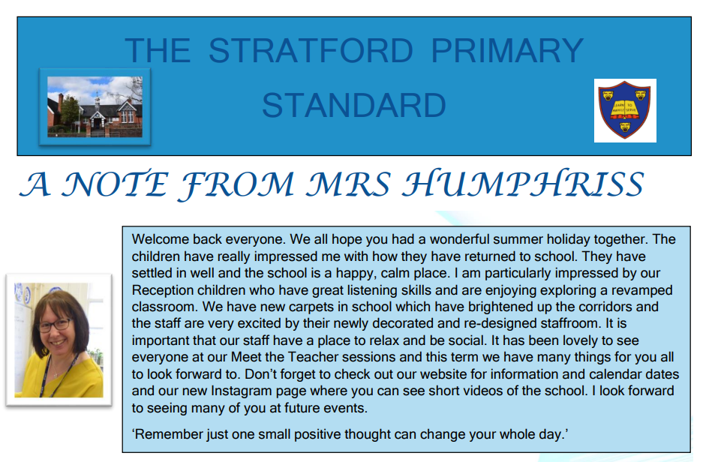
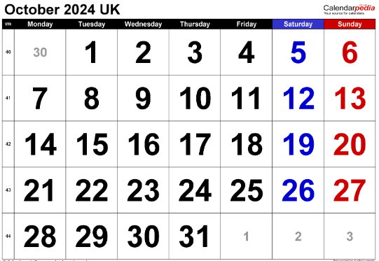
Communication…
Timetable and letter to parents​
Class Dojo
Instagram
Weekly News Letter​
Parents Consultations

Slide 11
Communication…
We are always here to support and listen. You may come and talk to us at the end of the school day; you can also send a message on class dojo. If it is urgent please email the school office and this will be forwarded to me. ​
Important issues can be spoken about in person and appointments with teachers can either be made directly through teachers or via the school office. ​
​
Serious injuries and head injuries will be communicated via a phone call home. Minor injuries such as cuts and grazes will be communicated via accident forms which are given out at the end of the day.​​
Please check Class Dojo for general class messages.

Slide 12
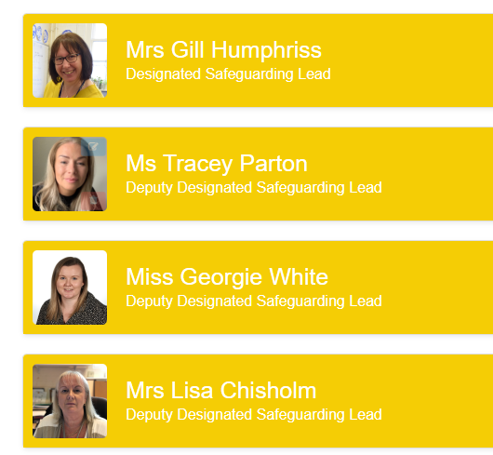
Additional Support/Concerns…
The DSL team are always welcoming and can support you with your concerns.
You can email or phone - contact information is available on the website.​
​
Social Media

Slide 13
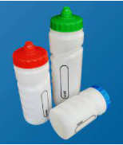
Expectations…
Behaviour – high expectations, in class, in the playground, moving around school, on educational visits, when visitors are in and during after school clubs. Class Contract and One School Rule: RESPECT
School uniform / PE kit / Lost Property – LABEL!
Presentation, in school and when completing homework – end of Year 6 expected standard (neat, joined, legible, fluent) and sense of pride in books. expected standard (neat, joined, legible, fluent) and sense of pride in books.
Encourage independence – knowing what they need each day!
Named water bottle needs to be in school every day.

Slide 14
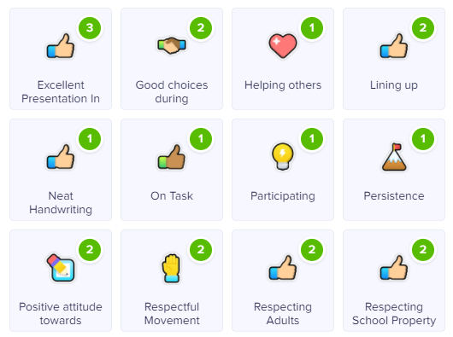
Celebrating Success…
Weekly certificates in celebration assembly – Headteacher’s award, Learner of the Week and Well-being Warriors. We will also have weekly awards celebrating TTRS achievements
Topic Sharing Events, the website and Instagram
Stickers, Dojo points/House Points and Respect certificates

Slide 15
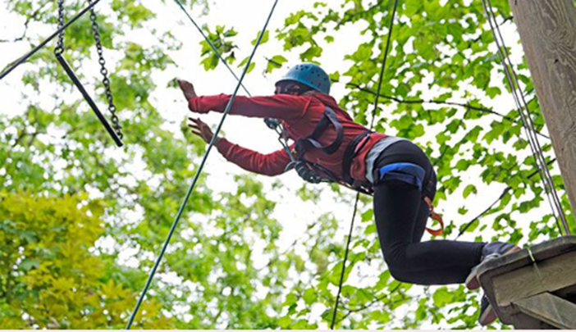
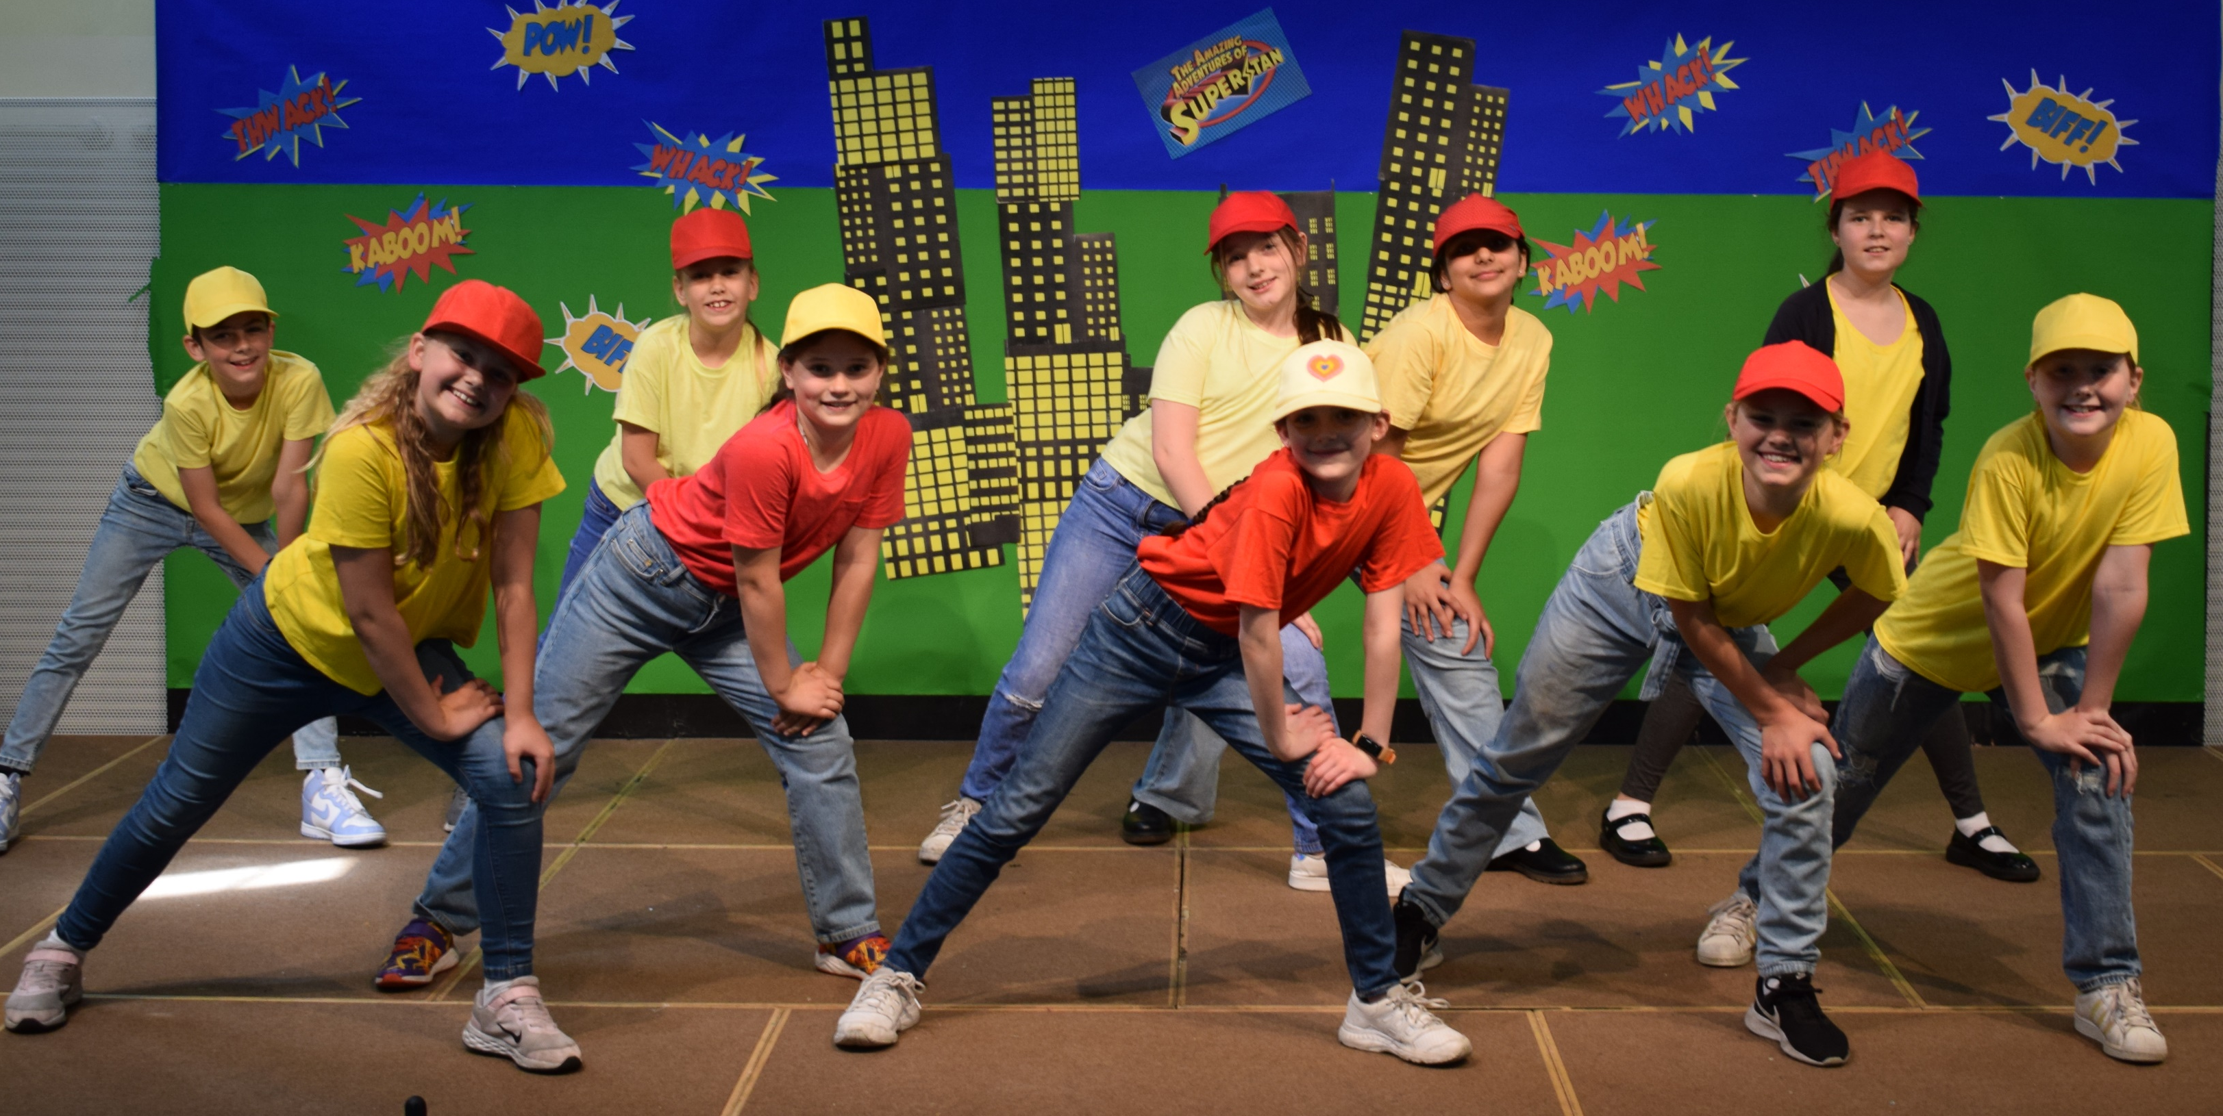
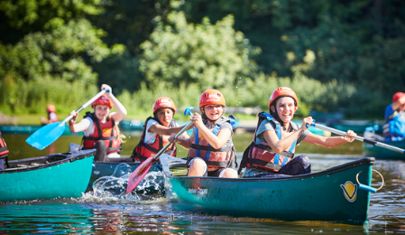
Year 6 dates …
SATS WEEK
Monday 12th May – Thursday 15th May 2025 (PAST PAPERS)
Y5 AND Y6 PRODUCTION
June 2025
Manor Adventure WEEK
Monday 7th - Friday 11th July 2025
LEAVERS’ASSEMBLY
Friday 18th July 2025

Slide 16
AOB…
​
Remind children at home they have a locker in which to store their items, encourage that independence​
Healthy snacks
​
PE Kit on Wednesday and Friday.​
​
Mobile Phones – letter and policy
Walking Home – let the office know if any changes
Road Safety
Behaviour when walking to/from school
​

Slide 17
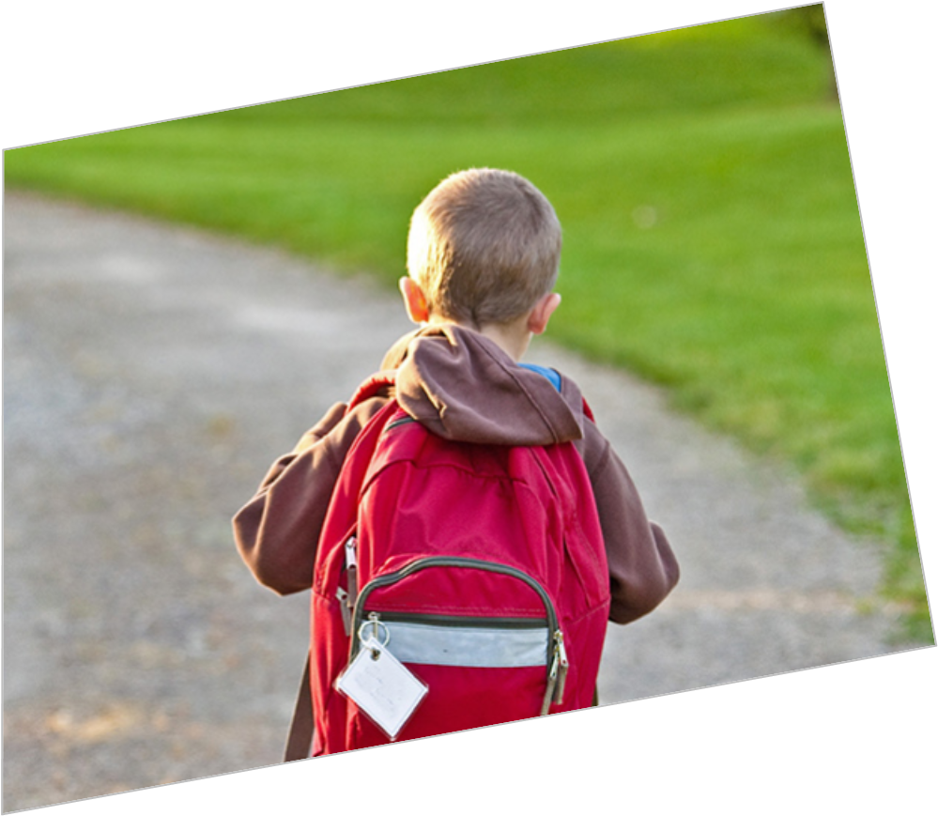
Any Questions?
​
Thank you!

