Slide 1

Welcome to Year 2
Mrs Nailor

Slide 2
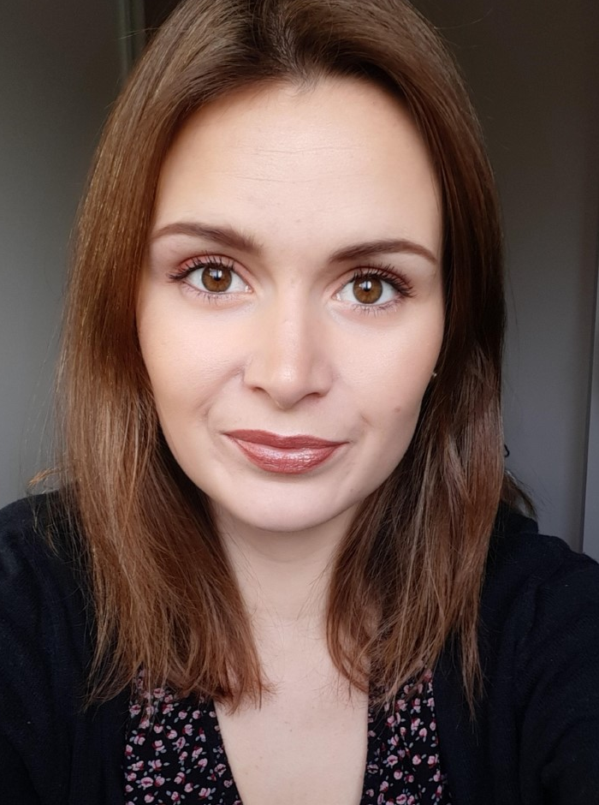
I am Mrs Nailor
I will be your child’s Year 2 teacher and I am so excited to teach them this year.
Every Wednesday morning they will have Mrs Beesley.
Every other Thursday they will have Mrs Vandenberg for the day with Amber for PE.

Slide 3
A typical morning in Year 2 is very busy…
They will walk themselves through the playground in the morning and come in through the same door.
Once they have put their things on their peg they will come in and do handwriting straight away. This is why it is important for them to be in on time so that they have time to do it each day. When the bell goes we will stop to do the register.
They will then go into phonics/spelling and maths.
They will stop at 10.20am for break, where they will grab their snack and head out to play.
After break they will do shared reading and English before lunch at 12.
On Wednesdays Mrs Beesley will do music and art.
Every other Thursday Mrs Vandenberg will do French and DT with them in the morning.

Slide 4
A typical afternoon in Year 2 …
After lunch they will have time for a quick drink before sitting on the carpet for the register.
After the register they will do mastering number apart from on Tuesdays.
After mastering number we will do our foundation subjects.
PE is on Tuesdays and Thursdays afternoons.
These will be involve lots of creative activities and tasks.
We will do Geography, History, Science, PSHE, RE and Computing.
On a Wednesday afternoon we will do English to catch up from the morning and on Thursday afternoons.

Slide 5
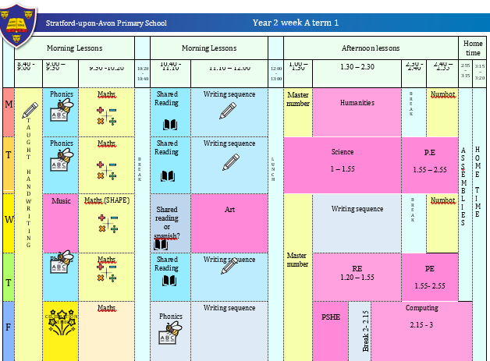
The timetable might look like this.

Slide 6
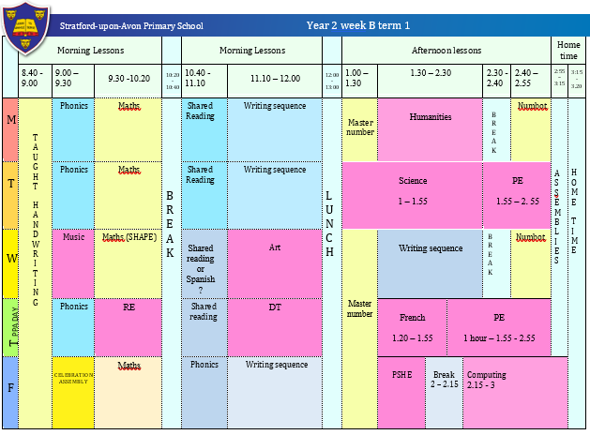
The timetable might look like this.

Slide 7
English and Mathematics.
English – is based on a whole class text that is linked to that terms topic.
The class texts this year are…
King Arthur and knights of the round table
The castle the king built
Rapunzel
The owl who was afraid of the dark by Jill Tomlinson.
The Tempest by Shakespeare
The story of Grace Darling
The lighthouse keeper’s lunch
We will also do shared reading every day.
We will have a big focus on handwriting and spelling this year.
Mastering number–is about deepening children’s understanding, use and manipulation of all things maths.

Slide 8
Topic learning.
We will also teach Geography, History, Science, French, ICT, RE, PSHE, Music and Art/ Design.
Learning in these subjects is, where possible, linked to each terms topics.
This year our term topics will be…
Magnificent monarchs, excellent engineers, amazing animals, Stratford streets, Places, people, planet and curious coastlines.

Slide 9
Trips...
This year I have tried to think of how I can further enhance the children’s learning through trips and experiences at as low cost for as possible.
Here are the planned and potential trips for the year…
Warwick castle visit – TBC
Stratford bridge tours
Owl experience – tbc
Stratford walks
Cotswold waterpark visit - TBC

Slide 10
Assessment…
Assessment in KS1 is carried out daily with live marking happening during the lesson and targeted questioning as the children are working. This ensures that children have time to respond to the feedback, make changes and any misconceptions can be addressed immediately.
There will be weekly assessments in spelling, which will be used for any individual spellings they are given.
Children will take part in termly assessments in reading, writing and mathematics across the year to show progress and inform us of their next steps or any gaps in learning.
The Statutory Assessment does not make up the whole picture. We use teacher assessment to make a final judgement on whether children have met the Expected Standard for the end of Year 2.

Slide 11
Home Learning…
Home learning will be similar as in Year 1!
Children will be given a maths Key Instant Recall Facts (KIRF) for each term, which will give you ideas of things you can recap at home to help with fluency. These will be quick ideas of things they can practise in the car, on the way to school or whilst queuing at the shops etc.
They also have one minute white rose maths.
Children will be given books to take home to read each week. They will be given on a Friday and will be the book they have read in school that week. This is to give them the opportunity to practice developing their reading fluency and expression.
They will have the spelling words from the previous week that we learnt in school to keep practicing at home. They may have individual spellings to practice based on those from the year 1 common exception list or that they have struggled with in class.

Slide 12
Expectations…
Behaviour – high expectations, in class and in the playground, on school on trips and when visitors are in or in after school clubs..
School uniform/PE kit/ and snack pots should all be clearly labelled and we will now encourage the children to be more responsible in looking after these.
Named water bottle should be in school every day.
Presentation of their work at all times
Encourage independence – putting their things on their peg, brining into the classroom their water bottle, remembering their reading book, remembering to hand in letters, remembering to wear their PE kit and show any homework.

Slide 13
Celebrating Success…
Weekly certificates of head teachers award and learner of the week to celebrate success.
Well–being warriors and respect awards
Stickers, Dojo points and going on the WOW wall.
Showing work to the head teacher or subject lead.

Slide 14
Communication…
Class dojo is our only form of communication. I will update the class story page with key information when needed.
Children will be given positive dojos regularly, either for impressive work, great work ethic, showing positive learning behaviours or being respectful.
Accident forms will be given out for any minor injuries, such as cuts and grazes. Any serious injuries or head injuries (even if minor) will be a phone call.
Please check classdojo, weekly newsletters and the notice board outside to keep up to date with messages and events happening.

Slide 15
Communication…
We are always here to support and listen whatever it may be.
If you have any minor inquiries you can contact me through the admin email with the subject for the attention of Mrs Nailor. We can respond to emails weekdays between 8am and 6pm.
Important issues can be spoken about in person and appointments with myself can either be arranged via the school office or directly at the end of the day.

Slide 16
AOB…
Medicines – Only prescribed medicines with child’s name on are allowed. They must be handed to the office. No medicines should be left in a child’s bag.
Healthy snacks – NUT FREE!
Children will come to school in their PE kit and in trainers on Tuesday and Thursdays
New statutory guidance in place by the government means that all children must attend school and holidays/ leave of absence can not be granted except for exceptional circumstances… the policy is available on the website.
RESPECT – the one school rule

Slide 17
Designated Safeguarding leads...…
If you have any concerns about your ​
child or need our support you can contact me or the school office and arrange a meeting in private.​
The DSL team are always welcoming and can support you with your concerns.​
Our safeguarding leads are…
Mrs G. Humphriss
Mrs L. Chisholm
Miss T. Parton
Mrs C. Nailor
Ms H. Desai

Slide 18
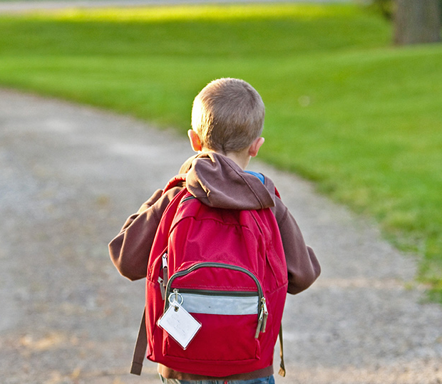
Thank You!

