Slide 1
TRUE FRIENDS

Slide 2
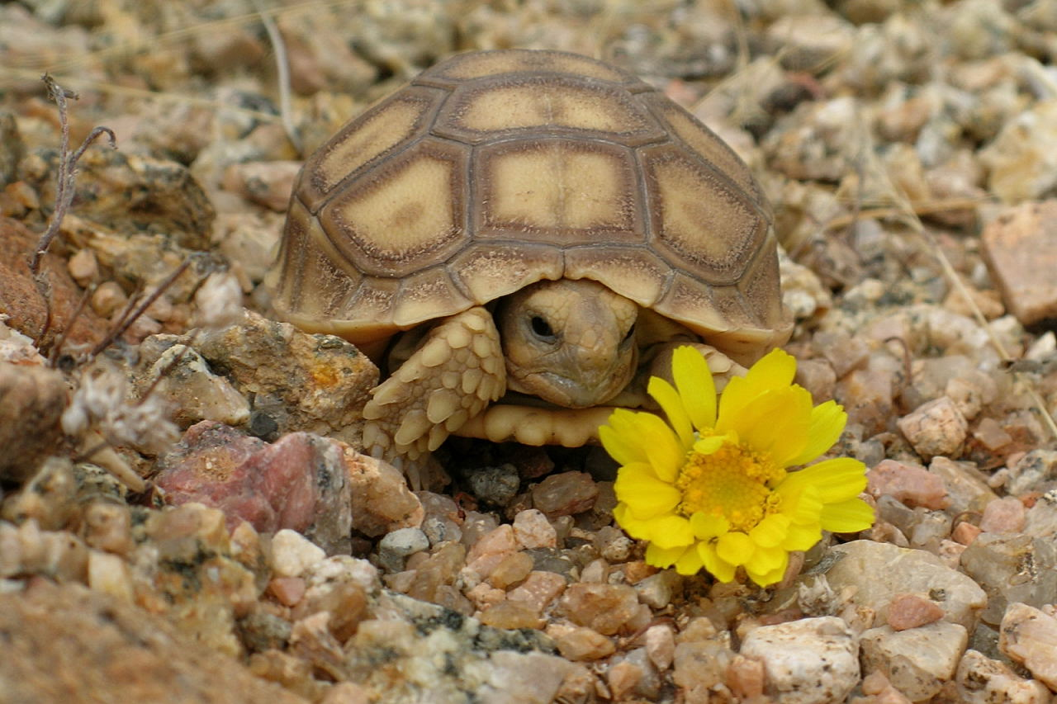
The Fox and The Tortoise

Slide 3
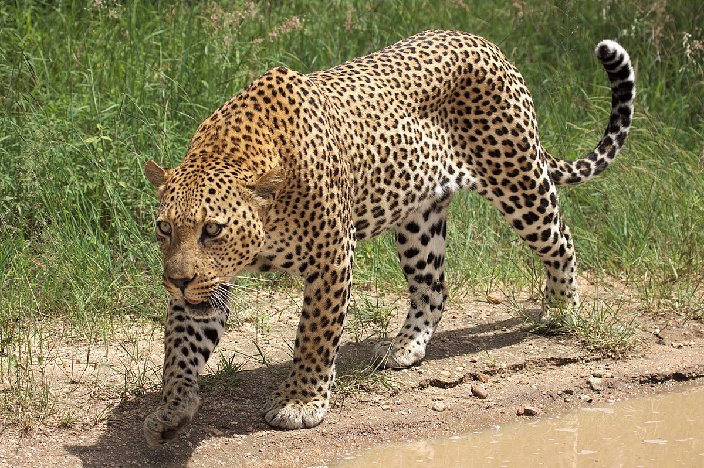

Slide 5
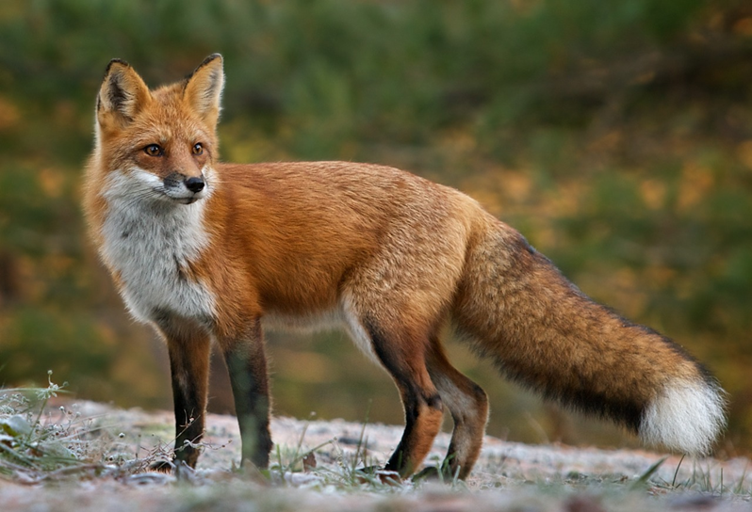

Slide 6
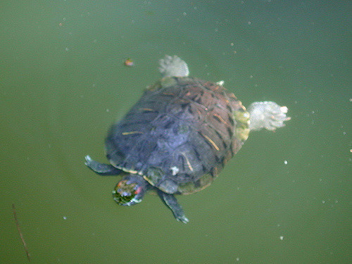

Slide 7
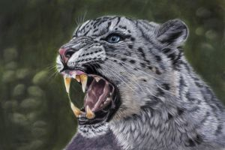

Slide 9
Be a friend – don’t be a bystander!

Slide 10
House Points/School Council

Slide 11
Sing

