Slide 1
Welcome to Year 4
Mrs Archer
Mrs Buchanan

Slide 2
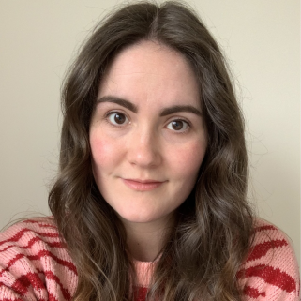
Meet the teacher – Mrs Archer
Welcome to Year 4!
I am Mrs Archer and I am the Year 4 teacher.

Slide 3
A typical day in Year 4…
As soon as the children arrive at school they will put their belongings away in their lockers and sit at their tables to quietly complete the morning activity of Fluent in 5 (maths fluency questions) during registration. They will also have time to use their colour monsters to let us know how they are feeling if they wish to.
They then will have either an assembly or Times Table Rockstars session. After that they have their morning lessons which consist of the core subjects Mathematics, English and Spelling, Punctuation and Grammar (SPAG).
After lunch they will have time either for quiet reading or handwriting before starting our topic based learning and the foundation subjects.
The day will end with either an assembly or a whole class story.

Slide 4
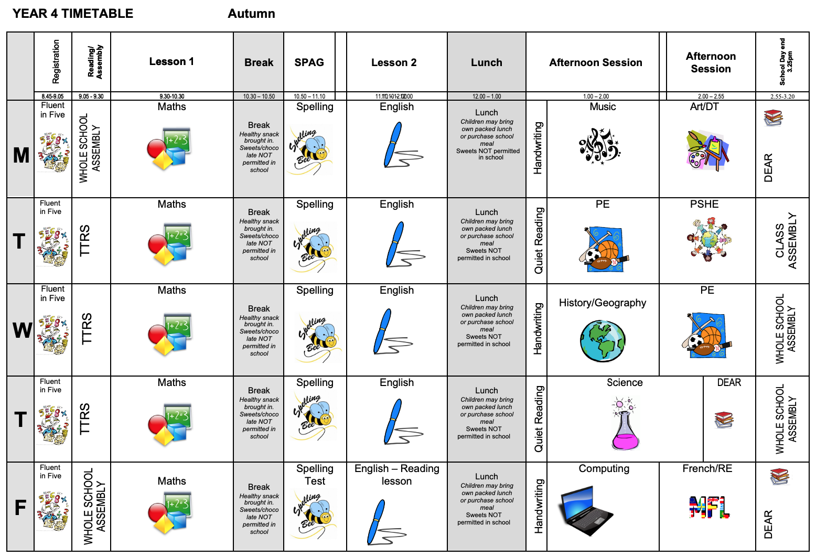
The timetable will look similar to this, occasionally we shuffle foundation subjects around to accommodate different types of learning or longer projects.

Slide 5
English and Mathematics.
English – based on a whole class text that is usually linked to that term’s topic.
The class texts this year are:
‘Saxon Tales’ by Terry Deary
‘How to train your dragon’ and ‘How to be a Viking’ by Cressida Cowell
‘King of the Cloud Forests’ by Michael Morpurgo
Romeo and Juliet – Shakespeare
‘Marcy and the Riddle of the Sphinx’ by Joe Todd-Stanton
‘Secrets of a Sun King’ by Emma Carroll
‘Egyptian Cinderella’ by Shirley Climo
Whole class reading also takes place daily to help children be immersed in a range of texts.
Maths Mastery is about deepening children’s understanding, use and manipulation of all things maths.
Fluent in five – Takes place daily and will help develop speed and accuracy with arithmetic skills.

Slide 6
Topic learning.
We will also teach Geography, History, Science, French, Computing, RE, PSHE,
Music and Art/Design Technology.
Learning in these subjects is, where possible, linked to each terms topics.
This year our term topics will be Invaders: Anglo Saxons and Vikings (Autumn), Misty Mountains and Winding Rivers (Spring) and Ancient Civilisations: Egyptians (Summer).

Slide 7
Trips...
This year I have tried to think of how I can further enhance the children’s learning through trips and experiences at as low cost for as possible.
Here are the planned and potential trips for the year…
Heart of England – 24th September 2024
Whole school theatre visit near Christmas – Date TBC
Heart of England – 18th March 2025
York Residential – 3rd to 4th April 2025
River Trip – Date TBC
Egyptian workshop (in school) - 28th April 2025 approx. £10pp

Slide 8
Assessment…
Assessment in KS2 is carried out daily with live marking happening during the lesson and targeted questioning as the children are working. This ensures that children have time to respond to the feedback, make changes and any misconceptions can be addressed immediately.
Children will take part in assessments in reading, writing and mathematics across the year to show progress and inform us of their next steps or any gaps in learning.
The Statutory Assessment does not make up the whole picture. We use teacher assessment to make a final judgement on whether children have met the Expected Standard for the end of Year 4.

Slide 9
Assessment: Multiplication Check…
In Year 4 children have to complete a statutory Multiplication Check (MTC) in June.
The purpose of the MTC is to determine whether pupils can recall their times tables fluently, which is essential for future success in mathematics. It also helps schools to identify pupils who have not yet mastered their times tables, so that additional support can be provided.
But why are times tables so important?
Having rapid recall of times tables makes other areas of maths much easier. Fractions is the most obvious area where learning times tables well is essential. However, every multiplication, division, long multiplication method and short division and long division method require speed and instant recall of times tables while at primary school. At secondary school the needs become even greater.
Furthermore, having the tables secure frees up their working memory for newer, more challenging tasks at hand. So learning them now, in Year 4, sets children up for a more successful maths career later in their school life.
Please help to support us in teaching your child their times tables by encouraging them to complete their 30 minutes of TTRS homework each week.

Slide 10
Home Learning…
Children are all expected to read at home three times a week and this should be recorded in their diaries.
Children will be given a maths KIRF (Key Instant Recall Facts) for each term, which will give you ideas of things you can recap at home to help with fluency. These will be quick ideas of things they can practise when in the car, on the way to school or whilst queuing at the shops etc.
Children should also complete 30 minutes of Times Table Rock Stars a week.
Children should also practice their weekly spellings on the sheet provided or any additional paper at home. Some children may have individualised spellings of common exception words from previous years or that we have noticed they need to practice from lessons. Please encourage them to focus on these words first.
Home learning is for recall of facts, knowledge and skills learnt. It will not be ‘marked’ as such, but any completed will be rewarded with dojo points.

Slide 11
Communication…
We will contact you with any information through Class Dojo, email or physical parent letters.
We will also share things that we get up to on our Instagram page @stratforduponavonprimary
Accident forms will be given out for any minor injuries, such as cuts and grazes. Any serious injuries or head injuries (even if minor) will be a phone call.
Please check Class Dojo, both the Whole School and Year 4 story for information, reminders and messages.
You must sign up to Class Dojo using your child’s unique code to access our class information.

Slide 12
Communication…
We are always here to support and listen whatever it may be.
If you have any minor enquiries you can contact me via Class Dojo messages or via email, through admin2042@welearn365.com marking it FAO Mrs Archer.
Please note that, to help manage their workload, staff are not expected to respond routinely to emails/messages outside of school hours. It is our aim to respond to all emails within three school days of receipt.
You can also talk to the member of staff on the gate in the morning about any general enquiries or come to me in the playground at the end of the day (being mindful of adults releasing children).
Important issues can be spoken about in person and appointments with myself can either be arranged directly at the end of the day or via the school office.

Slide 13
Expectations…
Behaviour – high expectations, in class and in playground, in school on trips and when visitors are in and in after school clubs.
Class dojo points - house points.
School uniform/PE kit/ snack pots should all be clearly labelled and it is the children's responsibility to look after these.
Presentation – high expectations in school and when completing work/homework.
Encourage independence – children to inform us when they need a new reading book, handing in a letter, bringing sheets and kits home, handing homework in.
Named water bottle needs to be in school every day.

Slide 14
Celebrating Success…
Weekly certificates of head teachers award and learner of the week to celebrate success
Wellbeing warriors and respect awards
Stickers and Dojo points (House points)
Topic Sharing Events
Our Instagram page and Class Dojo stories

Slide 15
AOB…
Remind children they have a locker in which to store their items, encourage that independence.
Medicines – Only prescribed medicines with child’s name on are allowed. They must be handed to the office. No medicines should be left in a child’s bag.
Healthy snacks – NUT FREE!
Children will get changed in school for PE so please make sure there PE bags and trainers are in school on PE days - Tuesday and Wednesdays
Follow us on Instagram @stratforduponavonprimary
RESPECT – our one school rule

Slide 16
Designated Safeguarding leads...…
If you have any concerns about your ​or another child or need our support you can come and speak with me directly. You may want to contact the school office and arrange a meeting in private.​
The DSL team are always welcoming and can support you with your concerns.​

Slide 17
Thank You!

