Slide 1
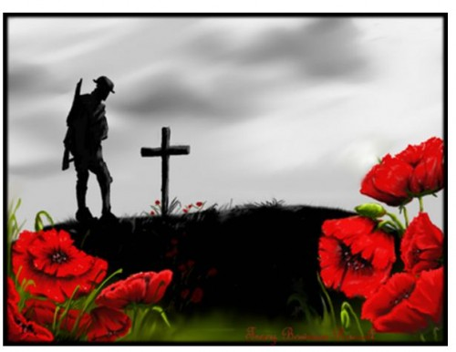
Why do we remember?

Slide 2
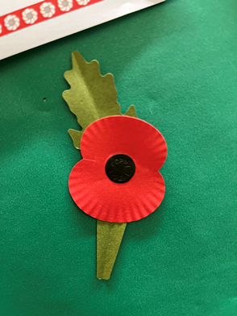
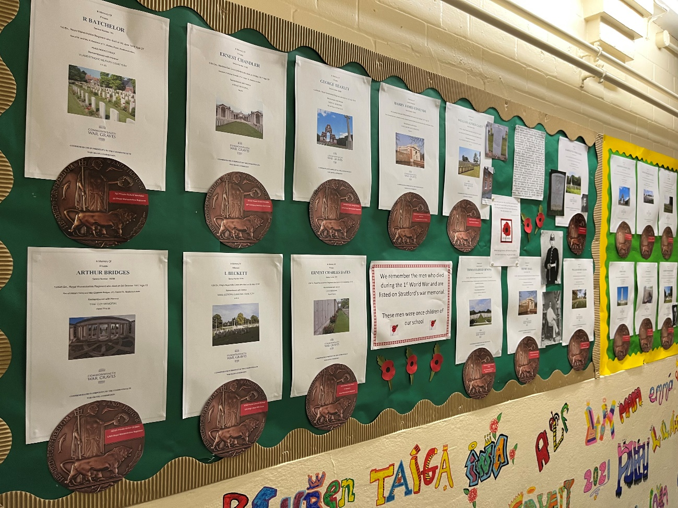
We remember here because…

Slide 3
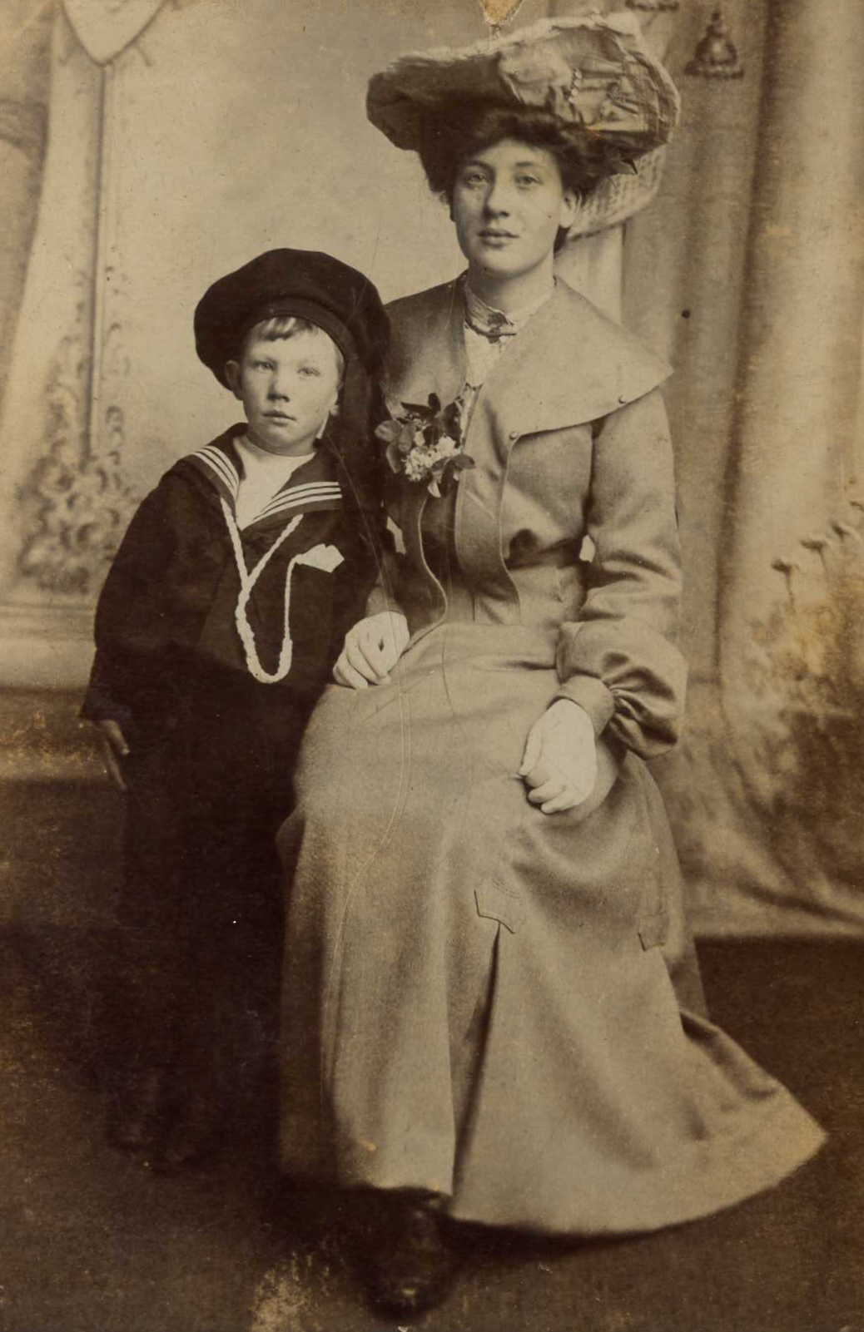
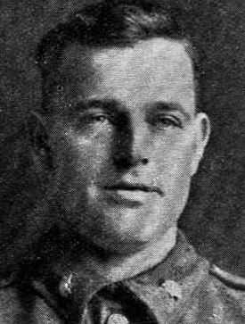
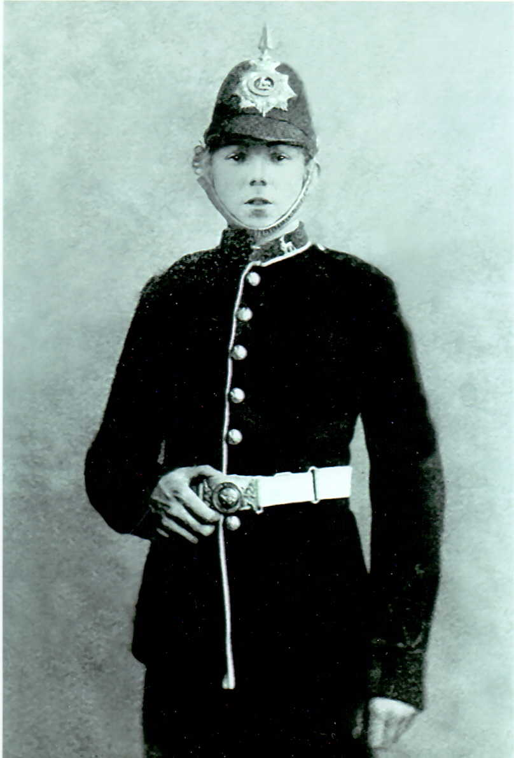
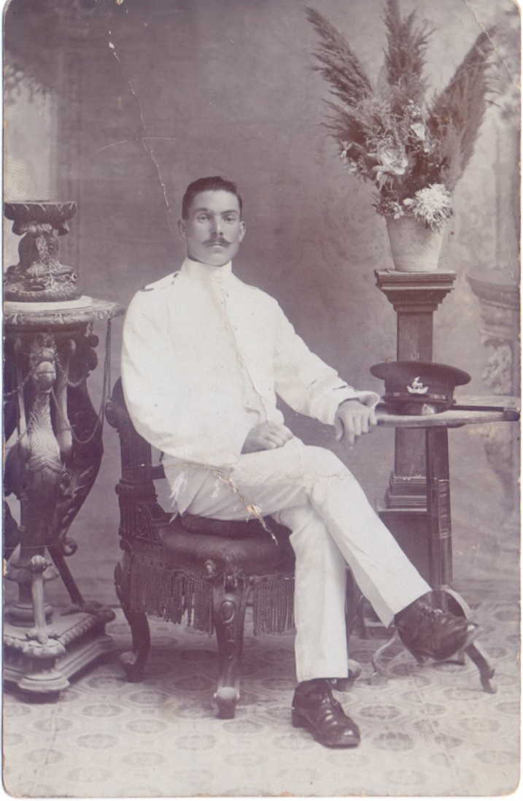
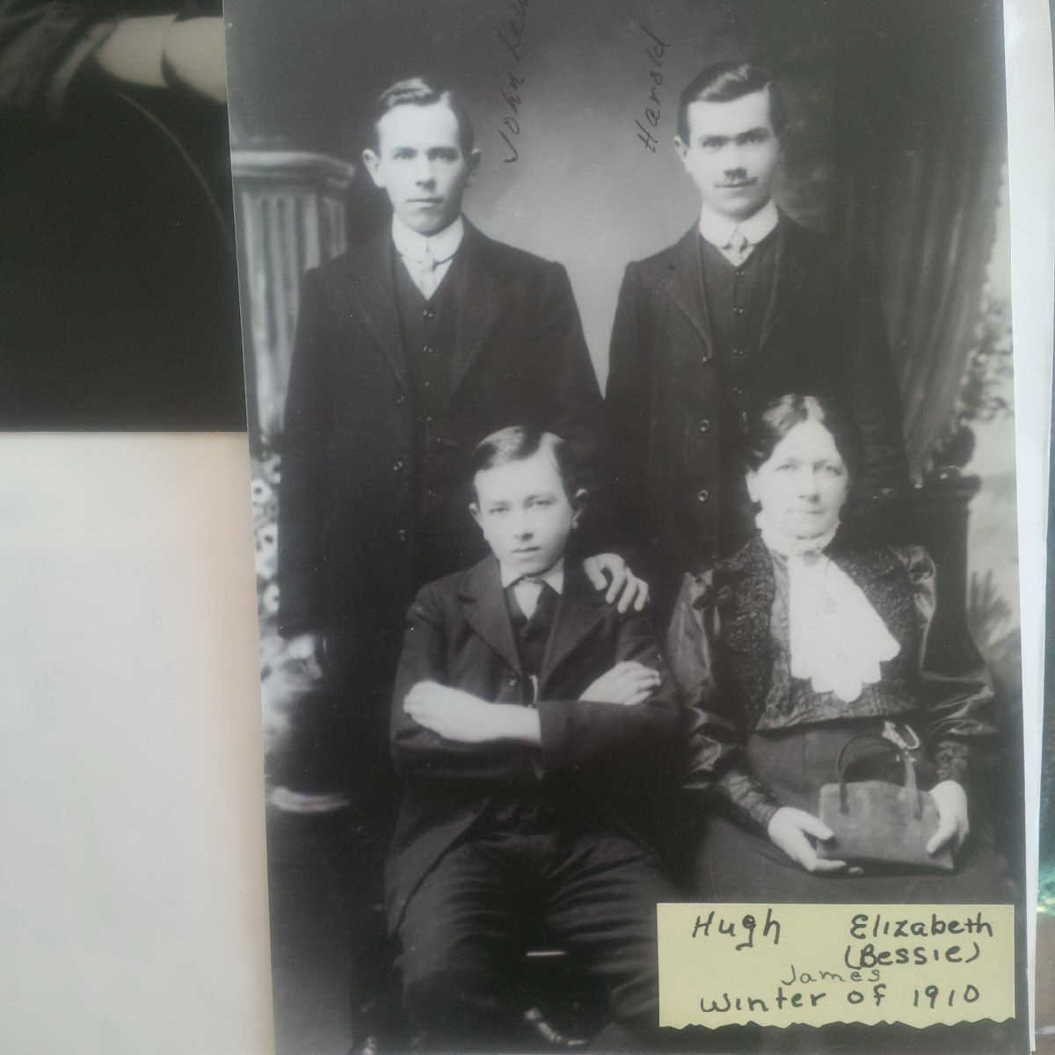

Slide 4
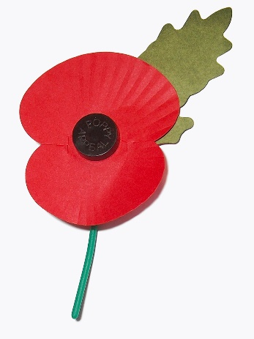
What is Remembrance?
When we take part in Remembrance we are saying thank you to all the people who keep us safe. We are saying thank you to:
To all those who have fought in wars and conflicts and still do
People who fight to protect us
People who help us
People who put themselves ahead of others

Slide 5
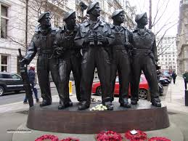
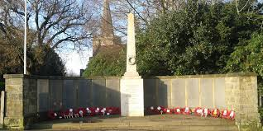
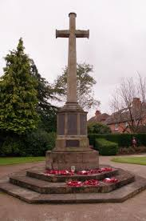
War memorials
In many towns, villages and cities there are war memorials to remember all those who have died in wars and conflicts – WW1, WW2, Korea, Bosnia, Northern Ireland, Iraq, Afghanistan and more. These help people to have a place they can reflect and remember.

Slide 6
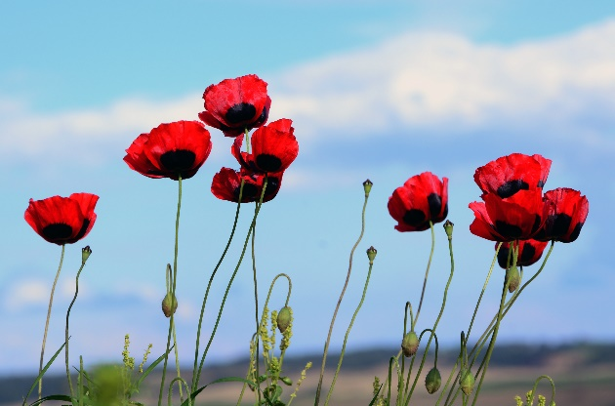
Why do we have Remembrance?
To remember
To show respect.
To say thank you
To preserve peace and freedom

Slide 7
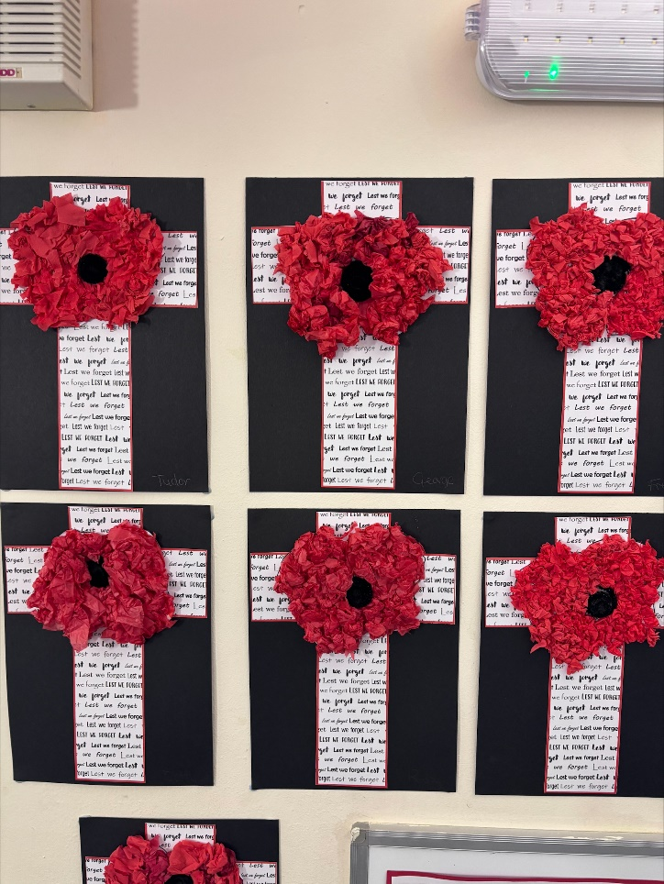
Year 6 will now read the names of the men who were once of our school

Slide 8

We will now remember in silence
They shall grow not old, as we that are left grow old:
Age shall not weary them, nor the years condemn.
At the going down of the sun and in the morning
(All say) We will remember them.
SILENCE

Slide 9
REMEMBER
When you go home, tell them of us and say,
For your tomorrow, we gave our today.

Slide 10
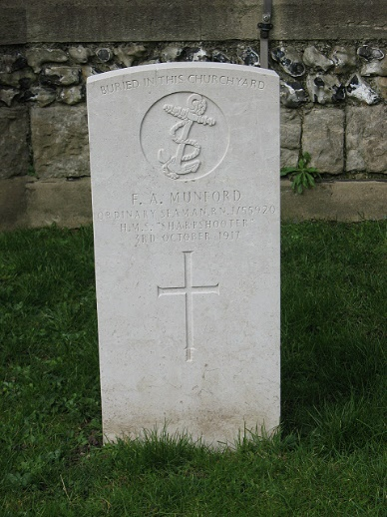

Remember
At some point in our history a member of our family will be involved in war or conflict
Every family history story has someone who has made a sacrifice
Find out more.

