Slide 1
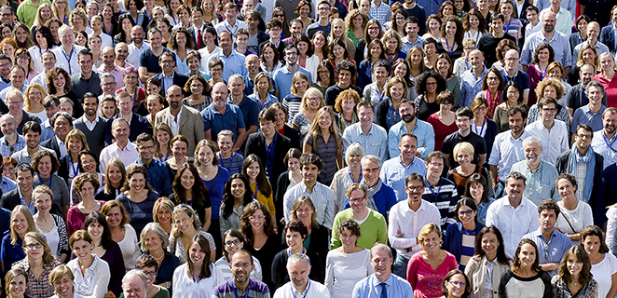
How many can you see?

Slide 2
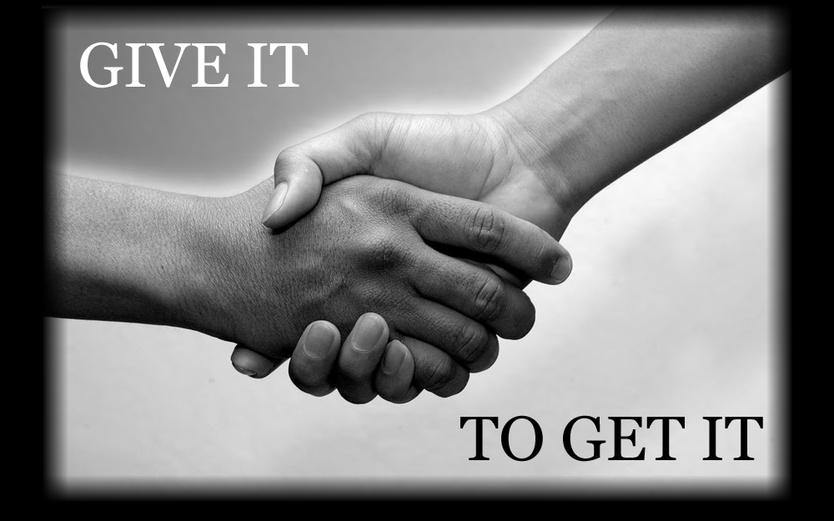
Respect
http://www.youtube.com/watch?v=XnSwQhF0C_c

Slide 3
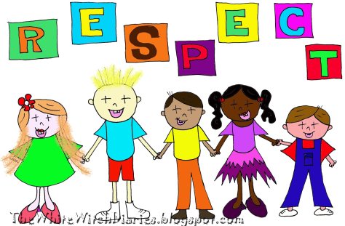
What is respect?
How you treat others
Being thoughtful about peoples feelings
Looking out for other people, property and the environment.

Slide 4
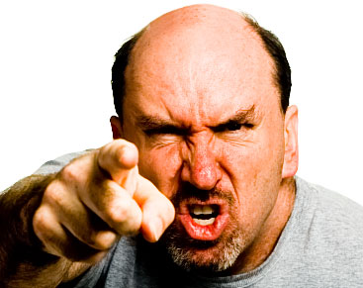
When you are angry
Do you hit people or things?
Do you try to upset other people?
Do you scream and shout and interrupt?
These are disrespectful

Slide 5
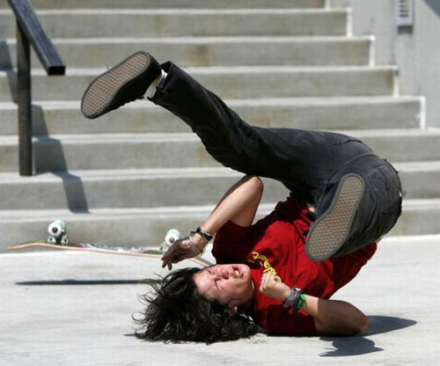
When you see someone fall over
Do you laugh?
Do you push them over?
Do you call them stupid?
These are disrespectful

Slide 6
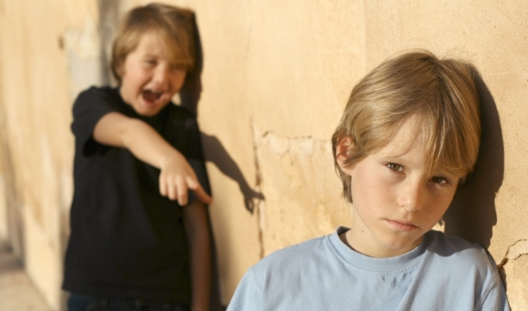
If you see someone you don’t like
Do you laugh at them?
Do you call them names?
Do you say nasty things about them?
Do you hit them?
These are disrespectful

Slide 7
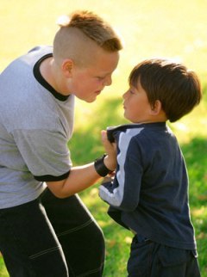
How would you feel
If someone shouted at you?
If someone hit you?
If someone called you names?
If someone took your things?

Slide 8
Treat other people how YOU would like to be treated.
Help people who need it
Listen to your friends
Hold open a door for someone
Smile at someone you don’t normally speak to
Ask someone to join you on the playground

Slide 9
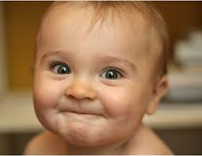
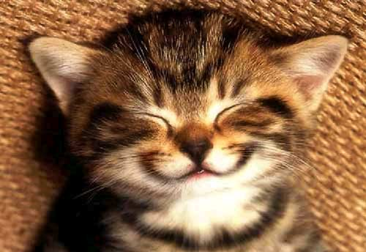
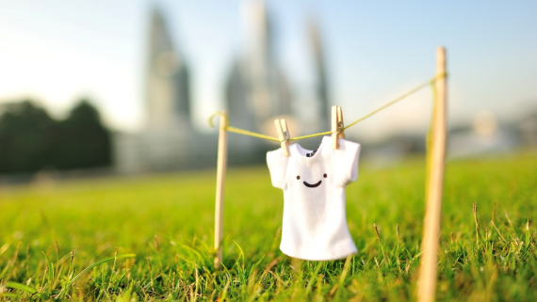
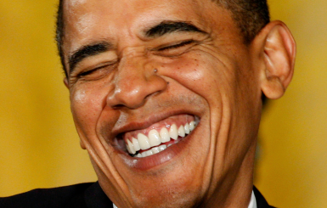
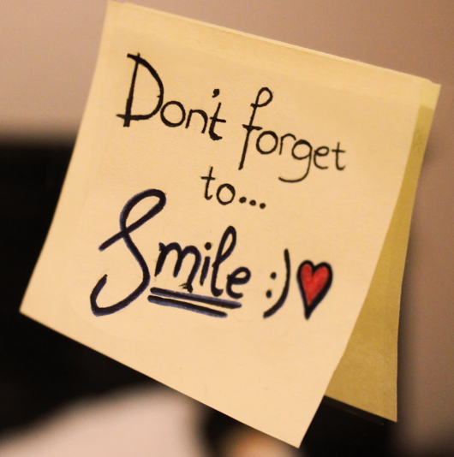
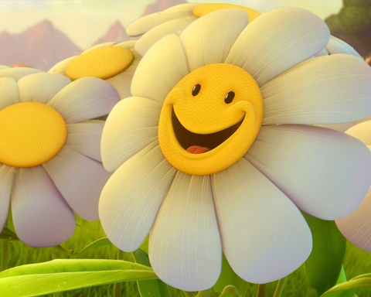
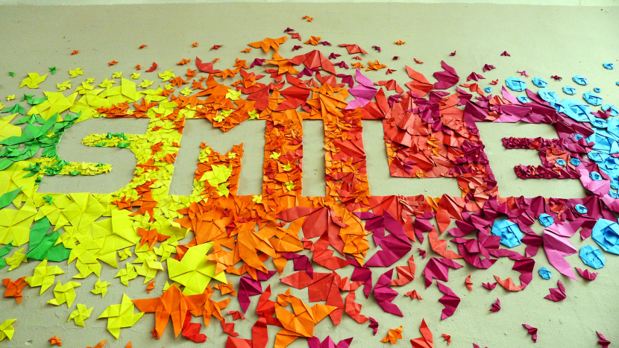
Be Respectful!

Slide 10
https://www.youtube.com/watch?v=A3yCcXgbKrE

