Slide 1
Year One
Welcome to
2023-24

Slide 2
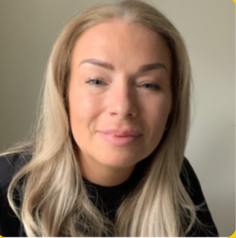
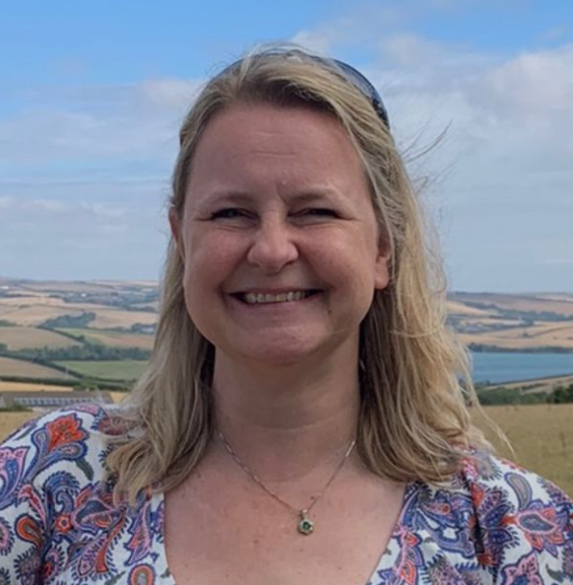
Year 1 Staff
Teachers
Miss Parton- Monday and Tuesday
Mrs Rushton –Wednesday, Thursday, Friday
Support Staff
Monday to Friday mornings
Mrs Green and Ms Desai
Monday to Friday afternoons
Mrs Hartley and Maisy (Student)

Slide 3
School starts at 8:45am. A typical day in Year 1 is fast paced and action packed! Children arrive at school, put their belongings away and settle down quietly to complete their early morning activities during registration time. They then move straight into morning lessons, which are the core subjects: Phonics, English and Maths. There are also enhanced provisions in place during these lessons. The afternoon runs similarly to the morning, with Topic based learning. The children will have an afternoon starter, these are either spellings, number bonds or phonics recap. They then move into the foundation subjects. Continuous provisions are running along side teacher lead activities. Towards the end of the day the children have story and song time. Throughout the week, the children have daily handwriting practice, whole class/ guided reading, reading with an adult.
A Typical Day in Year 1

Slide 4
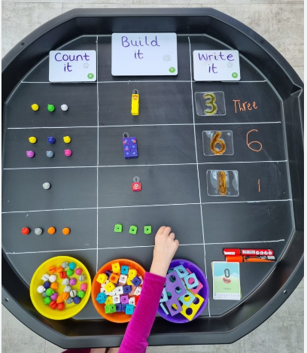
Learning through Play
Continuous provision
In Year 1 we have a heavy focus on learning through play. This allows the children to develop their independence, resilience, and determination as well as covering all areas of the curriculum.
The classroom is set up with lots of resources that the children can access to facilitate their learning.
Each week the children have independent challenges to complete. These challenges are linked to our topic.
As well as completing the challenges the children will also complete set work with adult support. For example, after a Maths lesson the children will work with an adult to complete an activity linked to the lesson. This is done in groups and one to one.

Slide 5
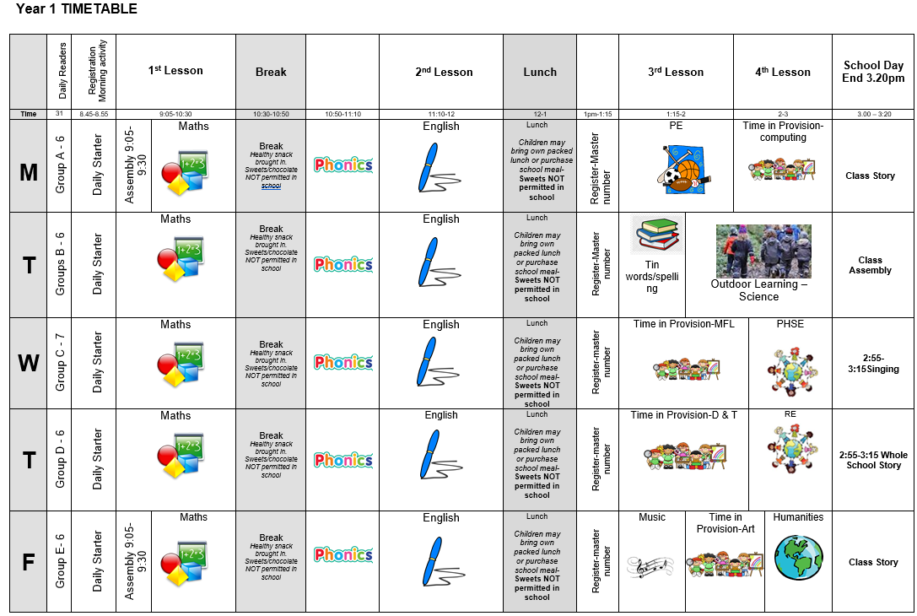
Class Timetable

Slide 6
PE and Outdoor Learning
Our PE lessons is on Monday. Children should come to school in their PE kits.
Our outdoor learning sessions will be on Tuesday afternoons. The children will start the term using the outdoor space. Later in the term they will be split into two groups for outdoor learning which will take place at the
Outdoor Learning at the Paddock
Children will need long trousers and sleeves all year for paddock days. They will also need appropriate shoes such as wellies as well as a waterproof coat. Waterproof trousers are also recommended.
Please ensure every item is clearly named!

Slide 7
How we assess the children
Assessment in KS1 is carried out daily, using live marking and targeted questioning as the children are working. This is to ensure that feedback is immediate, and children can respond immediately, ensuring the misconceptions are quickly addressed. Observations will take place and be recorded on Tapestry.
Children will then have differentiated work and adaptations to suit their ability or need.
Throughout the year, children will take part in assessments in reading, writing and mathematics to inform us of next steps; gaps in learning etc.
Children will be assessed in phonics in Year 1 in June. This is a check where the children have to read real and nonsense (alien) words. E.g. wup
It is completed in a relaxed and informal way. Children are not made aware that it is a formal assessment.
The Statutory Assessment does not make up the whole picture. We use teacher assessment to make a final judgement on whether children have met the Expected Standard for the end of Year 1.

Slide 8
Curriculum
Each term Year 1 will have a new learning topic and key text

Slide 9
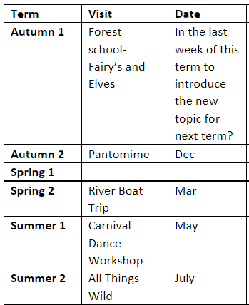
Educational Visits

Slide 10
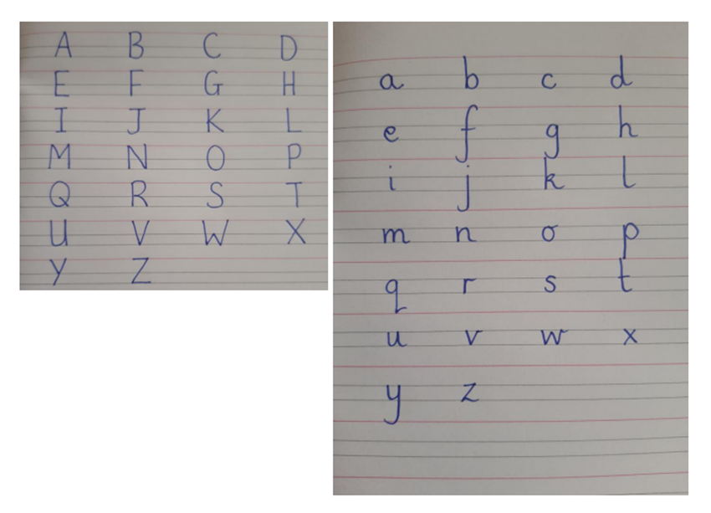
Homework
Reading- Please read with your child daily, books and reading records need to be in school every day! Books are changed on Fridays. The children will come home with a book linked to Phonics sounds and a book for pleasure. Children will read at least three times a week in school.
Phonics- Daily practice in school. Links have been added to the next page to support parents teaching at home.
Maths- White Rose Maths One Minute Maths, KIRFs, Number formation.
Spelling- Each week the children will be given 5 tricky words to learn. These will come home in small folders. New words will be added once they can read, spell and write the word.
Writing- Below is an example of letter formation. When completing work with your child at home please help them to form their letters correctly; including starting and ending them in the right place. There is a link to a video to support the correct formation at home. Children will complete letter formation and handwriting two times a week.

Slide 11
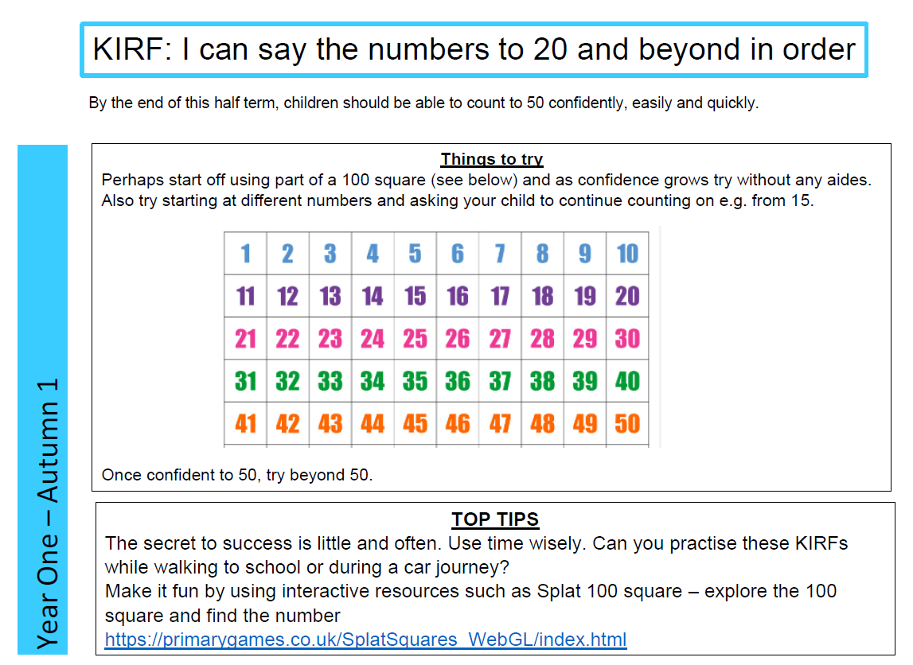
Homework

Slide 12
Phase 2 sounds- single sound https://www.youtube.com/watch_popup?v=-ZtjFIvA_fs Phase 2 sounds https://www.youtube.com/watch_popup?v=qDu3JAjf-U0 Phase 3 sounds https://www.youtube.com/watch_popup?v=DvOuc7cWXxc Tricky Words https://www.youtube.com/watch_popup?v=3C1KTDag0ZA Parent Phonics Page https://www.littlewandlelettersandsounds.org.uk/resources/for-parents/ Letter formation https://www.youtube.com/watch_popup?v=2a_e2z78xM4&list=PLGCpNseRUqM4DZKJwKPKmRxTc0lsP0l47 Maths App https://whiteroseeducation.com/1-minute-maths
Parent Links

Slide 13
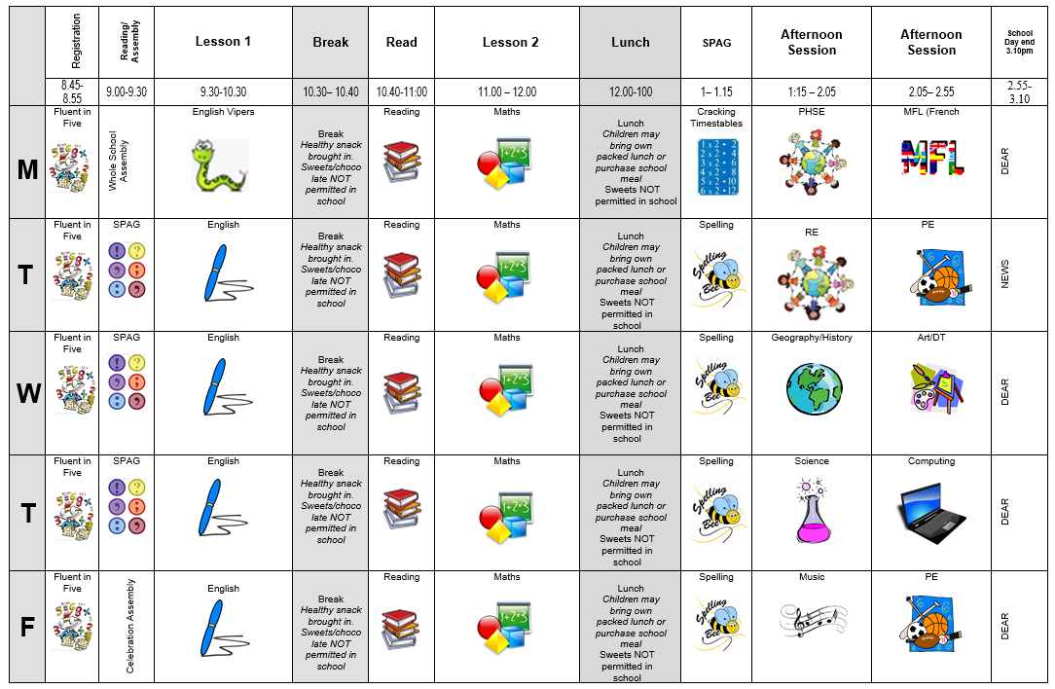
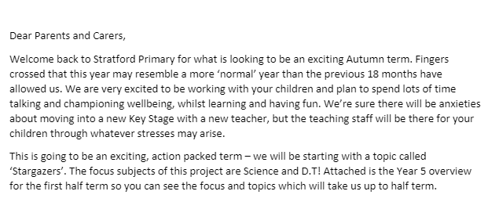
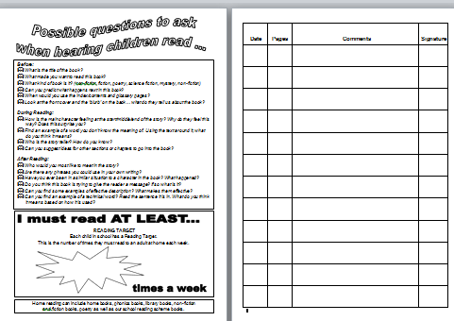
Communication
Timetable​
Parent letter
Weekly News Letter​
eSchools-home learning
Reading diary ​
Twitter- learning

Slide 14
Communication
We are always here to support and listen. You may come and talk to us at the end of the school day. If it is urgent, please email the school office. ​
​
If you have any minor inquiries, such as lost items/afterschool clubs, you can contact us via the school office. You can also use reading diaries to send messages. ​​
Important issues can be spoken about in person and appointments with teachers can either be done directly through teachers or via the school office.
​
​Serious injuries will be either a phone call home or a face-to-face chat. Minor injuries such as cuts and grazes will be communicated via accident forms which are given out at the end of the day.​​
.

Slide 15
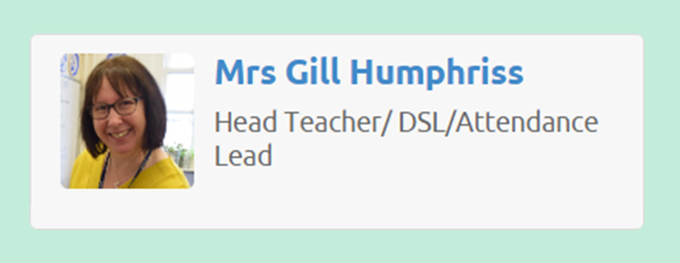
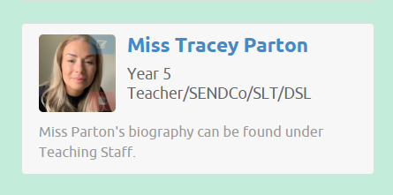
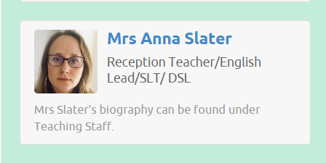
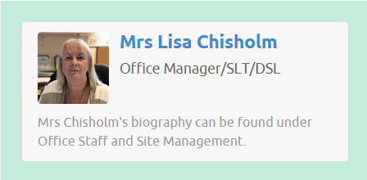
Additional Support/Concerns…
If you have any concerns about your child or need our support, you can directly come and talk to me after school. You may want to contact the school office and arrange a meeting in private.
The DSL team are always welcoming and can support you with your concerns.
You can email or phone - more contact information is available on the website.​
​

Slide 16
Expectations
Behaviour – high expectations, in class, in the playground, moving around school, on educational visits, when visitors are in and during after school clubs.
School uniform / PE kit / Lost Property – LABEL!
Presentation, in school and when completing work.
Encourage independence – children to inform when they need a book changed, need to hand in a letter, bring sheets and uniform home, hand homework in. Homeworks starts after the 11th September.
Named water bottle needs to be in school every day.
Phone or email the school office of your child is absent.

Slide 17
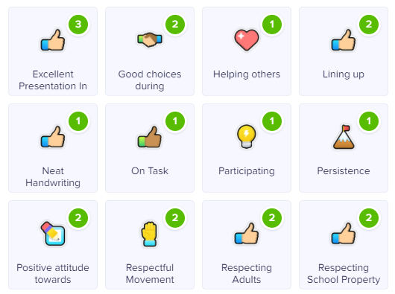
Celebrating Success…
Well-being Warrior in celebration assembly
Topic Sharing Events/Writer of the month
Looking at the website and Twitter
Stickers, Dojo points, House Points, and ‘WoW’ board

Slide 18
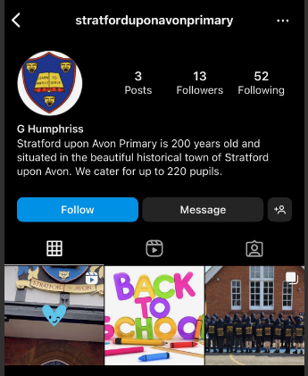
AOB…
​
Healthy snacks for break and in lunches - no nuts
Clearly label: uniforms, coats, shoes and bags​
PE is on a Monday- Please send them to school in PE kits
Only Prescribed medication -should be clearly labelled and taken to the office-not in school bags​
Follow us on Twitter … stratfordprim ​
Follow us on Instagram… stratforduponavonprimary
​
RESPECT – the one school rule ​
​

