Slide 1
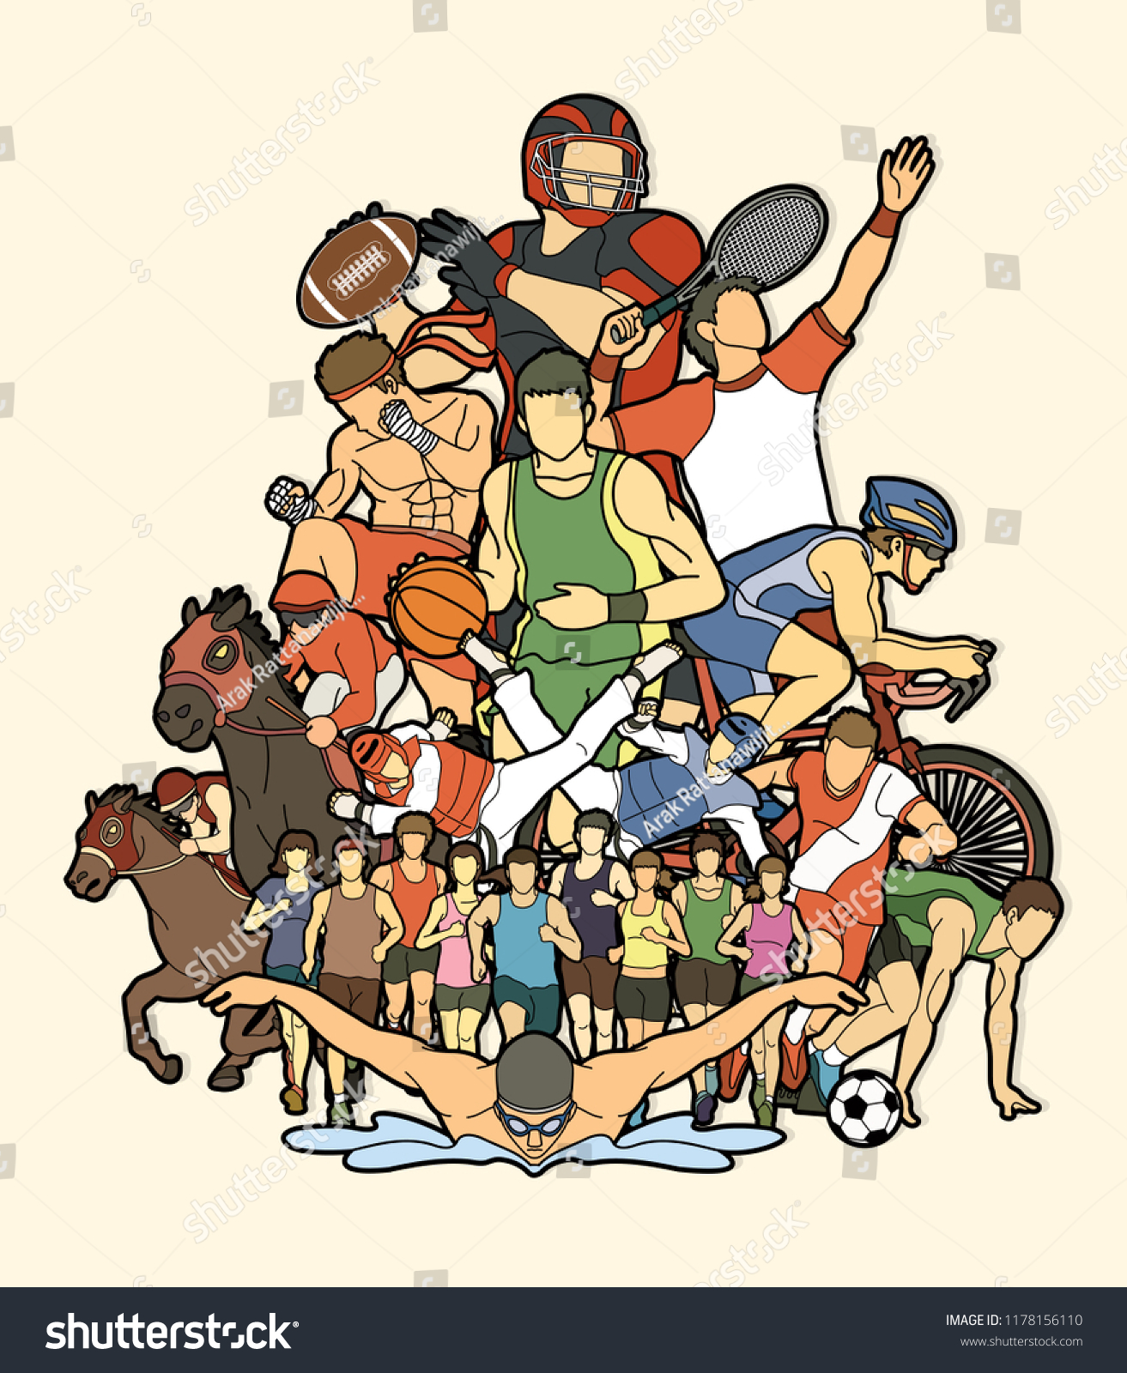
How many sports can you see?

Slide 3
Olympic Values

Slide 4
Olympic Values
Striving for excellence and encouraging people to be the best they can be.
Demonstrating respect in many different manners: respect towards yourself, the rules, your opponents, the environment, the public, etc.
Celebrating friendship, which is quite unique to the Olympic Games – an event that brings people together every few years. https://www.youtube.com/watch?v=Vy9a-z946Rg

Slide 5
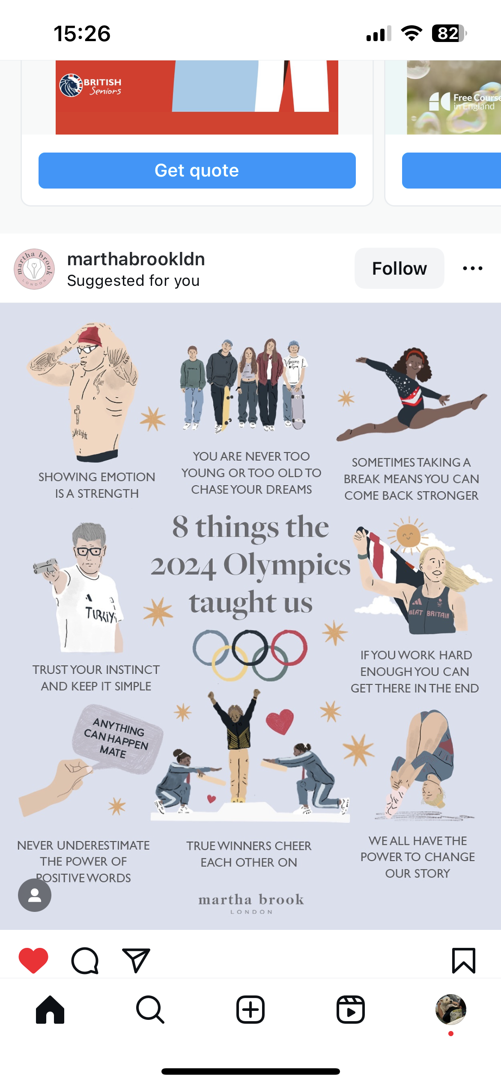

Slide 6
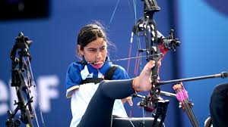
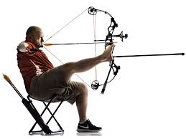
https://www.youtube.com/watch?v=eDmO-kMmE6s

Slide 7
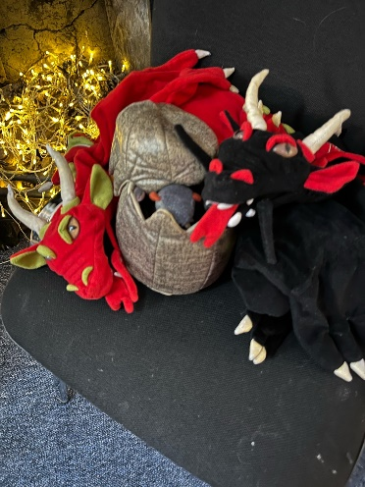
House Points & Attendance & choir
Class Dojos convert to house points
Counted on Thursdays then cleared
Announce on Mondays
Attendance is key to success
Choir Tuesdays 12 – 12.20

