Slide 1
Stratford Primary School Council

Slide 2
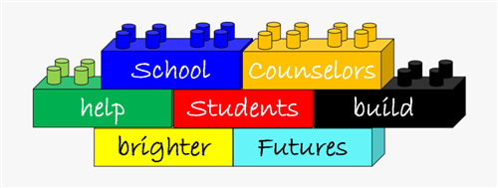
The School Councillors
Year 1 - Ben
Year 2 - Artemis
Year 3 - Isabelle
Year 4 - Emilia
Year 5 - Baden
Year 6 - Ananya and Oliver - Hall House and Vice captain
Isla and Hattie - Hathaway House and Vice captain
Oscar and Chloe - Arden House and Vice captain
Imogen and Ines - Shakespare House and Vice captain

Slide 3
Purpose of School Council
The school council and House teams come together to discuss ways to make our school even better.
At our last meeting, the school council discussed options for our school charity.
We took a vote and decided, as a group(each house), to support Guide Dogs

Slide 4
HOUSE TEACHER TEAM
HALL – Miss White
SHAKESPEARE - Mrs Slater
HATHAWAY - Miss Hitchens
ARDEN - Miss Parton

Slide 5
Purpose of House Meetings!

Slide 6
What Will Happen in House Meetings
House meetings will take place this Tuesday at 2.45 pm
Will be held in class rooms, with the teachers that have been allocated each house
We discuss how to fundraise for our chosen charity (Guide dogs)
You have the opportunity to talk about any ideas you may have for the school council and to make the school a better place for everyone
We can also talk about any worries that you have at school or at home
If you have any questions tell us or the school council WE WILL HELP YOU!

Slide 7
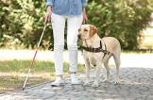
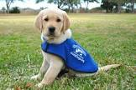
GUIDE DOGS Fundraising

Slide 8
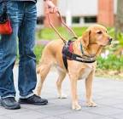
Our School Charity and Ways to Support
The school council has chosen Guide Dogs as the school’s charity for this year. There will be several fundraising events to raise funds – so we need your help! Each house would like to raise as much money as possible for the Guide Dogs. Tell your house captain if you have any fundraising ideas. All ideas are great ideas and all ideas will be considered!

