Slide 1
Wednesday 12th October 2022

Slide 3
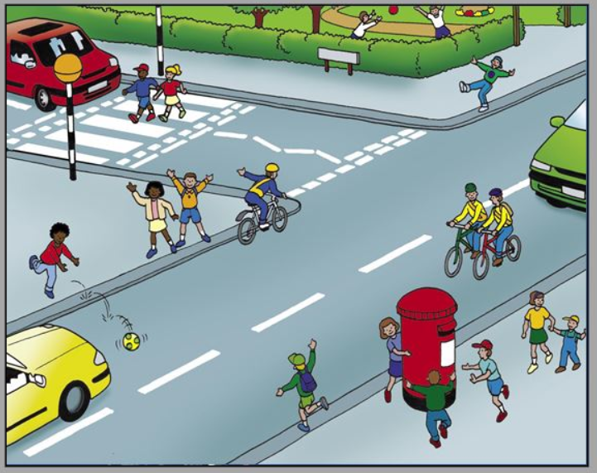
How many hazards
can you spot?

Slide 9
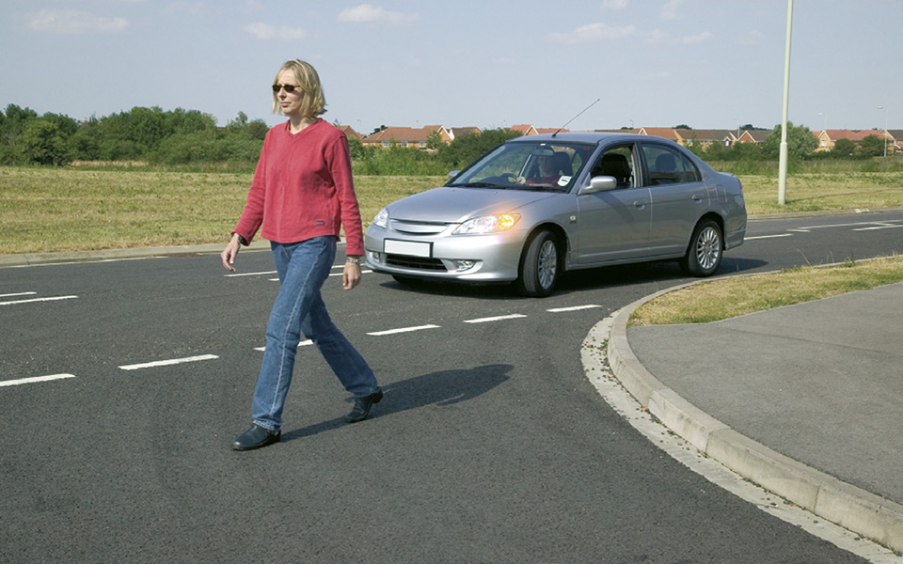
What is wrong about the way these people are crossing the roads?

Slide 14
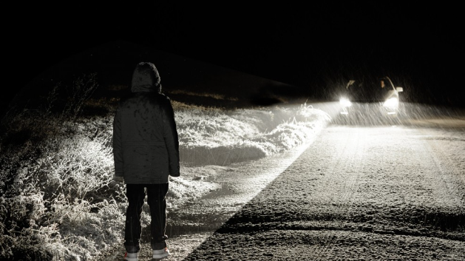
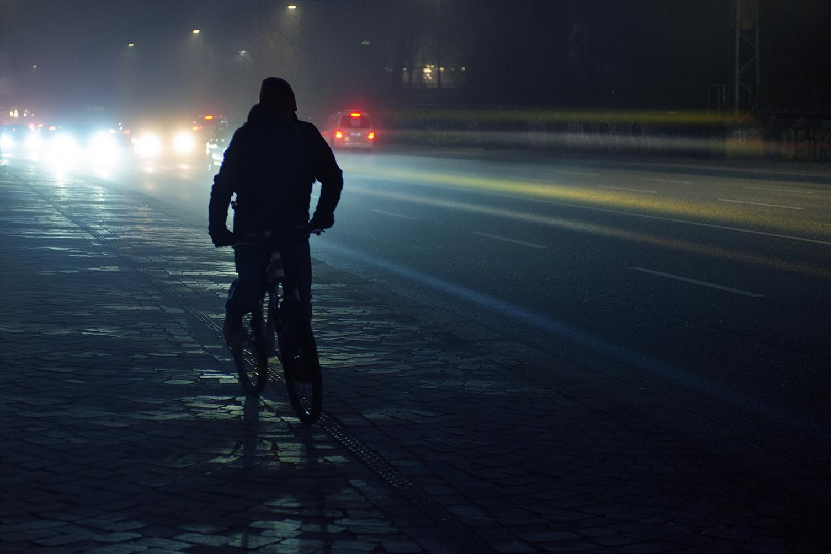
What is wrong about the way these people are using the roads?

Slide 15
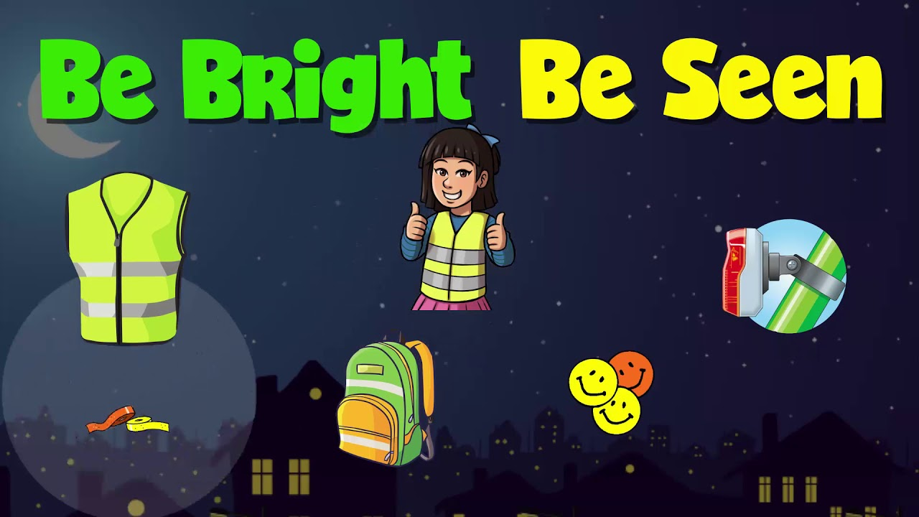
You know how to use the road safely but now consider how you can stay safe on the roads as the evenings become darker…
Click on the picture to find out more…

Slide 16
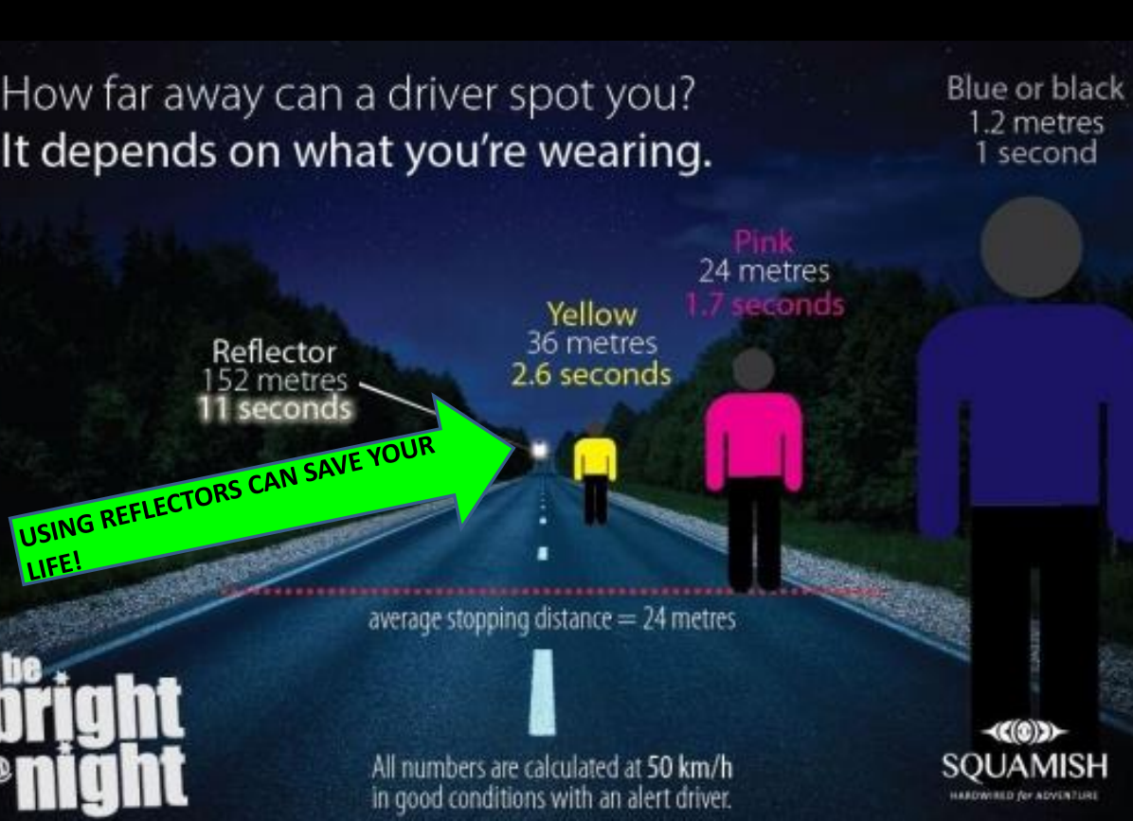

Slide 18
Mrs Withers is the Road Safety Champion for the school and the Safeguarding Committee are also Junior Road Safety Officers, part of the Warwickshire Safer Active Travel programme…
They have planned a year of activities to help raise awareness about being safe when on or near roads…
We are currently working towards the Silver Award…

Slide 19
Team Safe have created a Be Safe, Be Seen Quiz for you...
Go to www.kahoot.it and type in the game pin…

Slide 20
Over to you…
The Safeguarding Committee are running a poster competition – we would like you to design a poster that encourages others to Be Bright, Be Seen…
There will be a winning design for KS1 and a winning design for KS2…
The closing date for entries is Friday 21st October.

Slide 21
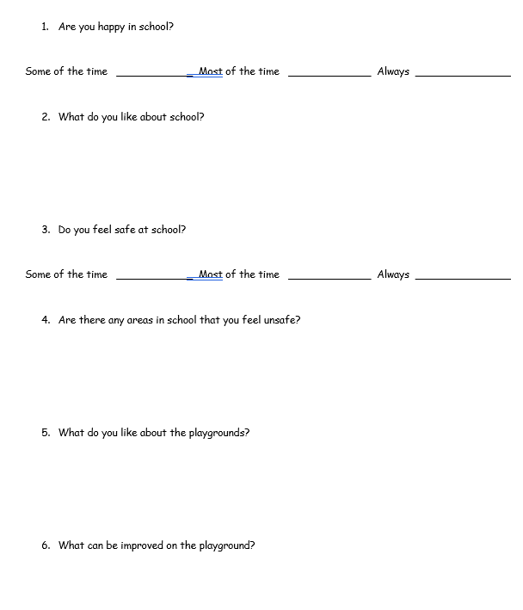
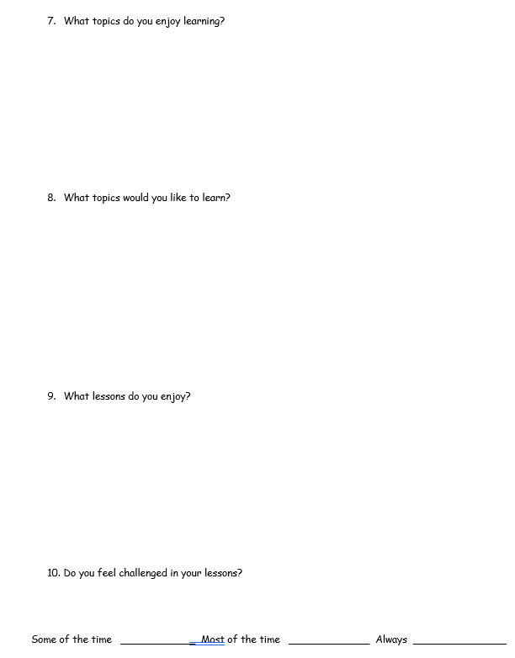
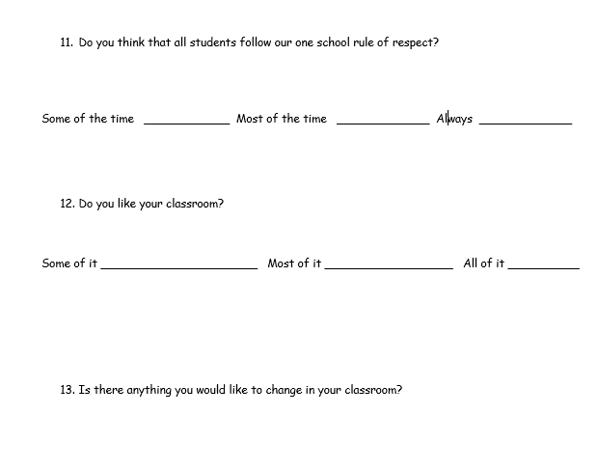
And finally… Miss White and the school council would like you to complete a survey about being safe in and around school…

Slide 22
