Slide 1
Welcome to Year 2
Miss White, Miss Beggs and Mrs Hartley

Slide 2
Year 2 staff
Miss White, Miss Beggs and Mrs Hartley
Mrs Beesley – Monday afternoon
Mrs Fade – Tuesday morning

Slide 3
A typical day in Year 2…
A typical day in Year 2 is very busy.
As soon as the children arrive at school they will put their belongings away and sit at their tables to quietly complete the morning activity of colour monsters and handwriting practice during registration.
They then move straight into the morning sessions which consist of the core subjects English and Mathematics.
After lunch they will cover Topic based learning.
In the day we have time for independent reading, whole class reading, an extra 15 minute maths session to practice fluency and spelling.

Slide 4
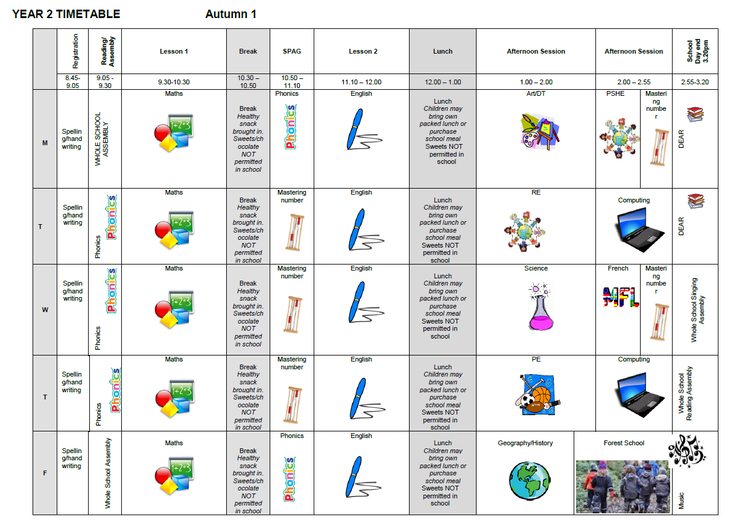
Timetable
Autumn 1 – phonics
Rest of the year - SPAG

Slide 5
Assessment…
Assessment in KS1 is carried out daily with live marking happening during the lesson and as the children are working. This ensures that children have time to respond to the feedback, make changes and any misconceptions can be addressed immediately.
Any child that did not meet the expected score for the phonics screening test in Year 1 will have an opportunity to try again at the end of Year 2.

Slide 6
English, Maths and the other areas.
English – is based on a whole class text that is normally linked to that terms topic. Whole class reading also takes place daily to help children be immersed in a text. This means by the end of the half term they will have read and understood a novel.
Maths Mastery –is about deepening children’s understanding, use and manipulation of all things maths. It will help develop speed and accuracy with arithmetic skills.
We will also teach Geography, History, Science, French, ICT, RE, PSHE,
Music, Art and Design & Technology. Learning in these subjects is, where possible, linked to each terms topics.
This year our term topics will be… Magnificent monarchs, Animal survival, Movers and Shakers, and Coastlines.

Slide 7
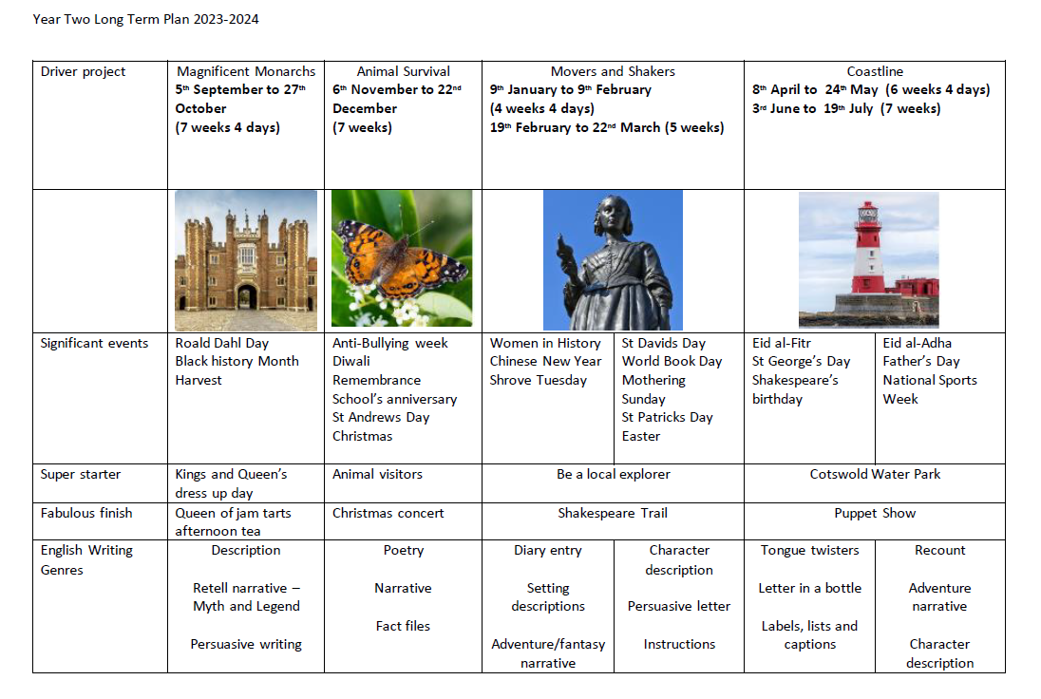
Long Term Plan
King’s and Queen’s dress up day: Friday 15th September

Slide 8
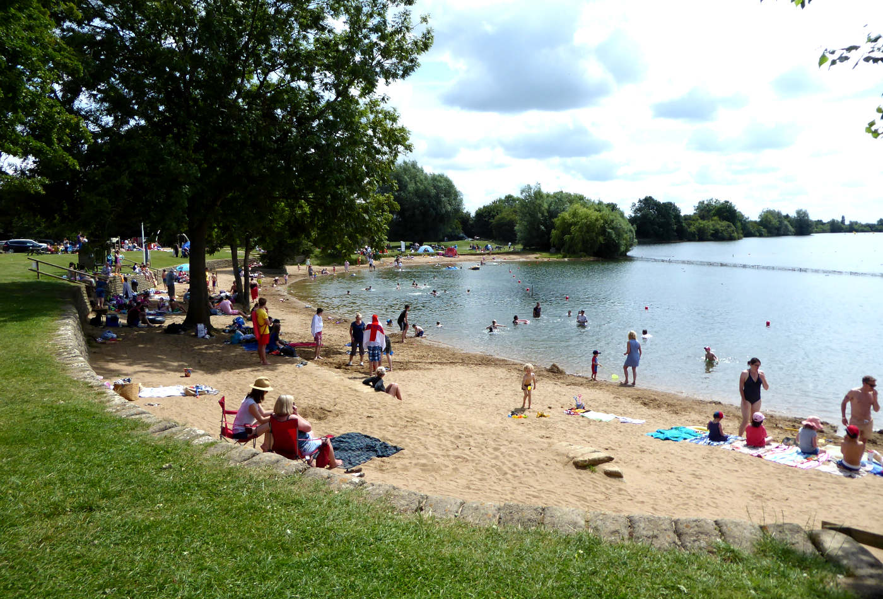
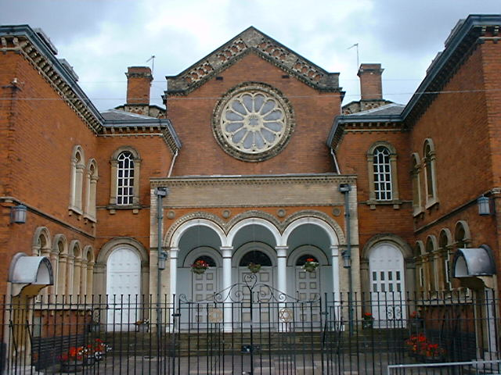
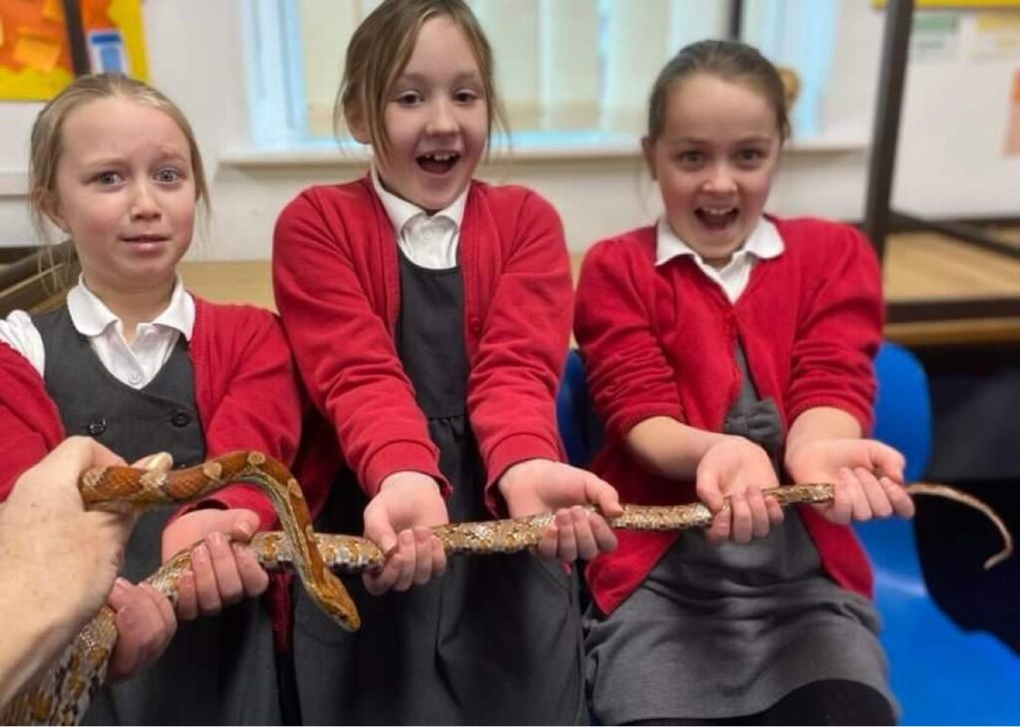
Trips
Animal experience – Autumn 2 – approx. £8
Birmingham Synagogue and library - Spring term – approx. £15
Beach trip (Cotswold Water Park?) – Summer term – approx. £20

Slide 9
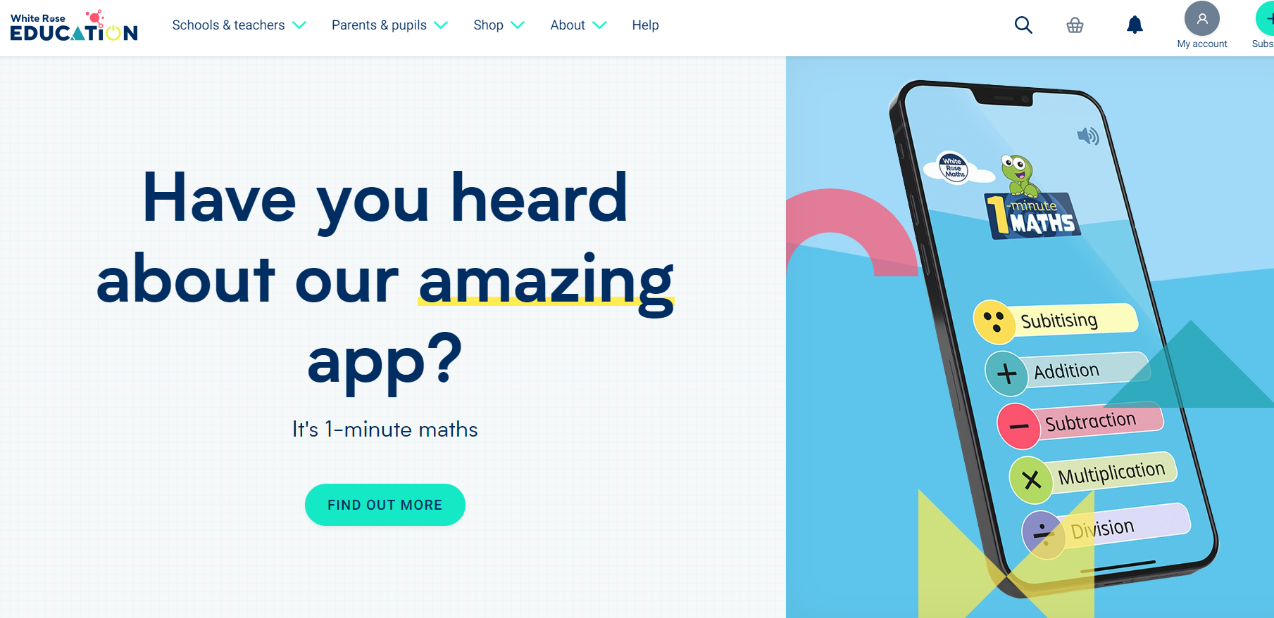
Home Learning…
Children are all expected to read once at home every day.
Please write the date and the page number they read to so we can continue where they got to when reading with them in school.
Children will also need to complete the 1-minute maths challenge on the white rose app at least 3 times a week.
.

Slide 10
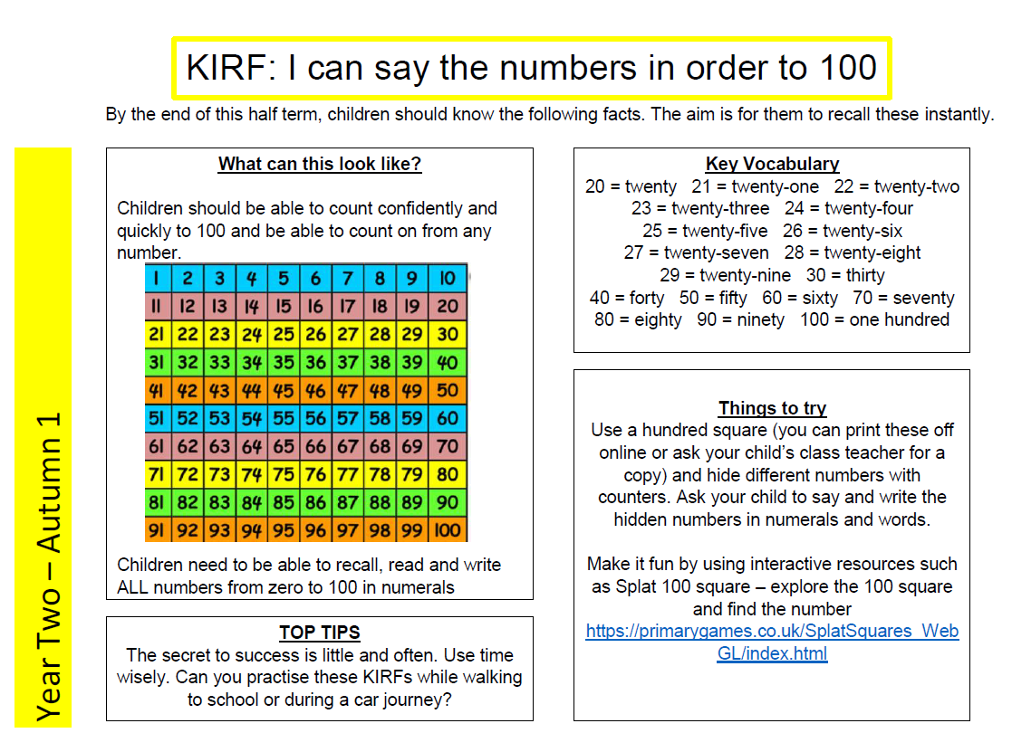
Home Learning…

Slide 11
Home Learning…
Children are also expected to practise 10 spellings every week. This will be given to them in school and will contain the 10 words and 5 columns for them to practise writing each word in.
These may be spellings we have noticed they need to practise from lessons or previous common exception or high frequency words that they should know.
When practising spelling, children should also be practising their handwriting so please encourage your child to form each letter properly and to write small with tall ascenders and descenders.
I will give dojos for every attempt the children try each week so please make sure sheets are returned into bags so the dojos can be handed out.
Spelling is a big focus this year so please do support your child with their spelling at home.

Slide 12
A few things
We are a nut free school – no nut products for snacks or lunch (including Nutella)
Medicines – prescribed medicines only and they need to be handed in to the office.
Forest School volunteers – Friday afternoons from 2pm starting from 22nd September
Head/face injuries

Slide 13
Communication…
We are always here to support and listen whatever it may be. You can come talk to us on the door at the beginning or end of the day (being mindful of adults releasing children). We try our best to pass on all messages at home time.
If you have any minor inquiries you can contact us via eSchools or speak to the office to arrange a meeting. We will also use eschools and the reading diaries to send messages home to you.
Important issues can be spoken about in person and appointments with teachers can either be done directly through teachers or via the school office.
Accident forms will be given out at the end of the day for any minor injuries, such as cuts and grazes. Any serious injuries will be either a phone call/face to face chat.
Please check the website and eschools for copies of the home learning task. Our class timetables and planning.

Slide 14
Expectations…
Behaviour – high expectations, in class and in playground, in school on trips and when visitors are in and in after school clubs.
Class dojo points - house points.
School uniform/PE kit/ snack pots should all be clearly labelled and it is the children's responsibility to look after these.
Presentation, in school and when completing homework.
Encourage independence – children to inform when they need a book changed, need to hand in a letter, bring sheets and uniform home, hand homework in.
Named water bottle needs to be in school every day.

Slide 15
Celebrating Success…
Weekly celebration assembly
Stickers and Dojo points
Topic Sharing Events
Looking at the website, Twitter and Instagram

Slide 16
AOB…
Saying Goodbye at the door
Remind children at home they have a peg in which to store their items, encourage their independence
Follow us on Twitter and Instagram
RESPECT – the one school rule

Slide 17
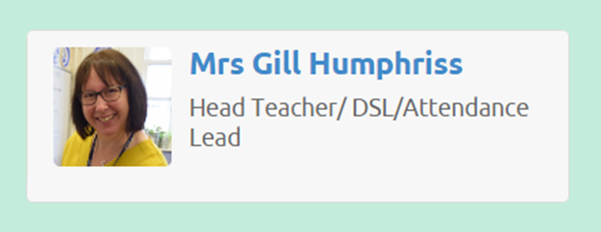
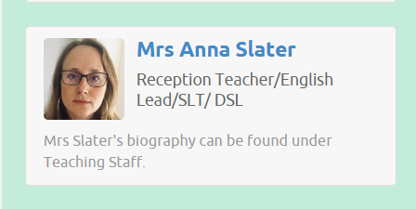
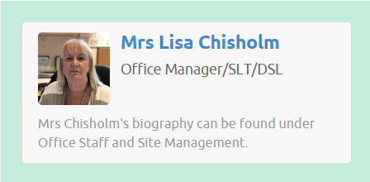
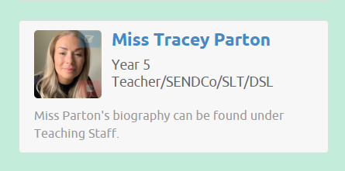
Designated Safeguarding leads...…
If you have any concerns about your ​
Child or need our support you can contact me directly through eschools or come and talk to me after school. You may want to contact the school office and arrange a meeting in private.​
The DSL team are always welcoming and can support you with your concerns.​

Slide 18
Thank You!

