Slide 1

Welcome to Year 5
Mrs Nailor and Mrs Buchanan

Slide 2
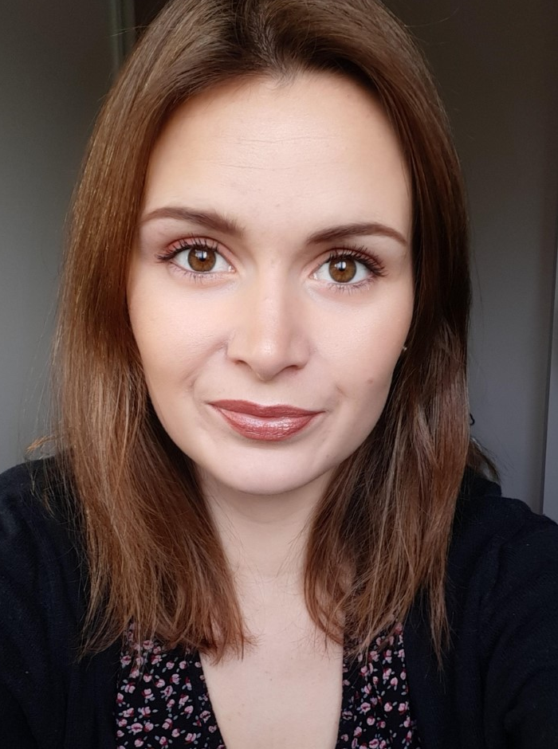
Meet the teacher – Mrs Nailor
Welcome to Year 5!
My name is Mrs Nailor and I will be the Year 5 teacher.

Slide 3
A typical day in Year 5…
As soon as the children arrive at school they will put their belongings away in their lockers and sit at their tables to quietly complete the morning activity of fluent in 5 during registration. They will also have time to fill in their colour monsters to let us know how they are feeling.
They then will have either an assembly or a short handwriting/ SPAG session. After that they have their morning sessions which consist of the core subjects English, Mathematics and spelling.
After lunch they will quiet read before starting our Topic based learning and the foundation subjects.
The day will end with assemblies or a whole class story.

Slide 4
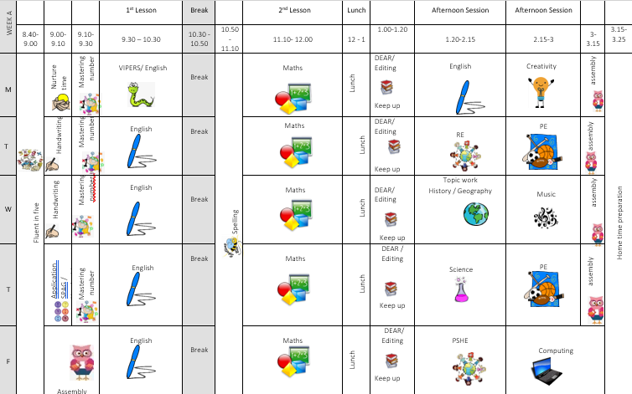
The timetable will look similar to this.

Slide 5
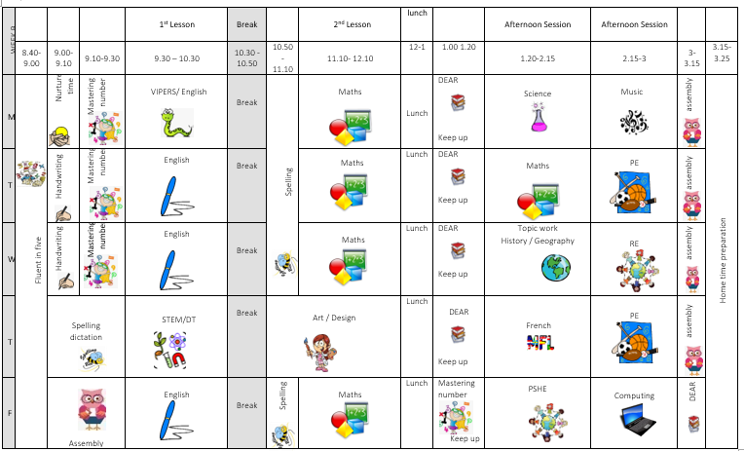
The timetable will look similar to this.

Slide 6
English and Mathematics.
English – is based on a whole class text that is normally linked to that terms topic.
The class texts this year are…
The sleeper and the spindle by Neil Gaiman
Tuesday by David Wiesner
Space detectives by Mark Powers
Hidden figures by Margot Lee Shetterly
A midsummer’s night dream by Shakespeare
Adventures of Odysseus by Hugh Lupton
Whole class reading also takes place daily to help children be immersed in a range of texts.
Maths Mastery –is about deepening children’s understanding, use and manipulation of all things maths.
Fluent in five – Takes place daily and will help develop speed and accuracy with
arithmetic skills.

Slide 7
Topic learning.
We will also teach Geography, History, Science, French, ICT, RE, PSHE, Music and Art/ Design.
Learning in these subjects is, where possible, linked to each terms topics.
This year our term topics will be… Dynamic Dynasties, Stargazers and Groundbreaking Greeks.

Slide 8
Trips...
This year I have tried to think of how I can further enhance the children’s learning through trips and experiences at as low cost for as possible.
Here are the planned and potential trips for the year…
Bell boating – 24th September all day
Mad museum – 2nd October pm
Heart of England –22nd October – forces
Heart of England – 4th February (afternoon into evening) – Stargazing
Bikeability – Spring term
Greek workshop day – Summer term
El Greco visit – Summer term

Slide 9
Assessment…
Assessment in KS2 is carried out daily with live marking happening during the lesson and targeted questioning as the children are working. This ensures that children have time to respond to the feedback, make changes and any misconceptions can be addressed immediately.
Children will take part in assessments in reading, writing, spelling, mathematics and science across the year to show progress and inform us of their next steps or any gaps in learning. Most of these assessments will now be completed online using the GL assessments. However, we will still ensure to do some in the traditional paper format to help them prepare for SATs next year.
The Statutory Assessment does not make up the whole picture. We use teacher assessment to make a final judgement on whether children have met the Expected Standard for the end of Year 5.

Slide 10
Home Learning…
Children are all expected to read once at home at least 3 times a week and this should be recorded in their diaries. They can record this themselves.
Children will be given a maths Key Instant Recall Facts (KIRF) for each term, which will give you ideas of things you can recap at home to help with fluency. These will be quick ideas of things they can practise in the car, on the way to school or whilst queuing at the shops etc.
Children should also complete at least 20 minutes of times table rock stars three times a week.
They will also have a weekly spelling tests so children should be practicing these spellings each week as part of their homework. Children may have individual spellings of common exception words from previous years or that we have noticed they need to practice from lessons. Please encourage them to focus on these words first.
Home learning is for recall of facts, knowledge and skills learnt. It will not be marked
but any completed will be rewarded with dojos or stickers.
.

Slide 11
Expectations…
Behaviour – high expectations, in class and in the playground, on school on trips and when visitors are in or in after school clubs..
School uniform/PE kit/ snack pots should all be clearly labelled and it is the children's responsibility to look after these.
Named water bottle should be in school every day.
Presentation of their work at all times
Encourage independence – children to inform when they need a book changed, need to remember to hand in letter, take sheets home, remember to wear their PE kit or uniform and show any homework. Remind children they have a locker in which to store their items, encourage that independence.

Slide 12
Celebrating Success…
Weekly certificates of head teachers award and learner of the week to celebrate success.
Well–being warriors and respect awards
Stickers, Dojo points and going on the WOW wall.
Instagram

Slide 13
Communication…
Class dojo is our only form on communication. I will update the class story page with key information when needed.
Children will be given positive dojos regularly, negative dojos can also be given, however, hopefully won’t need to be!
Parentpay will remain as it was, as will Instagram.
Accident forms will be given out for any minor injuries, such as cuts and grazes. Any serious injuries or head injuries (even if minor) will be a phone call.
Please check the website and classdojo for copies of our class timetables and messages.

Slide 14
Communication…
We are always here to support and listen whatever it may be.
If you have any minor inquiries you can contact me through admin for the attention of me. We are also now only allowed to respond to emails weekdays between 8am and 6pm.
Important issues can be spoken about in person and appointments with myself can either be arranged via the school office or directly at the end of the day.

Slide 15
AOB…
Medicines – Only prescribed medicines with child’s name on are allowed. They must be handed to the office. No medicines should be left in a child’s bag.
Healthy snacks – NUT FREE!
Children will get changed in school for PE so please make sure there PE bags and trainers are in school on PE days… Tuesday and Thursdays
Only Year 6 children have permission to walk to and from school on their own and only Year 6 children are allowed mobiles. All other children must be escorted to school.
New statutory guidance in place by the government means that all children must attend school and holidays/ leave of absence can not be granted except for exceptional circumstances… the policy is available on the website.
I have attached some 11+ resources on class dojo if you wish to explore this. These are completely optional. I do have more resources that I was unable to attach, due to the format of those documents, so if you wish for more at any point in the year, please let me know.
Follow us on Instagram… stratforduponavonprimary
RESPECT – the one school rule

Slide 16
Designated Safeguarding leads...…
If you have any concerns about your ​
Child or need our support you can contact me or you may want to contact the school office and arrange a meeting in private.​
The DSL team are always welcoming and can support you with your concerns.​
Our safeguarding leads are…
Mrs G. Humphriss
Mrs L Chisholm
Miss T Parton
Miss G White

Slide 17
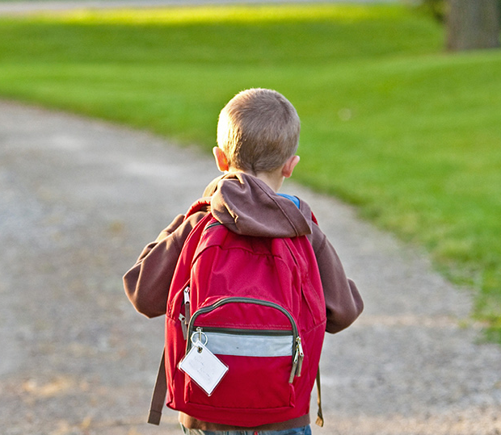
Thank You!

