Slide 1
Parent Forum
Stratford upon Avon Primary School

Slide 2
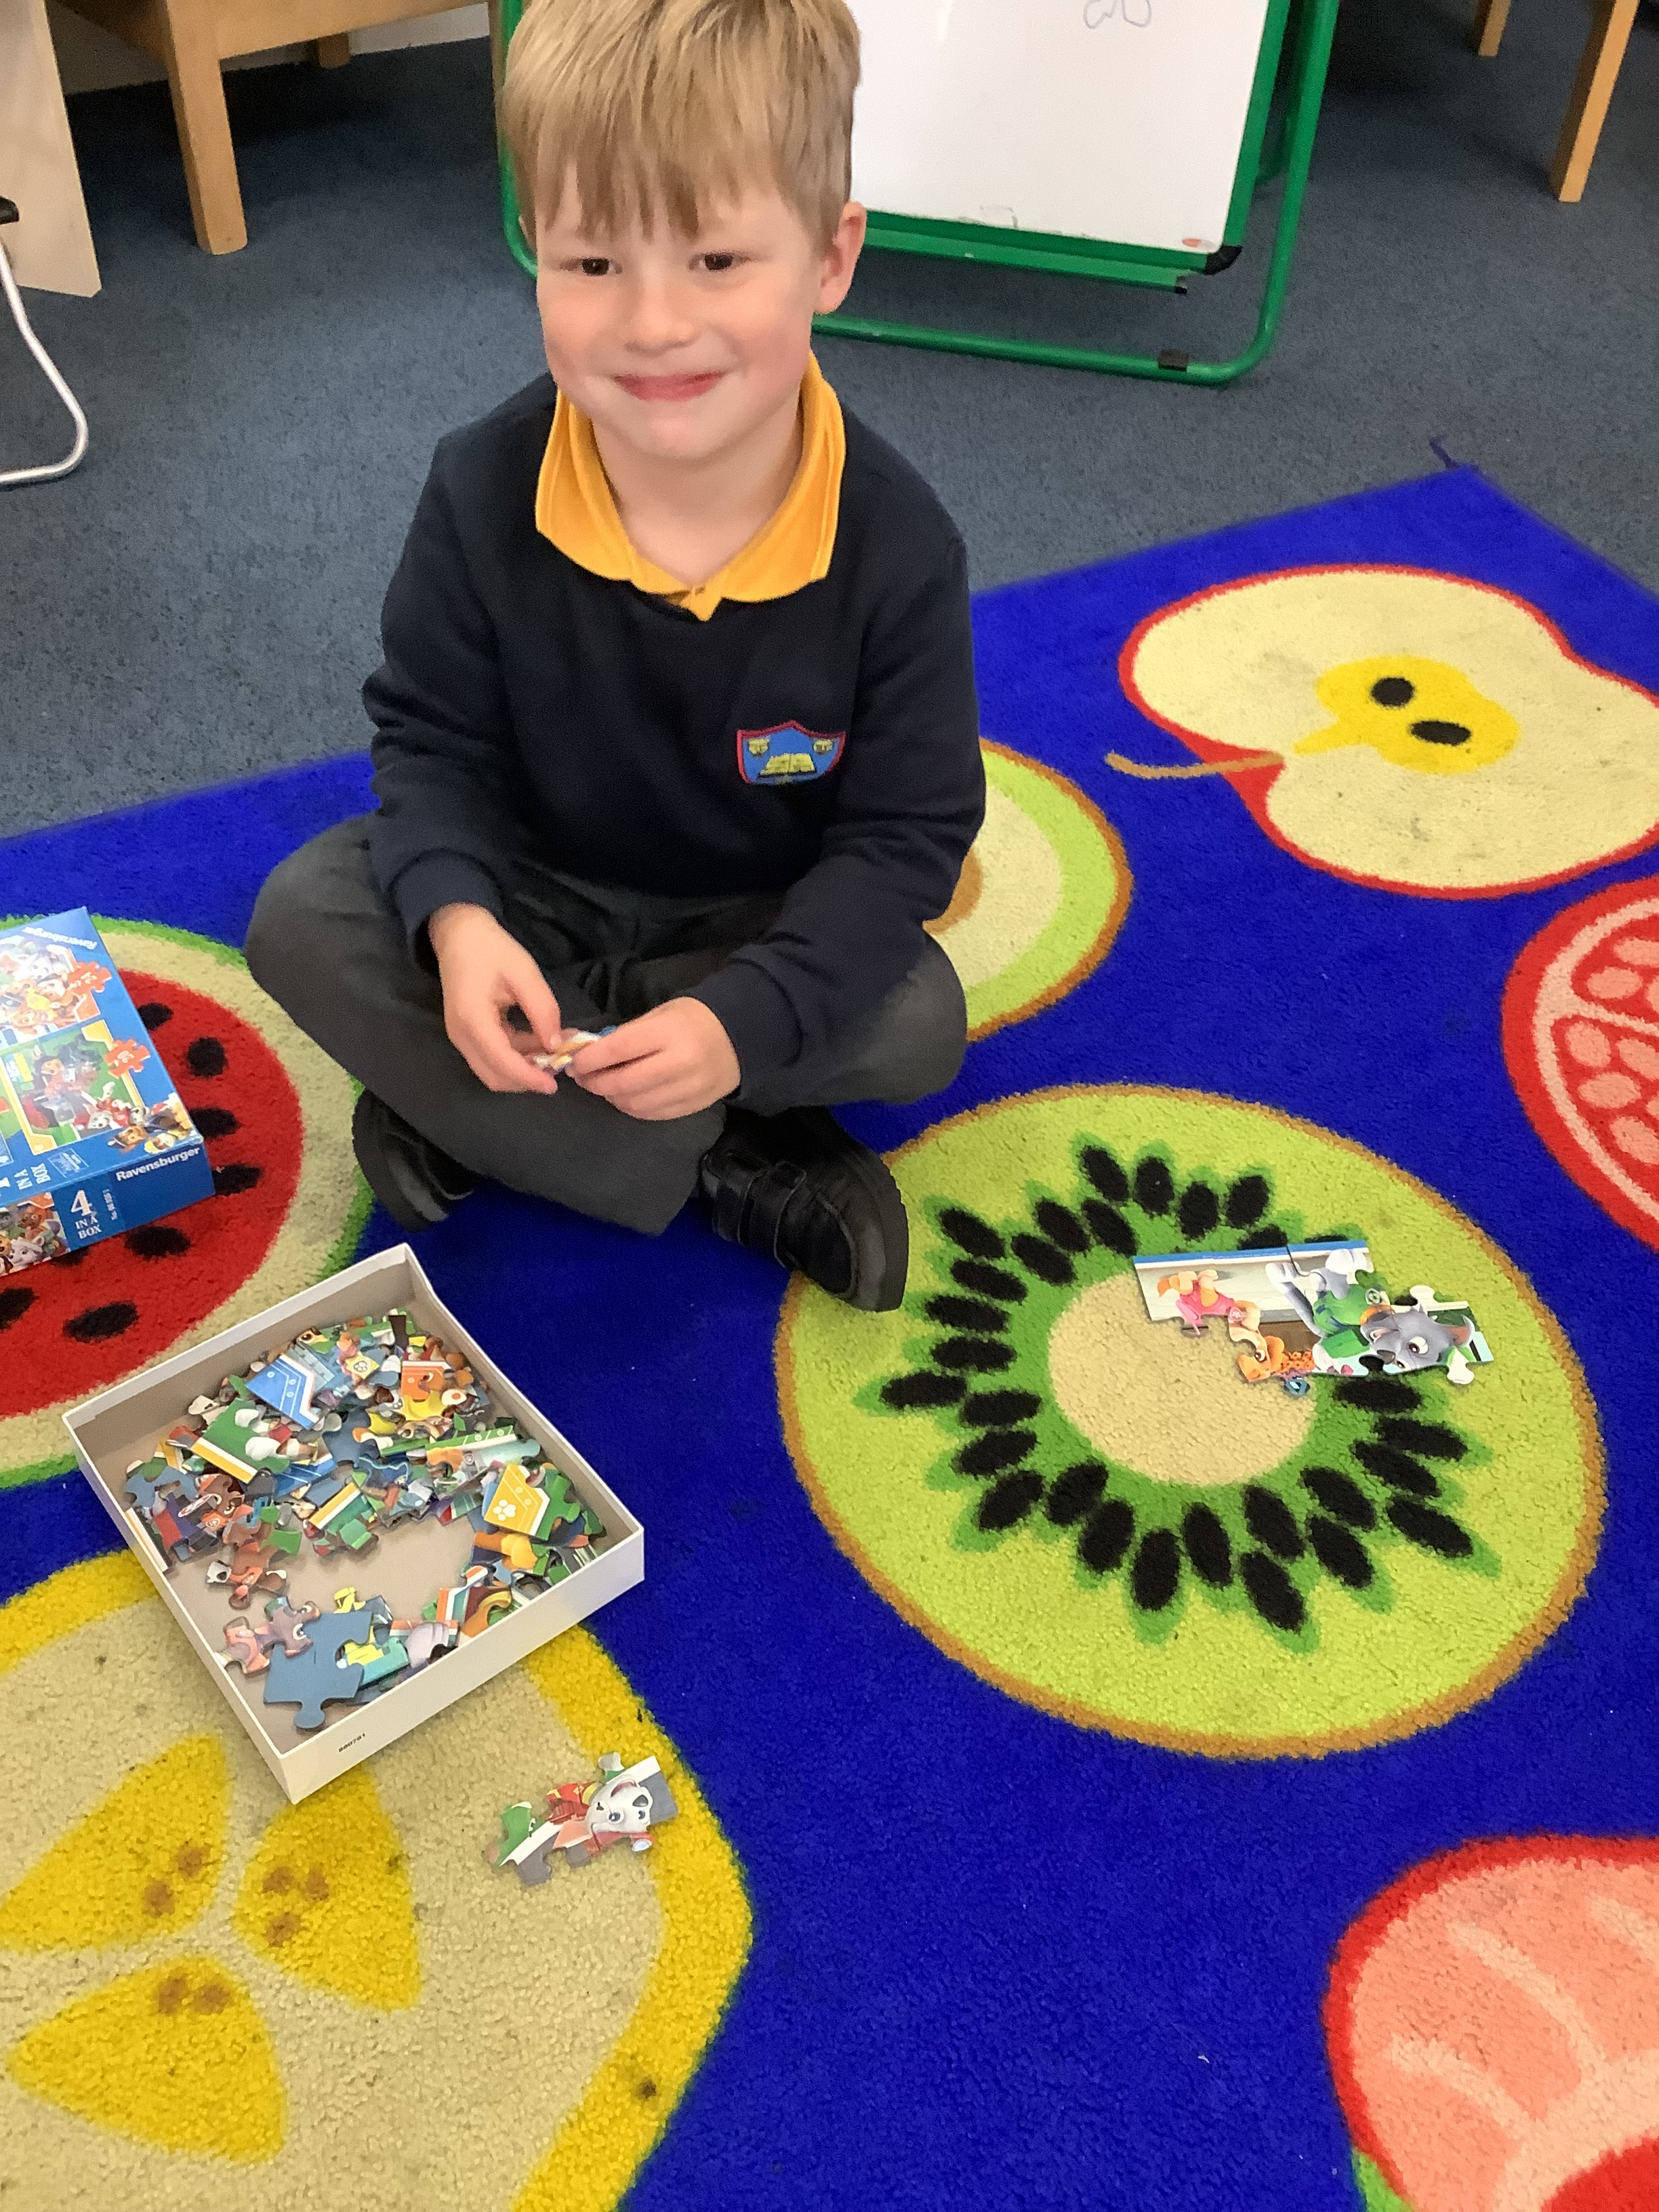
Agenda
Item 1: Welcome and introductions
Item 2: Our visions and values
Item 3: Our communication policy - discussion topic
Item 4: Our curriculum - general overview
Item 5: Questions answered
Item 6: Any other business and ideas for next forum.

Slide 3
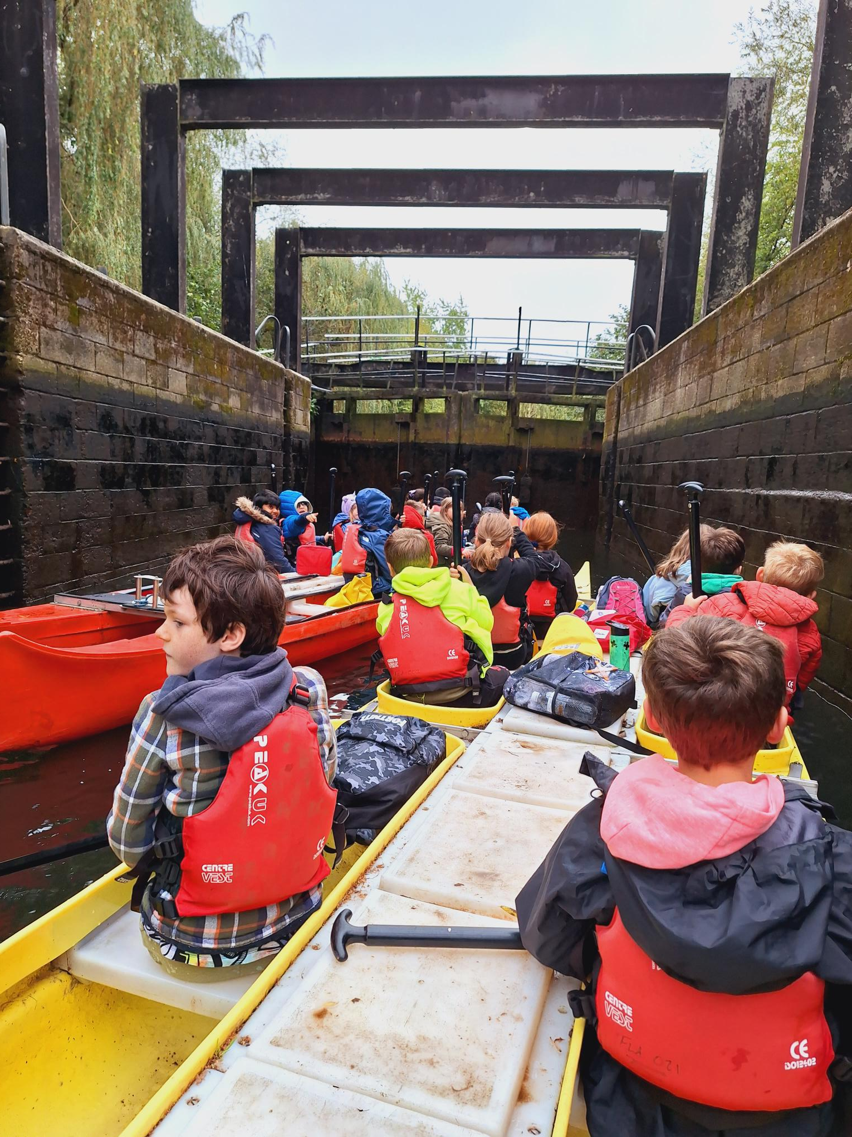
Our vision
‘To create a happy place, where children and adults learn and flourish in a creative, rewarding atmosphere and are given as many opportunities and experiences to increase their life chances and careers.’

Slide 4
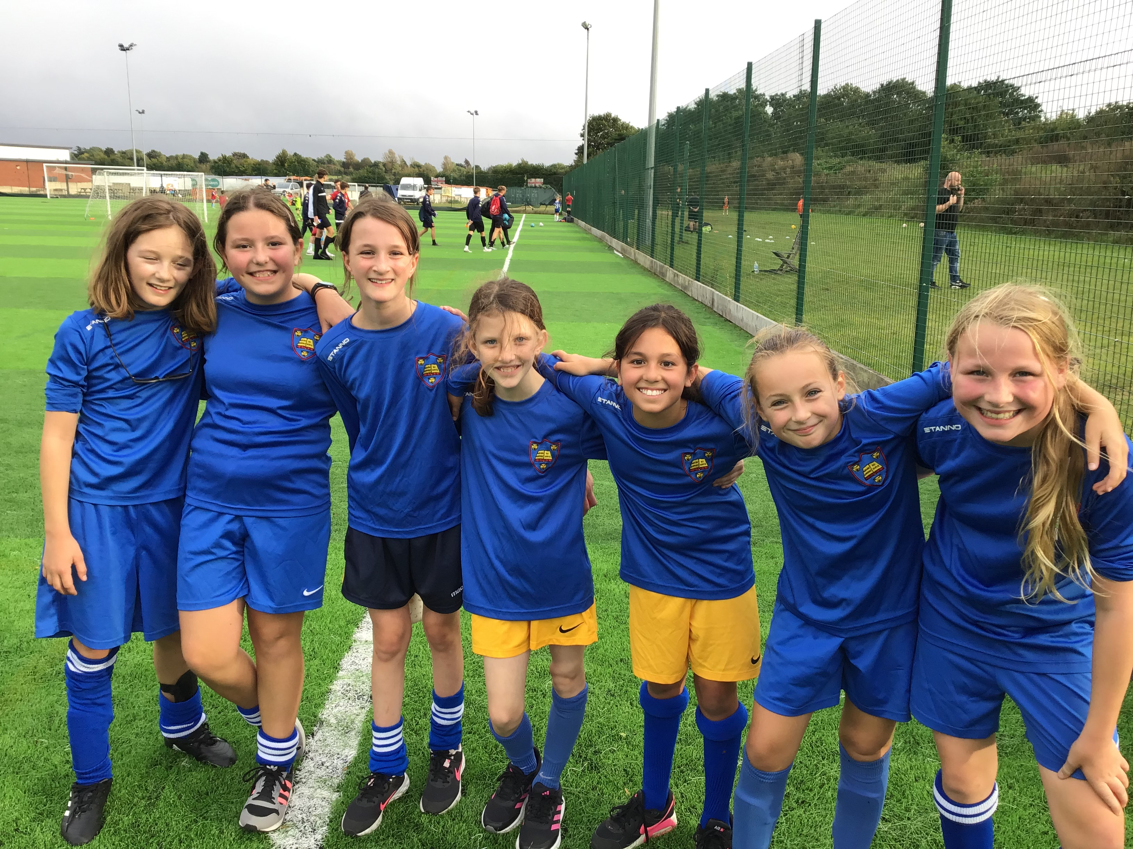
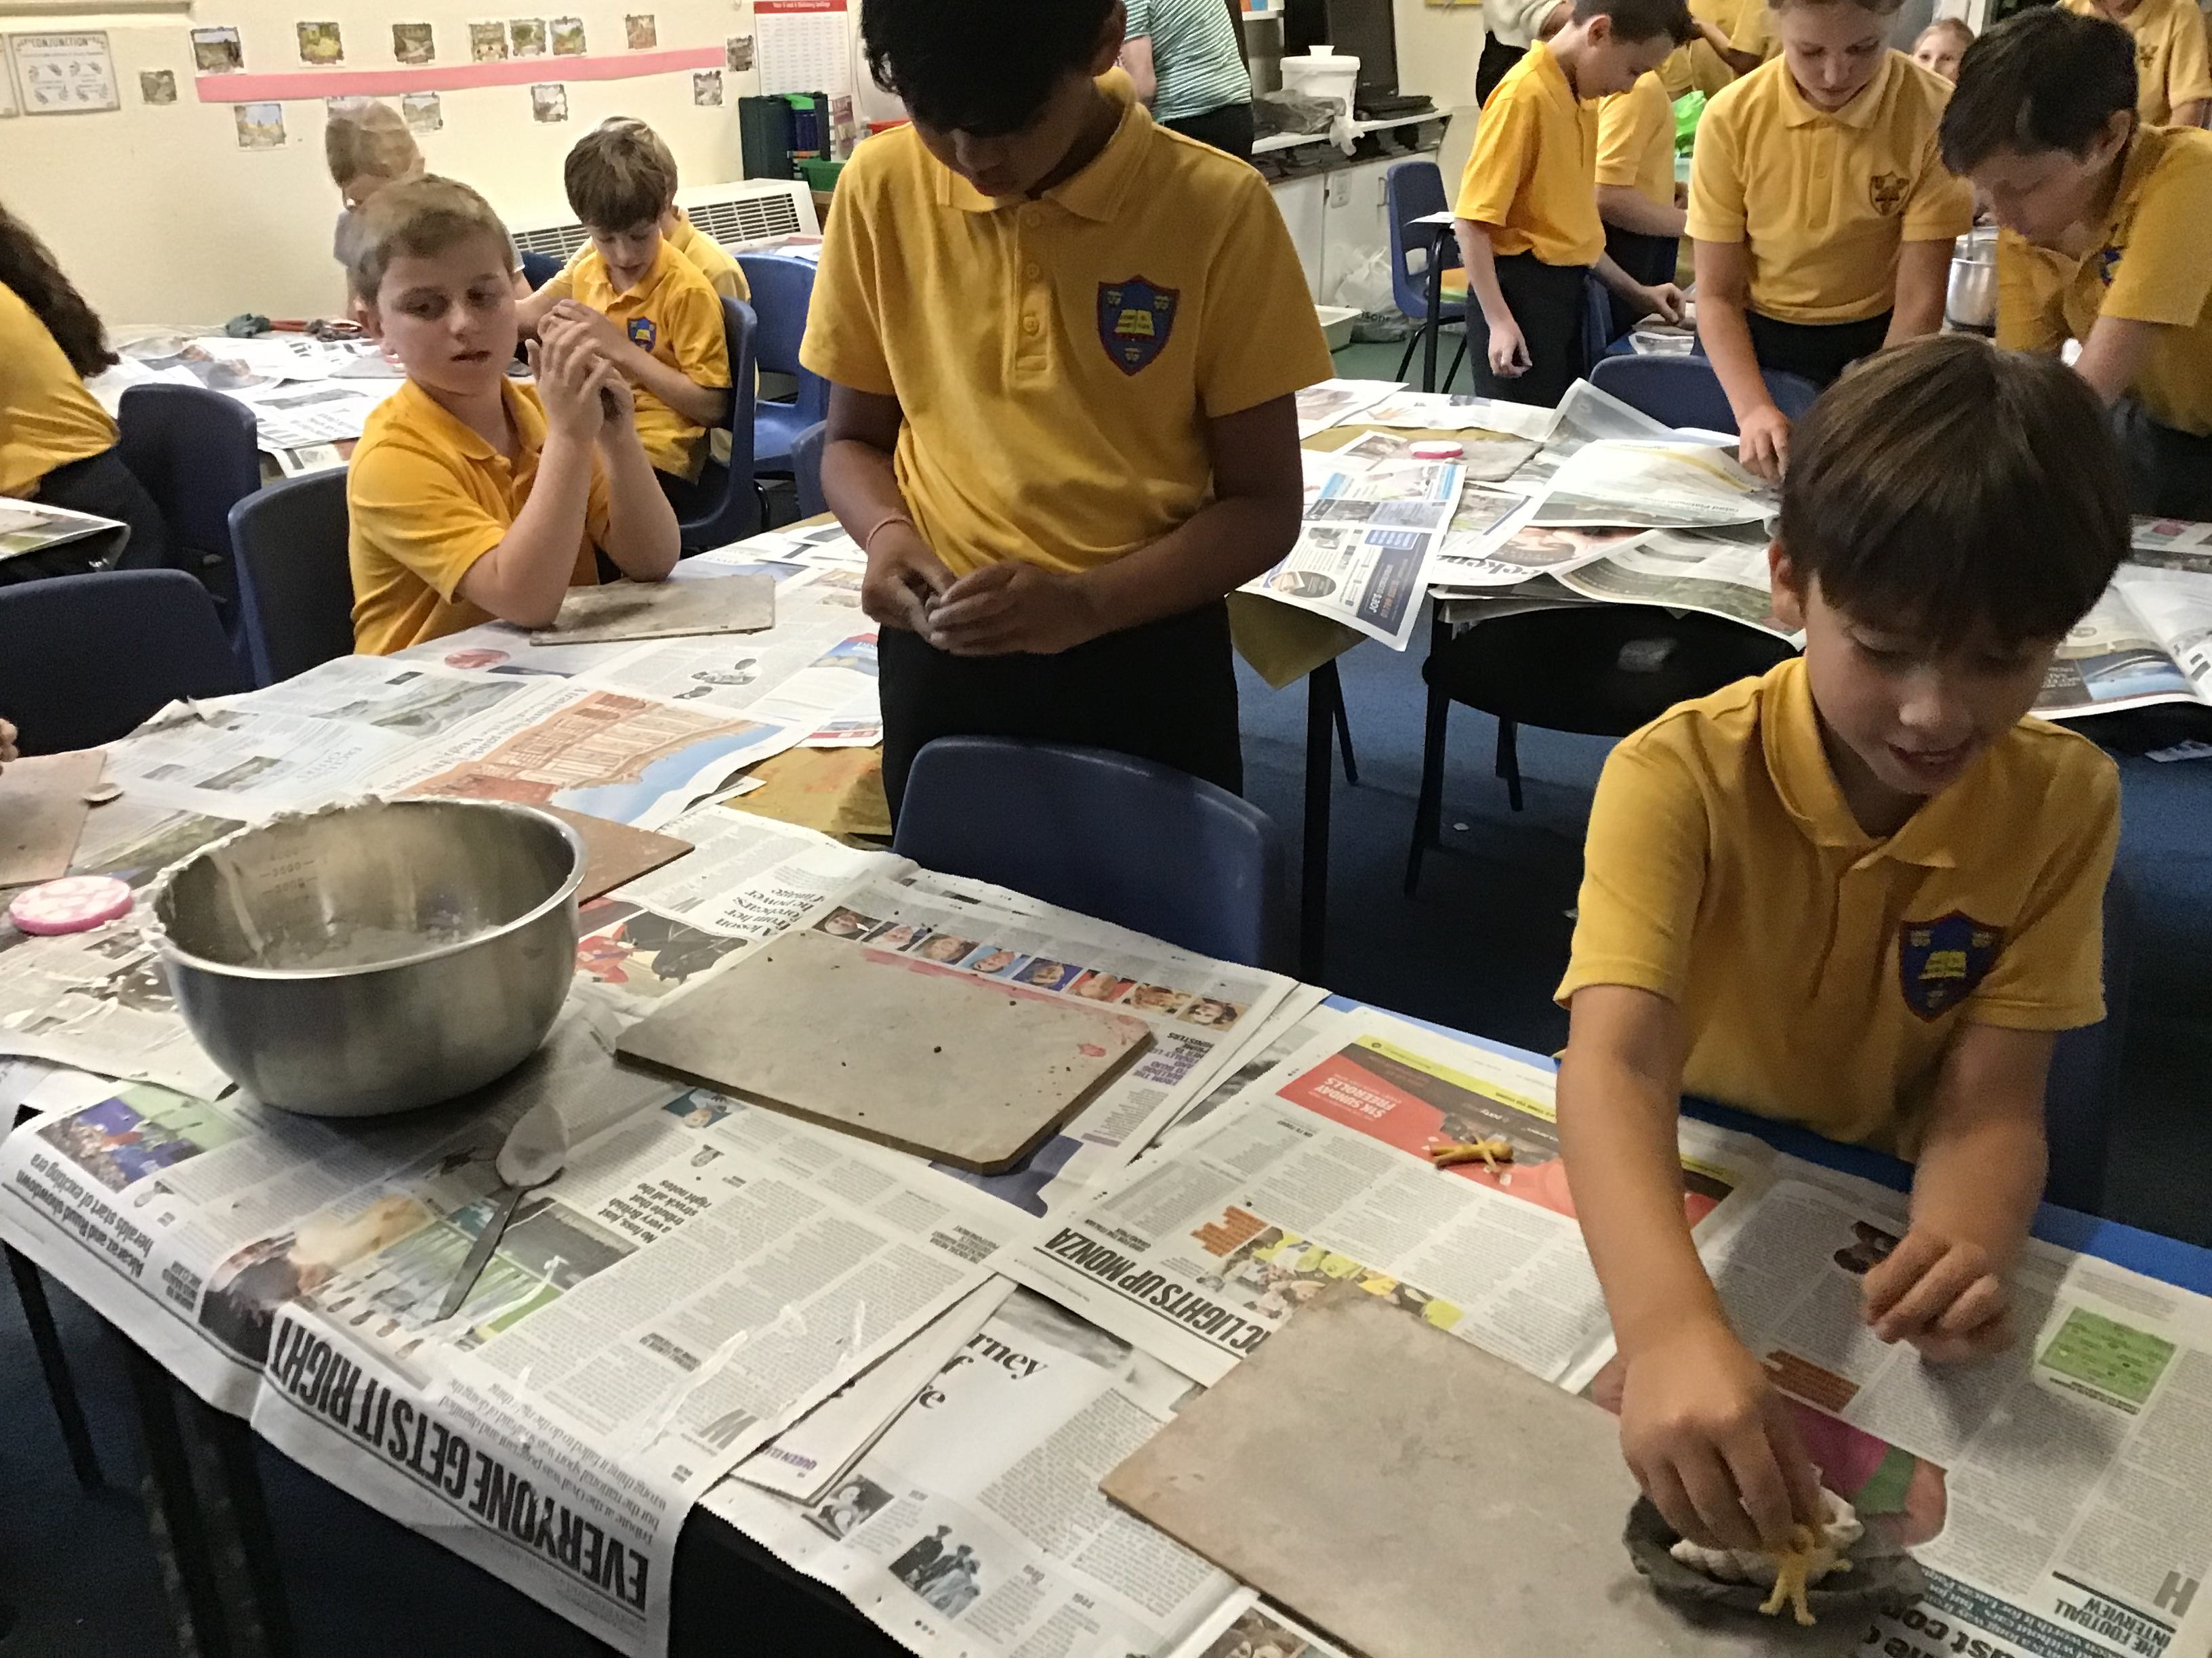
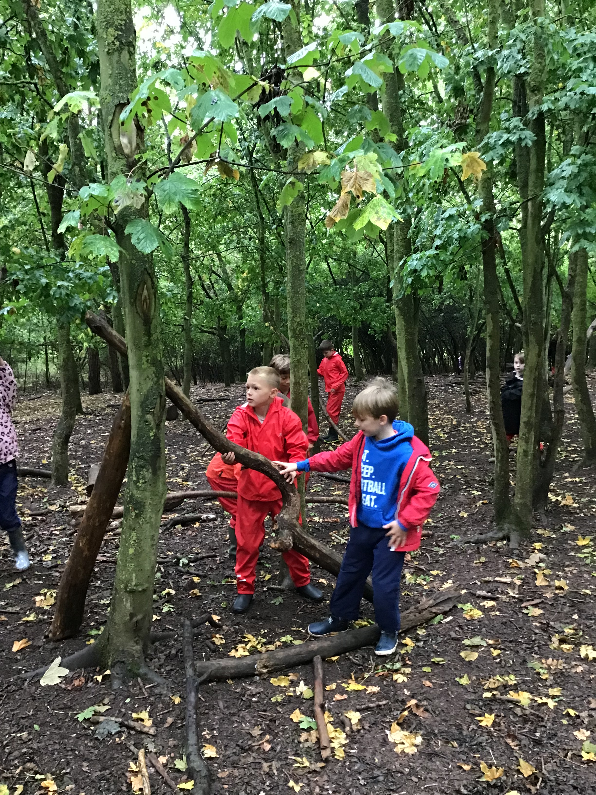
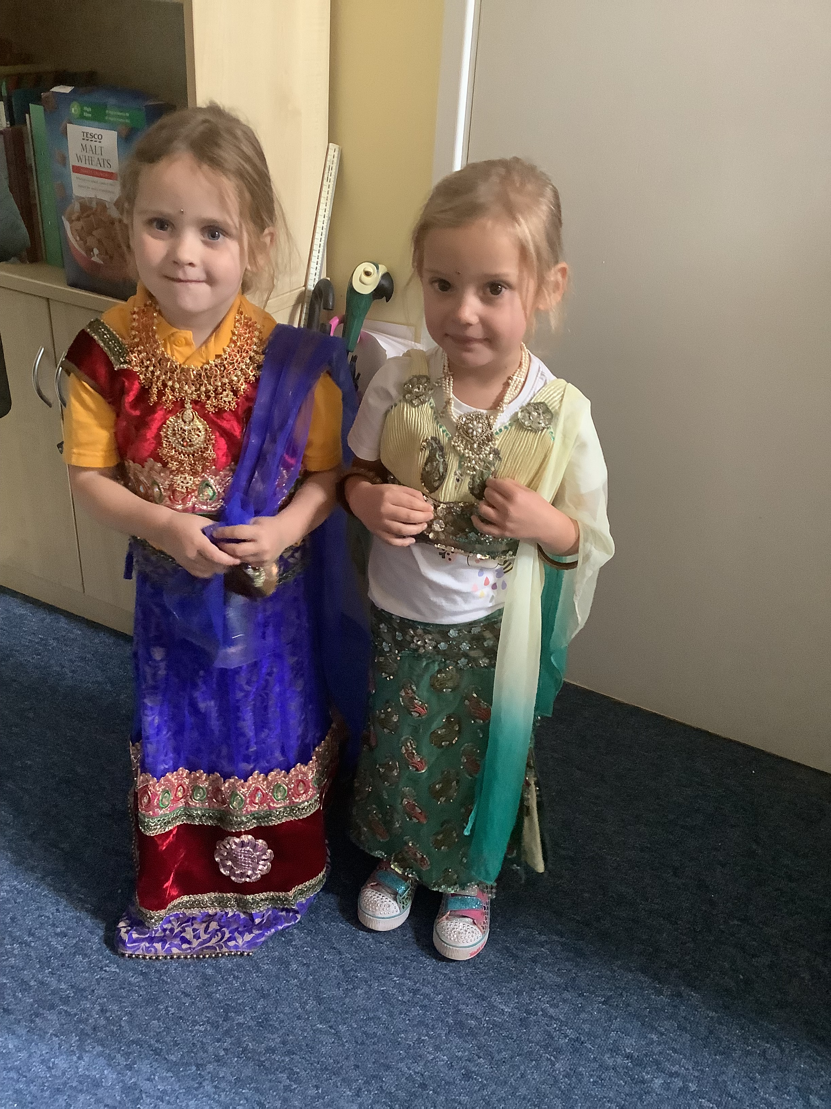
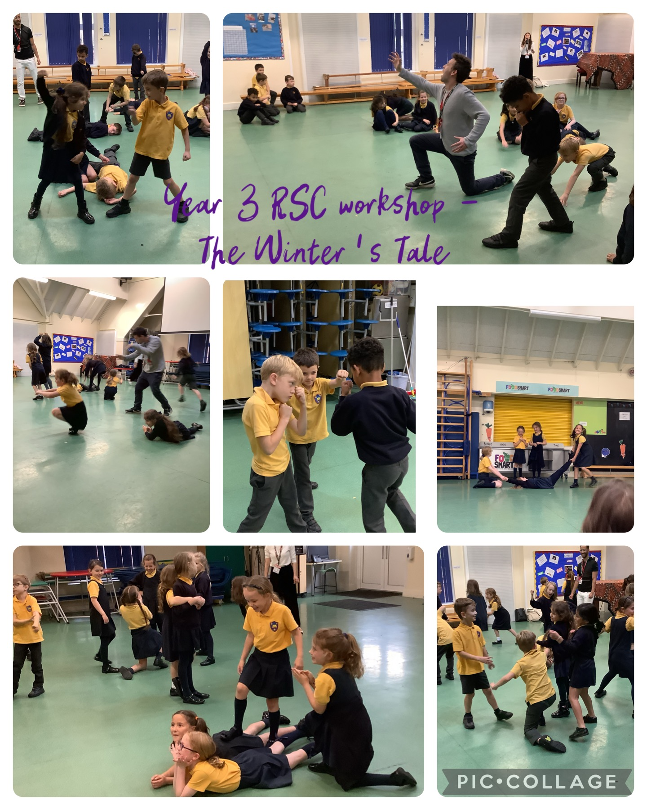
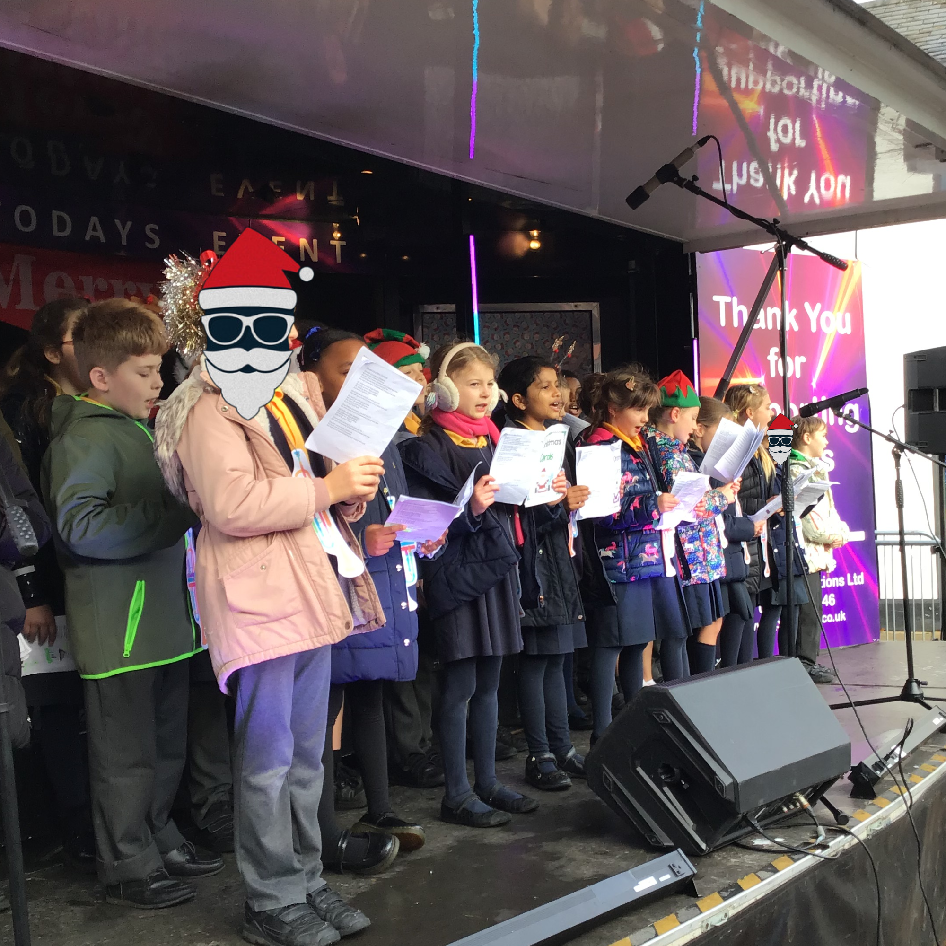
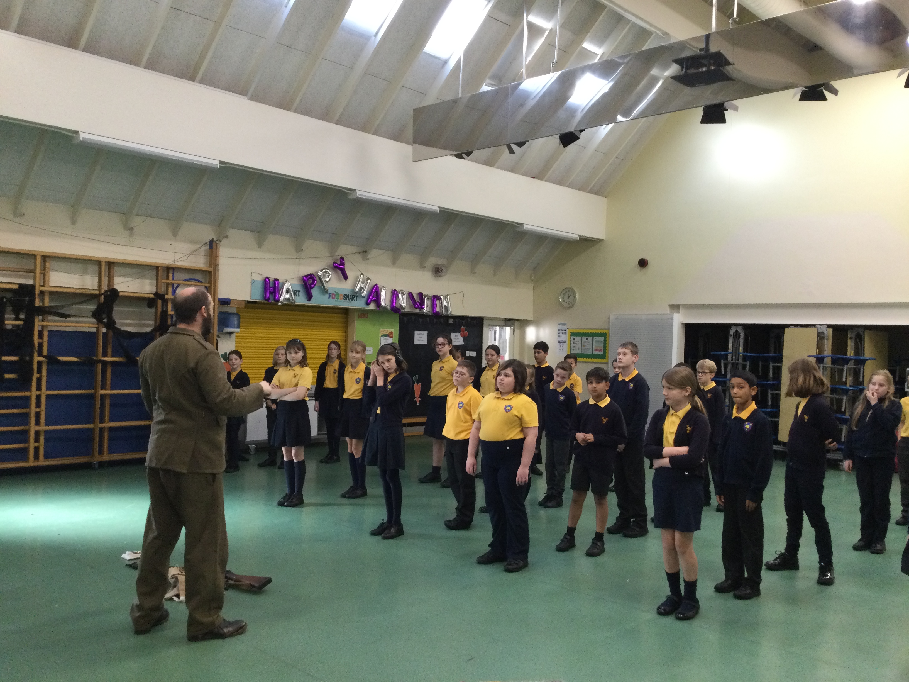

Slide 5
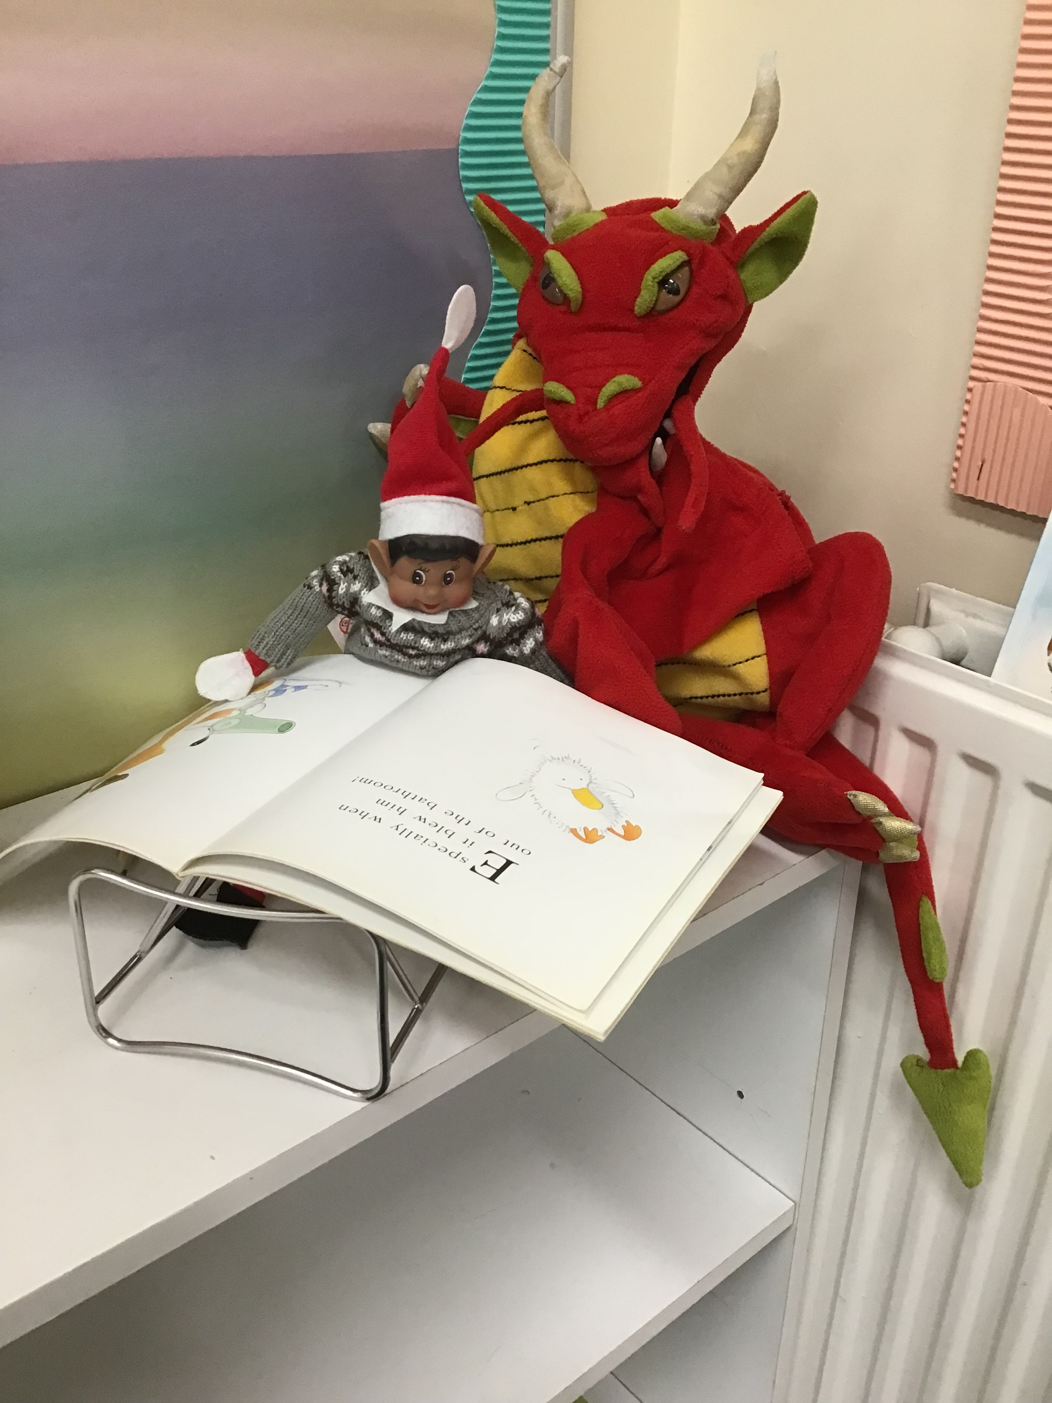
Our communication policy
Parent survey – mixed on communication responses.
Main communication of everything – newsletter, parentpay – whole school events, messages etc
Classes – Rec-Y2 – Tapestry/E-schools Y3 – Y6 – E-schools – all relates to specific class
Enhancements – website, social media – Instagram, twitter – marketing
Weekly communication board – updated each week at front of school
Key dates sent out at start of year, followed by monthly dates
Open door – always welcome, members of staff on gate etc daily

Slide 6
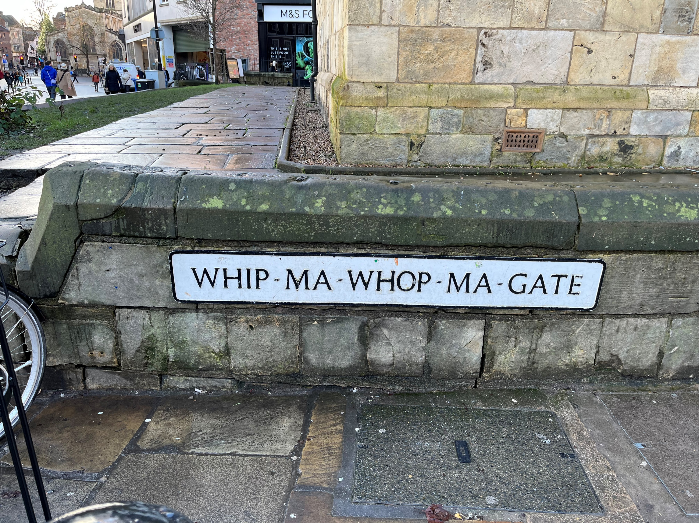
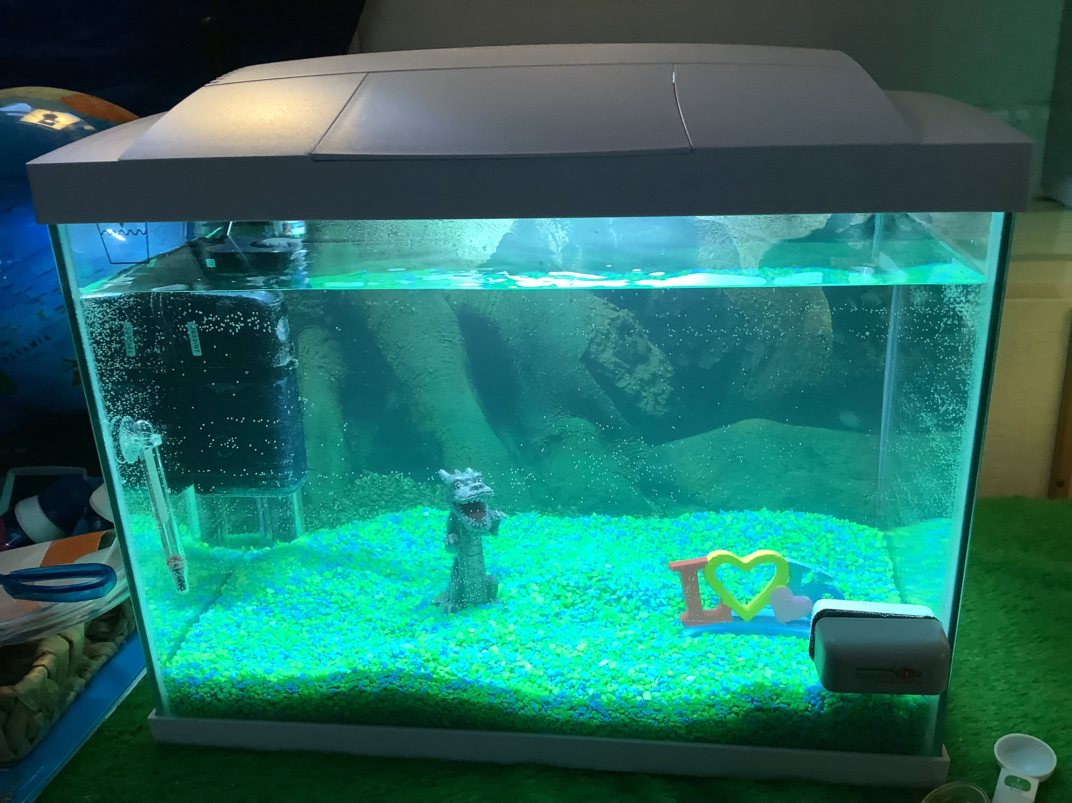
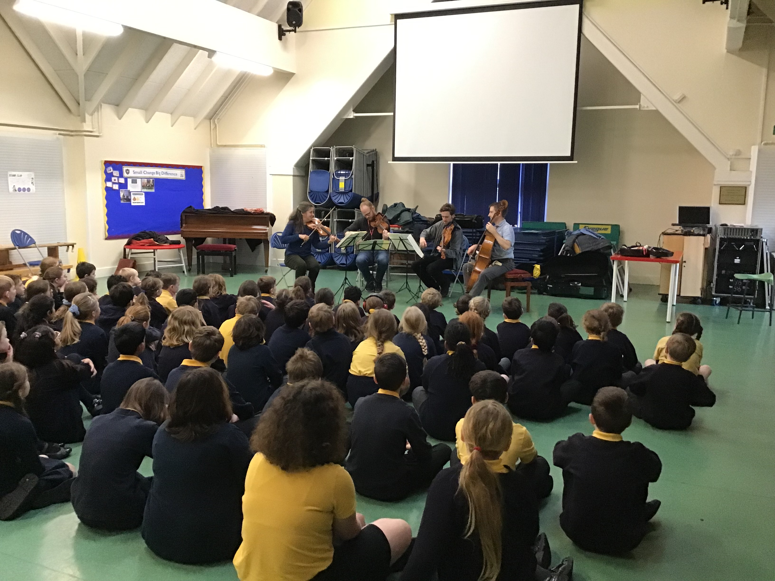
Our curriculum
National curriculum https://www.gov.uk/government/publications/national-curriculum-in-england-primary-curriculum
Curriculum maestro – linked to history/geography themes and key texts - https://www.stratfordprimary.co.uk/web/curriculum_at_stratford_upon_avon_primary/337803
Wider curriculum – trips, visitors, residentials, community events e.g. Shakespeare week, poppy trail, singing at care homes, Royal Albert Hall etc
See our experience, career pathways https://www.stratfordprimary.co.uk/web/experience_pathways_for_all_our_children/662915

Slide 7
Questions
Would like to see more sports such as football…
Could we have more a choice of after school clubs?

Slide 8
Any other business?

