Slide 1
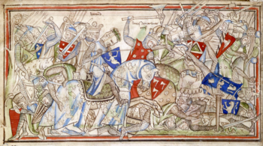
Respect
Resilience
Responsibility

Slide 2
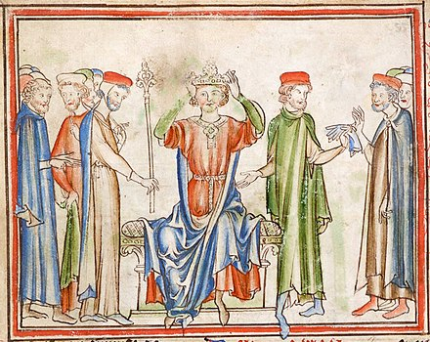
King Harald Day October 14th
Commemorates the life and historical significance of King Harald II of England
Ruled from 6th Jan 1066 to 14th October 1066
Last Anglo Saxon King of England

Slide 3
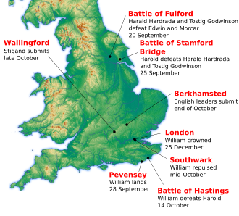
Share knowledge

Slide 4
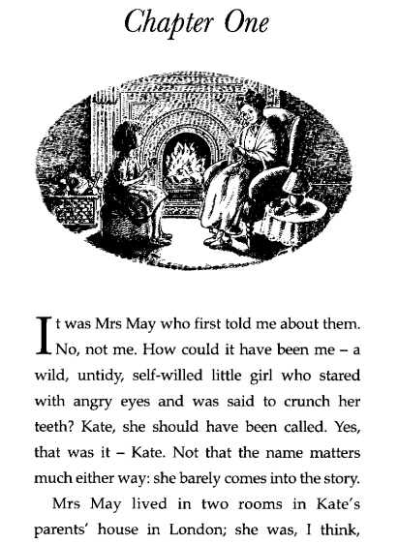
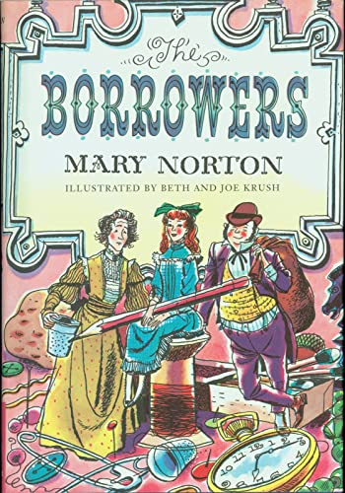

Slide 5
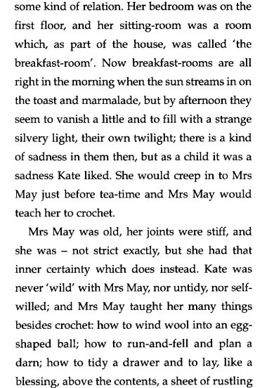
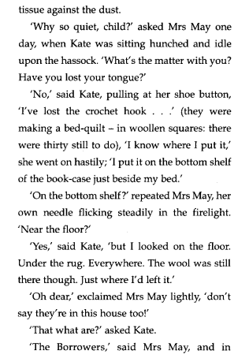

Slide 6
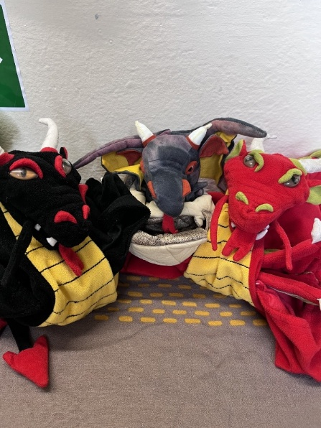

Attendance – week 6 – 6th – 10th Oct
Dragons go to Y3,Y2, Y4
Reception 95.7%↓
Year One 94.7%↓
Year Two 99.7%↑
Year Three 100%↑
Year Four 98.8%→
Year Five 98.1%↑
Year Six 97.2%↓
Whole School 97.8%↑

Slide 7

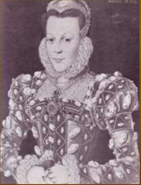
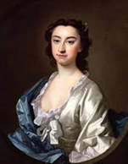
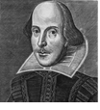
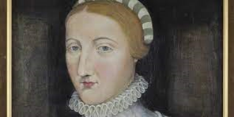
House Points
Arden
1494
Shakespeare
1632
Winners
Hall
1853
Hathaway
1597

Slide 8

What was reported?
0 incidents of bullying
This means bullying is rare at our school

Slide 9
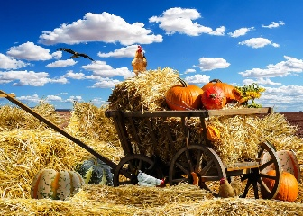
Harvest Song
Verse 1: There is a farmer who stands in his fields,
And he sees all the work to be done.
He has been watching for many a month,
He’s been waiting for this day to come.
Chorus:
There’s a song to sing as the harvest comes in,
To the One who gives sunshine and rain.
Let us all join in with a thank-offering
For the harvest that’s gathered again.

Slide 10
2: There was a time when the fields were prepared,
And the good soil was carefully ploughed.
Then came the day for the farmer to sow
And the seeds were all scattered around.
Chorus
There’s a song to sing as the harvest comes in,
To the One who gives sunshine and rain.
Let us all join in with a thank-offering
For the harvest that’s gathered again
3.There was a time for the farmer to wait
As the seeds slowly grew out of sight.
Then came the day when the first shoots appeared,
And the farmer was filled with delight.

Slide 11
Chorus
There’s a song to sing as the harvest comes in,
To the One who gives sunshine and rain.
Let us all join in with a thank-offering
For the harvest that’s gathered again
4.Now is the time when the crops are full grown,
And the farmer must gather them in.
He’ll need some help ’cause there’s lots to be done,
And it’s hard to know where to begin.
Chorus
There’s a song to sing as the harvest comes in,
To the One who gives sunshine and rain.
Let us all join in with a thank-offering
For the harvest that’s gathered again
Repeat the chorus.

