Slide 1
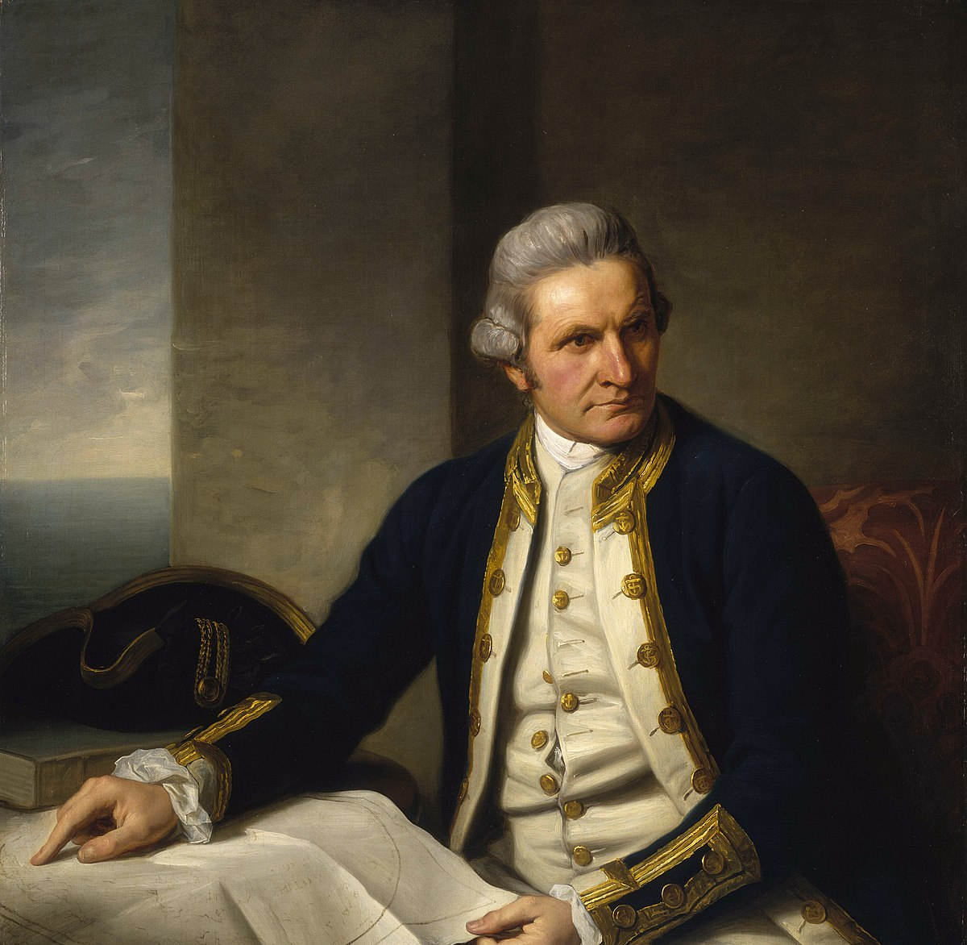
Captain James Cook
“as far as I think it possible for a man to go”

Slide 2
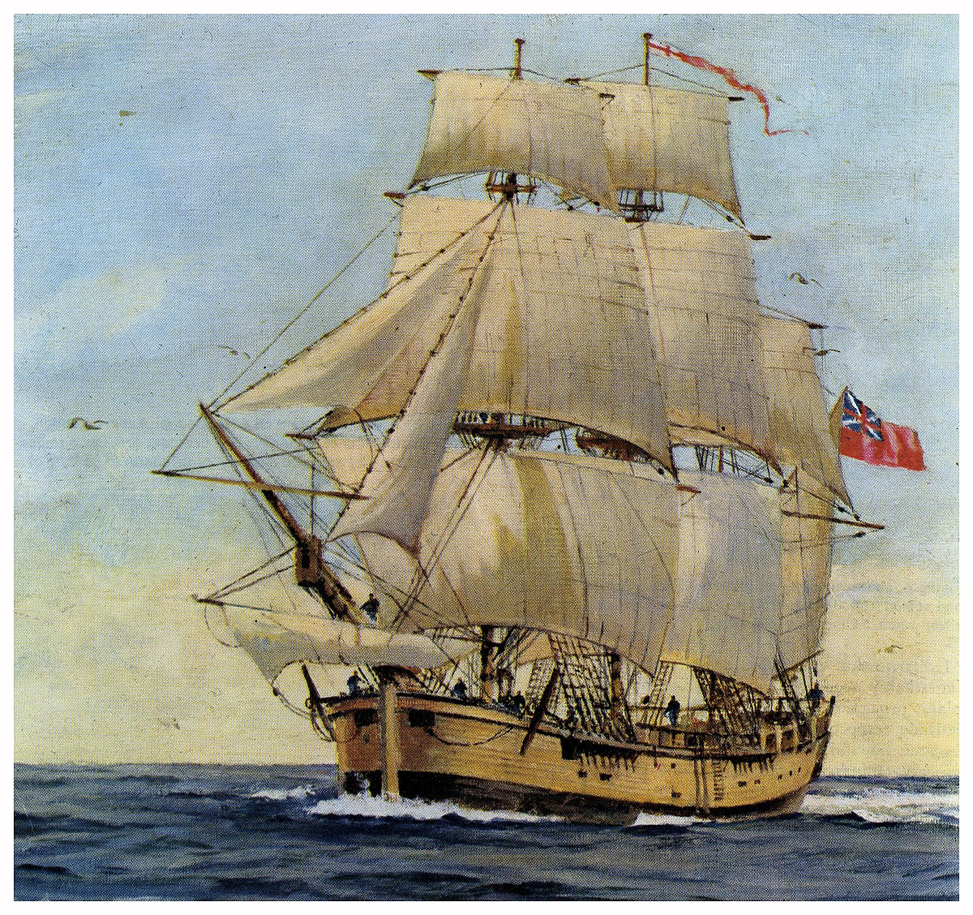
The life of Captain James Cook.
Born on the 7th November 1728 in Yorkshire, England.
He was a Royal Navy officer.
He fought in the seven years war.
He did very well in the siege of Quebec in Canada.
Because he did so well, he became the commander of his famous ship, the HMS Endeavour.
He went on the first of three of his Pacific voyages in 1766.

Slide 3
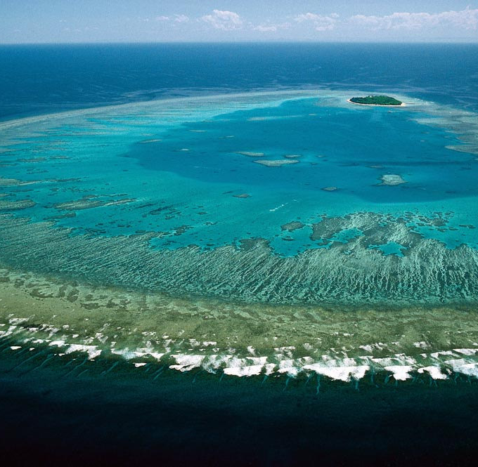
In the Pacific.
His ship nearly sank on the Great Barrier Reef.
HMS Endeaver struck some sharp coral on the reef.
It took twenty hours for the crew to stop the leak.
They had to throw lots of their equipment overboard including their cannons.

Slide 4
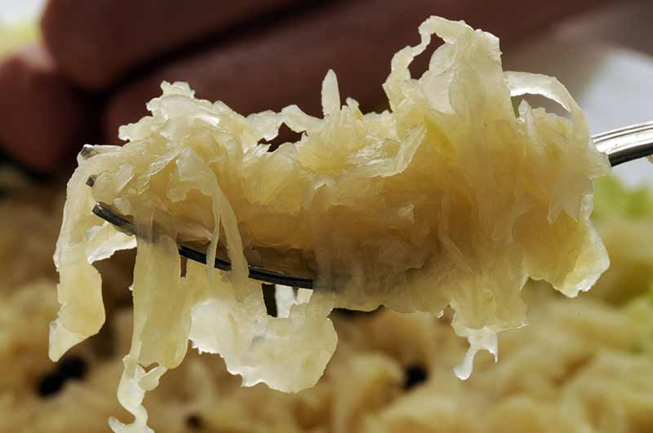
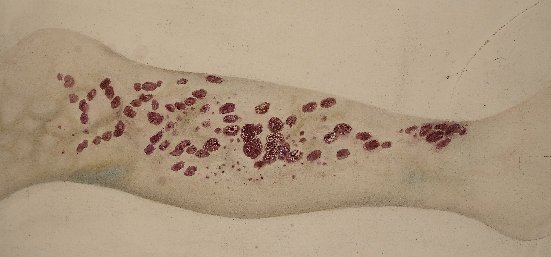
Scurvy, the sailor’s foe.
Scurvy is a disease that affected sailors because of a lack of vitamin C.
It loomed over every long-distance sea voyage.
Cook managed to avoid his sailors from getting scurvy because he liked to buy lots of fresh food, especially sauerkraut (PICKLED CABBAGE! EW)
Cook convinced his crew to eat it.

Slide 5
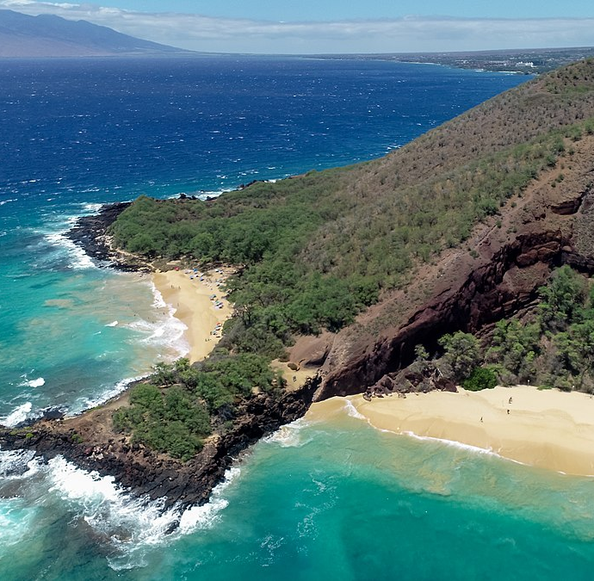
A God in Hawaii…
He was mistaken for a God when he arrived in Hawaii.
He landed on Sandwich Islands, which were named after his patron the Earl of Sandwich.
When he arrived, it was on the day of a very important festival in Hawaii therefore they thought he was a God, they had never seen someone like him before.
One day a crew member died from a stroke and this made the Hawaiians realise that they were not immortal and started to not like Captain Cook and his men.
This Photo by Unknown Author is licensed under CC BY-SA

Slide 6
Death – 14th February 1779 (Valentines Day!)
The native Hawaiians stole a piece from his ship.
Captain James Cook fired cannons at them.
He went ashore to take their King Kalani’opu’u hostage.
A Hawaiian warrior stabbed him with a knife, which was a gift from Captain James Cook.
When he died, the Hawaiians treated his body like a King.
They cut off his hands and preserved them in salt water, roasted his body and cleaned his bones.

Slide 7
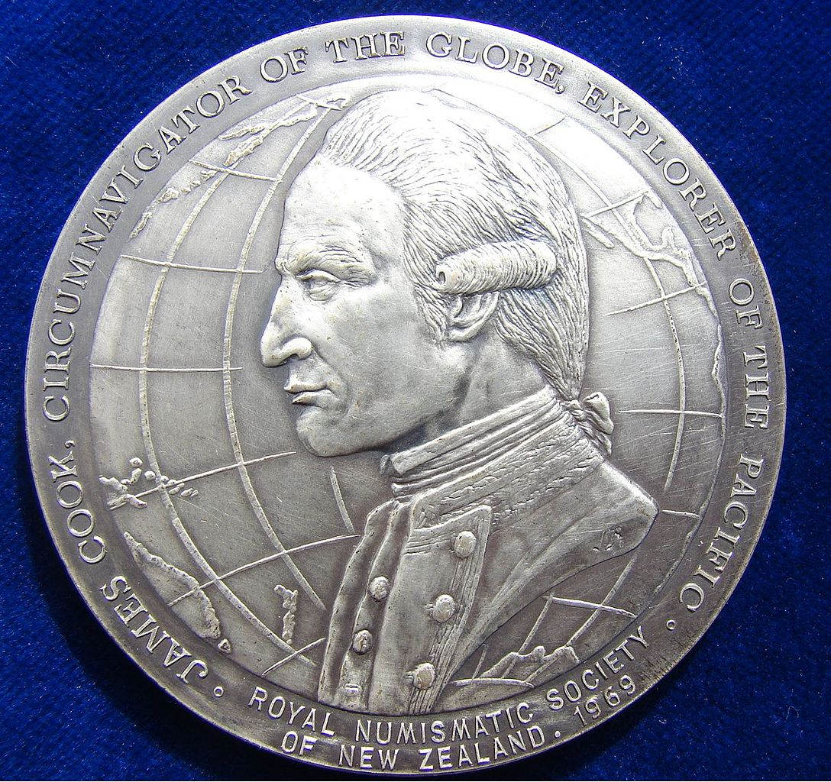
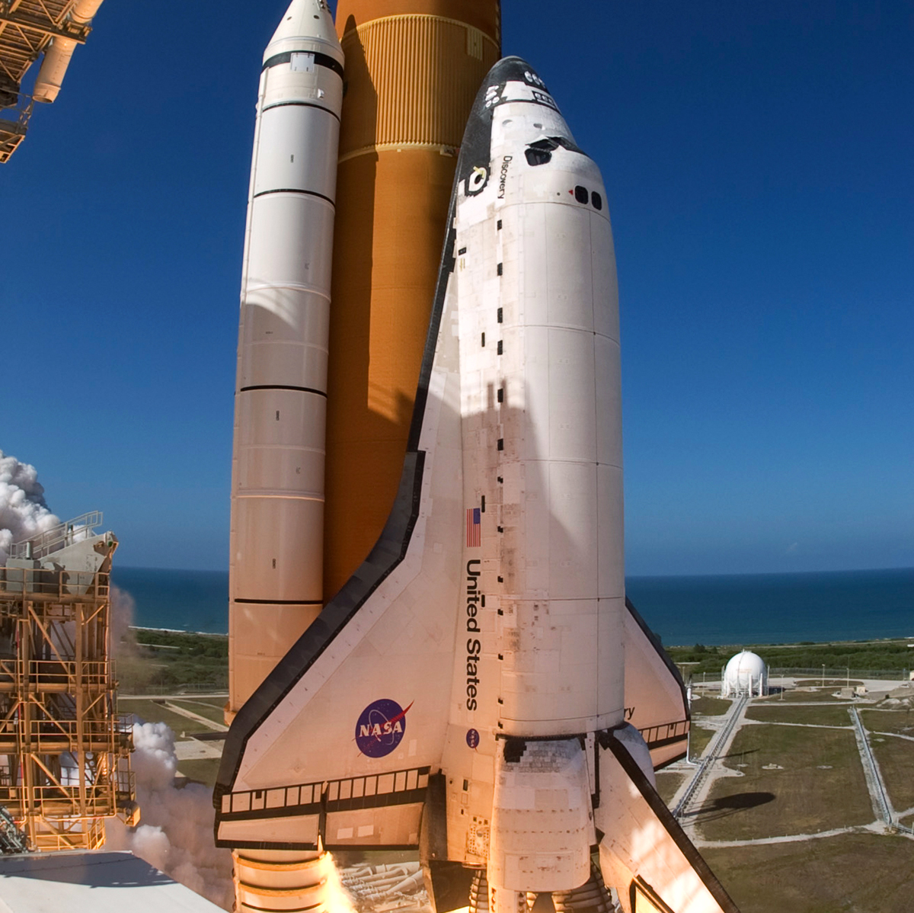
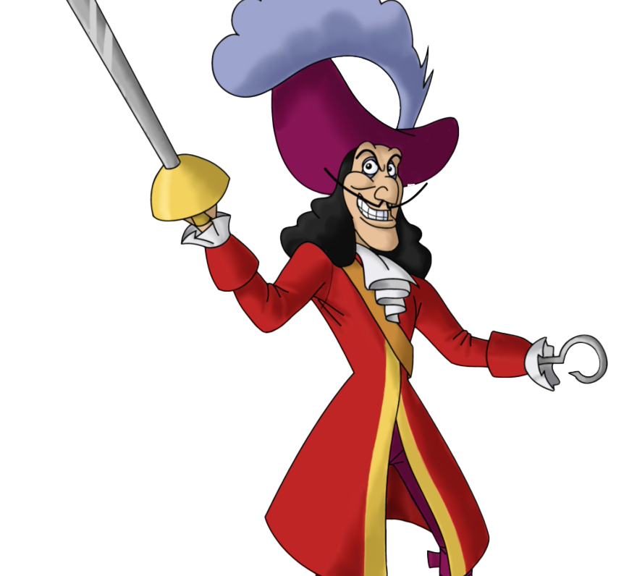
Captain James Cook’s legacy.
J M Barrier (another James) who wrote Peter Pan played on his name for Captain Hook.
Captain James cook explored and mapped more territory than any navigator in his time.
He was honoured by NASA with their shuttles Endeavour and Discovery after his famous ships.

