Slide 1

Welcome to Year 3
Miss Clemons
Mrs Mingins, Miss Buchanan & Mrs Hartley

Slide 2
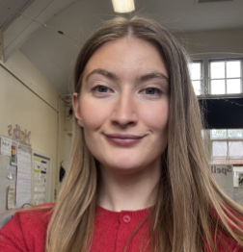
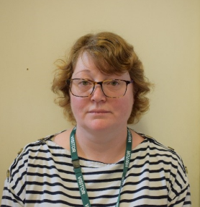
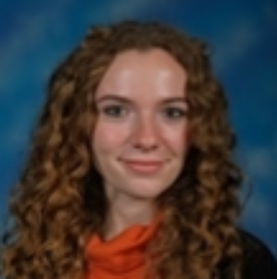
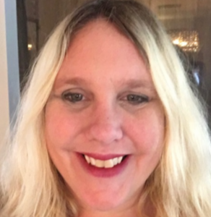
Meet the teachers
Welcome to Year 3!
I am Miss Clemons and with me in year 4 we have:
Mrs Mingins in the mornings, Miss Buchanan Monday-Wednesday and Mrs Hartley Thursday-Friday

Slide 3
A typical day in Year 4…
As soon as the children arrive at school they will put their belongings away in their lockers and sit at their tables to quietly complete handwriting during registration. During this time, adults also do check-ins to see how children are.
They then will have their morning lessons which consist of the core subjects Spellings, Mathematics, English and Reading comprehension.
After lunch they will have our topic based learning and the foundation subjects such as History, Geography, science, PSHE, RE, Music, French, DT/Art etc.
The day will end with either an assembly or a look at events in the news.

Slide 4
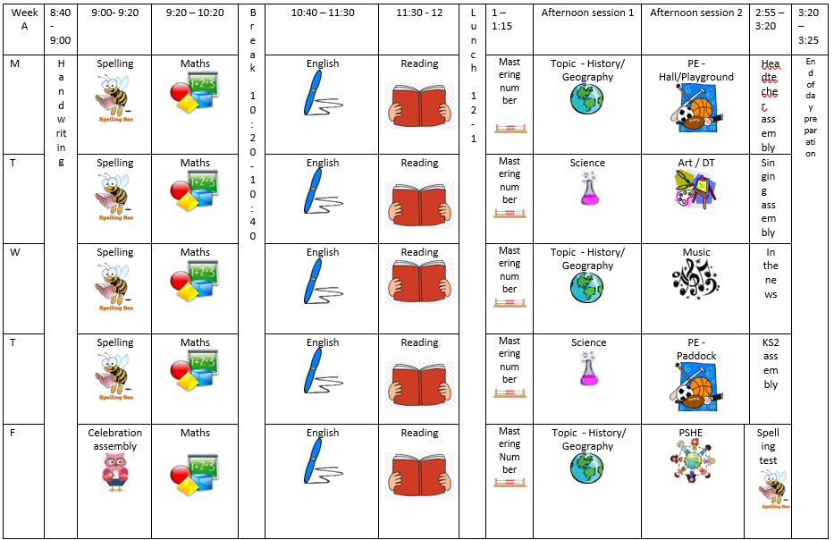
The timetable will look similar to this, occasionally we shuffle foundation subjects around to accommodate different types of learning or longer projects.
This year we have and A/B cycle where children will get an extra STEM based lesson fortnightly.

Slide 5
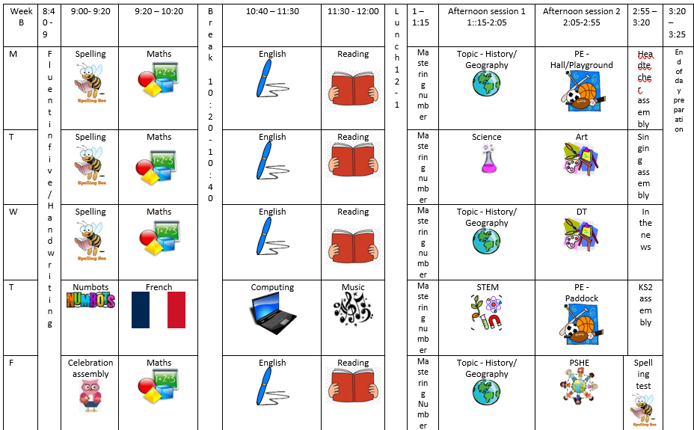
The timetable will look similar to this, occasionally we shuffle foundation subjects around to accommodate different types of learning or longer projects.
This year we have and A/B cycle where children will get an extra STEM based lesson fortnightly.

Slide 6
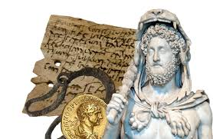

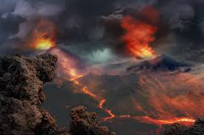
Year 3’s Creative Learning Themes for 2026-2027
Autumn –
The Sensational Stone-Age
The Brilliant Bronze Age
Spring –
The Incredible Iron Age
Rocks, Relics and Rumbles
Summer –
Empowered Emperors
Exceptional Empires

Slide 7







English Key Texts
English is based on a whole class text that is normally linked to that terms topic.
Autumn – Through the Ages
Stone Age Boy by Satoshi Kitamura
The Lost Spear by Saviour Pirotta
How to Wash a Woolly Mammoth by Michelle Robinson
Summer – Emperors & Empires
The Romans: Gods, Emperors and Dormice! By Marcia Williams
Julius Zebra – Rumble with the Romans: Colin Northfield
Spring – Rocks, Relics and Rumbles
Pebble in my Pocket by Meredith Hooper
Escape from Pompeii by Christina Balit

Slide 8
Maths
Scheme of Learning
Autumn
Place Value
Addition and Subtraction
Multiplication and Division A
Spring
Multiplication & Division B
Length & Perimeter
Fractions A
Mass & Capacity
Summer
Fractions B
Money
Time
Shape
Statistics
Maths is taught every day following the scheme of learning across the year. Importance of multiplication * division is reinforced with continued practice using Time Tables Rockstar after break. Maths Mastery aids with the deepening children’s understanding, use and manipulation of all things maths!

Slide 9
Topic Learning
Where possible the foundation subjects - Geography, History, Science, French, ICT, RE, PSHE, Music and Art/Design – are linked to each term’s theme of learning incorporating cross curriculum teaching where possible.

Slide 10
PE and Outdoor Learning
Year 3 PE lessons are on Monday and Thursday.
Children will need come into school in their PE kits.
You will be sent dates with plenty of notice – waterproofs and wellies/walking boots will be needed!​ We will hopefully restart Forest School later on in the year.
Please ensure every item is clearly named!

Slide 11
Trips & Visitors...
To further enhance the curriculum and children’s class based education, we have planned trips and experiences that will captivate and stimulate the intrinsic learning.
The planned and potential trips for the year are…
Stonehenge: 22nd September
Heart of England: 20th October & Spring term date TBC
Christmas Theatre: Date & Cost TBC
Shakespeare Week trip: Spring term – no cost
Roman workshop: Summer term & cost TBC

Slide 12
Assessment…
Assessment in KS2 is carried out daily utilising a range of strategies such as: live marking, targeted questioning and quizzes. This is to ensure the teaching team can monitor children’s understanding promptly and enable children have time to respond to the feedback, make changes and address any misconceptions.
Throughout the year, children will take part in assessments in reading, writing and mathematics to show progress and inform us of next steps or gaps in learning.​ Children are not made aware that it is a formal assessment.​
​The Statutory Assessment does not make up the whole picture. We use teacher assessment to make a final judgement on whether children have met the Expected Standard for the end of Year 3.

Slide 13

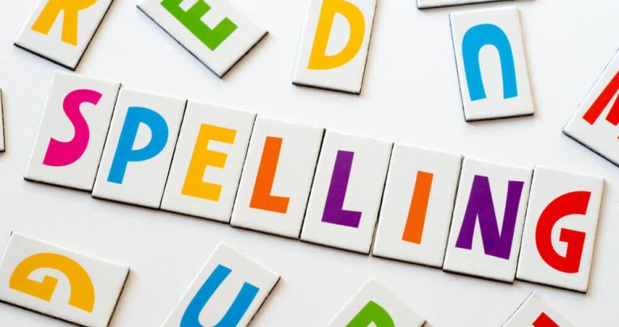
Home Learning…
All children are expected to read at home every day out loud with an adult or independently to improve fluency, pronunciation and comprehension.
Children should also complete 20 minutes of Times Table Rock Stars a week.
Children will be given spellings sheets to practice at home every week in readiness of the Friday spellings quiz! . Some children may have individualised spellings of common exception words from previous years or that we have noticed they need to practice from lessons. Please encourage them to focus on these words first.
.

Slide 14
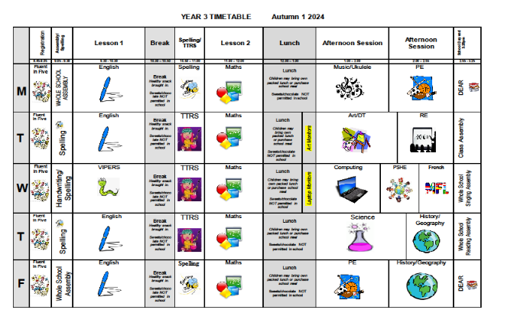
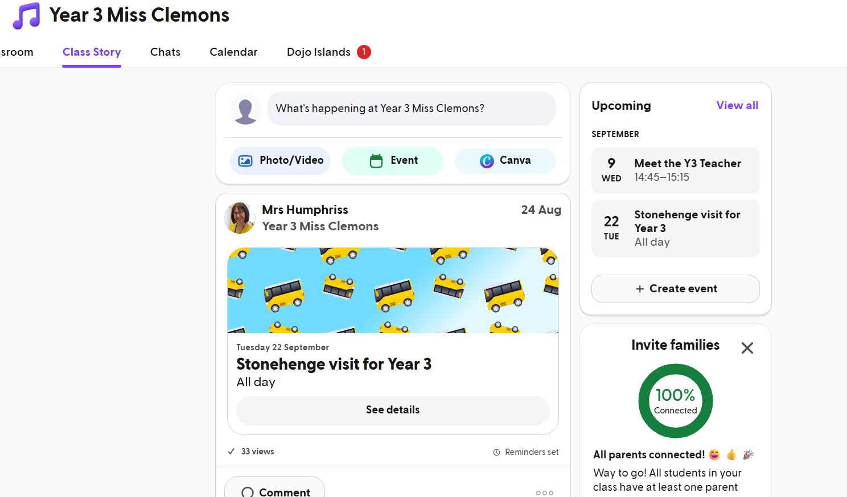
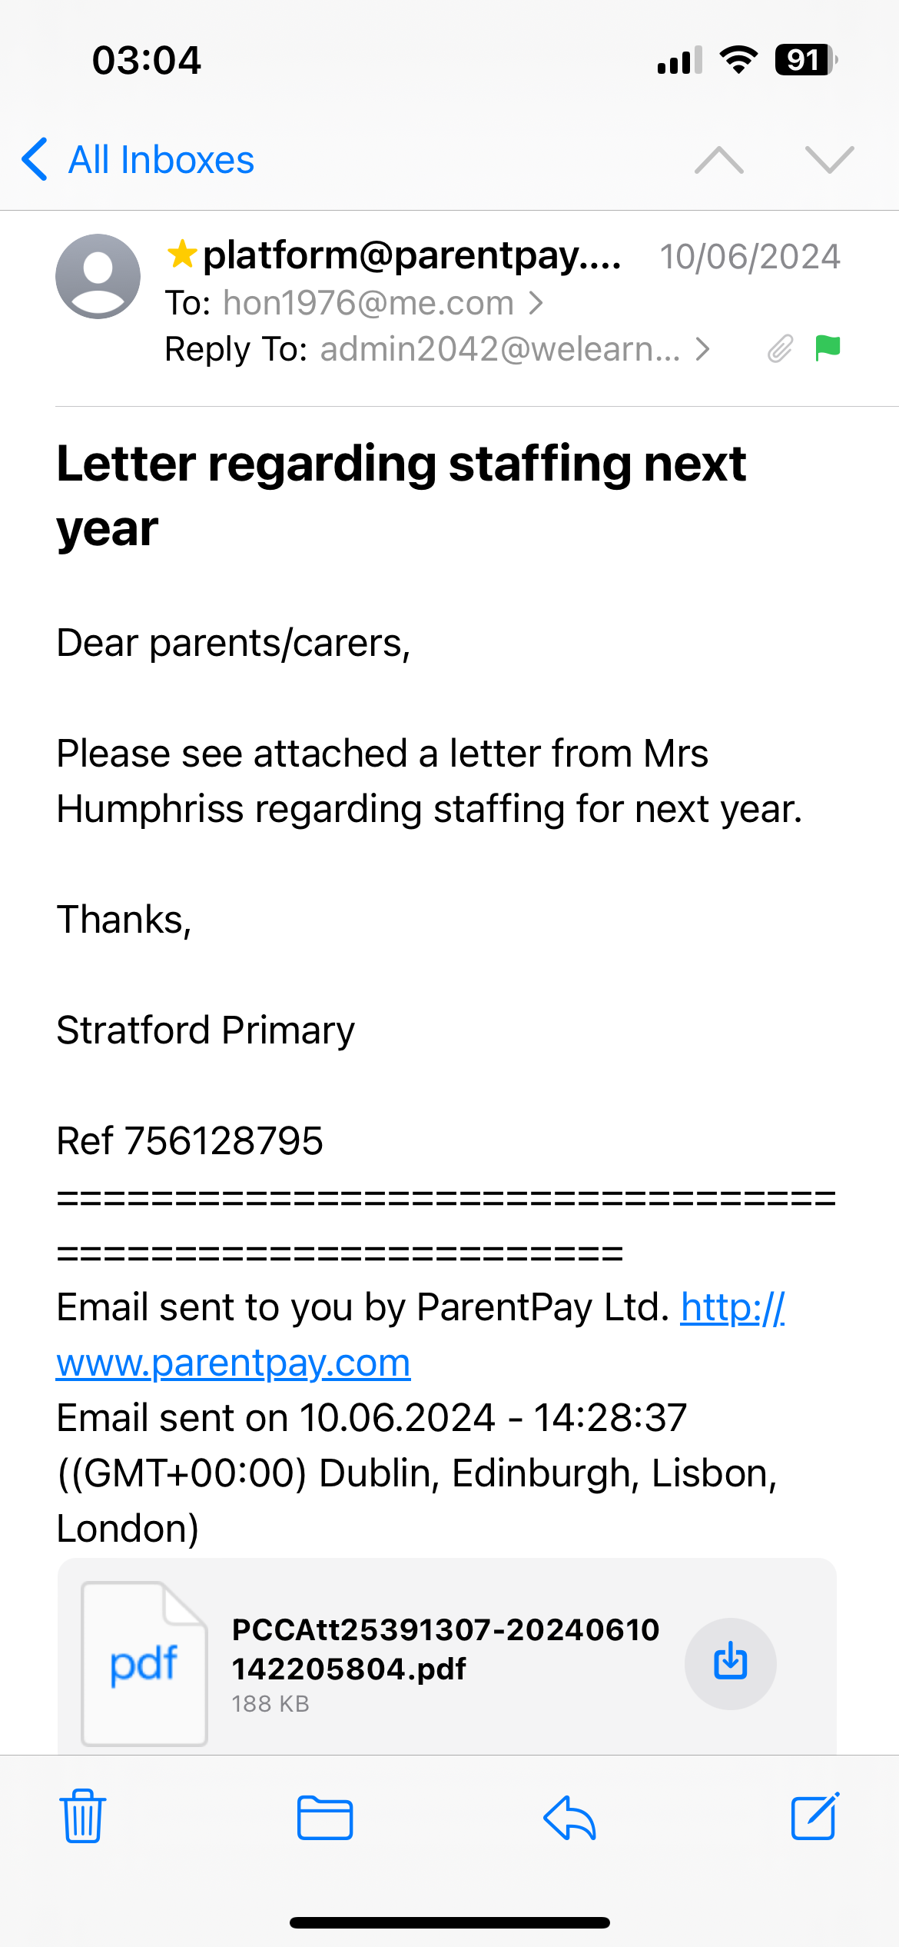
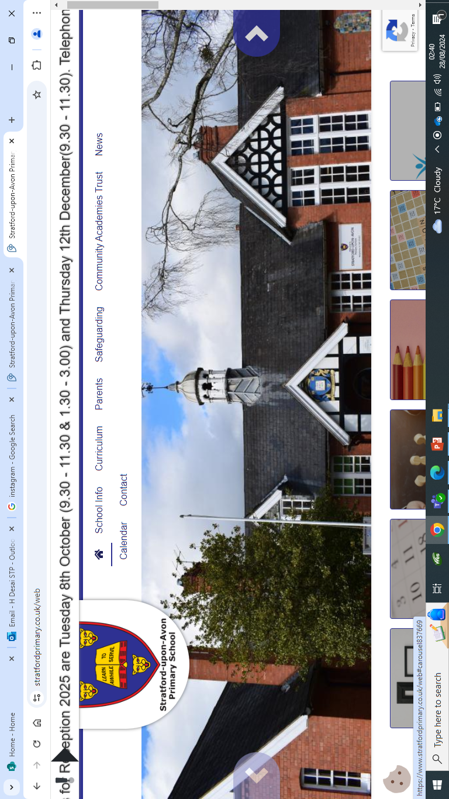
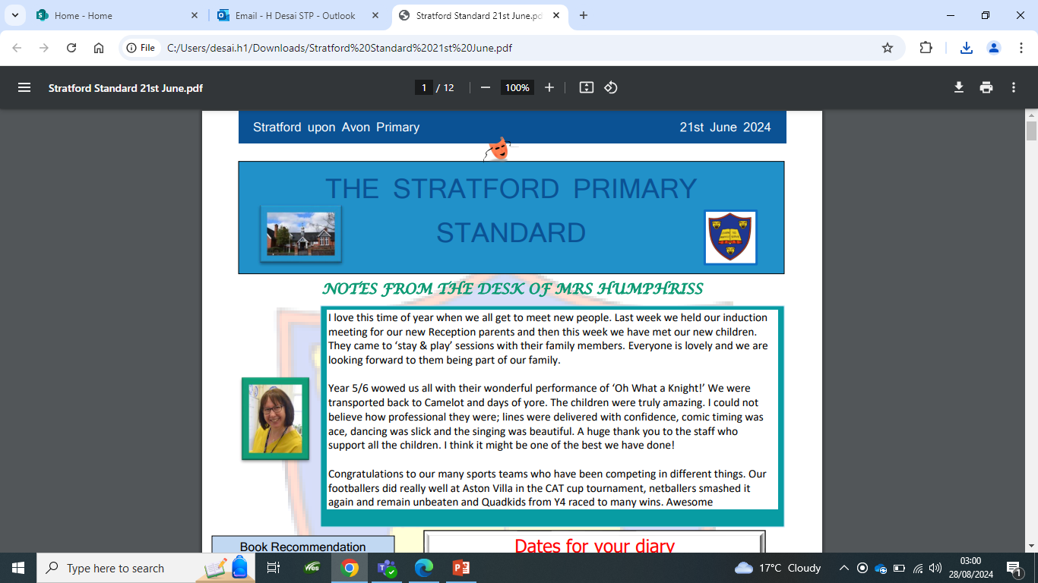

Communication…
Timetable
Emails
ClassDojo
Website
Newsletter
Arbor

Slide 15
Communication…
We are always here to support and listen! You will receive communication via parent letters, emails, weekly newsletter, ClassDojo and school website. We will also share Year 3 news via the aforementioned platforms.
You can contact me via ClassDojo.
If the matter is urgent please email admin2042@welearn365.com and it will be forwarded on to me.
Please note staff can only respond to emails/messages between 8am-5pm (and not during direct teaching time). Do regularly check ClassDojo for general class messages.
You can also talk to the member of staff on the gate in the morning about any general enquiries or seek me out at the end of the day (please be mindful that we will be in charge of children during these times). If you require an appointment to speak to me or any other member of staff this can be arranged directly at the end of the day or via the school office.
​​Serious injuries will be either a phone call home or a face-to-face chat. Minor injuries such as cuts and grazes will be communicated via accident forms which are given out at the end of the day.​​​

Slide 16
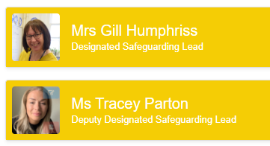

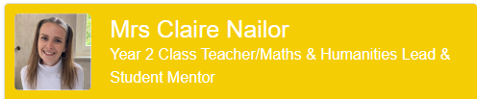
Designated Safeguarding leads...…
If you have any concerns about your child, or another child and need our support you can come and speak with me directly. You may want to contact the school office and arrange a meeting in private.​
The DSL team are always welcoming and can support you with your concerns.​

Slide 17
Expectations…
Behaviour – high expectations are required: in class, in playground, moving around school, on trips, when visitors are in and at after school clubs. We consistently relate this abck to our one school rule of Respect.
School uniform/PE kit/lunch/snack pots/water bottles(every day)/pencil cases should all be clearly labelled and it is the children's responsibility to look after these.
Presentation: high expectations both within school and when completing homework.
Encourage independence: encourage children to organise themselves for a successful day; to inform staff when they need a book changed, need to hand in a letter, bring sheets and uniform home, hand homework in.

Slide 18
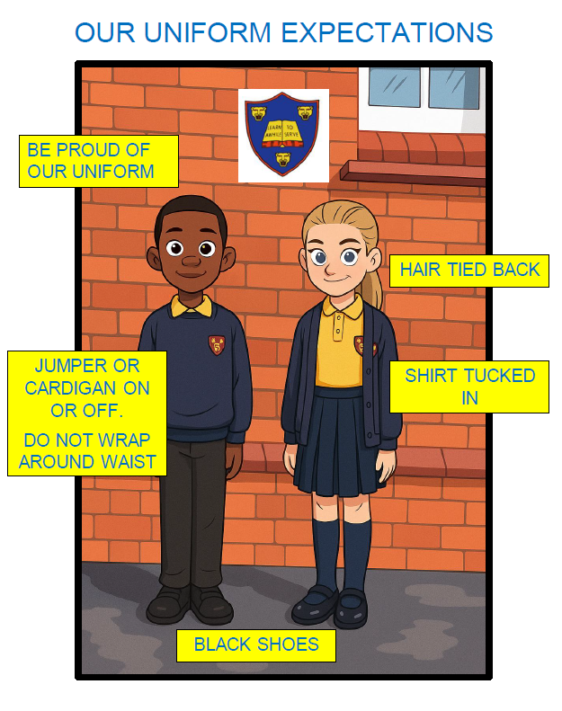
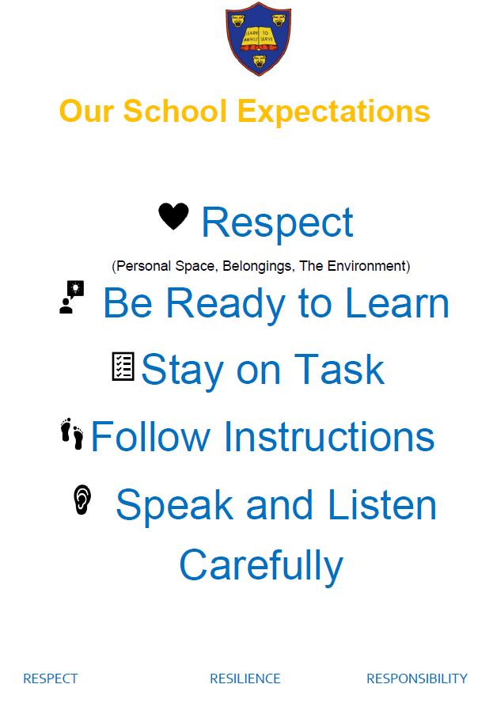
Expectations…

Slide 19

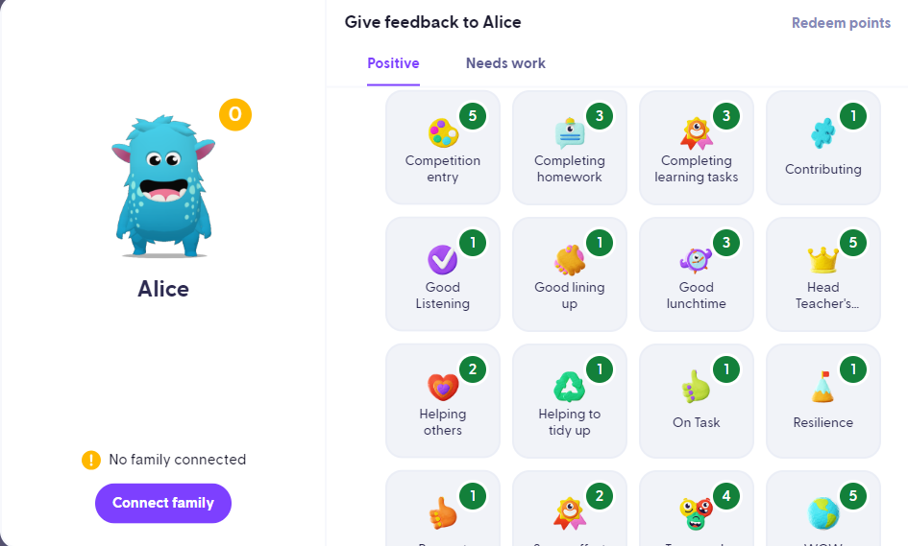
Celebrating Success…
Celebration Assembly: Head Teacher’s Award, Learner of the Week, Well-being Warrior, Respect Certificate.
Daily: Affirmations, stickers, Dojo Points, verbal praise and feedback
Shakespeare Hall Arden Hathaway

Slide 20
AOB…
Please remind children they have a locker in which to store their items, encourage independence.
Arbor – lunches and trip payments
Medicines – Only prescribed medicines with child’s name are permitted. They must be handed to the office. No medicines should be left in a child’s bag.
Healthy snacks – NUT FREE! No sweets or chocolate. KS2 children are not provided with fruit.
PE days – Mondays and Thursdays. Children to come to school in PE kits.
Only Y6 are permitted to walk to school and have mobile phones. All Year 3 children must be escorted to and from school.
In accordance to new statutory guidance holidays/leave of absence will NOT be granted except in exceptional circumstances.

Slide 21
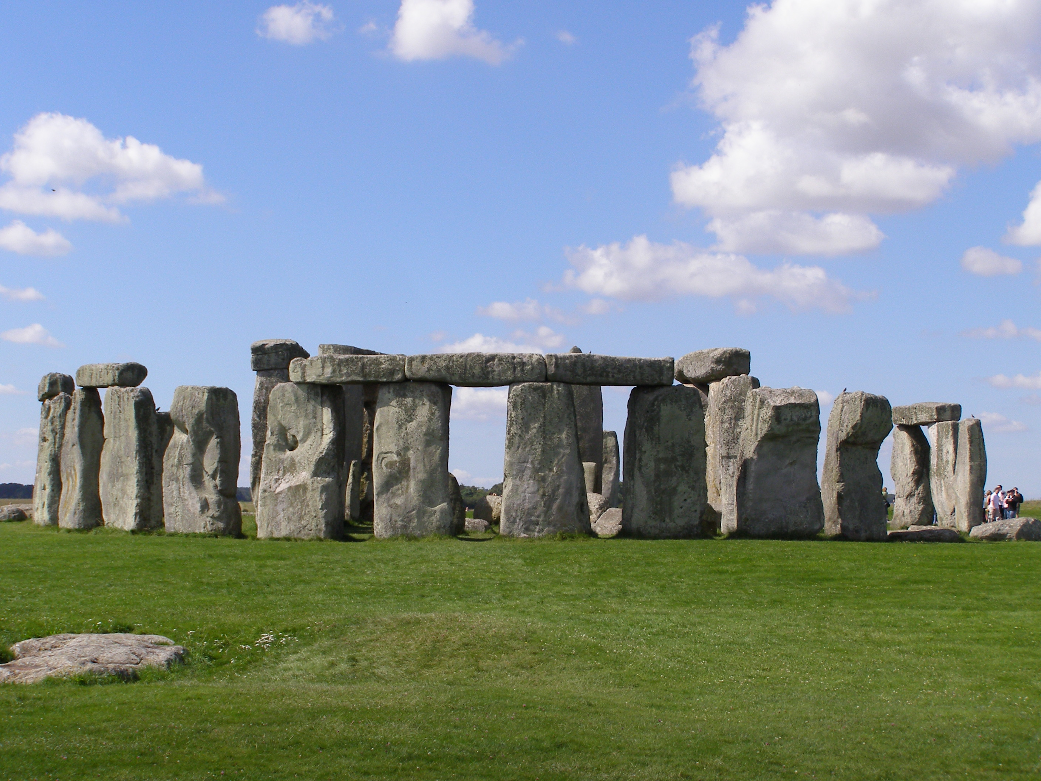
Stonehenge
Please arrive by 7:55 at the very latest. The bus is arriving at school at 8am.
Packed lunch and snacks.
Wear school uniform.
No electronic devices.
The children can bring £10 in a labelled purse.
Weather will hopefully be good but a coat may be necessary, a reminder will be sent out the Friday before.
I will also update on dojo of our eta in the evening.

Slide 22
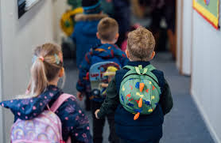
Any Questions?
Thank you!

