Slide 1

Welcome to Reception!
Miss Hitchens
Mrs Banks (Monday – Wednesday)
Miss Buchanan (Am)
On Thursdays and Fridays

Slide 2
A typical day in Reception…
8:45am - The children will arrive at 8:45am, they will put their coat, book bag and water bottle away. The children will complete a morning activity focusing on writing or maths.
9-9:30am -Phonics
10:35-10:55am – Break time where children will enjoy a snack.
10:55-11:10am – Whiterose maths.
11:10-11:40 – Continuous provision. Arts and crafts, construction, Maths and English and creative play.
11:45-1pm – Lunch.
1:10-1:25pm –Then we will do some work on understanding the world or expressive art and design or communication, literacy and language.
1:25-2:40pm - Continuous provision which includes Arts and crafts, construction, Maths and English and creative play.
2:40-2:55pm – Snack and story time.
2:55pm – Monday, Tuesday, Wednesday
3:20pm – Home time

Slide 3
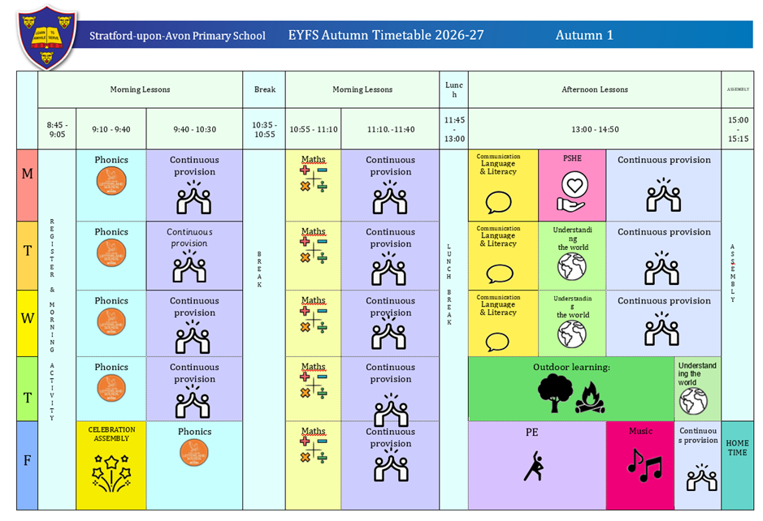
The timetable will look similar to this.

Slide 4
Topic books
Do you want to be my friend?
The Lion and the Mouse Once There were Giants.
Lost and Found.
Five minutes peace.
People who help us.
Leaf Man
Pumpkin Soup
The Gruffalo
The stick man
Hibernation Station
The Gruffalo’s Child.
One Winters Day
One snowy night Snowflakes.
All About Animals in Winter.
Jolly Christmas Postman.
Goldilocks Jack and the Beanstalk.
Mr Wolf’s pancakes.
The three little pigs.
How to Grow a Dragon.
Cinderella
Tad.
Everything Spring.
One spring Day.
The First Egg Hunt.
The Tiny Seed.
That’s MY flower!
Superworm.
What the Ladybird Heard.
Diary of a Spider.
The very hungry caterpillar.
Twist and Hop, the Minibeast Bop! T
he Buggliest Bug.
The Rainbow Fish.
The Singing Mermaid.
Sharing a Shell.
One is a snail Ten is a Crab.
The odd fish.
At the Beach.
Under the Sea.
The lighthouse keeper’s Picnic.
Teddy bear picnic.

Slide 5
Phonics, English, Maths and the other areas.
Phonics – we will be starting Little Wandle phonics after the first 3 weeks of the Reception children starting school.
Communication, literacy and language – we will be focusing on a new topic every term, each week we will read a book which links to our topic and continuous provision. We will be working on letter formation, using our phonics to decode and spell words as well as focusing on our comprehension skills.
Maths – We will be following the Whiterose Maths scheme and we will be teaching Maths every week. Maths activities will be emerged into our continuous provision. We will teach mastering number in the afternoon.
We will also teach Understanding the world which covers Geography, History, Science, French, ICT, RE, PSE, PE
Music and Art/ Design.
Intervention groups will also be throughout the week, focusing on phonics, Maths, letter formation, fine/gross motor skills etc. The interventions will be ran by either Miss Hitchens or Mrs Banks.

Slide 6
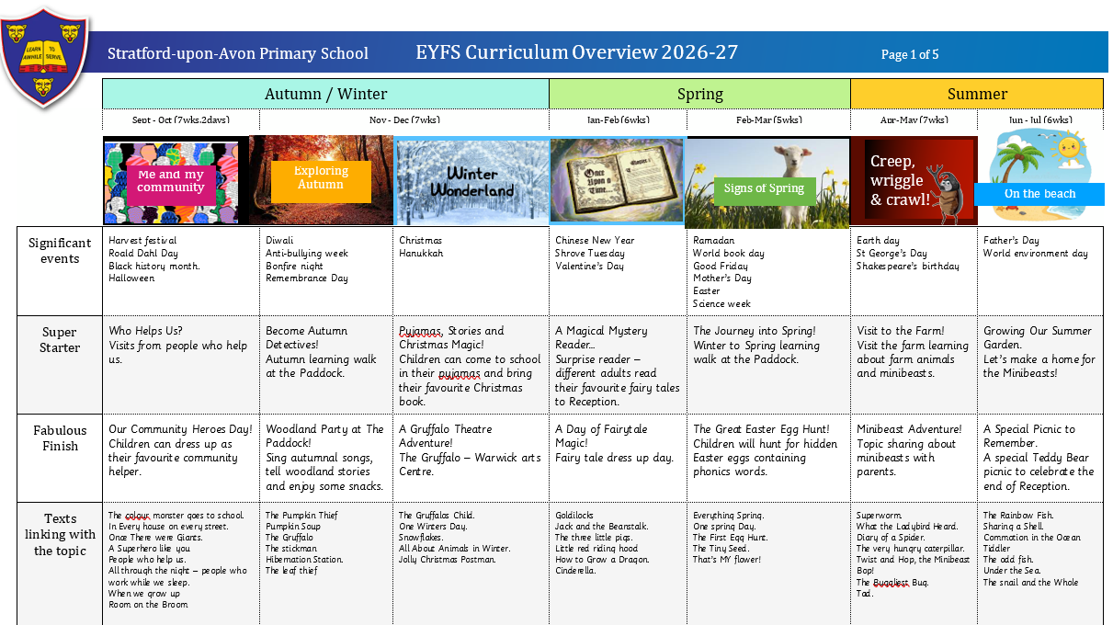
Super starters and fabulous finishes

Slide 7
Assessment…
In Reception we have a baseline assessment during the first few weeks of the children starting Reception.
In autumn term 2 (Christmas), Spring term 2 (Easter) we will do a checkpoint where we will assess your child’s progression.
In summer term 2, we will do our last checkpoint where we will see if your child has achieved their early learning goals for Reception.
Every child is different so don’t worry if your child is making different progress. We will communicate to you if your child would benefit from extra intervention support where appropriate e.g. phonics.
Assessment will also be done daily through talk, questioning and feedback.

Slide 8
Writing checkpoints

Slide 9


Reading books
Little Wandle reading books
All children will start on wordless reading books and then they will move onto books with words when they can confidently decode and blend the following sounds – s,a,t,p,i,n
Reading books will be changed on a Friday.
Your child will not be given a new reading book until they have returned the previous one.
If a book is damaged or not returned to school then you will need to replace to it.
They can be purchased from amazon for approximately £5.

Slide 10
Home Learning…
Children will need to be practicing their phonics by reading their book three times a week at home. This will be the same book for a week, to develop confidence with decoding, prosody and comprehension.
Phonics eye spy, phonics decoding games – anything to help them practice!
Keep reading stories
Fine Motor Skills
Mark making/writing
Maths KIRFS
Mastering number homework

Slide 11
AOB…
Children will need to arrive at school in their school PE kit on Fridays.
Children will need to arrive at school in their forest school clothes on Thursdays. These can be old clothes that you don’t mind getting dirty.
Please bring in a spare bag with spare underwear, socks, top and trousers. The bag will be kept on your child’s peg incase of emergencies.
Please ensure your child has a pair of wellies at school, the school can provide spare wellies if necessary please contact class teacher - Miss Hitchens.
Please ensure your child comes to school with a coat or waterproof jacket when it is cold and sun cream and a hat when it is warm.
Fruit and milk will be provided at school during break times but your child can bring in healthy snacks also.

Slide 12
Communication…
We are always here to support and listen whatever it may be. You can come talk to us in the playground at the end of the day (being mindful of adults releasing children). We try our best to pass on all messages at home time.
Important issues can be spoken about in person and appointments with teachers can either be done directly through teachers at the end of the day or via the school office.
Accident forms will be given out at the end of the day for any minor injuries, such as cuts and grazes. Any serious injuries or head injuries will be either a phone call/face to face chat.

Slide 13
Communication…
We are a nut free school – no nut products for snacks or lunch (including Nutella)
Medicines – prescribed medicines only and they need to be handed in to the office.
Forest School volunteers – Thursday afternoons starting 24th September
Head/face injuries – phone call home
No toys from home.
We will use class dojo to share photos and important updates

Slide 14
Expectations…
Behaviour – high expectations, in class and in playground, in school, on trips, when visitors are in and during after school clubs.
Our one school rule of respect.
Our class rules – respect, kindness, sharing and manners.
Class dojo points - house points.
School uniform/PE kit/ snack pots should all be clearly labelled.
Named water bottle needs to be in school every day.

Slide 15
Celebrating Success…
Weekly certificates to celebrate success
Stickers and Dojo points
Topic Sharing Events
Work, activities and other special moments on class dojo

Slide 16
Designated Safeguarding leads...…
If you have any concerns about your ​
Child or need our support you can contact me directly through eschools or come and talk to me after school. You may want to contact the school office and arrange a meeting in private.​
The DSL team are always welcoming and can support you with your concerns.​

Slide 17
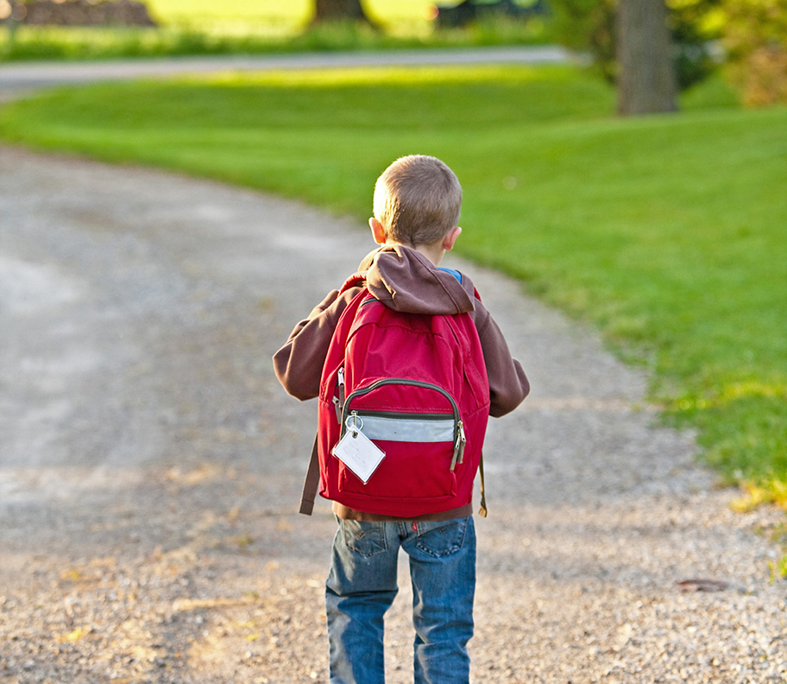
Thank You!
Any questions?

