Slide 1
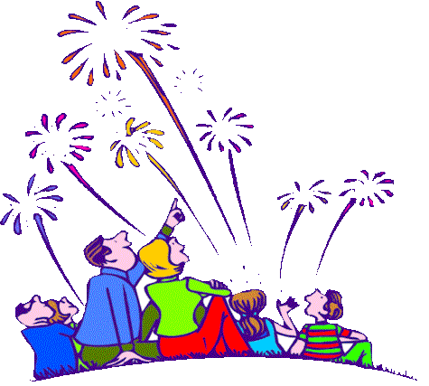
Staying Safe
Remember Remember the 5th November…

Slide 2
Bonfire Night
Remember, remember the fifth of November,
Gunpowder treason and plot.
We see no reason
Why gunpowder treason
Should ever be forgot!
Guy Fawkes, guy, t'was his intent
To blow up king and parliament.
Three score barrels were laid below
To prove old England's overthrow.

Slide 3
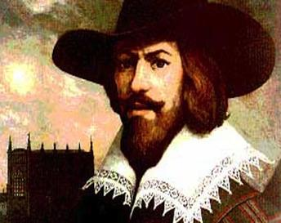
Who was Guy Fawkes?

Slide 4
Hero or Terrorist? Discuss

Slide 6
Do you know the firework code?

Slide 7
Staying Safe is important
Sparkler safety
Never put them in your pocket
Never pick one up off the floor
Make sure an adult is always present
Light them one at a time
Wear gloves
Hold them at arm's length
When it goes out, put the hot end in a bucket of water. Otherwise it could still burn you.

Slide 8
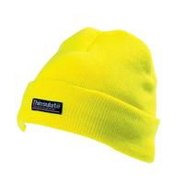
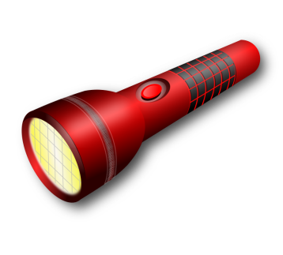
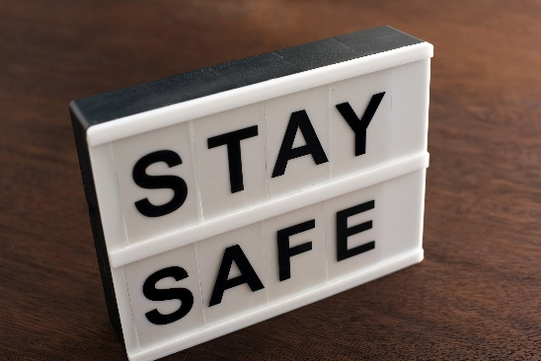
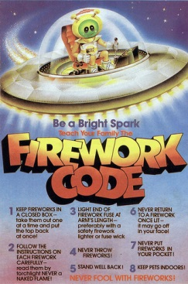
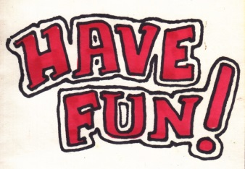
REMEMBER – STAY SAFE

