Slide 1
Why do we remember?

Slide 2
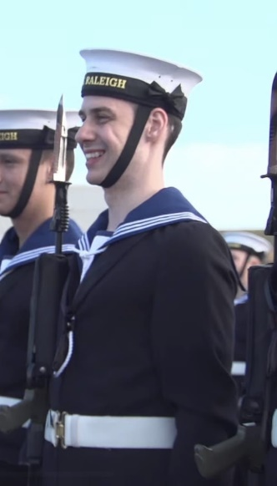
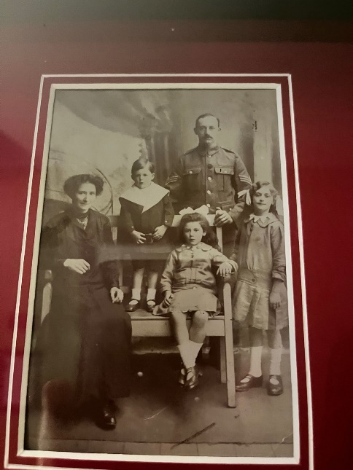
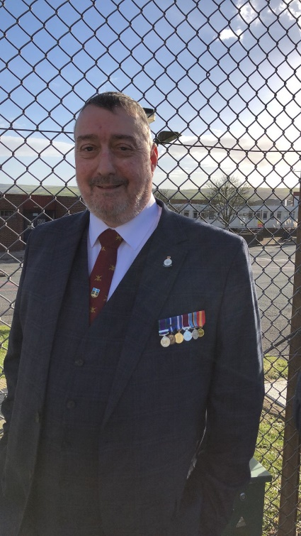
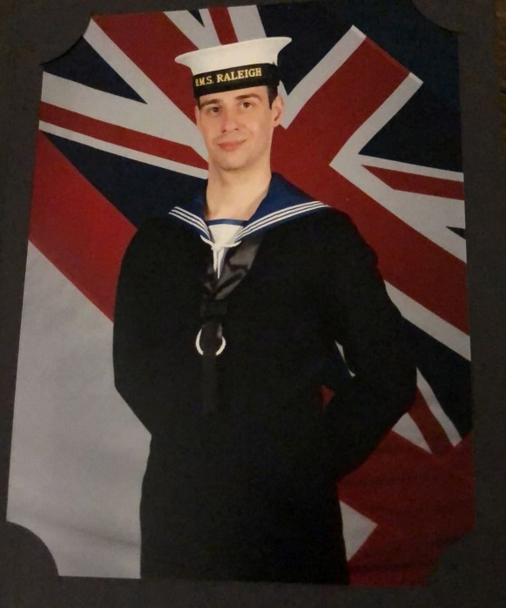
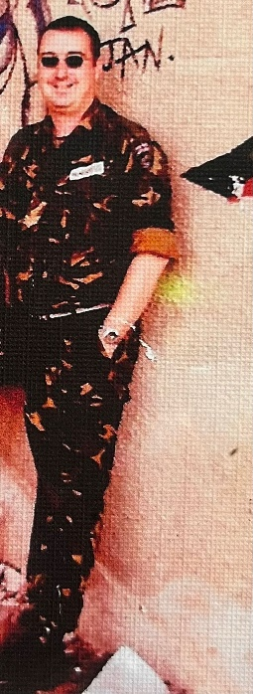
I remember because….

Slide 3
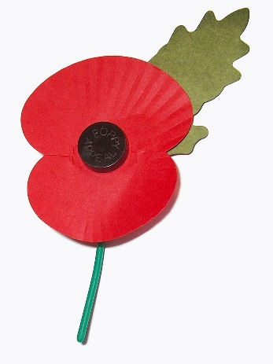
What is Remembrance?
When we take part in Remembrance we are saying thank you to all the people who keep us safe. We are saying thank you to:
To all those who have fought in wars and conflicts and still do
People who fight to protect us
People who help us
People who put themselves ahead of others

Slide 4
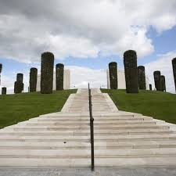
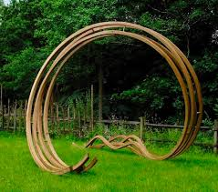
There are many places where people remember
The Remembrance Glade at The National Memorial Arboretum is a beautiful calm place where we can feel peaceful and remember. It is full of sculptures and plants that mean something special. When people come to the Glade they remember what other people have done to keep them safe.

Slide 5
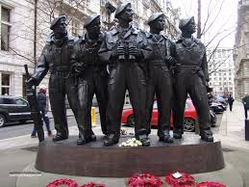
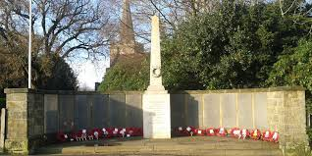
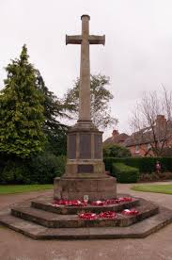
War memorials
In many towns, villages and cities there are war memorials to remember all those who have died in wars and conflicts – WW1, WW2, Korea, Bosnia, Northern Ireland, Iraq, Afghanistan and more. These help people to have a place they can reflect and remember.

Slide 6
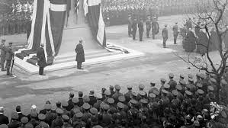
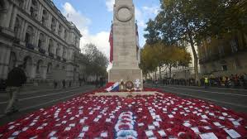
THE CENOTAPH
At The Cenotaph in London the whole nation know this is a symbol of remembrance and we unite as a country to say thank you and reflect. Without the sacrifices made by so many our lives would be very different.

Slide 7
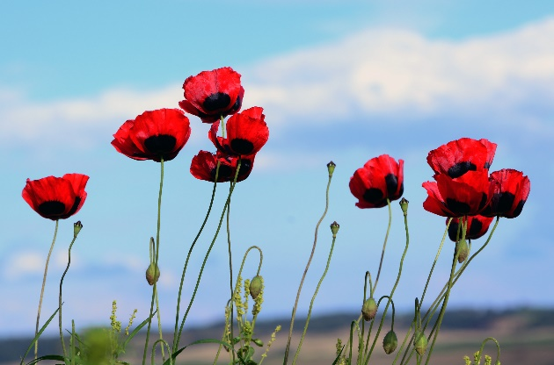
Why do we have Remembrance?
To remember
To show respect.
To say thank you
To preserve peace and freedom

Slide 8
We will now remember in silence
They shall grow not old, as we that are left grow old: Age shall not weary them, nor the years condemn. At the going down of the sun and in the morning We will remember them.

Slide 9
REMEMBER
When you go home, tell them of us and say, For your tomorrow, we gave our today.

Slide 10
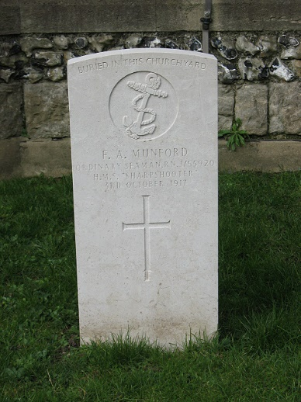
Remember
At some point in our history a member of our family will be involved in war or conflict
Every family history story has someone who has made a sacrifice
Find out more.

