Slide 1
Wednesday 28th September 2022

Slide 2
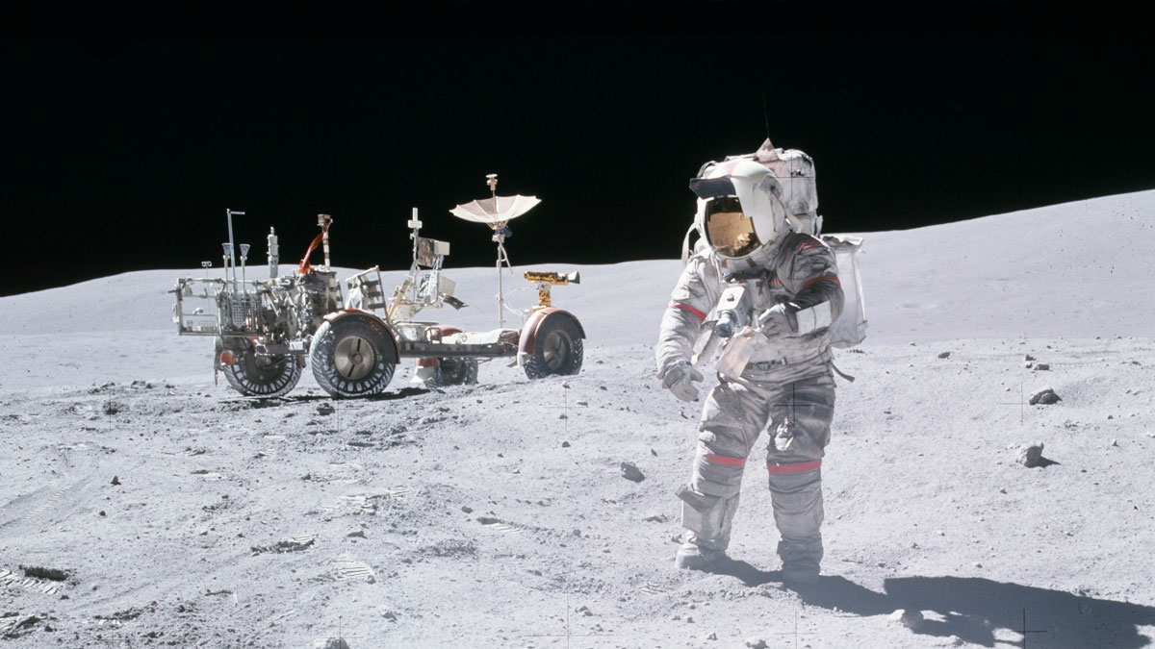
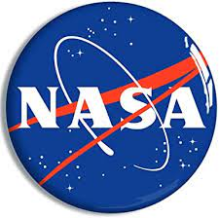
What is NASA?

Slide 3
NASA stands for
National Aeronautics and Space Administration

Slide 4
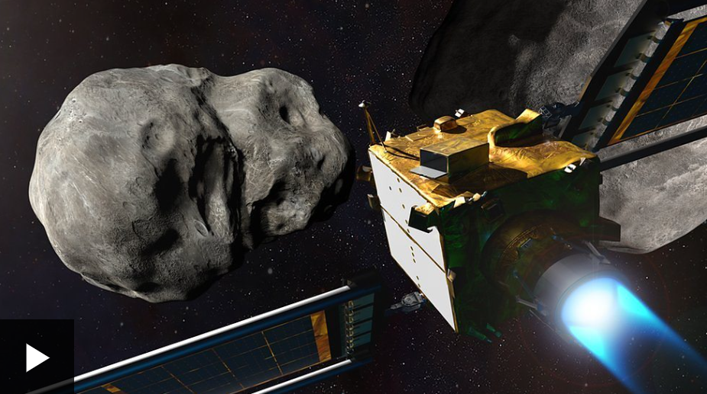
In the news this week, NASA have been carrying out a very important mission…
Let’s find out more…

Slide 5
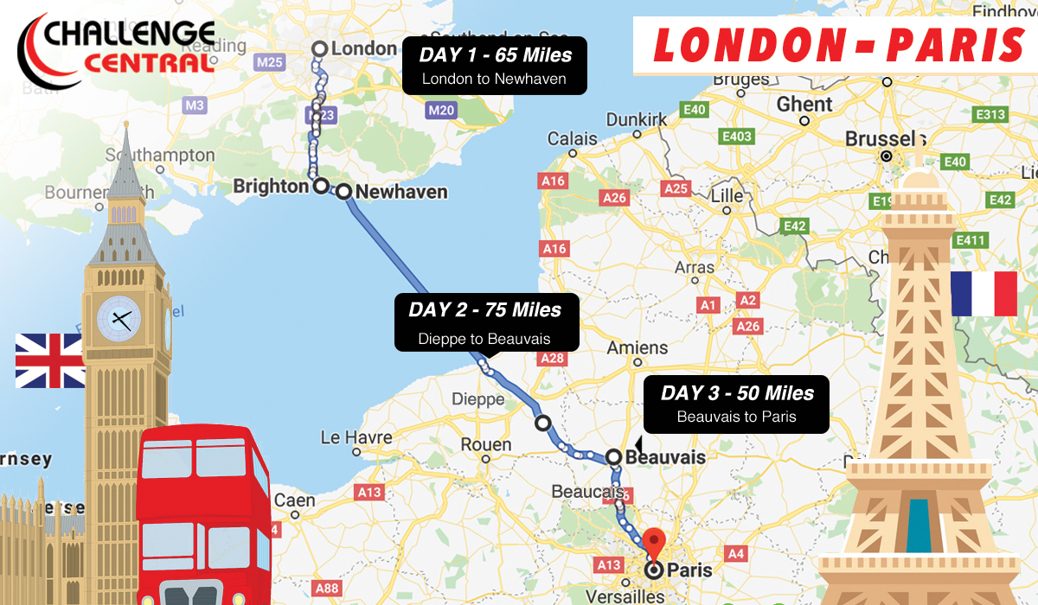
So what exactly is an asteroid?
An asteroid is a small rocky object that orbits the Sun.
Asteroids become meteors when they burn up in the Earth’s atmosphere.
Asteroids come in all sorts of different sizes. Vesta is one of the biggest asteroids – it is bigger than the distance from London to Paris!
A meteor is a streak of light in the sky

Slide 6
There are SO many asteroids in our Solar System – scientists know that an asteroid was responsible for making the dinosaurs EXTINCT!

Slide 7
NASA scientists watch asteroids in space using POWERFUL telescopes – it is their job to study these pieces of rock.

Slide 8
The James Webb Telescope…
Nasa have built a telescope which is SO big, it can show the deepest image of the universe EVER taken. It can take photos of our Solar System and send pictures back to Earth.
It is called the James Webb Telescope and it is the world's biggest and most technically advanced telescope ever built!
It cost a whopping $10 billion to create and is the size of a tennis court!
In fact, it's so big it had to be folded to fit inside its launch rocket!

Slide 9
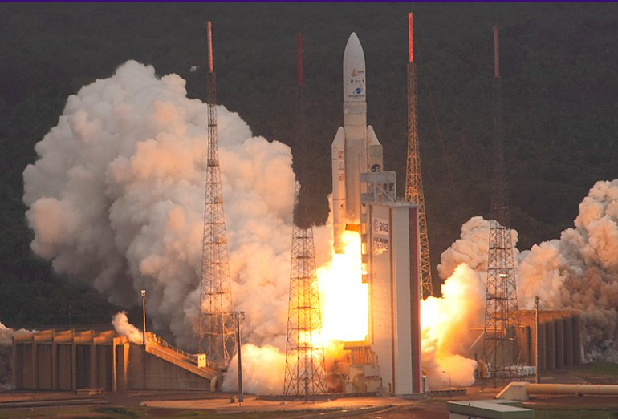
The telescope was launched into space in December last year and it was tasked to take pictures of some of the first galaxies ever formed.
Astronomers have now starting receiving pictures from the huge telescope, BUT, NASA won't be sharing them just yet!
Click here to watch the telescope launch!

Slide 10
So, what have you learnt about NASA’s special mission this week? Working with the people on your table, you will have 1 minute to answer each of the Kahoot quiz questions…

Slide 11
https://kahoot.it/challenge/06174665?challenge-id=f856194d-c2ab-4cbb-bc6e-ba87d9b15ec3_1664219461997

