Slide 1
Wednesday 14th September 2022

Slide 4
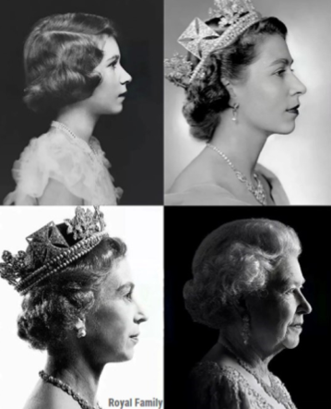
Let’s watch the news report about Queen Elizabeth II to find out more about the late monarch and her life…

Slide 5
On your post-it note, write one thing that you now know about our late sovereign, Queen Elizabeth II to display on our ‘In the News’ board.

