Slide 1

Welcome to Year 5
Miss Postlethwaite & Mrs Mingins.

Slide 2
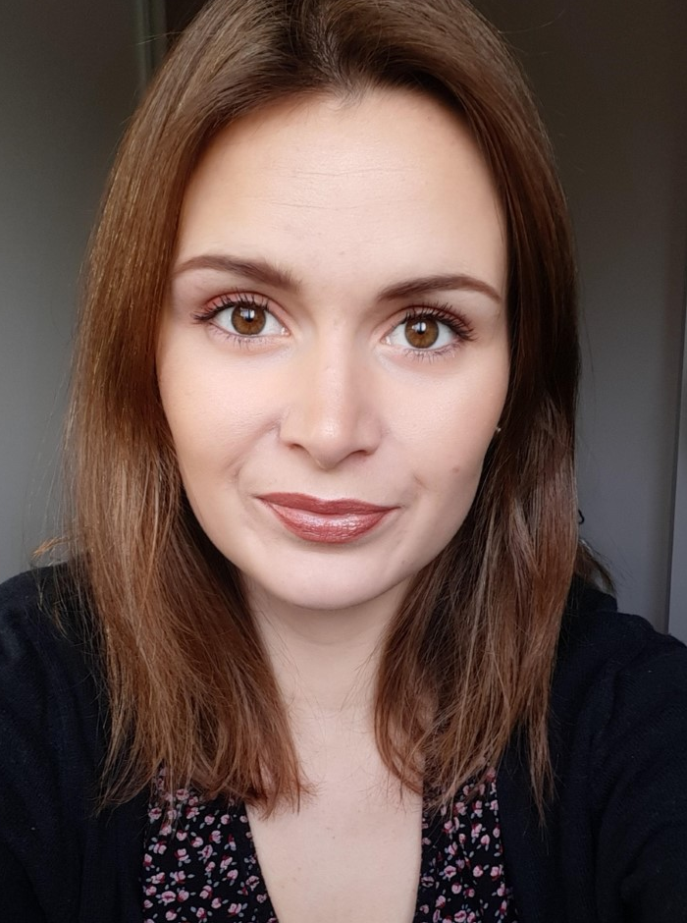
Meet the teacher - Miss Postlethwaite
Welcome to Year 5!
My name is Miss Postlethwaite and I will be the Year 5 teacher.

Slide 3
A typical day in Year 5…
As soon as the children arrive at school they will put their belongings away in their lockers and sit at their tables to quietly complete the morning activity of fluent in 5 during registration. They will also have time to fill in their colour monsters to let us know how they are feeling.
They then will have either an assembly or a short handwriting/ SPAG session. After that they have their morning sessions which consist of the core subjects English, Mathematics and spelling.
After lunch they will have time either for quiet reading or times table before starting our Topic based learning and the foundation subjects.
The day will end with assemblies and a whole class story.

Slide 4
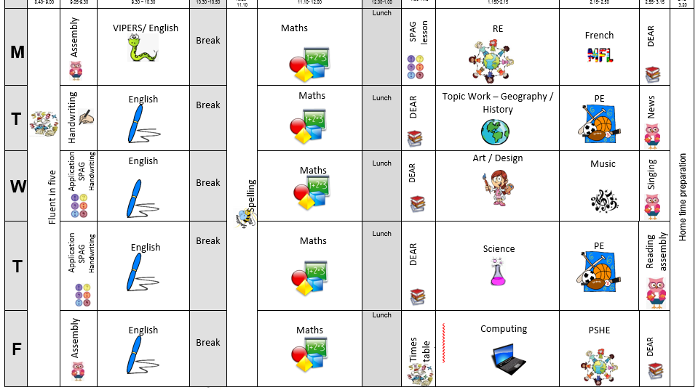
The timetable will look similar to this.

Slide 5
English and Mathematics.
English – is based on a whole class text that is normally linked to that terms topic.
The class texts this year are… The firework makers daughter by Philip Pullman.
Tuesday by David Wiesner
Cosmic by Frank Cottrell-Boyce
The Tempest by William Shakespeare
Athena: The story of a Goddess by Imogen Greenberg?
The Odyssey by Homer?
Whole class reading also takes place daily to help children be immersed in a range of texts. We will read Bronze and Sunflower by Cao Wenxuan, Northern lights by Philip Pullman, Alone on a wide, wide sea by Michael Morpurgo, Terrible Tudors (horrible history) and many more.
Maths Mastery –is about deepening children’s understanding, use and manipulation of all things maths.
Fluent in five – Takes place daily and will help develop speed and accuracy with arithmetic skills.

Slide 6
Topic learning.
We will also teach Geography, History, Science, French, ICT, RE, PSHE,
Music and Art/ Design. Learning in these subjects is, where possible, linked to each terms topics.
This year our term topics will be… Dynamic Dynasties, Stargazers, Tudors and Groundbreaking Greeks.

Slide 7
Trips...
This year I have tried to think of how I can further enhance the children’s learning through trips and experiences at as low cost for as possible.
Here are the planned and potential trips for the year…
Bell boating – 28th September
Mad museum – 20th October - £9.50
Heart of England – 2nd October ( date 2 in term 3 TBC) Cost to TBC. .
Whole school Theatre visit near Christmas – Date TBC - £10?
Gurdwara visit in Leamington – Date and cost TBC
Greek workshop day – Date and cost TBC

Slide 8
Assessment…
Assessment in KS2 is carried out daily with live marking happening during the lesson and targeted questioning as the children are working. This ensures that children have time to respond to the feedback, make changes and any misconceptions can be addressed immediately.
Children will take part in assessments in reading, writing and mathematics across the year to show progress and inform us of their next steps or any gaps in learning.
The Statutory Assessment does not make up the whole picture. We use teacher assessment to make a final judgement on whether children have met the Expected Standard for the end of Year 5.

Slide 9
Home Learning…
Children are all expected to read once at home every day and this should be recorded in their diaries.
Children will be given a maths Key Instant Recall Facts (KIRF) for each term, which will give you ideas of things you can recap at home to help with fluency. These will be quick ideas of things they can practise when in the car, on the way to school or whilst queuing at the shops etc.
Children should also complete 30 minutes of times table rock stars a week.
Children should also practice the weekly spellings on spelling shed. There will be games set for the words they are learning that week for them to play to help them practice and learn the 10 words of the week.
Some children may have individualised spellings of common exception words from previous years or that we have noticed they need to practice from lessons. Please encourage them to focus on these words first.
Home learning is for recall of facts, knowledge and skills learnt. It will not be marked but any completed will be rewarded with dojos or stickers. It will be set Monday to Monday.
.

Slide 10
Communication…
We will contact you with any information through parent letters, eschools, in the weekly newsletter or on twitter. We will also share things that we get up to on these platforms too.
We will also try our best to pass on all messages at home time.
Accident forms will be given out for any minor injuries, such as cuts and grazes. Any serious injuries or head injuries (even if minor) will be a phone call.
Please check the website and eschools for copies of the home learning task, our class timetables and messages.

Slide 11
Communication…
We are always here to support and listen whatever it may be.
If you have any minor inquiries you can contact me via eSchools or in their reading record if preferred.
You can also talk to the member of staff on the gate in the morning about any general enquiries or come to me in the playground at the end of the day (being mindful of adults releasing children).
Important issues can be spoken about in person and appointments with myself can either be arranged directly at the end of the day or via the school office.

Slide 12
Expectations…
Behaviour – high expectations, in class and in playground, in school on trips and when visitors are in and in after school clubs.
Class dojo points - house points.
School uniform/PE kit/ snack pots should all be clearly labelled and it is the children's responsibility to look after these.
Presentation, in school and when completing homework.
Encourage independence – children to inform when they need a book changed, need to hand in a letter, bring sheets and uniform home, hand homework in.
Named water bottle needs to be in school every day.

Slide 13
Celebrating Success…
Weekly certificates of head teachers award and learner of the week to celebrate success.
Well–being warriors and respect awards
Stickers, Dojo points, House points and going on the WOW wall
Topic Sharing Events
Looking at the website and Twitter

Slide 14
AOB…
Remind children they have a locker in which to store their items, encourage that independence.
Medicines – Only prescribed medicines with child’s name on are allowed. They must be handed to the office. No medicines should be left in a child’s bag.
Healthy snacks – NUT FREE!
Children will get changed in school for PE so please make sure there PE bags and trainers are in school on PE days… Tuesday and Thursdays
Follow us on Twitter … stratfordprim
Follow us on Instagram… stratforduponavonprimary
Optional 11+ resources on eschools - will not be marked or assessed in school
RESPECT – the one school rule

Slide 15
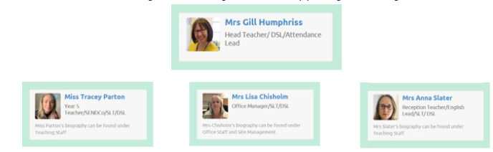
Designated Safeguarding leads...…
If you have any concerns about your ​
Child or need our support you can contact me directly through eschools or come and talk to me after school. You may want to contact the school office and arrange a meeting in private.​
The DSL team are always welcoming and can support you with your concerns.​

Slide 16
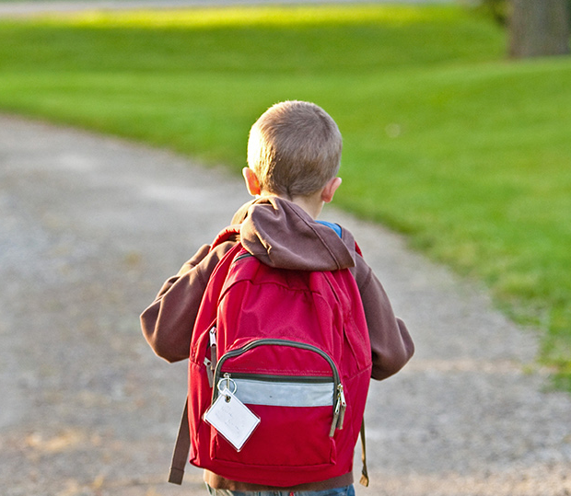
Thank You!

