Slide 1
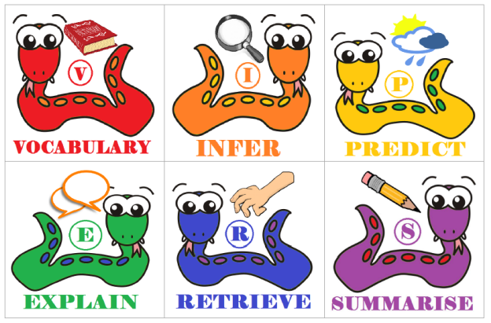
Wednesday 15th September 2021 We are learning to use our reading VIPERS skills to explore a text.
Introduce
Notes:
Today we are going to read Chapters 1, 2, 3, 4, 5

Slide 2
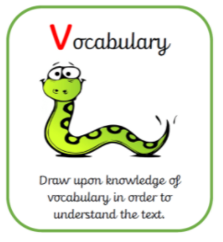
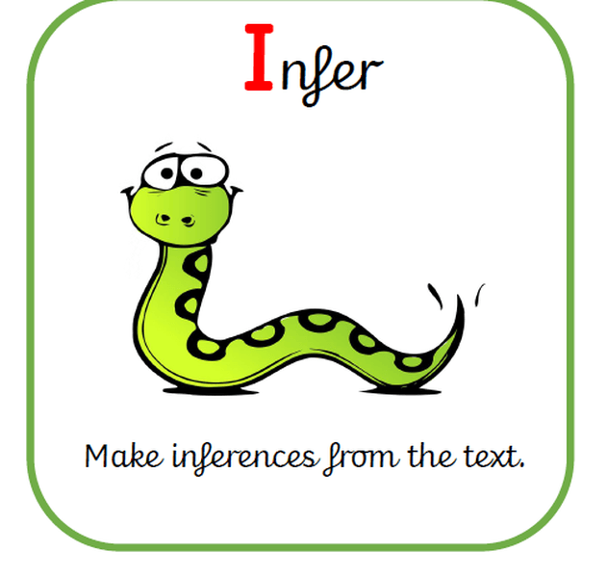
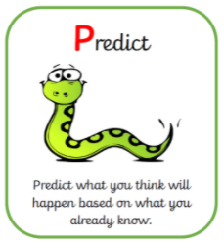
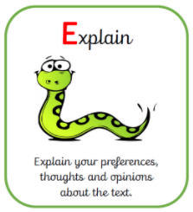

Slide 3
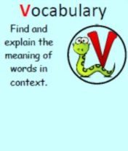
Let’s recap our reading VIPERS…
‘He’s more than clever. He’s a magician with chocolate! ‘
Which word in the sentence tells you about Willy Wonka’s abilities?
Why do you think this word is effective?

Slide 4
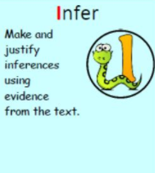
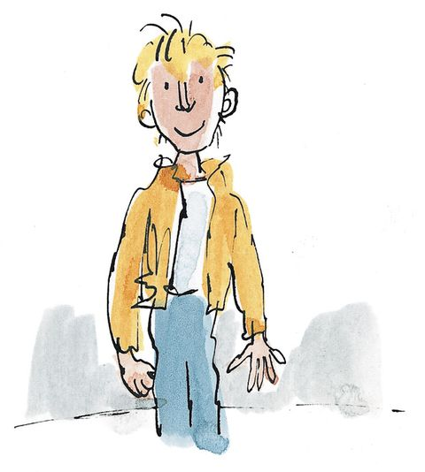
What impression of Charlie do you get from the text so far?

Slide 5
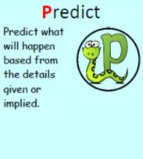
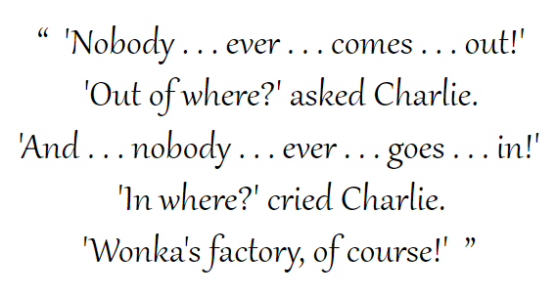
What do you predict the ‘secret workers’ are?
Who do you think they might be?

Slide 6
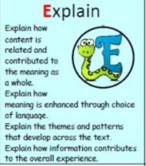
In the town itself, actually within sight of the house in which Charlie lived, there was an ENORMOUS CHOCOLATE FACTORY!
‘My dear boy, Mr Willy Wonka is the most amazing, the most fantastic, the most extraordinary chocolate maker the world has ever seen!
Some words are written in capital letters or in italics.
What effect does this have on the reader?

Slide 7
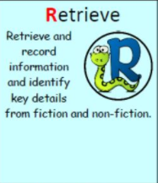
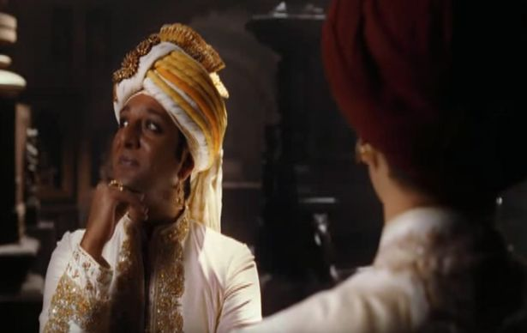
What do we know about Prince Pondicherry?
Retrieve some information from the text that tells you this. (Chapter 2/3)

Slide 8
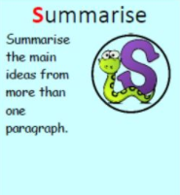
Can you summarise what we know about the Bucket family so far? What type of people are they?

Slide 9
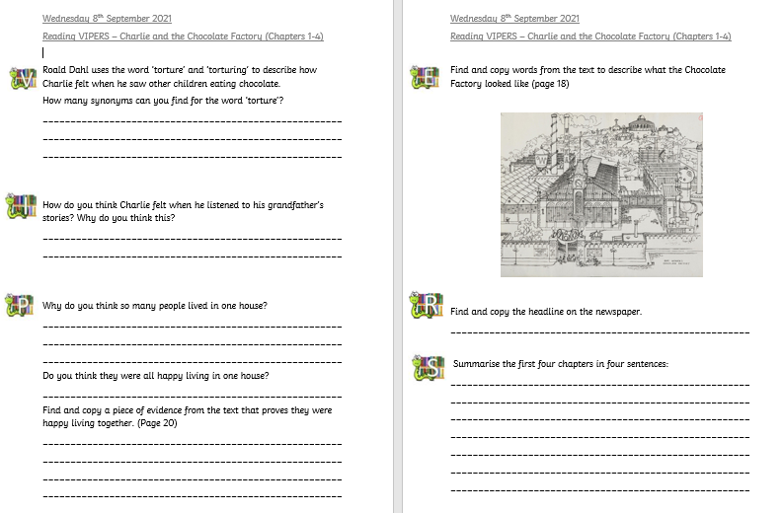
Independent task

