Slide 1

Welcome to Year 4
Mrs Rossborough and Mrs Lant & Mrs Buchanan.

Slide 2
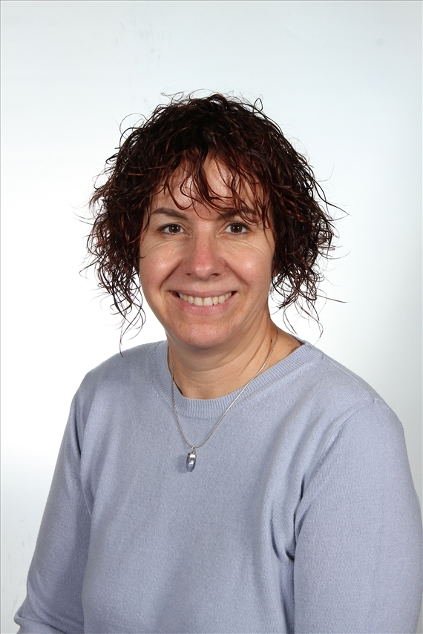
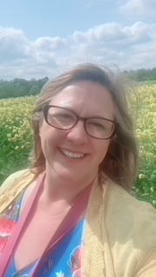
Meet the teacher – Mrs Rossborough and Mrs Lant
Welcome to Year 4!
We also have 2 teaching assistants – Mrs Buchanan and Mrs Matthews

Slide 3
A typical day in Year 4…
As soon as the children arrive at school they will put their belongings away in their lockers and sit at their tables to quietly complete the morning activity of fluent in 5 during registration. They will also have time to fill in their colour monsters to let us know how they are feeling.
They then will have either an assembly or practice Times Tables Rock Stars. They then move into Maths, English which includes spelling, punctuation and grammar.
After lunch they will have time either for quiet reading before starting our Topic based learning and the foundation subjects.
The day will end with assemblies and a whole class story.

Slide 4
The timetable will look similar to this.

Slide 5


English and Mathematics.
English – is based on a whole class text that is normally linked to that terms topic.
The class texts this year are…
Saxon Tales by Terry Deary
How to train your dragon and How to be a Viking
The King of the Cloud Forest
A Winter’s Tale by Shakespeare
Secrets of a Sun King
An Egyptian Cinderella Tale
Whole class reading also takes place daily to help children be immersed in a range of texts..
Maths Mastery –is about deepening children’s understanding, use and manipulation of all things maths.
Fluent in five – Takes place daily and will help develop speed and accuracy with arithmetic skills.
Year 4 need to know their multiplication facts up to 12 x 12 by June 2024.
They will complete a statutory test.

Slide 6
Topic learning.
We will also teach Geography, History, Science, French, ICT, RE, PSHE,
Music, Art & DT. Learning in these subjects is, where possible, linked to each terms topics.
This year our term topics will be… Invasion & Invaders, Misty Mountains – Winding Rivers, Ancient Civilisations Eygptians.

Slide 7
Trips...
This year we have tried to think of how we can further enhance the children’s learning through trips and experiences at as low cost for as possible.
Here are the planned and potential trips for the year…
Heart of England Forest trip– 12th September
. Whole school Theatre visit near Christmas – Date TBC - £10?
Residential one night trip to York – Jorvik centre and tour of York
Egyptian workshop
Local visits to Humanist church, Shakespeare’s properties.

Slide 8
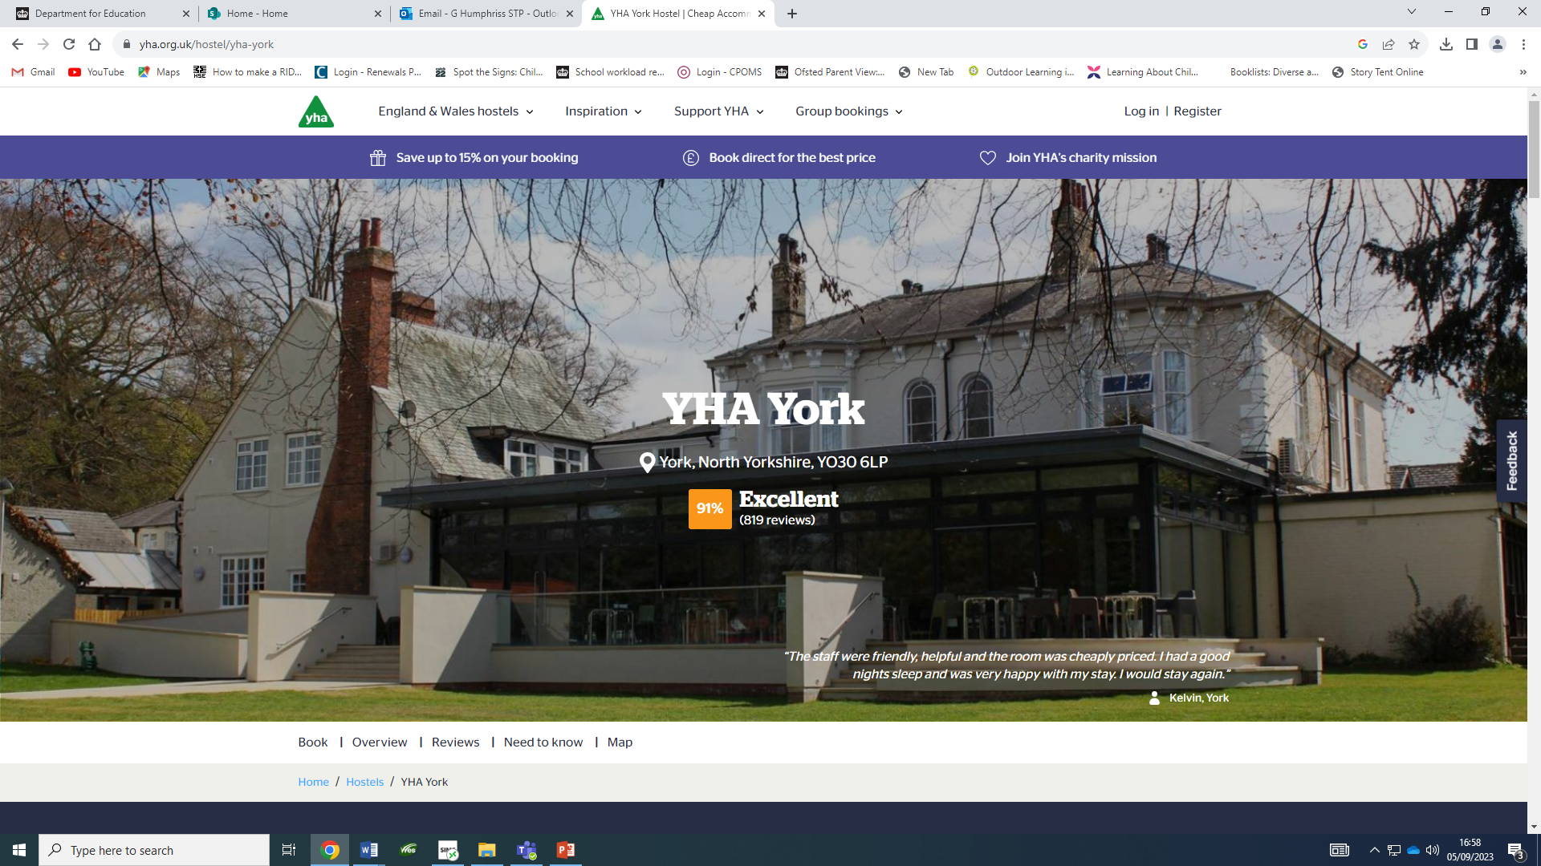
York Residential
In Year 6 the children go on residential for one week. This year 4 trip is to prepare them.
Mrs McCormack and Mrs Humphriss plus 2 more adults will accompany the children
We will be staying in York youth hostel
The children will go on a walking tour of York and immerse themselves in Vikings with a visit to the Jorvik centre
Coach, accommodation and food is included.
Builds confidence, love of history and resilience.

Slide 9
Assessment…
Assessment in KS2 is carried out daily with live marking happening during the lesson and targeted questioning as the children are working. This ensures that children have time to respond to the feedback, make changes and any misconceptions can be addressed immediately.
Children will take part in assessments in reading, writing and mathematics across the year to show progress and inform us of their next steps or any gaps in learning.
The Statutory Assessment does not make up the whole picture. We use teacher assessment to make a final judgement on whether children have met the Expected Standard for the end of Year 4.

Slide 10
Home Learning…
Children are all expected to read once at home every day and this should be recorded in their diaries.
Children will be given a maths Key Instant Recall Facts (KIRF) for each term, which will give you ideas of things you can recap at home to help with fluency. These will be quick ideas of things they can practise when in the car, on the way to school or whilst queuing at the shops etc.
Children should also complete 30 minutes of times table rock stars a week.
Children should also practice the weekly spellings on spelling shed. There will be games set for the words they are learning that week for them to play to help them practice and learn the 10 words of the week.
Some children may have individualised spellings of common exception words from previous years or that we have noticed they need to practice from lessons. Please encourage them to focus on these words first.
Home learning is for recall of facts, knowledge and skills learnt. It will not be marked but any completed will be rewarded with dojos or stickers. It will be set Monday to Monday.
.

Slide 11
Communication…
We will contact you with any information through parent letters and e-schools and parent pay We will also share things that we get up to on these platforms too: twitter -@stratfordprim and Instagram – stratforduponavonprimary
We will also try our best to pass on all messages at home time.
Accident forms will be given out for any minor injuries, such as cuts and grazes. Any serious injuries or head injuries (even if minor) will be a phone call.
Please check the website and eschools for copies of the home learning task, our class timetables and messages.

Slide 12
Communication…
We are always here to support and listen whatever it may be.
If you have any minor inquiries you can contact the class teacher via eSchools or in their reading record if preferred.
You can also talk to the member of staff on the gate in the morning about any general enquiries or come to me in the playground at the end of the day (being mindful of adults releasing children).
Important issues can be spoken about in person and appointments with myself can either be arranged directly at the end of the day or via the school office.

Slide 13
Expectations…
Behaviour – high expectations, in class and in playground, in school on trips and when visitors are in and in after school clubs.
Class dojo points - house points.
School uniform/PE kit/ snack pots should all be clearly labelled and it is the children's responsibility to look after these.
Presentation, in school and when completing homework.
Encourage independence – children to inform when they need a book changed, need to hand in a letter, bring sheets and uniform home, hand homework in.
Named water bottle needs to be in school every day.

Slide 14
Celebrating Success…
Weekly certificates of head teachers award and learner of the week to celebrate success.
Well–being warriors and respect awards
Stickers, Dojo points, House points and going on the WOW wall
Topic Sharing Events
Looking at the website and Twitter

Slide 15
AOB…
Remind children they have a locker in which to store their items, encourage that independence.
Medicines – Only prescribed medicines with child’s name on are allowed. They must be handed to the office. No medicines should be left in a child’s bag.
Healthy snacks – NUT FREE!
Children will get changed in school for PE so please make sure there PE bags and trainers are in school on PE days… Tuesday and Thursdays
Follow us on Twitter … stratfordprim
Follow us on Instagram… stratforduponavonprimary
RESPECT – the one school rule

Slide 16
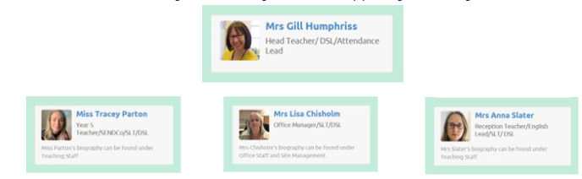
Designated Safeguarding leads...…
If you have any concerns about your ​child please speak with us.
The DSL team are always welcoming and can support you with your concerns.​

Slide 17
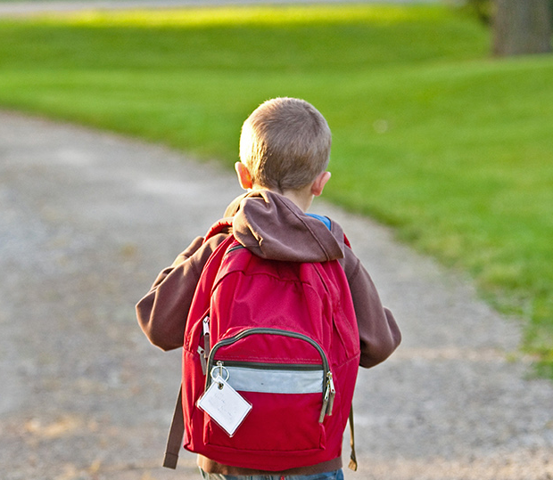
Thank You!

