Slide 1









SAFER INTERNET DAY
TECH IN OUR WORLD
Primary
Notes:
Notes for speaker – brief introduction and welcome.
Explain how long the talk will take and the types of things you will be doing over that time.
For example:
‘Today we are joining millions of people around the world in celebrating Safer Internet Day, a day for promoting a safer and better internet for all users, especially children. During this assembly we are going to talk about the role technology and the internet plays in our world and daily life. We will look at the benefits and challenges as well as some general advice on how to reset our online experiences to promote a positive impact on our time online.’

Slide 2

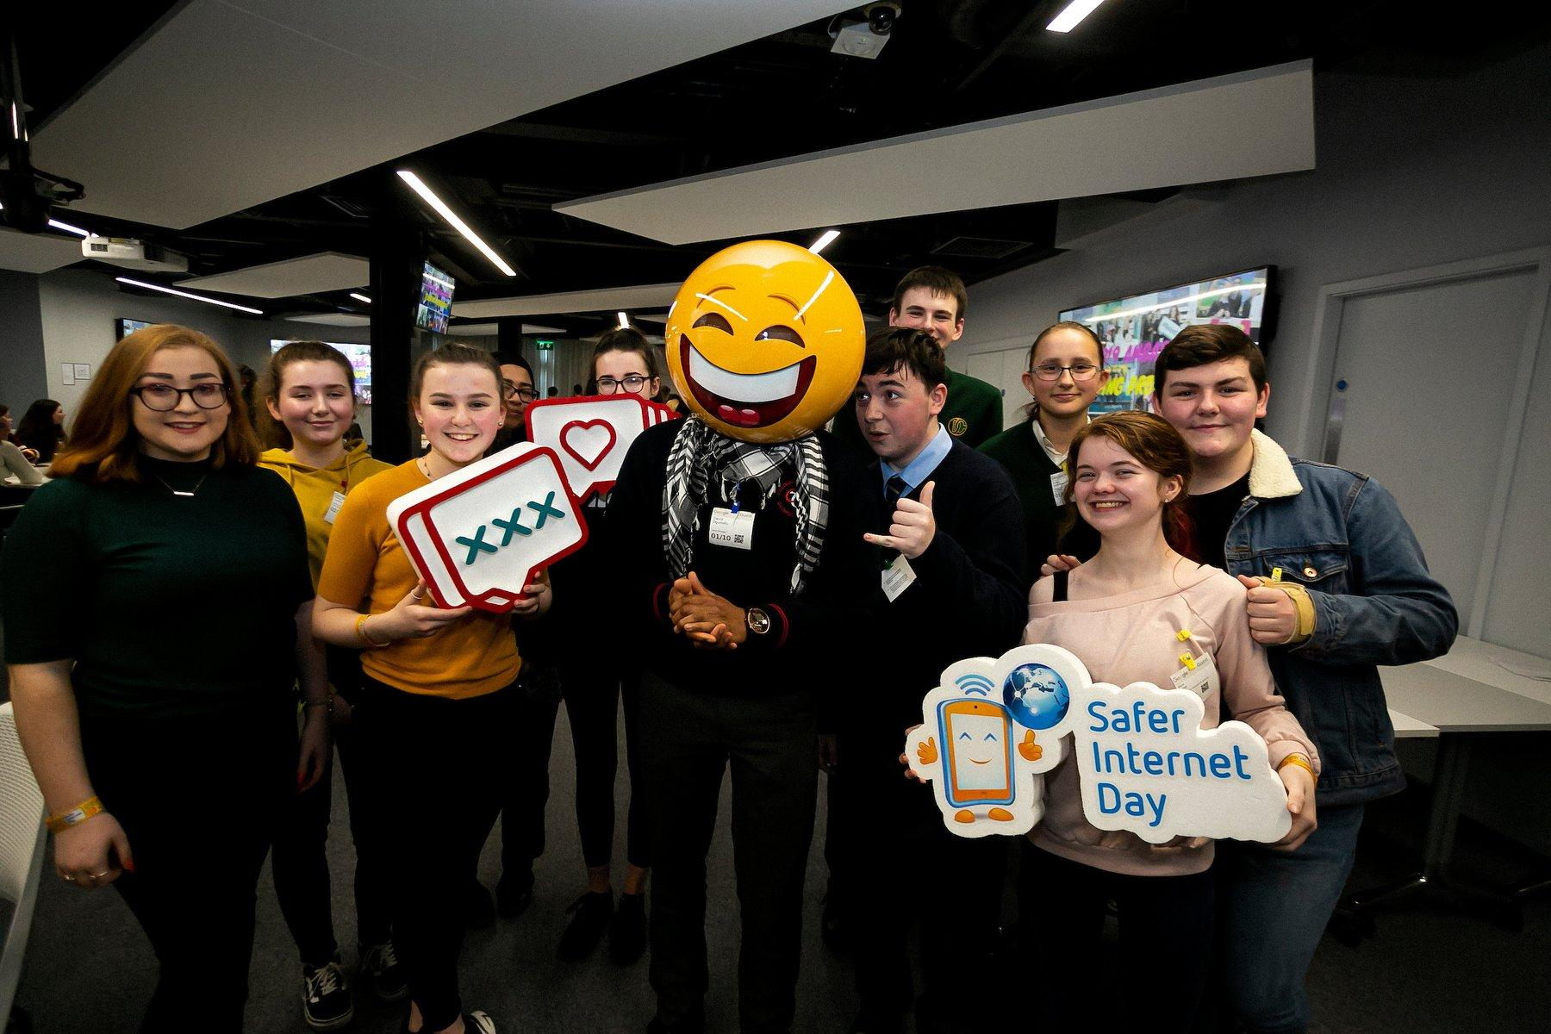
What is Safer Internet Day?
A day to create awareness of a better internet for ALL users
The theme for Safer Internet Day is “Together for a Better Internet”
Safer Internet Day began as an EU wide initiative and is now celebrated in over 180 countries worldwide
Notes:
Notes: Safer Internet Day (SID) is an EU wide initiative to promote a safer internet for all users, especially young people. Safer Internet Day in Ireland is promoted and coordinated by Webwise, the Irish Internet Safety Education Awareness Programme. The Theme for Safer Internet Day is “Together for a Better Internet“.
The aim of the day is a call on young people, parents, teachers, schools, government, businesses to join together to make the internet a safer and better place for all, and especially for children and young people.
Safer Internet Day is a day to promote safe and responsible use of the internet, a day for us to consider how all the different ways we use the internet and how we can make the internet a safer and better place for all, and especially for children and young people.

Slide 3


Tech in Our World
On Safer Internet Day let's take time to:
Reflect on the role of technology in our lives.
Understand the key features of these technologies.
Learn how to make the most of our time online.
Notes:
Notes: Run through the learning outcomes for this talk. On Safer Internet Day let's take time to:
Reflect on the role of technology in our lives.
Understand the key features of these technologies.
Learn how to manage our time online.

Slide 4
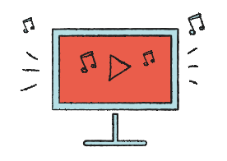






Tech in Our World
Let's consider...
Can you name the devices here?
Notes:
Notes: Today we are going to talk about how to be safe online, we are going to consider how we use technology and the internet in our everyday lives, sometimes without even realising it.
Ensure pupils understand that when we are talking about technology in their world we are talking about the digital devices, tools and apps they use in their day-to-day life.
Ask pupils to name the devices displayed on the slide:
From left to right devices include smart tv, smartphone, game console/controller, virtual assistant, smart watch, laptop, tablet.

Slide 5
Tech in Our World
Let's consider...
Where do you use technology (digital devices) in your daily life?
Notes:
Notes: Ask pupils to list all the different technology (devices) they use to connect to the internet every day. Make sure to clarify for pupils that the word technology includes lots of brilliant smart devices that allow you to use the internet to do lots of things. Suggestions could include: smart phone, smart tv, computer, tablet, laptop, game console, smart speaker/digital assistant e.g. Amazon's Alexa, smart toys.

Slide 6
Tech in Our World
Let's consider...
How do these types of devices help us?
Notes:
Notes: Ask pupils, how do these types of devices help us?
Emphasize the benefits of using technology including to talk to friends/relatives, to have fun, play games, instant access to music or films you want to watch, to find out information, to do school work, to record as a video or voice recording.

Slide 7
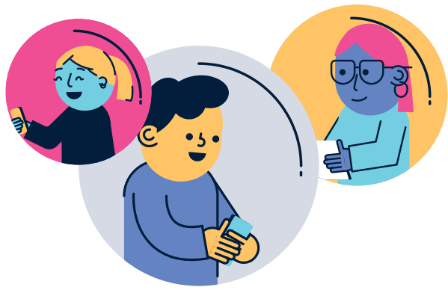
Tech in Our World
Our Time Online
Count the hours you spend online (e.g., t.v., tablet, game, etc.) each day.
Think about how much of that time online is:
          productive e.g., for homework, schoolwork, learning new skills.
        passive e.g., for entertainment, to watch videos for fun, communicate with friends, play games.
Which online activity do you spend the most time on? Is this time productive or passive, and why?
Notes:
Notes: Explain to pupils they will now do an activity to help them reflect on how much time they spend using technology/devices in their every day.
Ask pupils to count the hours you spend online (e.g., t.v., tablet, game, etc.) each day.
Think about how much of that time online is:
productive e.g., for homework, schoolwork, learning new skills.
passive e.g., for entertainment, to watch videos for fun, communicate with friends, play games.
Which online activity do you spend the most time on? Is this time productive or passive, and why?

Slide 8
Tech in Our World
Our Time Online
Both passive and productive use of technology is ok in moderation.
A healthy balance is important when it comes to time online.
Notes:
Notes: Emphasize to pupils that both passive and productive use of technology is ok in moderation.
A healthy balance is important when it comes to time online.

Slide 9
Tech in Our World
Switching Off
Do you ever find it hard to switch off from a game/app/website? Why?
Notes:
Notes: Next, ask pupils to consider if they ever find it hard to switch off from a game/app/website when they are using it? Why? What is it about the game/app/website that makes us want to stay using it for so long?

Slide 10
Tech in Our World
What keeps us online?
Technology companies design apps, games, social media using a technique called "persuasive design".
This means they design social media, apps, games in a way to persuade you to stay using it for longer.
Notes:
Notes: Explain to pupils that technology companies design apps, games, social media using a technique called "persuasive design". This means they design social media, apps, games in a way to persuade you to stay using it for longer.

Slide 11

Tech in Our World
Examples of persuasive design
Autoplay: most streaming services such as Netflix and Disney+ have an autoplay feature that automatically plays the next episode without you having to press play.
Have you come across this feature?
Do you like it? Why? Or Why not?
Notes:
Notes: Explain to pupils that you are now going to have a closer look at some examples of these 'persuasive design' techniques that tech companies use to keep us on our devices for longer.
Autoplay: most streaming services such as Netflix and Disney+ have an autoplay feature that automatically plays the next episode without you having to press play.
Have you come across this feature?
Do you like it? Why? Or Why not?

Slide 12

Tech in Our World
Examples of persuasive design
Notifications: this can include the banner that appears across the top of the screen, a noise or vibration, and the red bubble all to signal something new.
Have you come across this feature?
Do you like it? Why? Or Why not?
Notes:
Notes: Notifications: this can include the banner that appears across the top of the screen, a noise or vibration, and the red bubble all to signal something new.
Have you come across this feature?
Do you like it? Why? Or Why not?

Slide 13
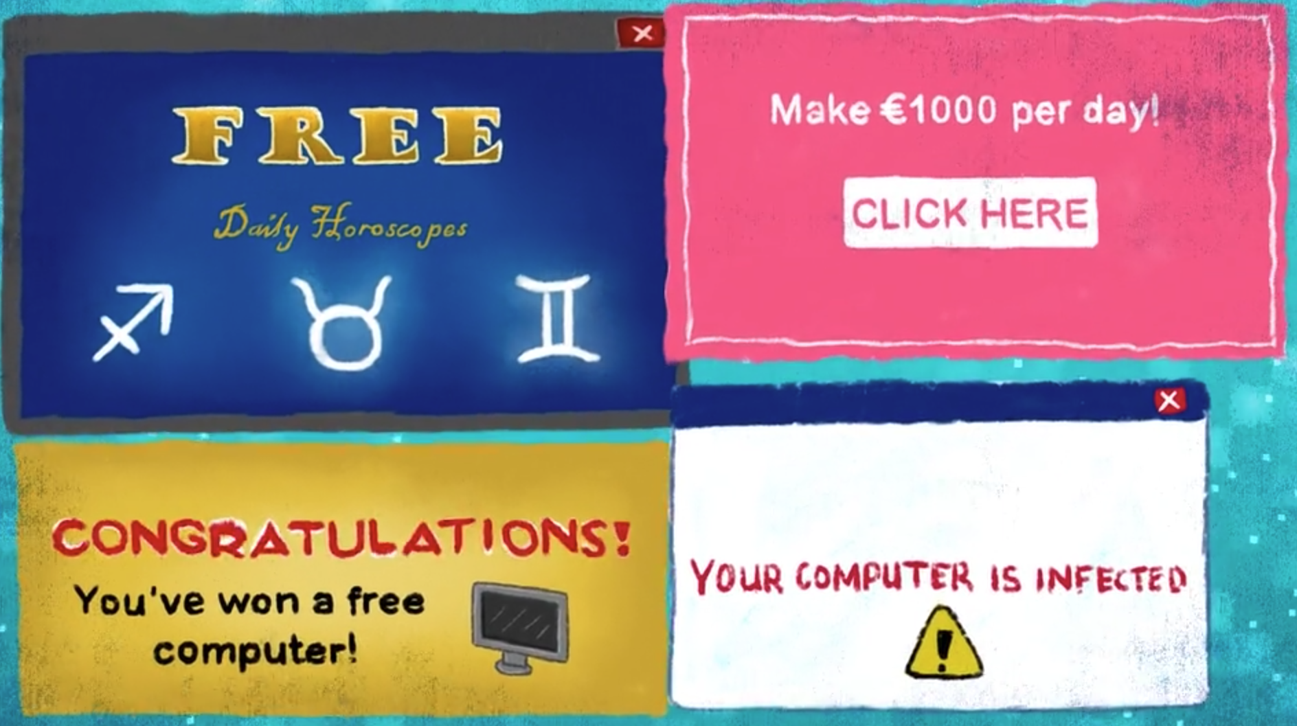
Tech in Our World
Examples of persuasive design
Pop Up: a small window that can
appear on your screen, even when you haven’t done anything. They are mainly used for advertisements, trying to get you to buy something or see something nasty and some of them try to put a virus on your device.
Have you come across this feature?
Do you like it? Why? Or Why not?
Notes:
Notes: Pop Up: a small window that can appear on your screen, even when you haven’t done anything. They are mainly used for advertisements, trying to get you to buy something or see something nasty and some of them try to put a virus on your device.
Have you come across this feature?
Do you like it? Why? Or Why not?

Slide 14

Tech in Our World
Examples of persuasive design
Streaks: a reward for doing something on an app over multiple days in a row.
Have you come across this feature?
Do you like it? Why Or Why not?
Notes:
Notes: Streaks: a reward for doing something on an app over multiple days in a row. For example, two people communicating to each other consistently over a number of days in a row.
Have you come across this feature?
Do you like it? Why Or Why not?

Slide 15

Tech in Our World
Examples of persuasive design
Loot boxes: a mystery bundle of items in a video game that a player can win as a reward or can buy with real money.
Have you come across this feature?
Do you like it? Why Or Why not?
Notes:
Notes: Loot boxes: a mystery bundle of items in a video game that a player can win as a reward or can buy with real money.
Have you come across this feature?
Do you like it? Why Or Why not?

Slide 16
Tech in Our World
Can you think of one positive and one downside to these features?
Notes:
Notes: Ask pupils to consider one positive and one downside to these features. Collate responses on the board.
Examples of positives include: notifications - let's me know when someone is trying to get in touch with me, loot boxes – a reward for playing well in a game, autoplay – can make it easier to enjoy watching a tv show, or find new shows/movies/music
Examples of downsides include: notifications – can feel urgent and make you feel like you have to open them straight away, streaks - it might make me feel pressure to keep opening a
game or app so that you don’t break the streak, loot boxes – it might make you feel pressured to spend real money to keep up with other people in the game, pop up – might make you feel like you have to buy something when it appears so you don't miss out on a good deal/bargain.

Slide 17

Switching Off
What activities do you like to do offline?
Notes:
Notes: Reflection: Ask pupils to brainstorm what are some fun offline activities that they like to do?

Slide 18
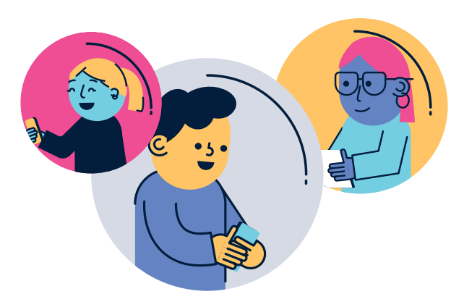
Tips for Striking the Balance
Follow the rules – check with parents about when it is okay to go online and when it is not.
Take regular breaks from your device.
Switch off – Don't forget about all the other fun activities offline.
Set a timer or use a screen time tracker/app to keep track of how much time you are spending online.
Make the most of your time online. It can be easy to lose track of time online, choose activities that you are interest in.
If you see something that bothers you online TELL a parent, guardian or trusted adult.
Notes:
Notes: Go through the following tips with pupils to help them manage their time better and strike a balance between online and offline activities.
Follow the rules – check with parents about when it is okay to go online and when it is not.
Take regular breaks from your device.
Switch off – Don't forget about all the other fun activities offline.
Set a timer or use a screen time tracker/app to keep track of how much time you are spending online.
Make the most of your time online. It can be easy to lose track of time online, choose activities that you are interest in.
If you see something that bothers you online TELL a parent, guardian or trusted adult.

Slide 19

Take Home Safer Internet Day Activity
Notes:
Notes: Distribute the Safer Internet Day take home activity sheet available at www.webwise.ie/saferinternetday
Pupils are to take this home and read through with their parents/guardians, agree on terms listed and sign.

Slide 20
Tech in Our World
On Safer Internet Day you have learned:
The role of technology plays in your daily life
Some examples of these technology features
Tips to make the most of our time online
Notes:
Notes: Recap with pupils what they have discussed and learned during today's talk. On Safer Internet Day you have learned:
The role of technology plays in your daily life.
Some examples of these technology features.
Tips to make the most of our time online.

Slide 21

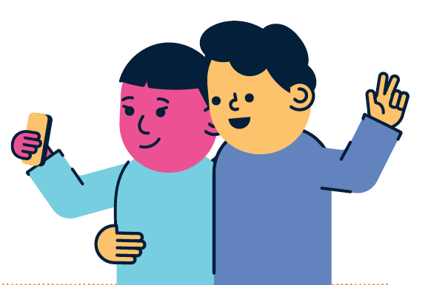
Safer Internet Day Selfie
Webwise love seeing all your photos from your online safety campaigns and Safer Internet Day activities.
Send in your photos, videos and posters to Webwise.
Notes:
Notes: Take a Safer Internet Day Assembly selfie and send it into Webwise on internetsafety@oide.ie or share you support on your school’s social media too using the hashtag #SaferInternetDay
Webwise love seeing all your photos from your online safety campaigns and Safer Internet Day activities. Send in your photos, videos and posters to Webwise and your school could be in with a chance of winning some great prizes.
There are lots of ideas and activities on the Safer Internet Day page: www.webwise.ie/saferinternetday
Register your school's Safer Internet Day events on the Webwise event’s map and receive free SID wristbands for your school. Register here: www.webwise.ie/saferinternetday
Share your SID activities
We love seeing all your photos from your online safety campaigns and Safer Internet Day activities. Connect with us on:
Twitter/X @Webwise_Ireland
Facebook: facebook.com/webwise_Ireland
Instagram: webwiseireland
Share ideas tips/plans using #SaferInternetDay
Share your internet safety messages on webwise.ie/saferinternetday

Slide 22
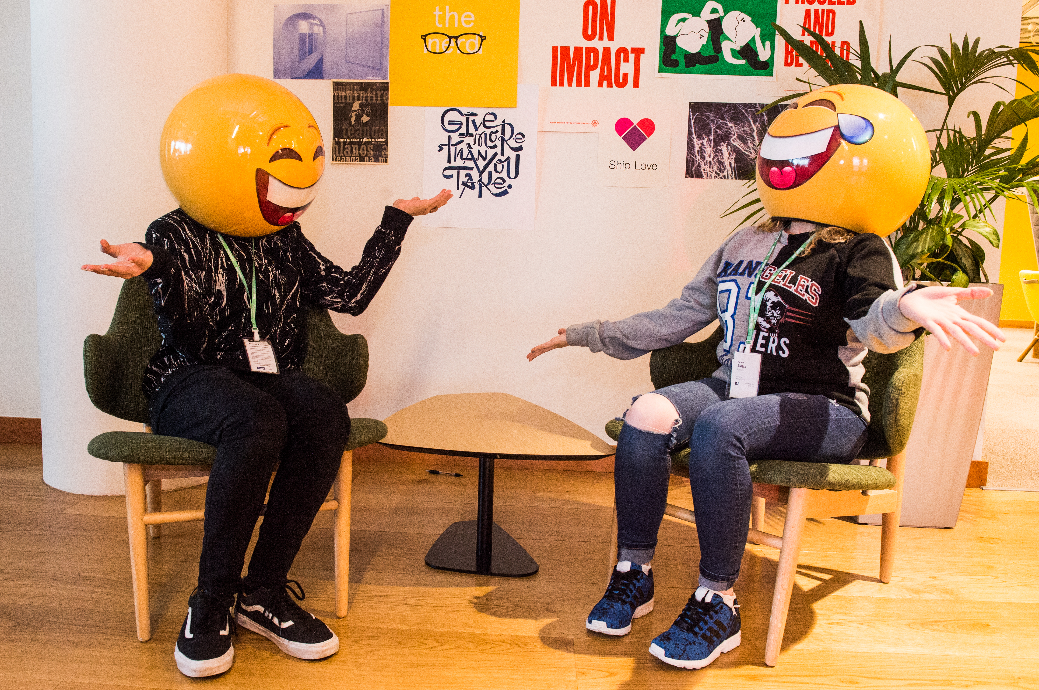

THANKS!
WANT TO FIND OUT MORE?
© Webwise_Ireland
This work is made available under the terms of the Creative Commons Attribution Share Alike 3.0 Licence http://creativecommons.org/licenses/by-sa/3.0/ie/. You may use and re-use this material (not including images and logos) free of charge in any format or medium, under the terms of the Creative Commons Attribution Share Alike Licence.
Notes:
Notes: Highlight the Webwise.ie/Parents Hub and resources to parents/guardians by disseminating copies of the Parents Guide to a Better Internet. You can access the book digitally or order hard copies via webwise.ie

Slide 23
SAFER INTERNET DAY
TECH IN OUR WORLD
Primary
Extension Activities
Notes:
Notes: These following supplementary extended Safer Internet Day slides are available for teachers to use to support the SID talk they will have just heard. These activities are to be completed in the classroom to continue the discussion on technology in our world with 5th and 6th class.

Slide 24
Tech in Our World
Key Points
Technology includes lots of brilliant smart devices that allow you to use the internet to do lots of things.
Technology companies design apps, games, social media in a way to persuade you to stay using it for longer.
Examples of this include features like autoplay, pop ups, streaks, loot boxes and notifications.
A healthy balance is important when it comes to time online.
Notes:
Notes: Today we already talked about technology and devices in our world. Here is a reminder of the key points we discussed:
Technology includes lots of brilliant smart devices that allow you to use the internet to do lots of things.
Technology companies design apps, games, social media in a way to persuade you to stay using it for longer.
Examples of this include features like autoplay, pop ups, streaks, loot boxes and notifications.
A healthy balance is important when it comes to time online.

Slide 25
Tech in Our World
Let's consider...
A lot of the technology we use nowadays is called "smart" but why is that?
They are called 'smart' because they work using something called Artificial Intelligence or A.I.
Notes:
Notes: Explain to pupils that a lot of the technology we use nowadays is called "smart" but what does that mean? It are called 'smart' is because it uses something called Artificial Intelligence or A.I. to work.

Slide 26

What is Artificial intelligence (A.I.)?
A.I. is when technology is able to gather information and put it together to perform a task in a human like way like make recommendations or solve problems.
Watch this video to find out more: https://www.youtube.com/watch?v=kQPC4_DsJ8I&t=17s
Notes:
Notes: A lot of the technology we use nowadays is called "smart" but what does that mean? It are called 'smart' is because it uses something called Artificial Intelligence or A.I. to work.
AI is when technology is able to gather information and put it together to perform a task in a human like way e.g. making recommendations. Watch this video to find out more about What is AI: https://www.youtube.com/watch?v=kQPC4_DsJ8I&t=17s

Slide 27
Examples of Artificial Intelligence include:
Digital assistants like Alex or Siri
Autoplay
TV Show/Movie Recommendations
Can you think of any other examples of artificial intelligence?
Notes:
Notes: Using think-pair-share ask pupils if they can think of any examples of artificial intelligence?
Suggested A.I. examples to go through with pupils include: many smartphones have a personal assistant, for example, that will do certain things for us like telling us what the weather will be like today or finding and starting up a piece of music we want to listen to. Other examples include when YouTube, Netflix recommend what you should watch next, translating a piece of text into another language for you, using Maps to find out what is the quickest route to your destination, Google search engine, a robot vacuum hoovering the floor by itself, facial recognition i.e. when a device is set to unlock by scanning your face.
After getting feedback from pupils and discussing how technology and the internet can help our lives, it’s important to explain to pupils that in order for a lot of these items, to work they collect information from us, for example, personal information when signing up, our location, searching history.
This means it’s important to check the settings of these items with a parent or guardian and make sure they are set to private and that they are not sharing too much information without realising it or knowing where it is going.

Slide 28
What do you think is one advantage and one disadvantage of A.I.?
Notes:
Notes: Ask pupils if they can think of one advantage and one disadvantage of A.I?
Example advantages include: AI can work out problems faster than humans, AI could solve complicated problems, AI can do simple tasks for us so we can spend more time on other things.
Example disadvantages include: AI is not as creative as humans, AI does not understand what it is saying and could give wrong information to an answer, AI might make the wrong assumptions about what people like or want. AI does not consider peoples emotions or feelings.

Slide 29
Create your own A.I. digital assistant.
Draw what they would look like.
Give your A.I. digital assistant a name.
Describe what tasks you would like them to be able to do to help you?
How would they help you in your daily life?
Notes:
Notes: Next, give pupils this task to help them consider the concept of AI further:
Create your own A.I. digital assistant.
Draw what they would look like.
Give your A.I. digital assistant a name.
Describe what tasks you would like them to be able to do to help you?
How would they help you in your daily life?

Slide 30
Reflection
The most surprising thing from this lesson was...
Action
One thing I will do now to have a balance of online and offline activity is...
Notes:
Notes: Ask pupils to reflect on the ideas that have discussed during the lesson. Display the following reflection prompts on the board and ask pupils to complete the sentences:
Reflection
The most surprising thing from this lesson was...
Action
One thing I will do now to have a balance of online and offline activity is...

