Slide 1
Dimensions of Health and Wellbeing

Slide 2
What are the dimensions?
Worrying and Anxiety
Mood
Sleep
Relationships
Loss and Grief
Sensory Responses
Education, Training or Work
Addictions
Eating
Supportive Environments

Slide 3
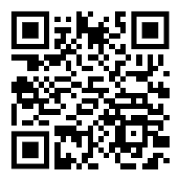
About Dimensions of Health and Wellbeing
Dimensions of Health and Wellbeing
The Dimensions of Health and Wellbeing is a free online tool providing self-care information to support adults, children and young people in Coventry and Warwickshire.
You can rate yourself or another person against a number of dimensions related to health and wellbeing.
The Dimensions tool is available 24/7 and creates a Dimensions report which provides information about self-care, local services and support.
https://dimensions.covwarkpt.nhs.uk/

Slide 4
Video
Notes:
https://www.youtube.com/embed/VtGnQnOfb7o

Slide 5
Webpage

Slide 7
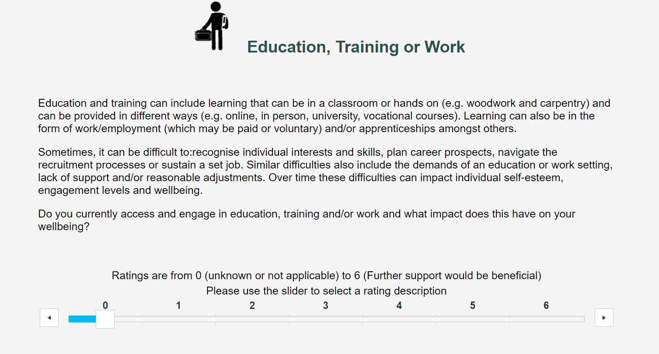
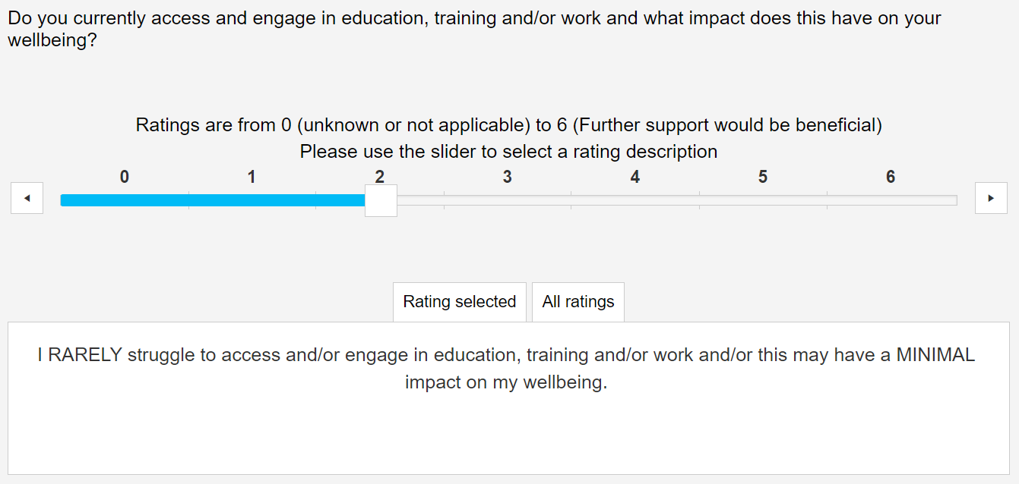
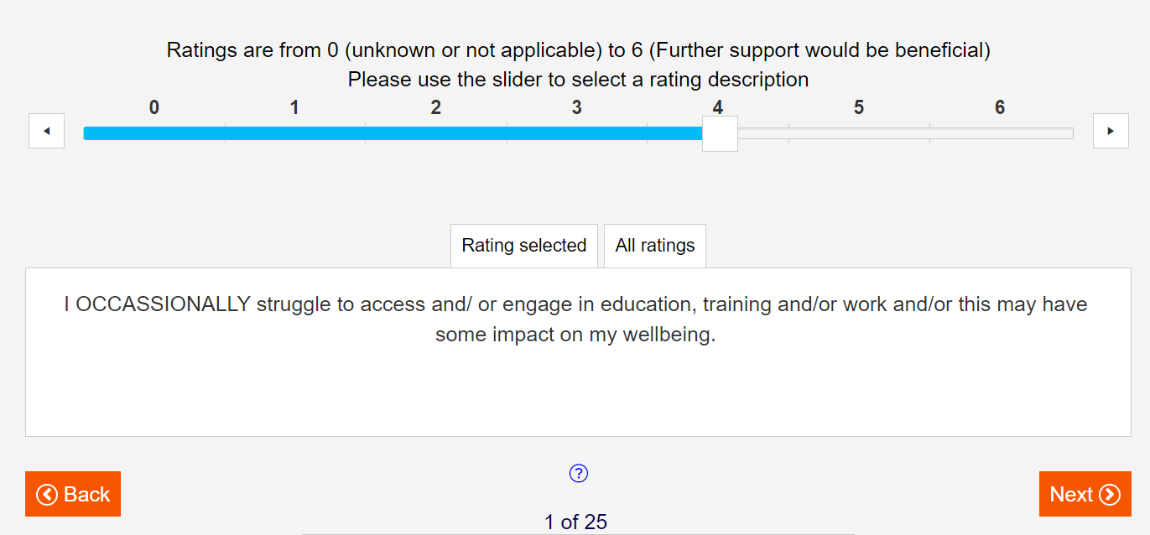

Slide 8
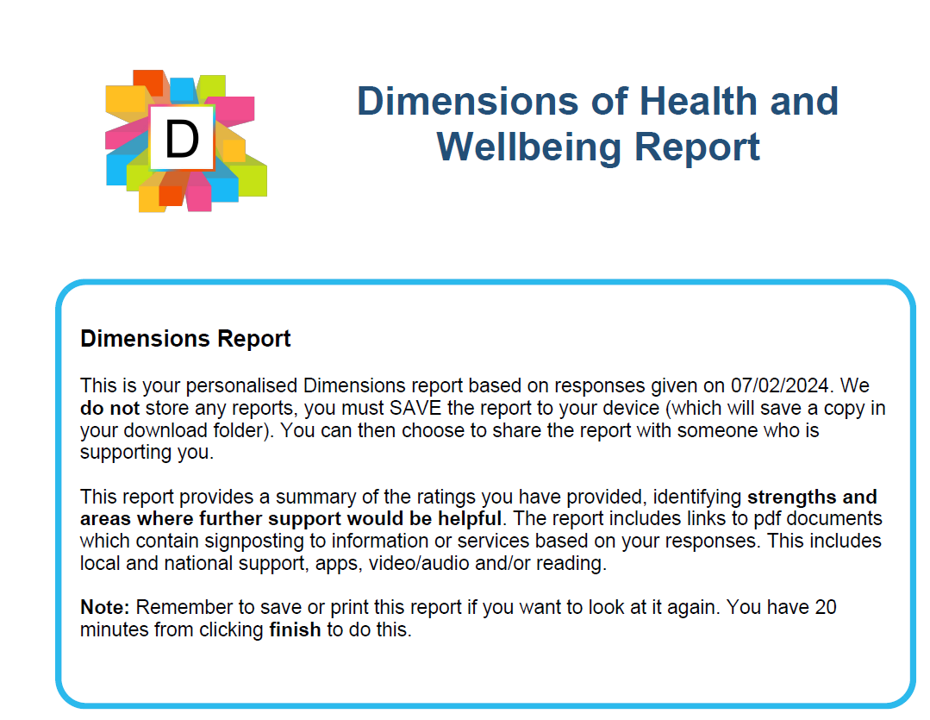
Report will relate to all 10 dimensions

Slide 9
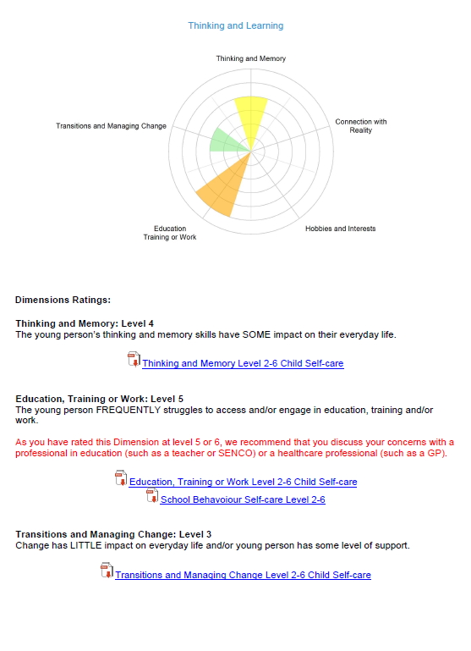
What can you do with the Report?

