Slide 1

Parent Forum
Stratford upon Avon Primary School
3rd October 2025

Slide 2
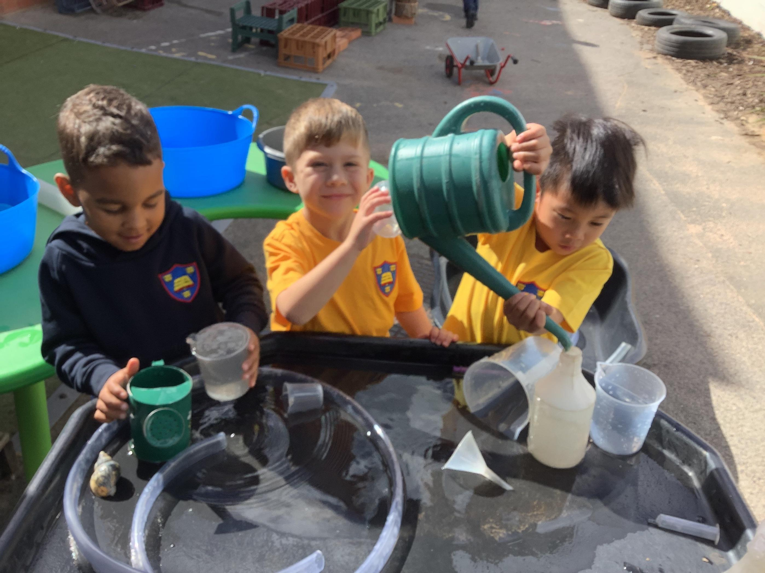
Agenda
Item 1: Welcome and introductions
Item 2: Our vision
Item 3: Our values
Item 4: Our curriculum
Item 5: Questions answered
Item 6: Any other business and ideas for next forum.

Slide 3
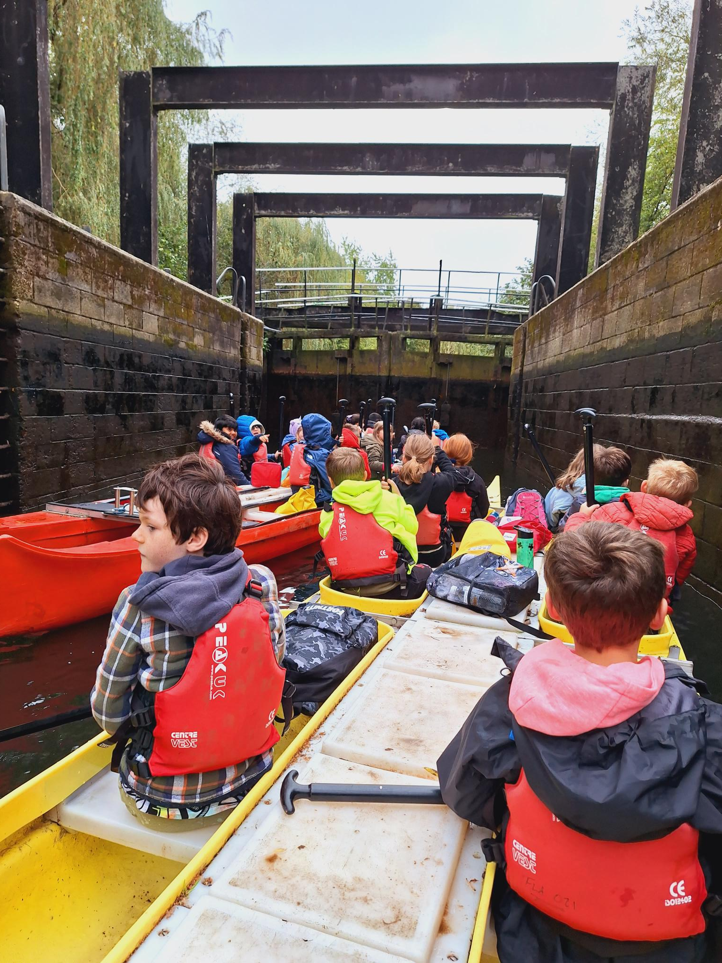
Our vision
‘To create a happy place, where children and adults learn and flourish in a creative, rewarding atmosphere and are given as many opportunities and experiences to increase their life chances and careers.’

Slide 4
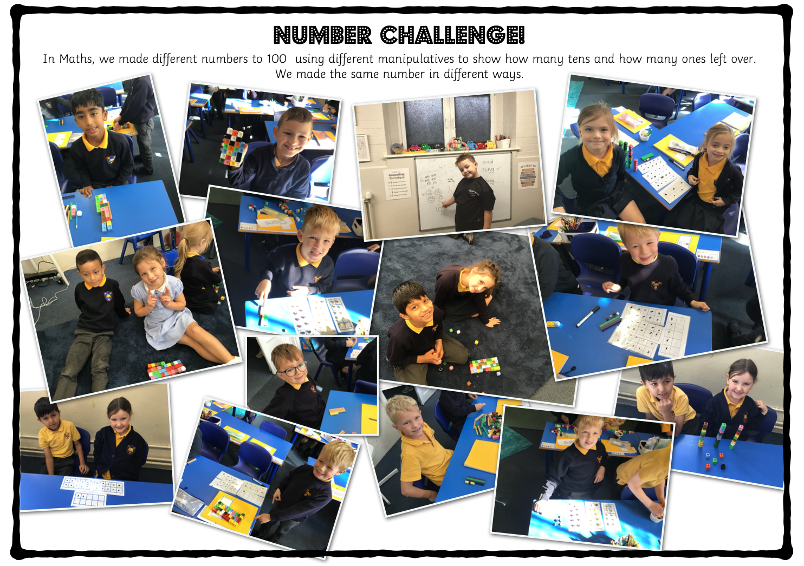
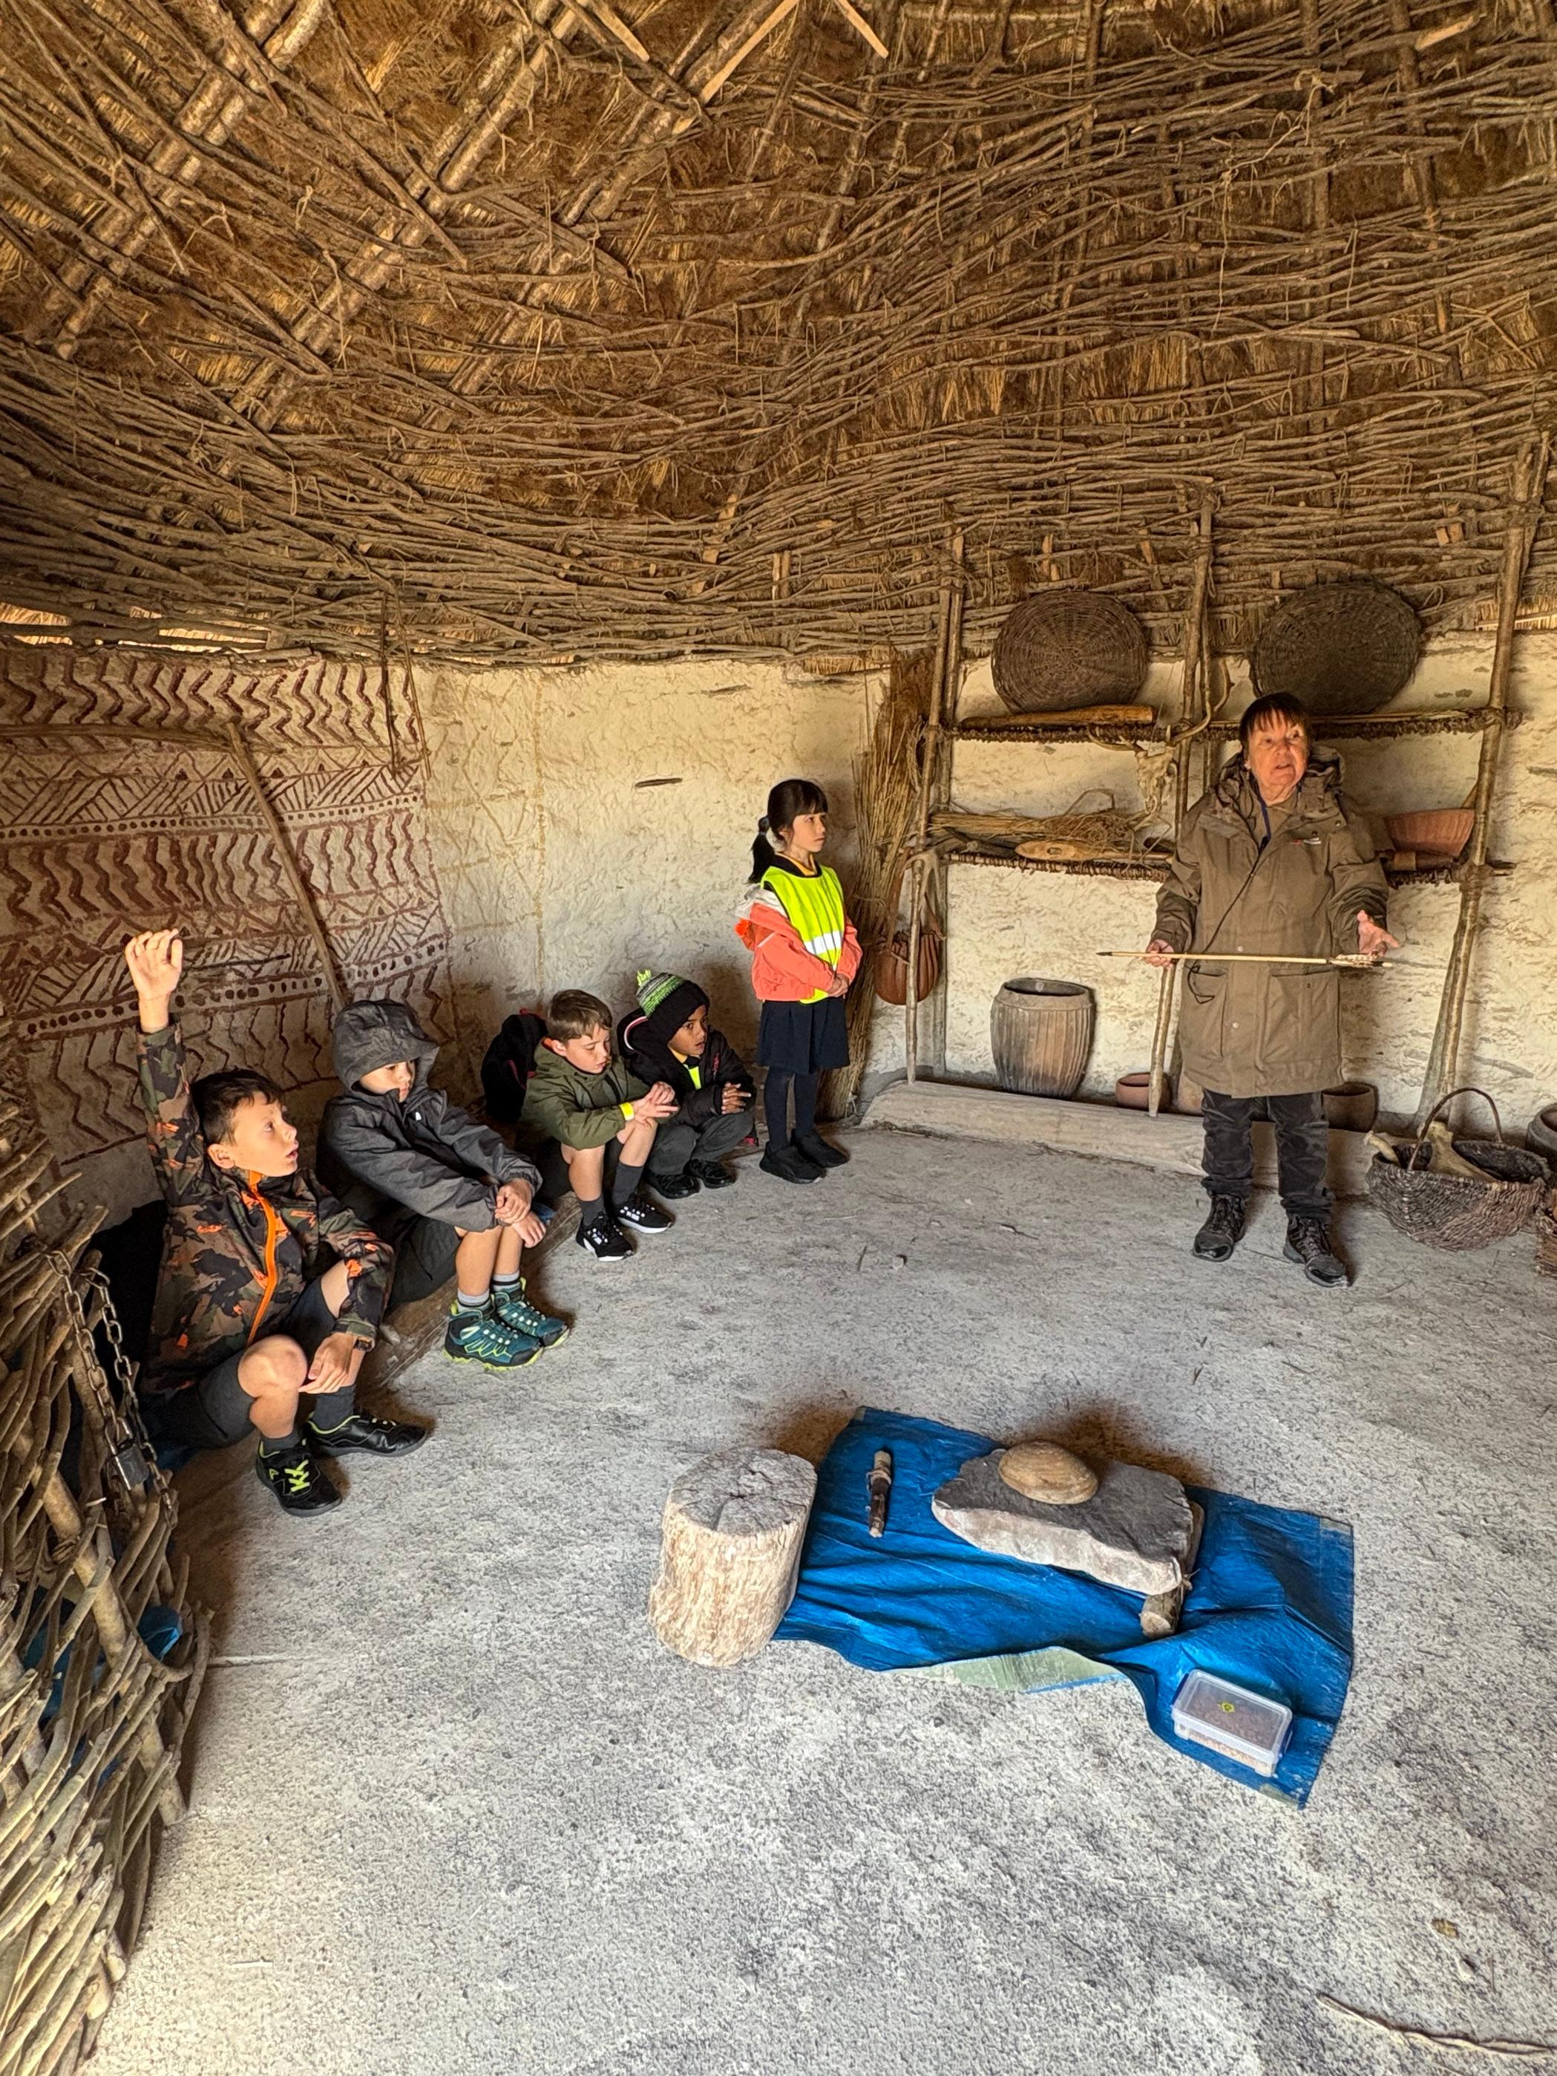
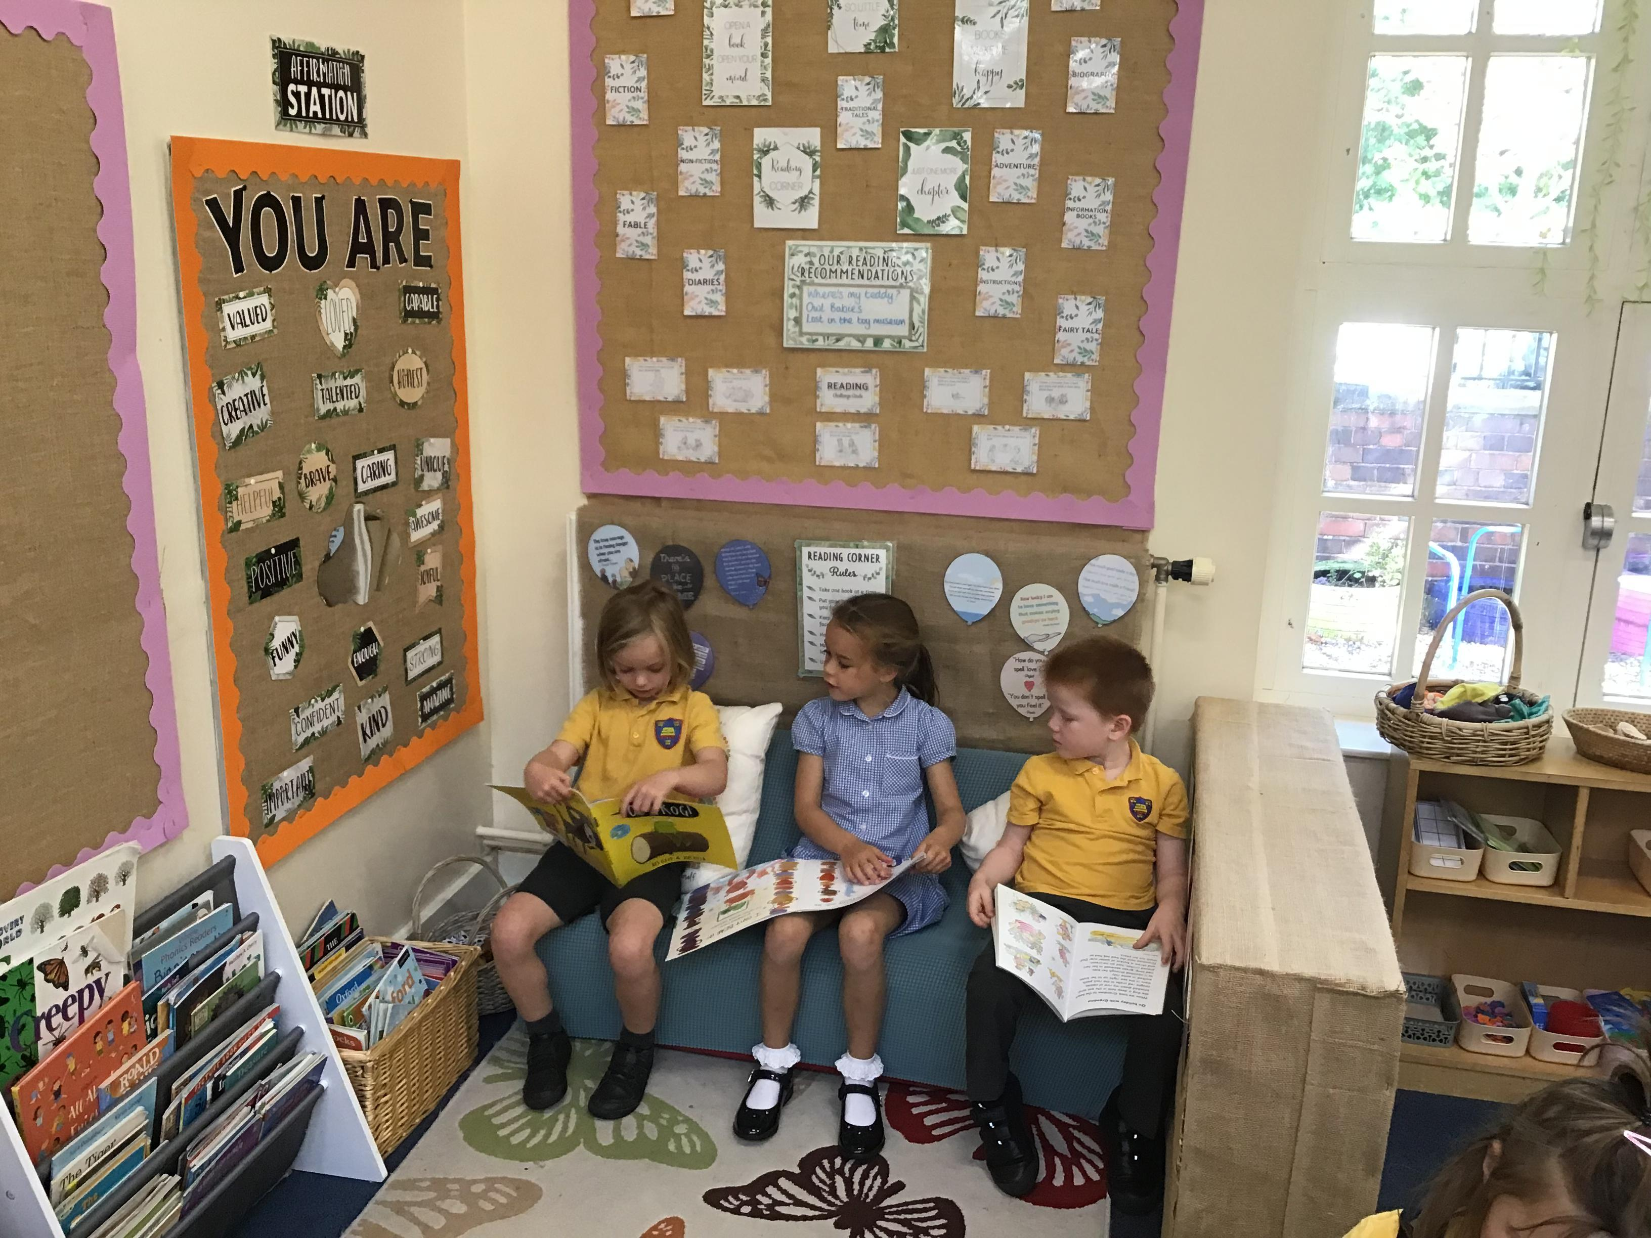
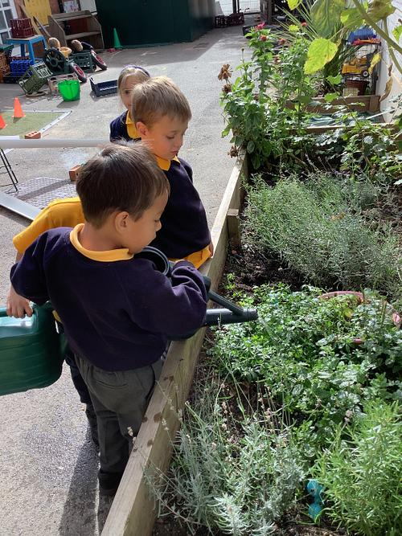
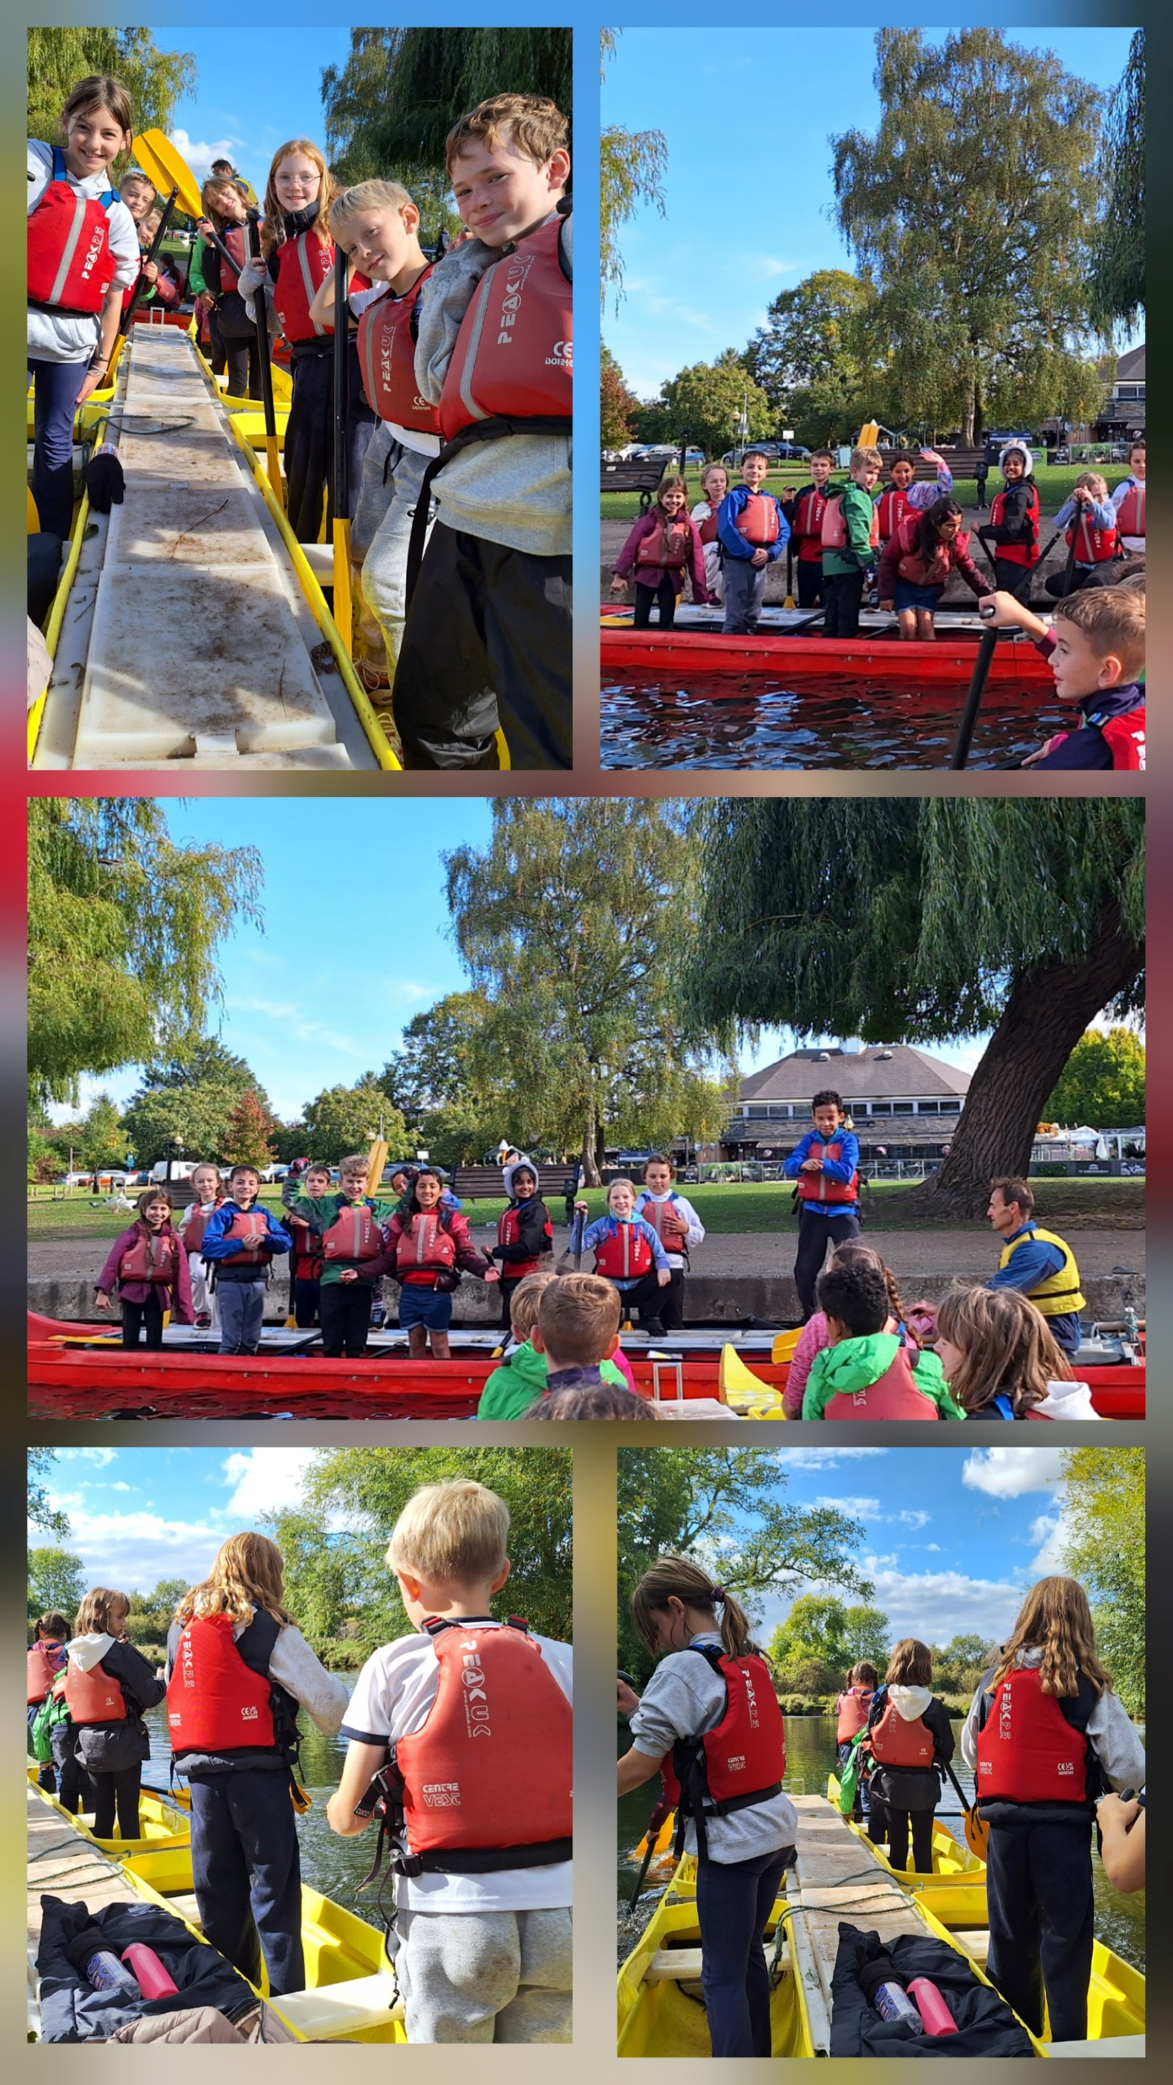
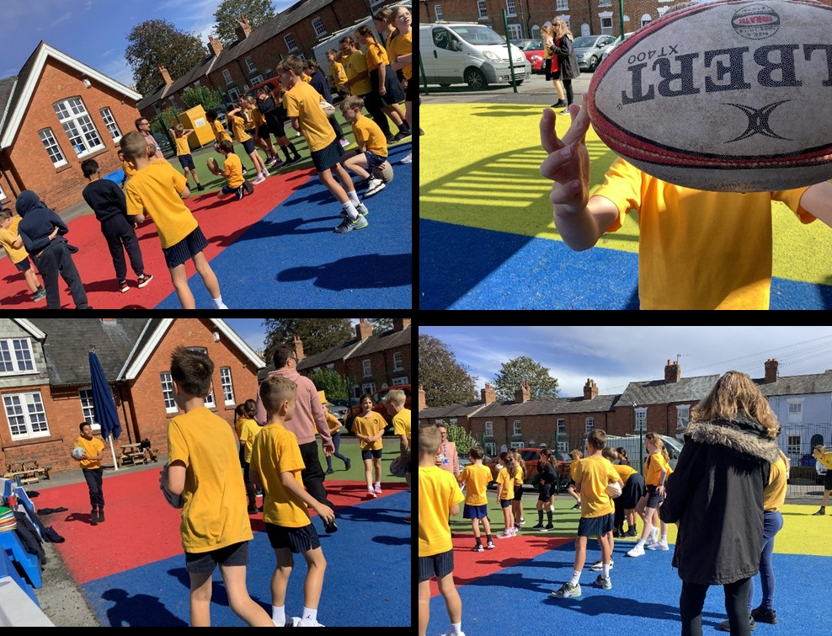
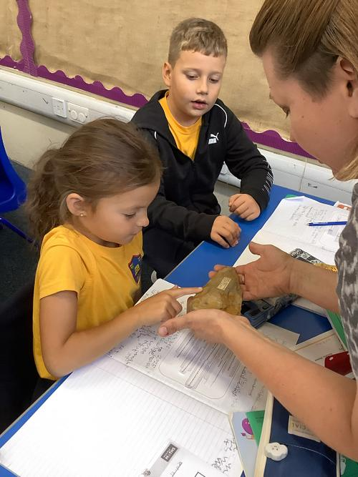
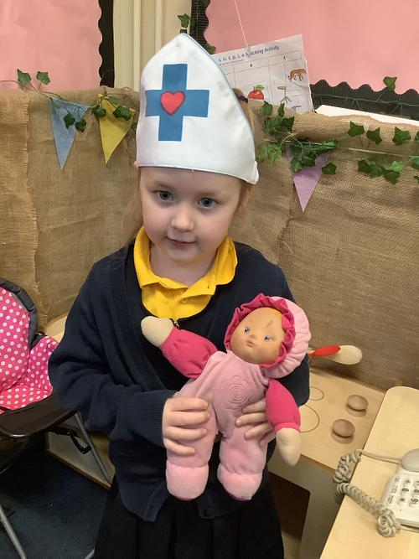
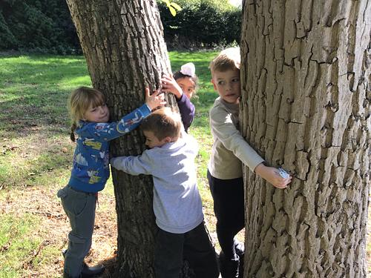

Slide 6
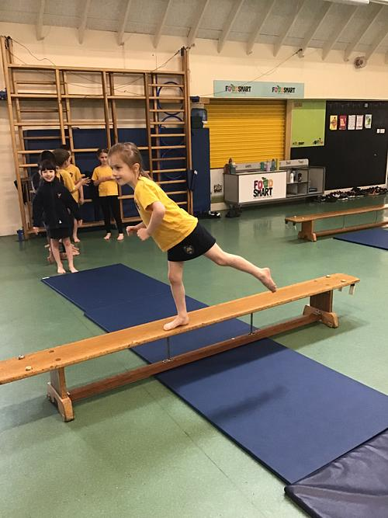
Our values
Respect
Responsibility
Resilience

Slide 7

Our curriculum – 14 subjects

Slide 9
Questions
As a parent I am conscious that we live in a world that exposes people to the concept of instant gratification, effortless performance and the idea that success is achieved first time round. Children are probably especially influenced by this false idea either via TikTok or even the BBC sport website which showcases the best goals or the best tennis shots. They don’t show you the misses or the hours and hours spent practising.
How can the school help to redefine failure as an opportunity and not a threat which ultimately encourages responsible risk taking and the idea that you can fail? How do we make young people understand authentic success happens through failure and through learning this allows you to achieve your potential.
All great inventions were riddled with failure and setback but people looked to understand why and accept feedback to achieve ultimate success.

Slide 10

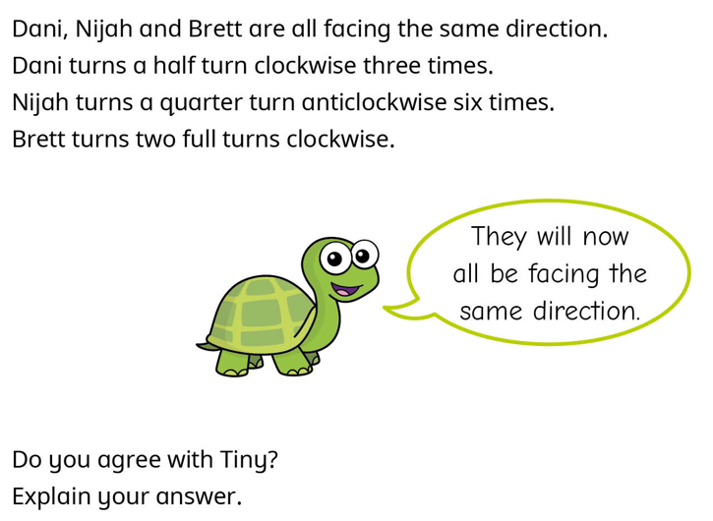

Failure is part of life
Giving children the opportunity to fail
Exploring mistakes and learning how to fix them – Tiny in Mathematics
Evaluation
Teachers often make mistakes
STEM activities

Slide 11
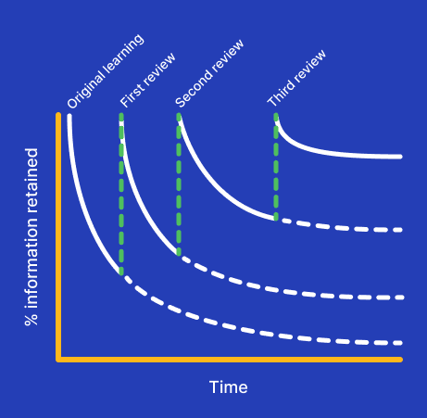
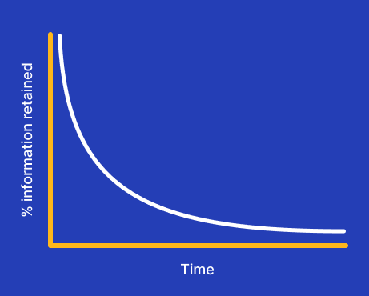
Spaced learning
Forgetting curve

Slide 12
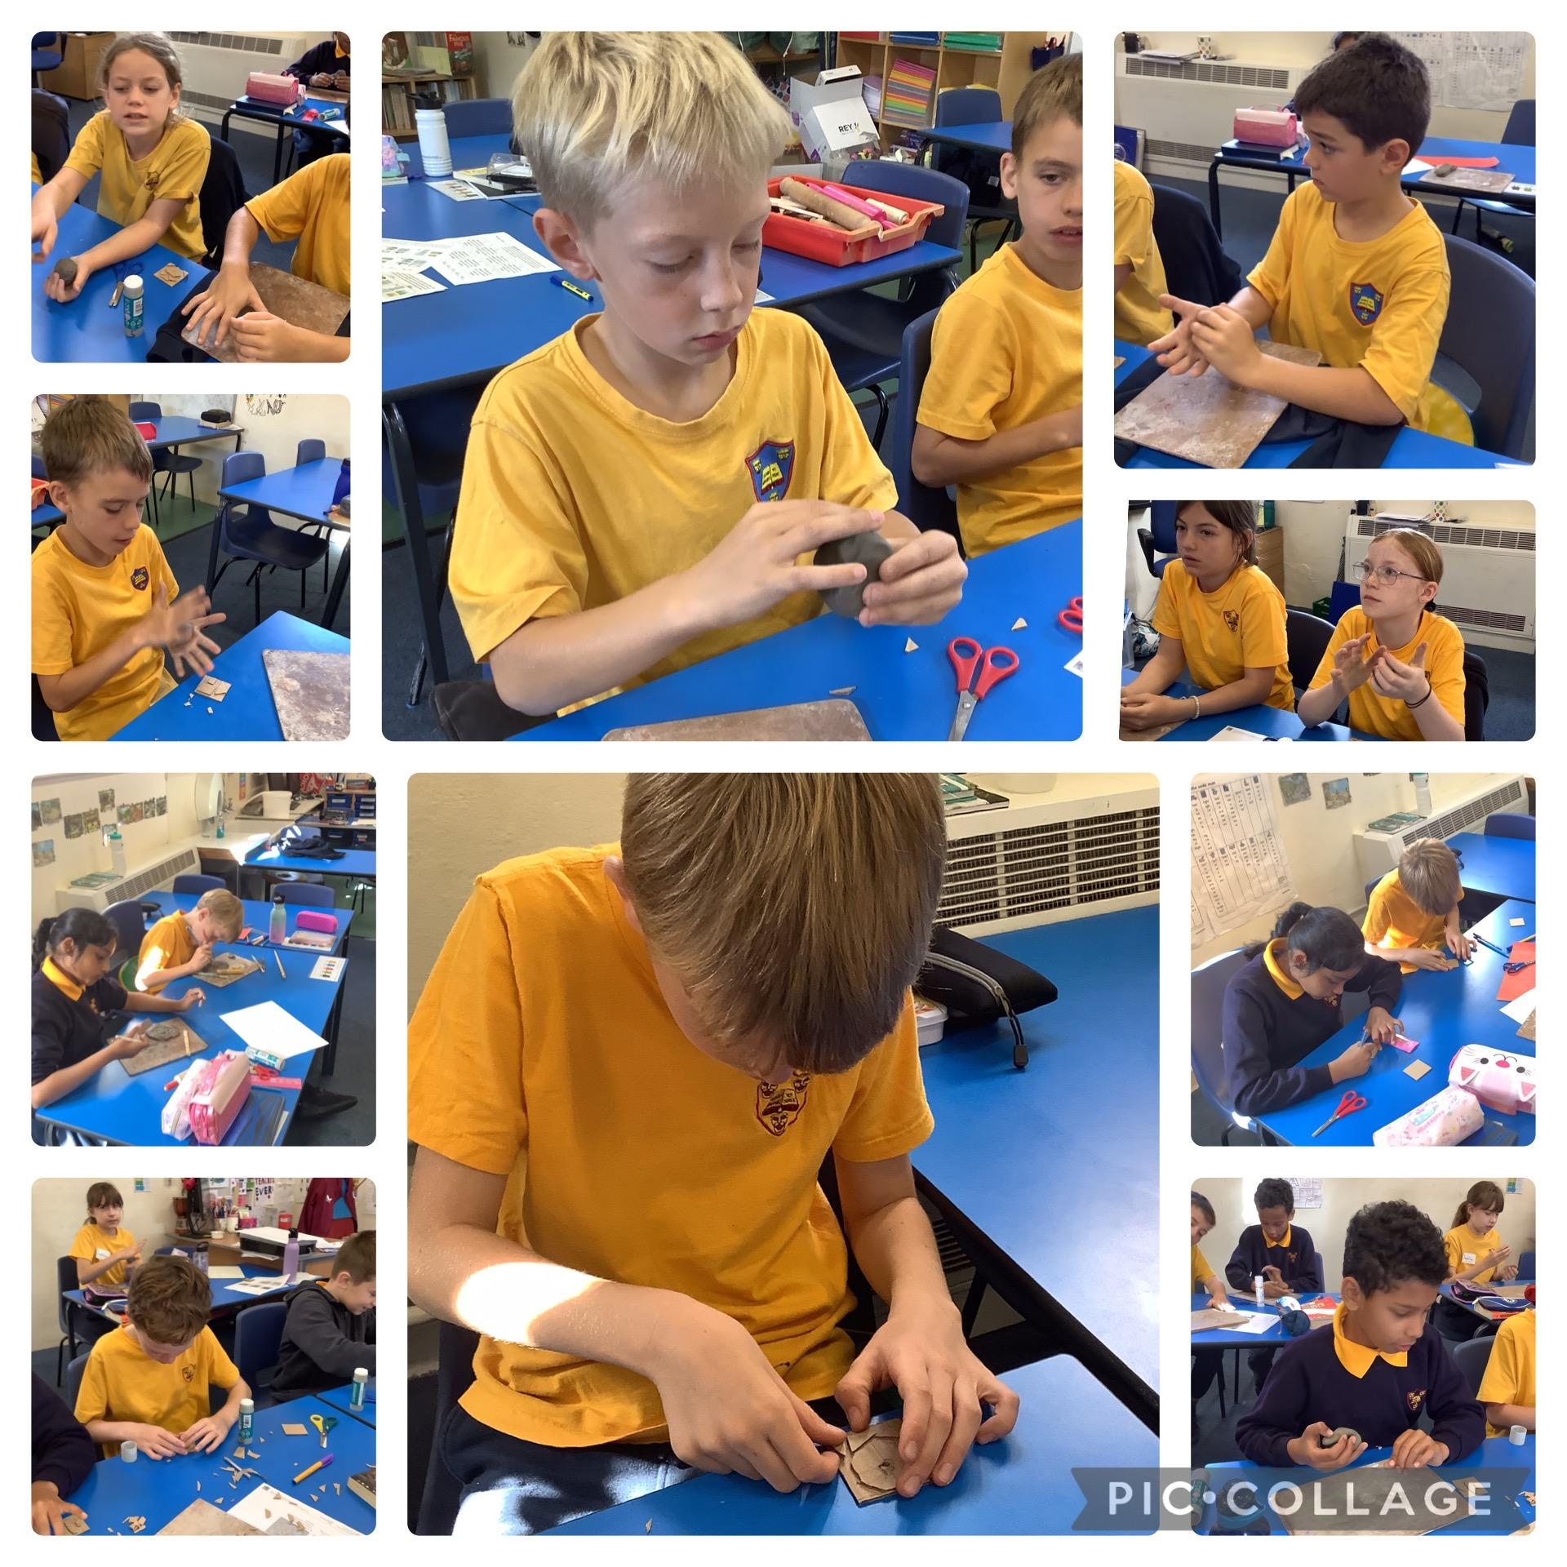
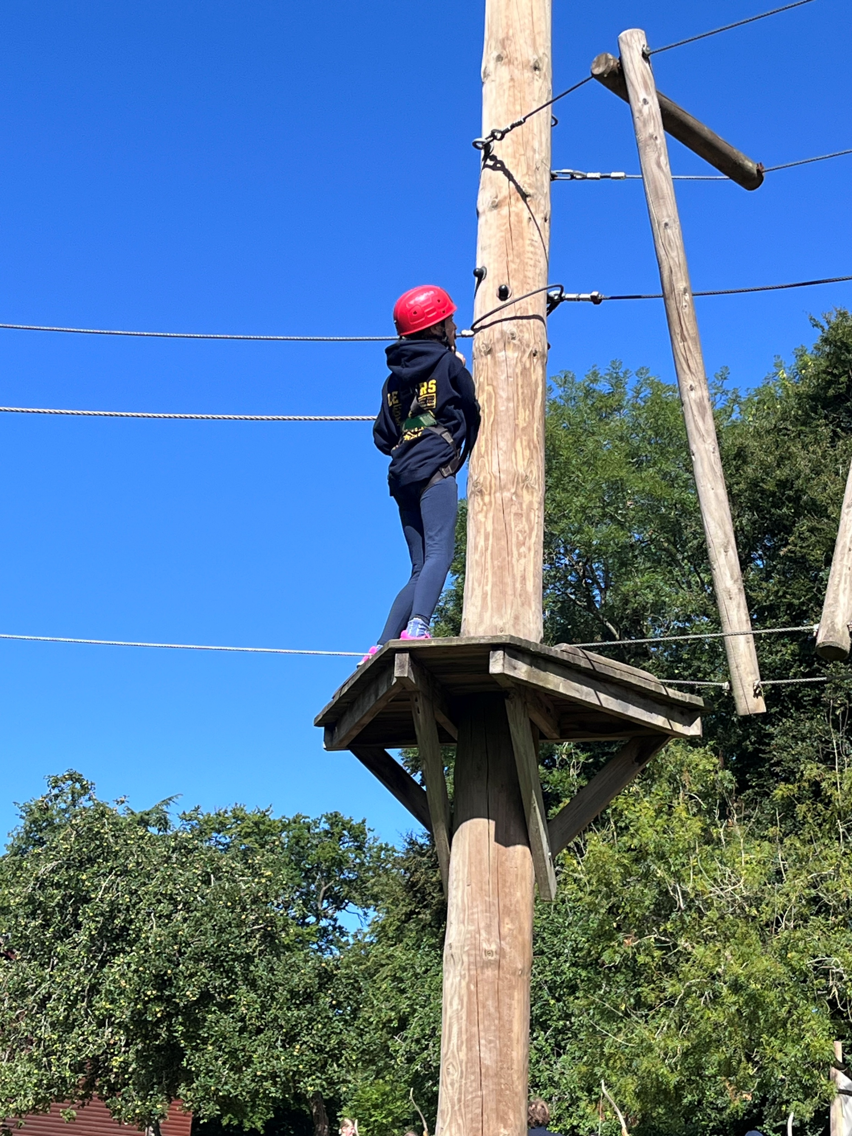
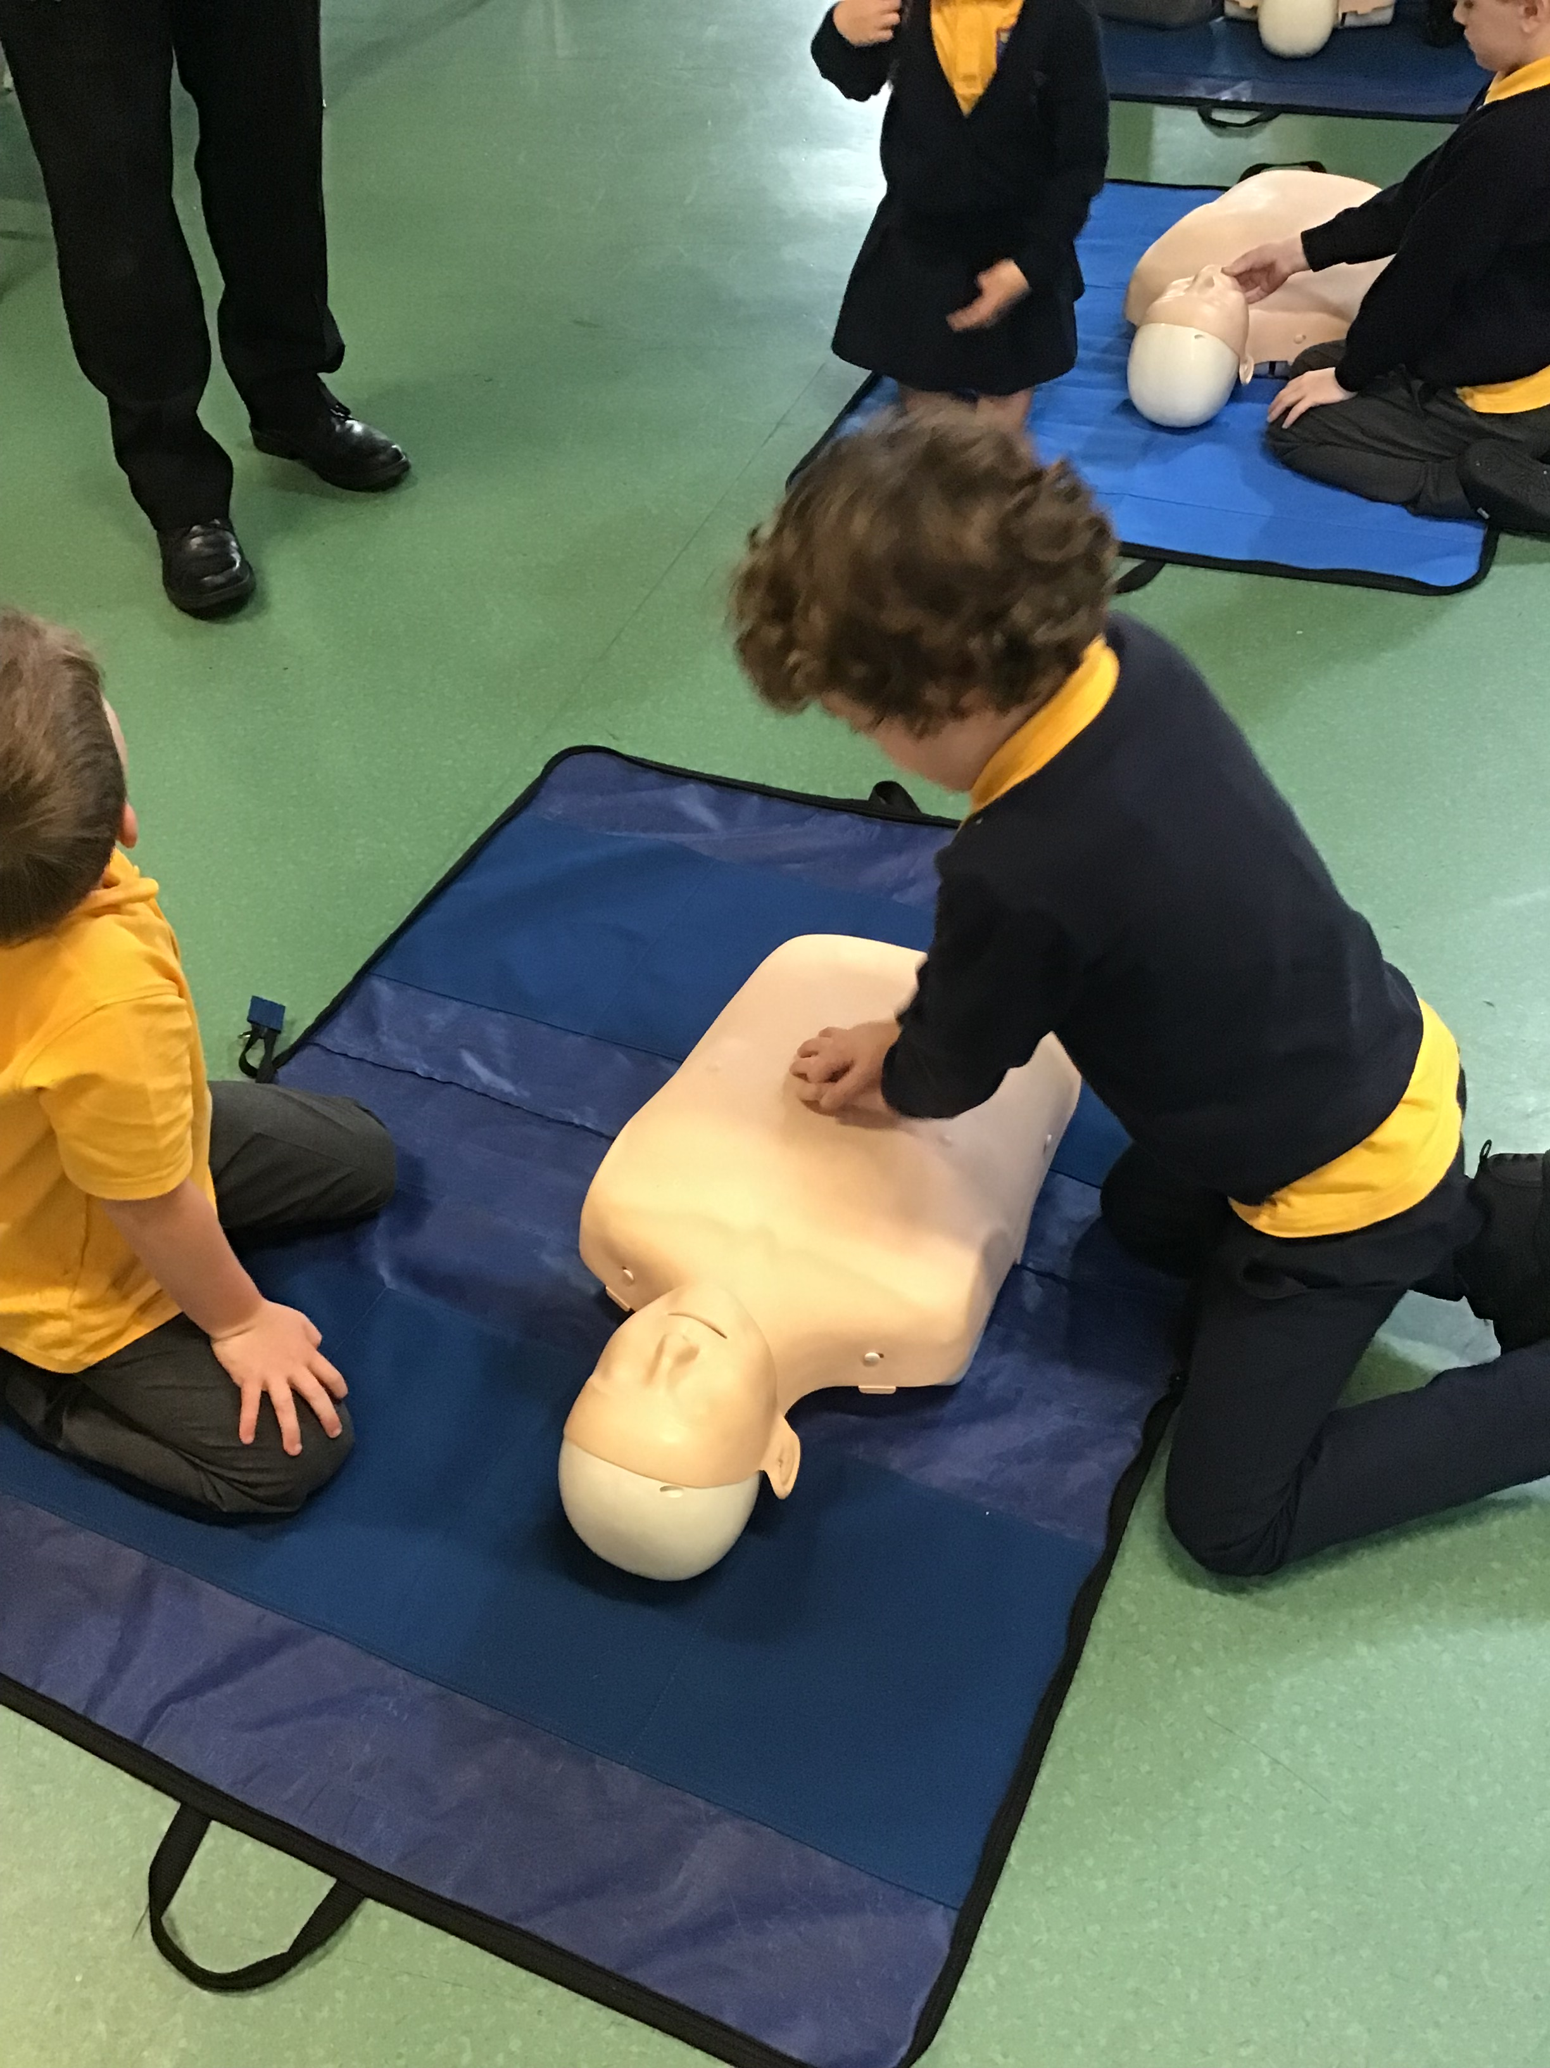
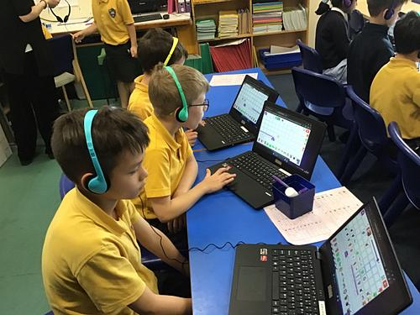
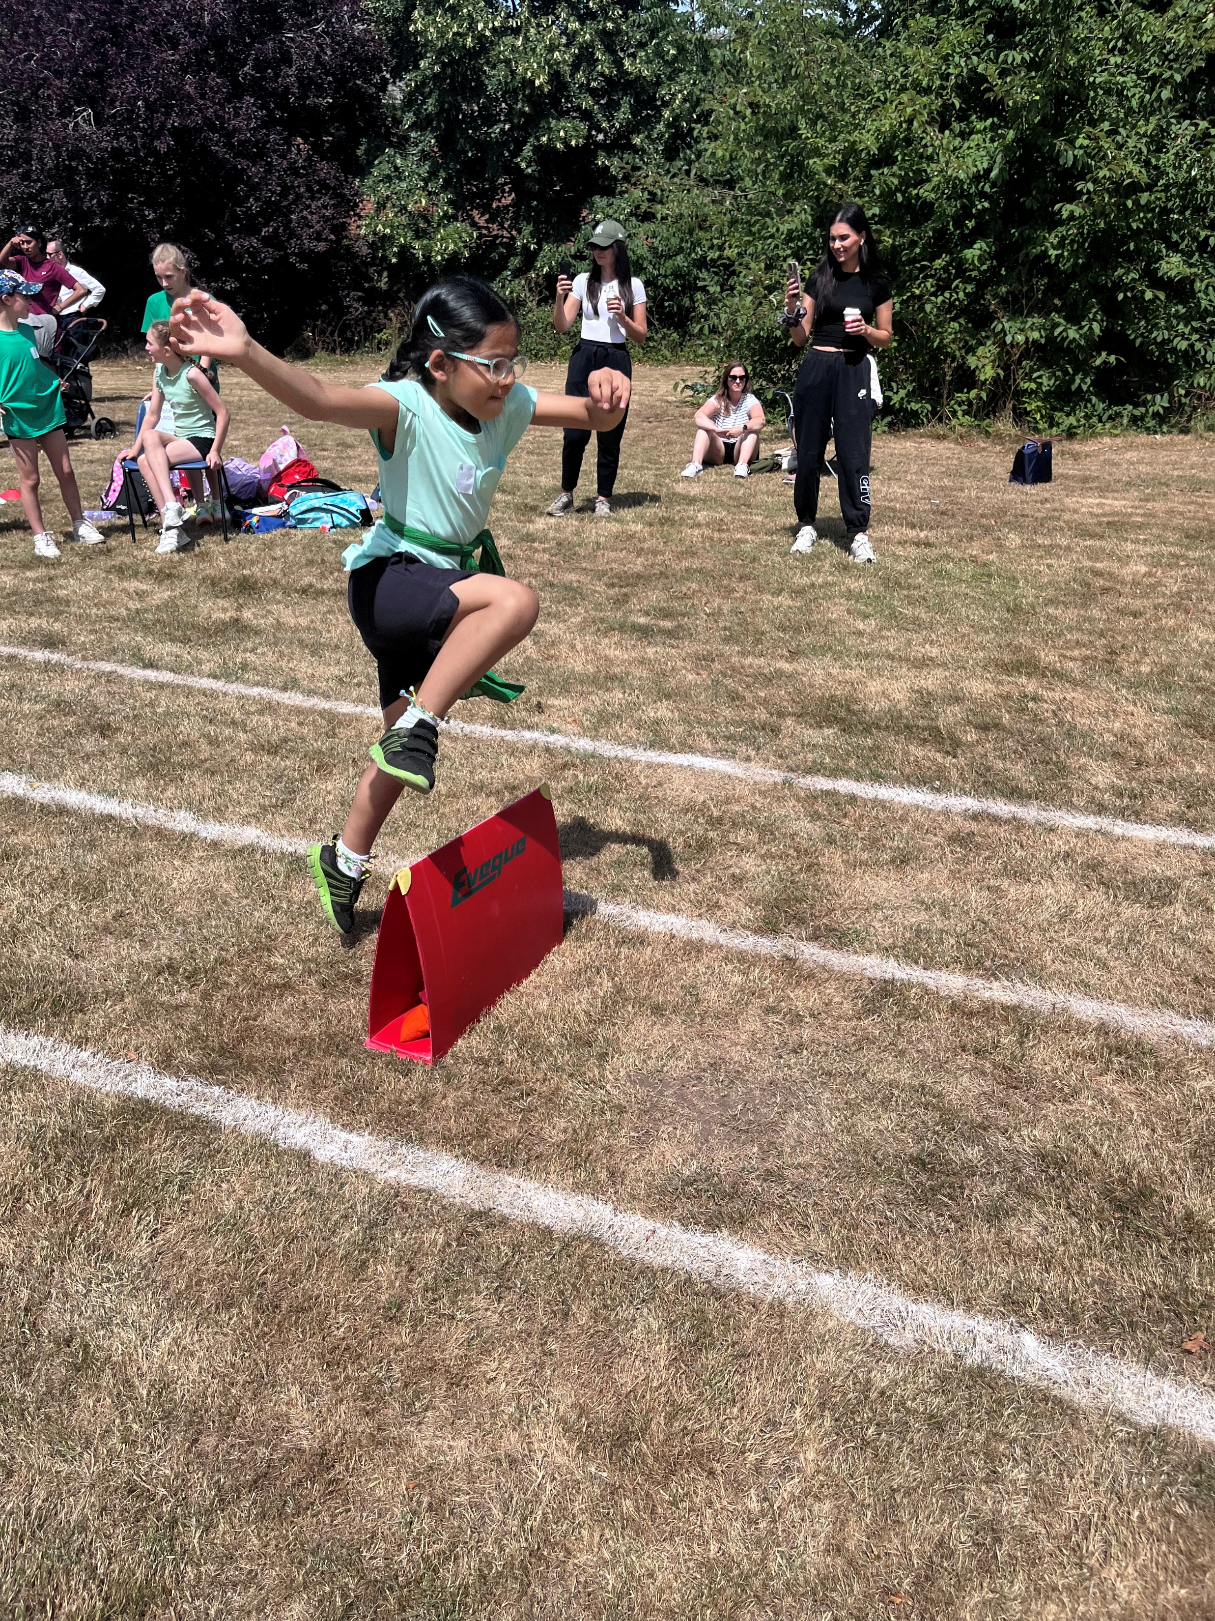
Make it meaningful

Slide 13
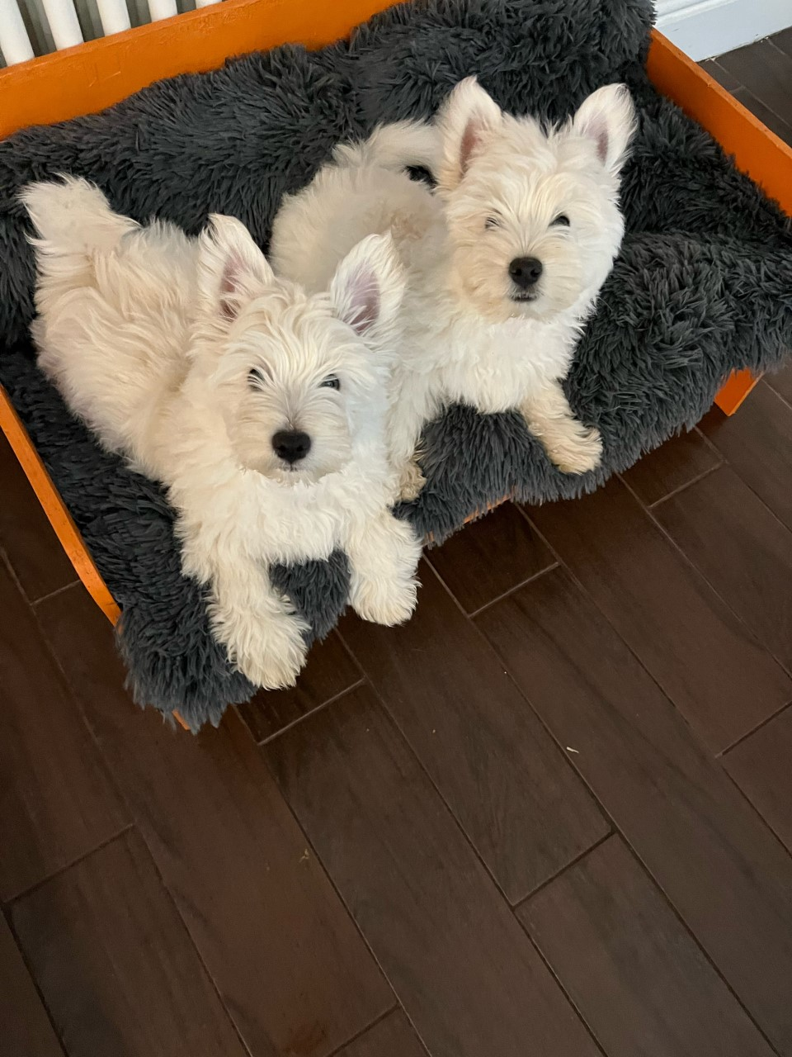
What would you like to know for the next forum?

