Slide 1
Remembrance
Notes:
To have displayed as pupils enter the hall. Perhaps have some WW1 music playing as they enter, e.g. ‘Keep the home fires burning’ or Ode to Death

Slide 2
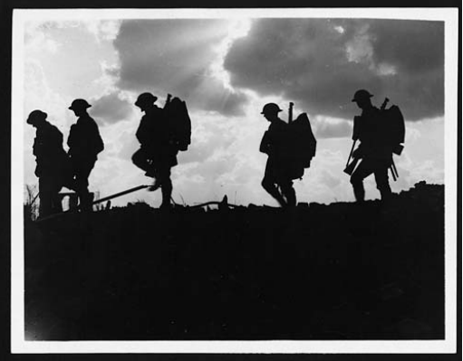
World War One
Notes:
In 1914 World War One began.
It was called The Great War and lasted more than four years, involving over thirty countries.
Over 16 million people lost their lives. It was then followed by another tragic world war in 1939.
That is why, every year, we stop, think, and pay respect to all those who lost their lives to war.
(311) C.2494 - Troops moving up at eventide - men of a Yorkshire regiment on the march Permanent URL: https://digital.nls.uk/74546492

Slide 3
11th November 1918
Notes:
Ask pupils if they know why this date is important?
At 11am on 11th November 1918, the guns fell silent. We remember this with a two minute silence at 11am on the 11th November every year
This year is particularly special because it is 100 years since World War One ended.

Slide 4
We will remember them
Notes:
It is important that we remember and pay respect to those who have worked hard and even died so that we could live a life of freedom.
Children have might have seen some people wearing poppies. Explain that this is a symbol of Remembrance and hope for a peaceful future, and when we wear a poppy we are acknowledging the service and sacrifice of the Armed Forces and their families.
Link with British values: individual liberty

Slide 5
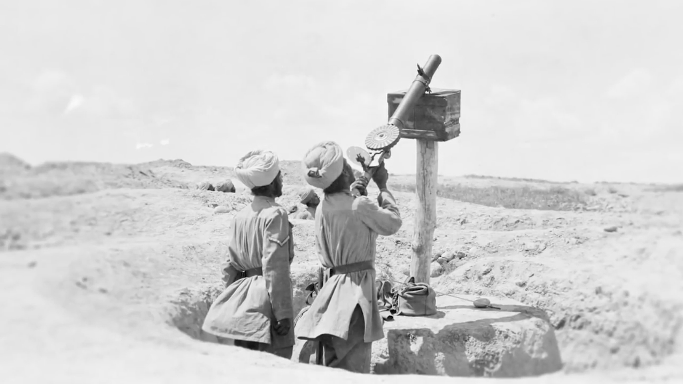
Thank You
Notes:
To mark 100 years since the end of the First World War, The Royal British Legion is leading a national movement to say ‘Thank You’ to the entire generation who lived through the war.

Slide 6
Saying Thank You
Our lives today would be very different if it wasn’t for the people who lived through the First World War.
We remember:

Slide 7

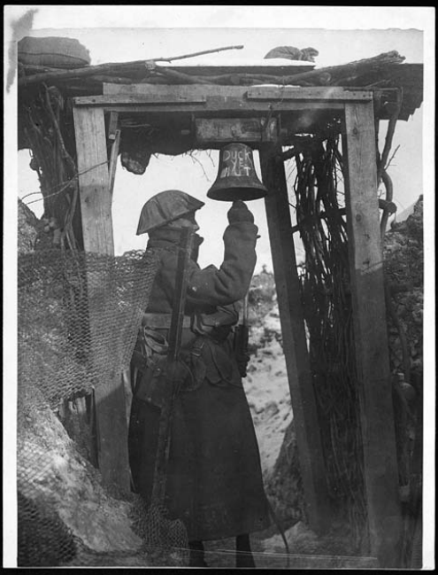
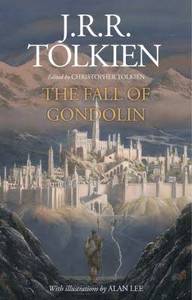

The artists who shared their stories, poems and music all influenced by the events of the war
Notes:
(68) C.1230 - Gas alarm in the front line Permanent URL: https://digital.nls.uk/74546428

Slide 8
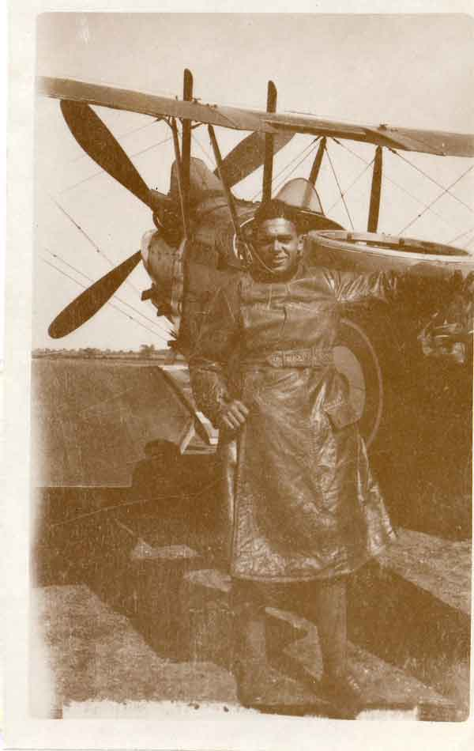
The Commonwealth who answered the call with volunteers from far and wide including pre-partition India, the Caribbean and Africa
Notes:
William “Robbie” Clarke. Source: RAF museum

Slide 9
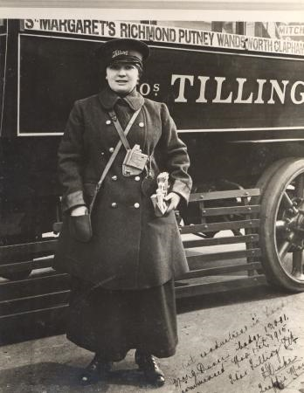
The women who went to work, many for the first time, to keep the country running while the men were fighting

Slide 10
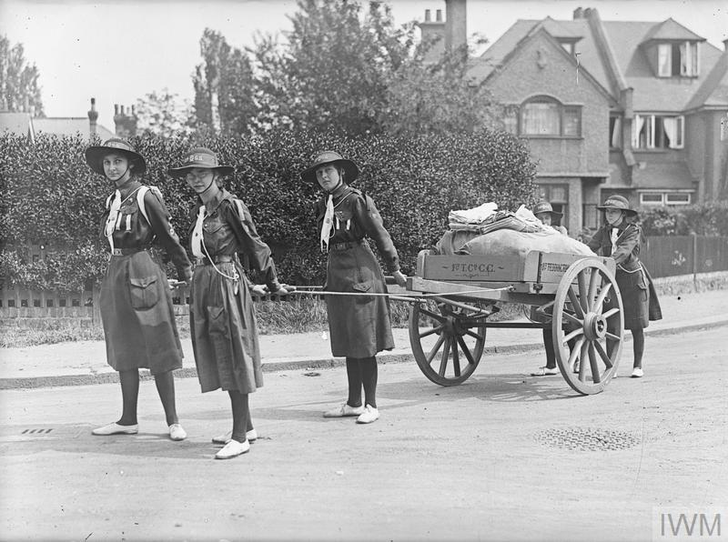
The children who volunteered, gave up their pocket money and grew vegetables to ‘do their bit’ for the war effort

Slide 11
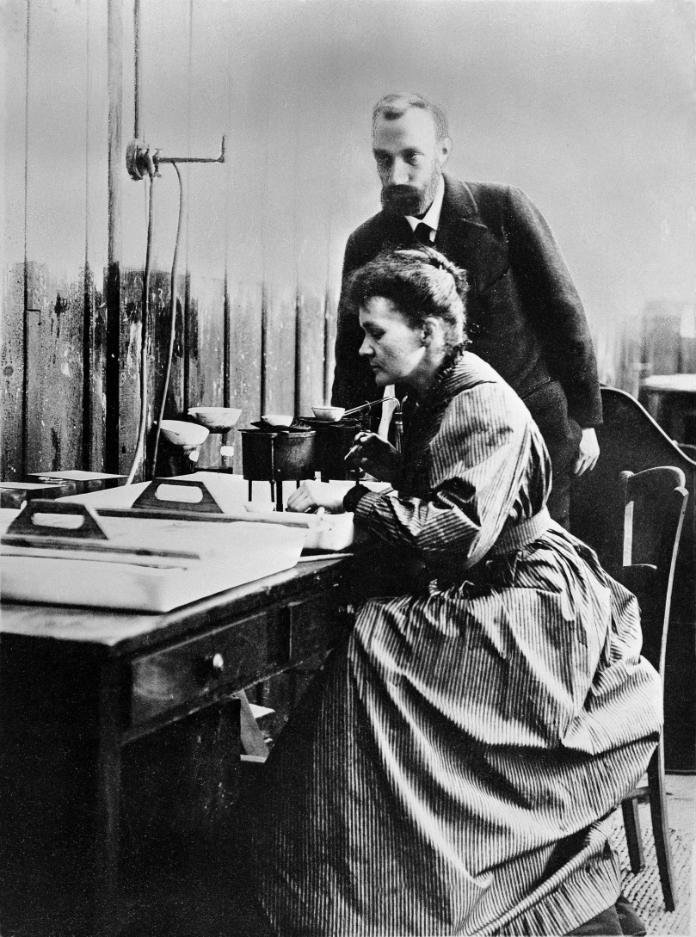
The pioneers who used their skills to invent stainless steel, mobile x-rays and blood banks which we still use today
Notes:
Image: National Library of Scotland

Slide 12
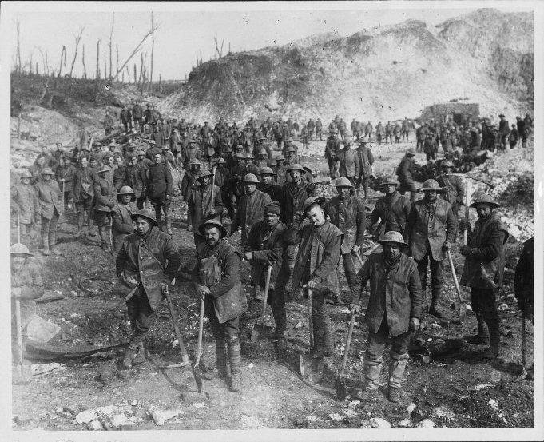
The Armed Forces who, despite returning home to a lack of housing and a poor economy, showed the same resolve in peace as in war and helped to rebuild Britain
Notes:
Image: National Library of Scotland

Slide 13
Thank You
We are grateful to them and to everyone who contributed to the war effort.
This week we will be finding out about some of these people and how our lives are different today because of the work they did.
We will write Thank You letters to them as our own personal act of remembrance.
Notes:
Ask pupils who they would most like to say thank you to for their contribution to the war effort.

Slide 14

Ways to say Thank You
Notes:
Ask students to think about how they will say thank you to the person they have chosen.

Slide 15

World War One 1914 - 1918
Notes:
However they choose to say thank you – an idea from the film, wearing a poppy, attending a remembrance service – ask the students to keep in mind a person they particularly want to thank. (If time, you could play a video focusing on the arts, Commonwealth, women, children, pioneers or the armed forces.)
We will now observe a one minute silence to remember and say thank you to all the people who contributed to the First World War.

Slide 16
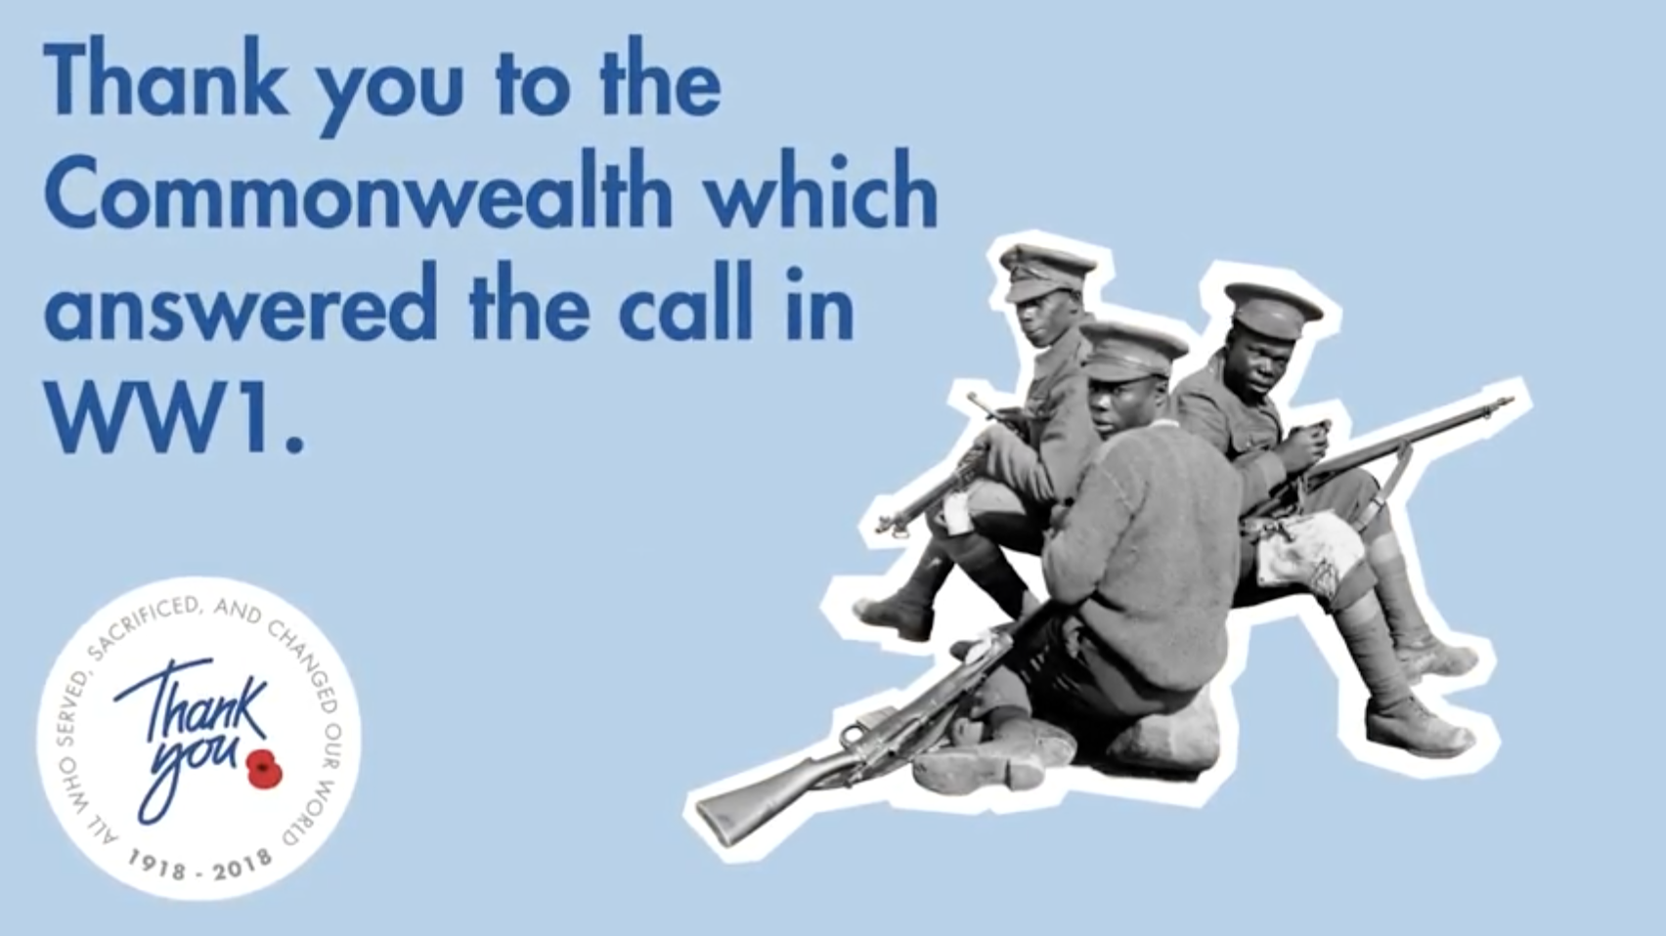
Commonwealth

Slide 17
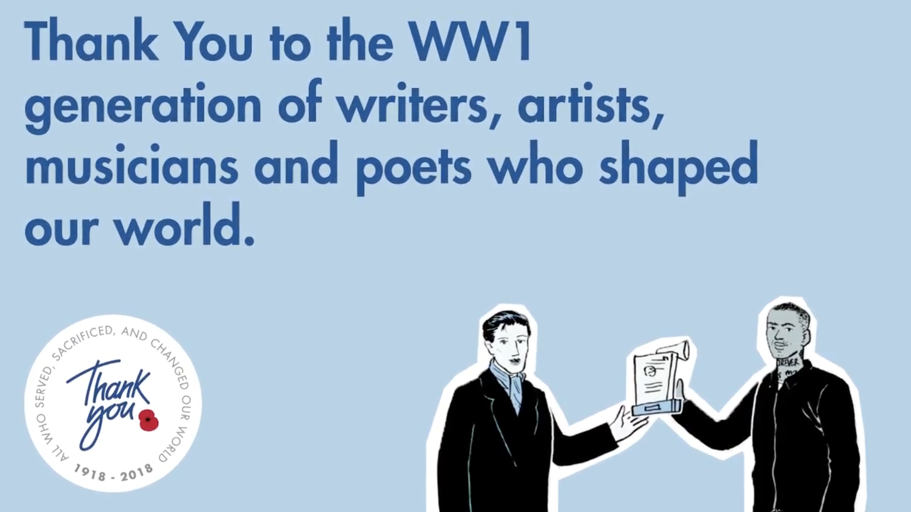
Arts and Culture
Notes:
The Arts

Slide 18

Women
Notes:
Women

Slide 19
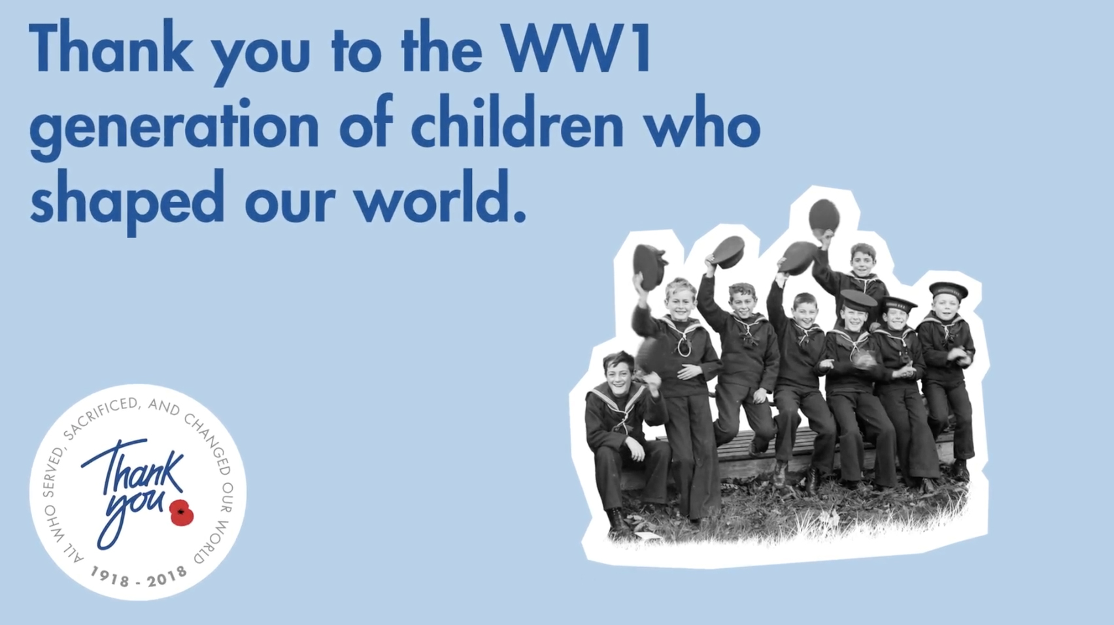
Children
Notes:
Children

Slide 20
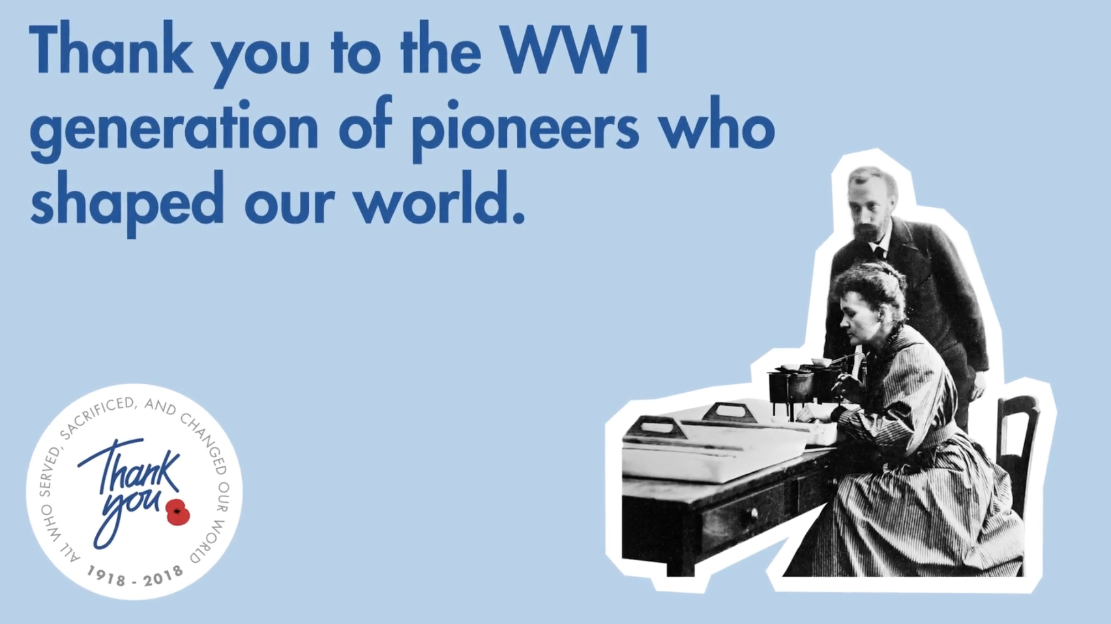
Pioneers
Notes:
Pioneers

Slide 21

Armed Forces

