Slide 1
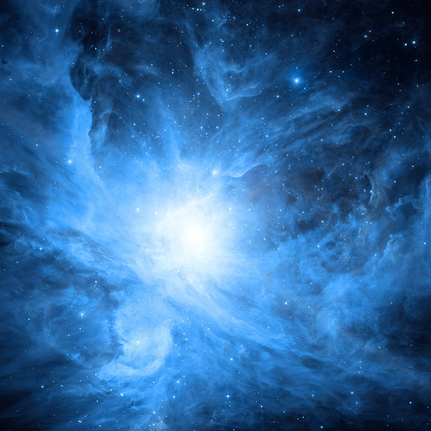
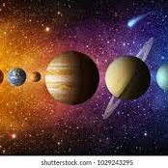
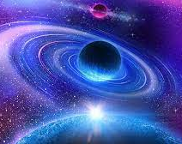
The Solar System
By Oliver Banks

Slide 2
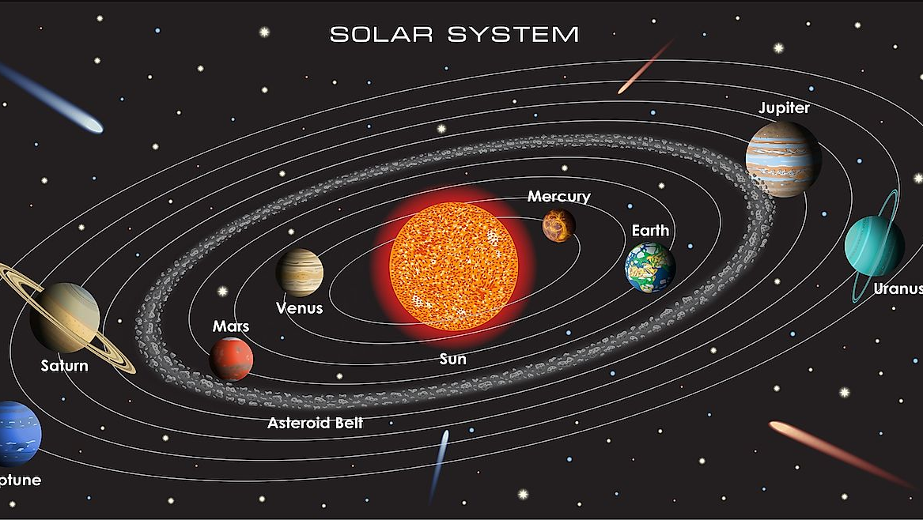
Our Solar System
Our Solar System is home to the seven planets that surround the Earth; Mercury, Venus, Mars, Jupiter, Saturn, Uranus and Neptune. You can find out about these planets in the following slides. Our Solar System is but one of many others in the Galaxy. As our Solar System is so big you can't see past it with the naked eye or telescope.

Slide 3
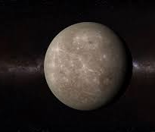
Mercury
Mercury is the closest planet to the sun. In the day, Mercury can reach 430 degrees Celsius whilst at night, it can drop down to minus 180 degrees Celsius. This planet is in fact the smallest planet in our Solar System – it is only just bigger than our Moon. Not only is it the smallest planet, but it is also shrinking!

Slide 4
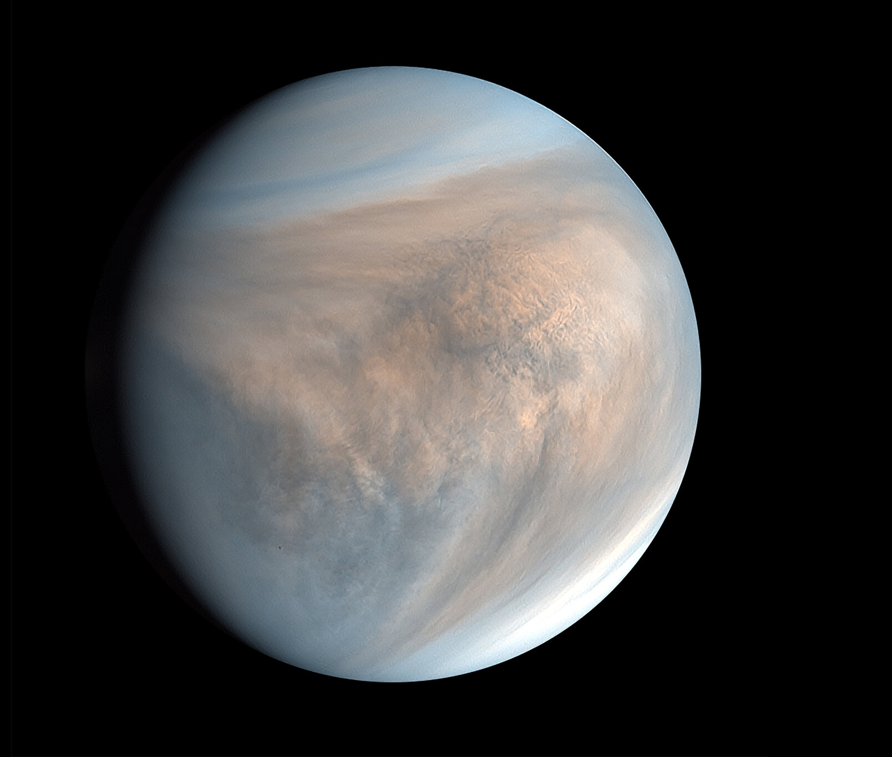
Venus
Venus is named after the Roman goddess of love and beauty because it is the brightest planet in the sky (after our moon). One day on Venus is longer than a year on Earth. Unlike other planets in our Solar System Venus spins clockwise on its axis.

Slide 5
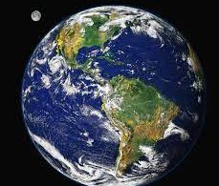
Earth
Earth our home planet, is a world like any other. The third planet from the sun , Earth is the only known planet to host life and liquid water on its surface. With a radius of 3,959 miles, Earth is the 5th largest plant in our solar system.

Slide 6
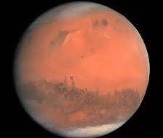
Mars
Named after the Roman god of war, Mars is the fourth planet from the sun. This red planet is home to the highest mountain in the solar system - a volcano called Olympus Mons. Standing at a whopping 24- kilometers its around 3 times the height of Mount Everest!

Slide 7
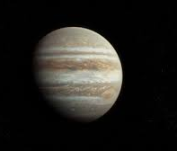
Jupiter
Jupiter is the largest planet in our Solar System – in fact it is 2.5 times as massive as all the other planets combined. It is made primarily of gasses and is therefore known as a ‘gas giant’. Its surface area is 61.42 billions kilometers making it so you can only fit one Jupiter into the Sun.

Slide 8
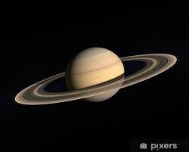
Saturn
Saturn is the sixth planet from the sun and second largest after Jupiter. It is the farthest planet from Earth that is visible to the naked eye, but the planets most outstanding feature – its rings – are better viewed through a telescope. Although the other ‘gas giants’ in the solar system – Jupiter, Uranus and Neptune – also have rings, Saturn’s rings are particularly prominent, earning the name “Ringed Planet”.

Slide 9
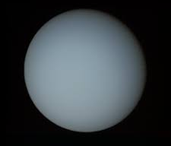
Uranus
Uranus is the seventh planet from the sun, and the third largest diameter in our solar system. It was the first planet found with the aid of a telescope; Uranus was discovered in 1781 by astronomer William Herschel, although he originally thought it was a star or a comet. It was two years later that the object was founded as a planet, by Johann Elert Bode.

Slide 10
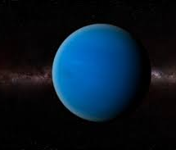
Neptune
Neptune is a ball of gas and ice, there's no way you could actually stand on its surface without just sinking in. However, if you could stand on the surface of Neptune, you would notice something amazing. The force of gravity pulling you down is almost exactly the same as the force of gravity you feel here walking on Earth!

Slide 11
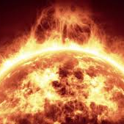
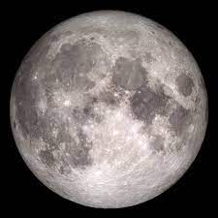
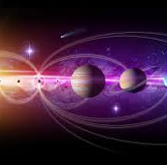
Thank you for reading my presentation

