Slide 1
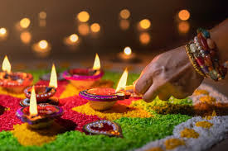
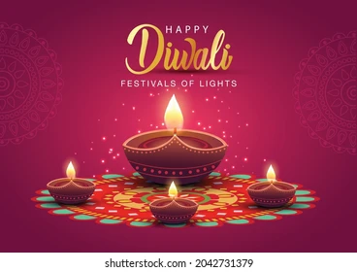
Diwali
The Festival of Lights

Slide 2
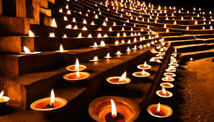
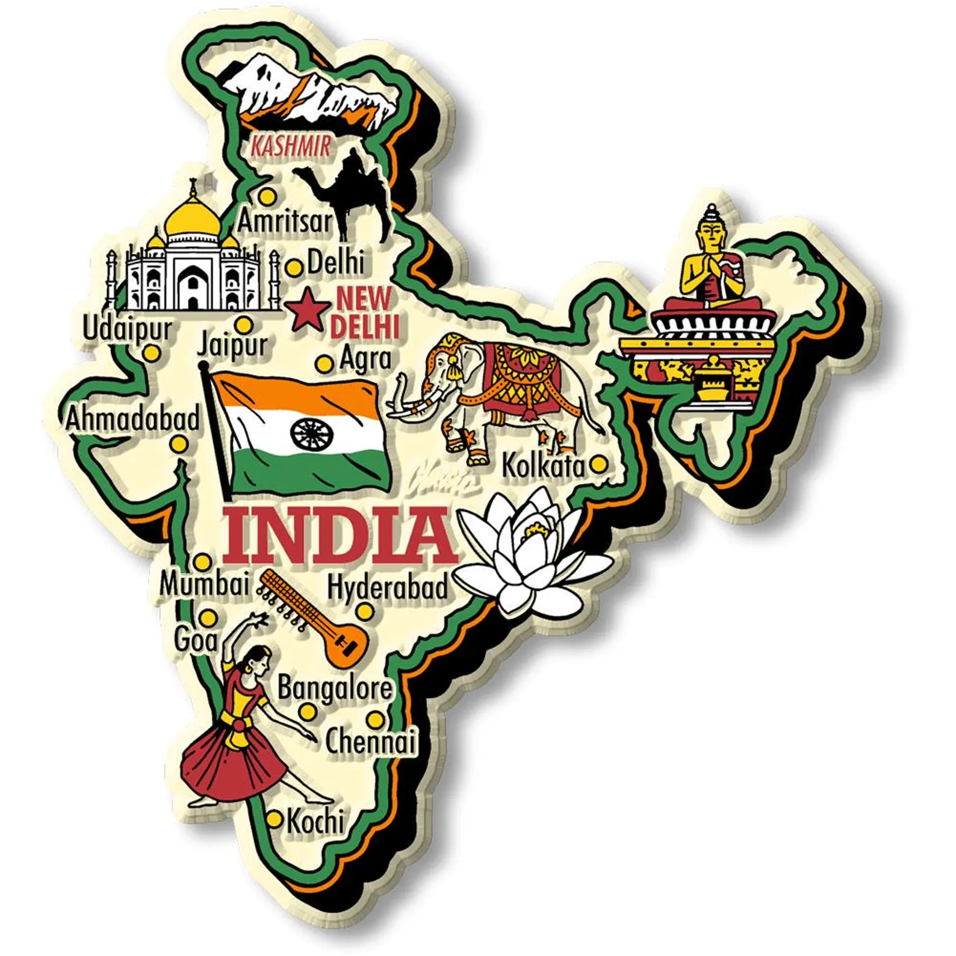
What is Diwali?
Diwali is known as the Festival of Lights and the word Diwali means “row of lights”.
The festival is one of the most important Hindu celebrations and marks the Hindu New Year
Diwali lasts for five days in either October or November
Different parts of India celebrate Diwali in different ways – the most well known is of Lord Rama and Sita. All the stories are centred around good conquering evil and light over darkness

Slide 3

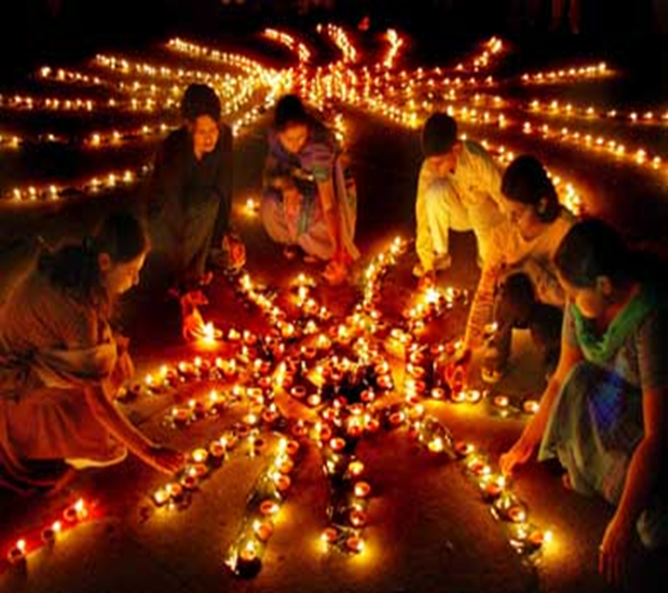
Five Days of Festivities
The history of Diwali is varied and so is the way its celebrated but here are the five most common things people do:
Day 1: People clean their homes and shop for gold, kitchen utensils and new clothes to help bring good fortune.
Day 2: Homes are decorated with clay lamps called divas and rangoli patterns for happiness and prosperity are created to welcome so the Goddess of Wealth - Lakshmi can see the houses and visit them to bring good fortune to the family.

Slide 4
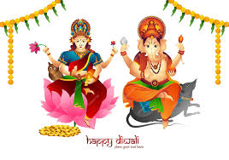
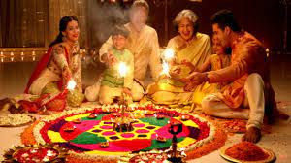

Day 3: Families gather together for Lakshmi and Ganesh puja, followed by feasts, gifts and fireworks warding off evil.
Goddess Laxmi is believed to bless the devotees with wealth, prosperity, and happiness. Lord Ganesh blesses the devotees with knowledge and wisdom. Worshipping Laxmi and Ganesh leads to all-around progress in one’s life.

Slide 5
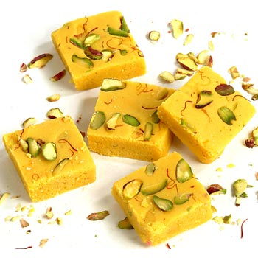

Day 4 - This is the first day of the new year, when friends and relatives visit with gifts and best wishes for the season.
Day 5 - Brothers visit their sisters, who welcome them with love and a lavish meal
Cards and small gifts are given out to family and friends. Hindu’s often make special Diwali sweets called Barfi.
https://www.youtube.com/watch?v=uRpNNF4fB4g

Slide 6
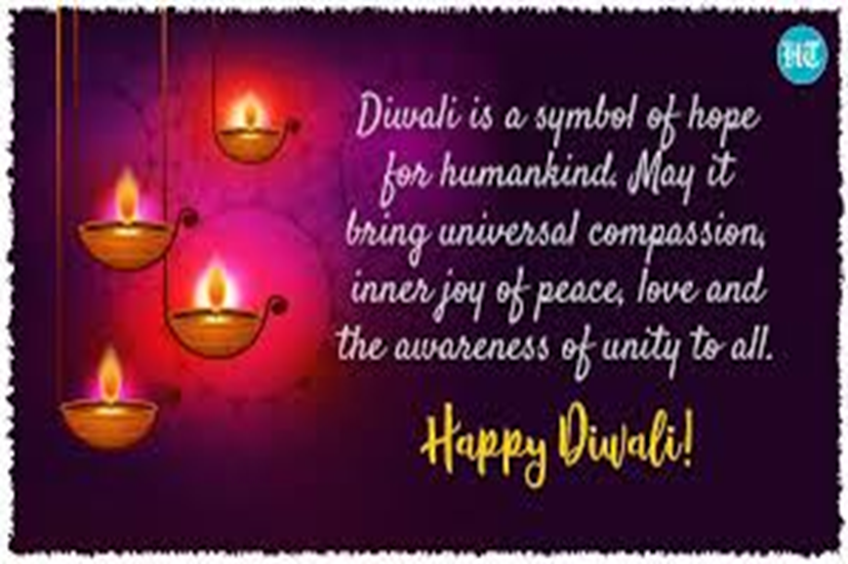
https://www.youtube.com/watch?v=l53N612meiY

Slide 7
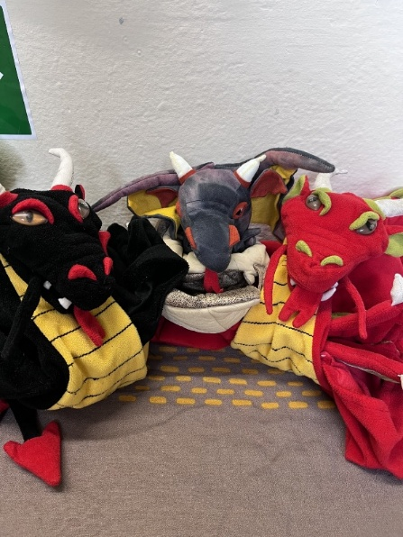

Attendance – week 7 13th to 17th Oct
Dragons go to Y6, Y3 and Y1.
Reception 92%↓
Year One 98%↑
Year Two 97.7%↑
Year Three 98.1%↑
Year Four 92.5%↓
Year Five 97.2%↑
Year Six 98.6%↑
Whole School 96.3%↓

Slide 8
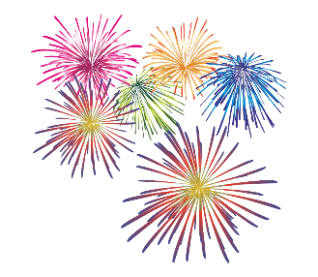
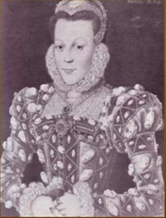
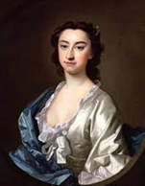
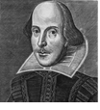
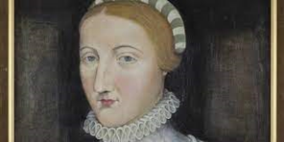
House Points
Winners
Arden
901
Shakespeare
835
Hall
880
Hathaway
725

