Slide 1
Welcome back

Slide 2
We’re going back to school
We’re going back to school; we might feel sad to say goodbye,
But friends are just like sunshine – they will help the tears to dry.
We’re going back to school; we might feel nervous at the door,
But joy will soon take over when we see our class once more.

Slide 3
We’re going back to school; we might forget a rule or two,
But soon we will remember as we gently talk them through.
We’re going back to school; we might do things a different way,
But new will turn to normal as we practise day by day.
We’re going back to school; we might not say that we are scared,
But don’t forget: a problem gets much smaller once it’s shared.

Slide 4
We’re going back to school; we might have grown-ups who are new,
But we will get to know them and they’ll get to know us, too.
We’re going back to school; we might be facing things unknown,
But doing them together means we’ll never be alone.
We’re going back to school, where we will laugh and learn and play,
Then head back home for cuddles once we’ve had a lovely day.

Slide 5
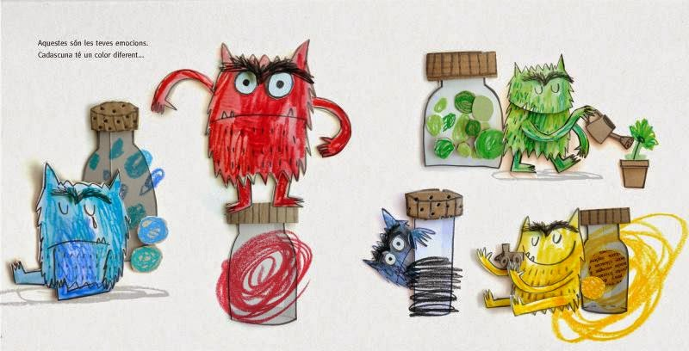
How do you feel?

Slide 6
What do we need to remember?
Respect yourself and others
Walk in school on the left
Smile and stop for adults
Talk quietly in corridors
Listen to each other
Seek help

Slide 7
What do we need to remember?
Breaktimes
Lunch
Safeguarding
Fire Drill
Lock Down
Attendance
End of the day
I have permission to be in
the school building

Slide 8
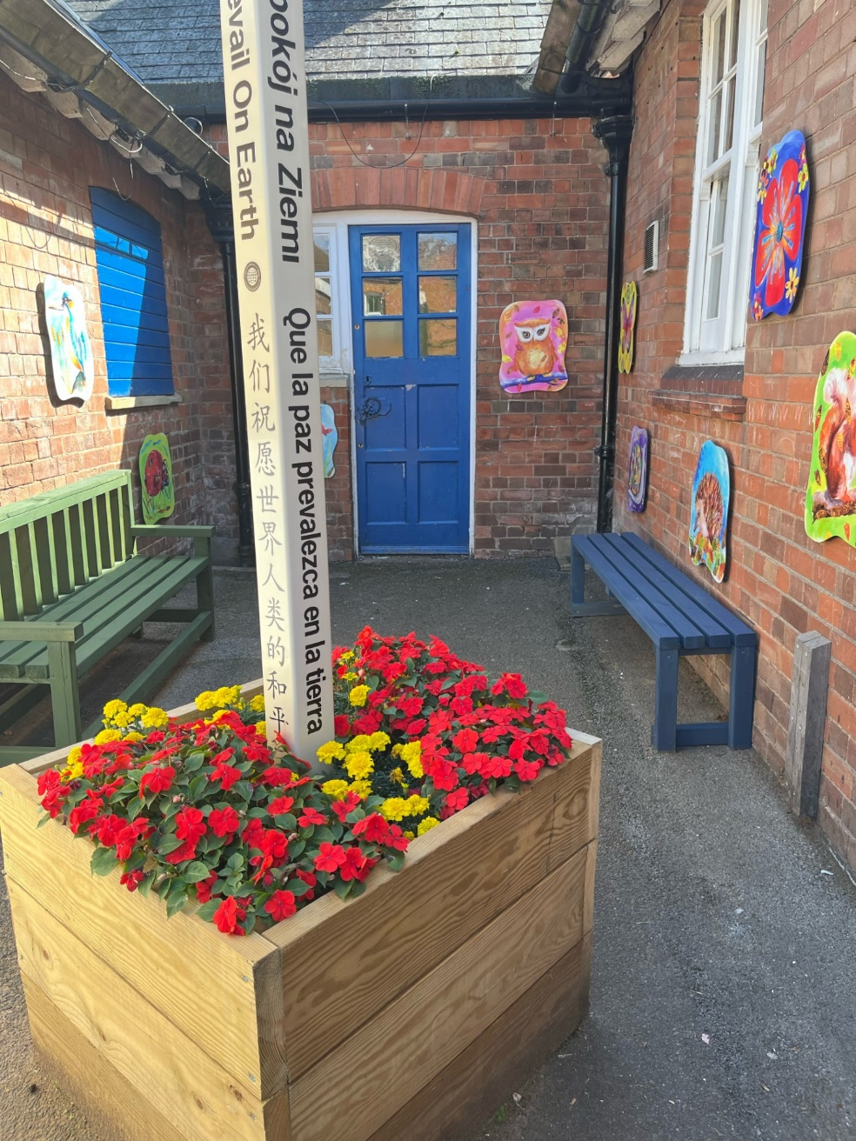

Slide 9
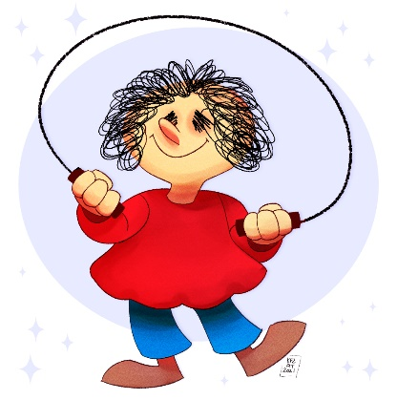
What have we got to look forward to?

Slide 10
Wake up Shake up

