Slide 1

Respect
Resilience
Responsibility

Slide 2

What does democracy mean?

Slide 3
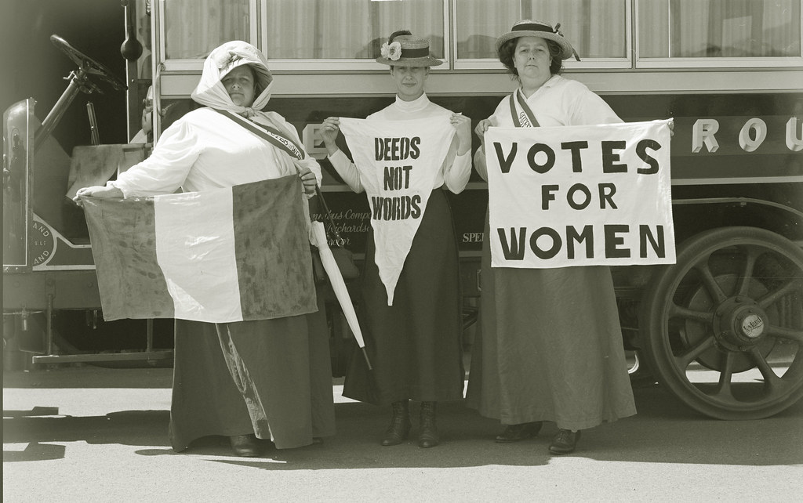
Would it be fair if only some people voted?

Slide 4

A better place for everyone

Slide 5

Democracy
In our classroom, big or small, we make decisions for us all.
No one person’s in control.
Everyone shares a happy role!
We listen when a friend speaks out,
We learn what everyone’s about. If we all want different things,
A voting choice the freedom brings
.

Slide 6
Democracy
Like making choices for a game,
Or which new colour to use, same!
With every voice, a chance to share,
In democracy, everyone will care.
Together, we decide what’s fair,
A chance for all, to show we dare
To build a future, strong and bright,
With every vote, we choose what’s right!
.

Slide 7
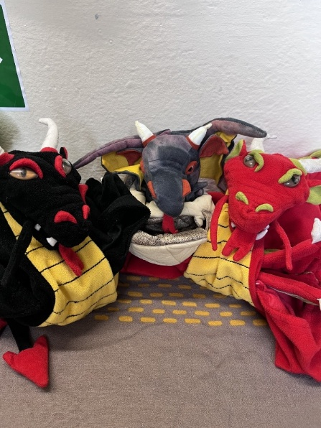

Attendance
Dragons go to Y4, Y6 and Y3
Reception 96.2%↑
Year One 88.6%↑
Year Two 97.4%↓
Year Three 98.2%↓
Year Four 99.6%↓
Year Five 94.2%↓
Year Six 99.1%↓
Whole School 96.2%↓

Slide 8

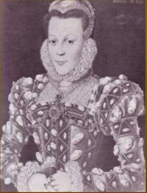
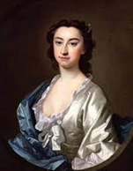
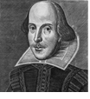
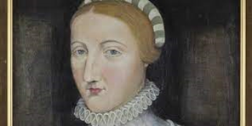
House Points
Winners
Arden
1901
Shakespeare
1885
Hall
1985
Hathaway
1830

Slide 9

Wake up Shake up

