Slide 1
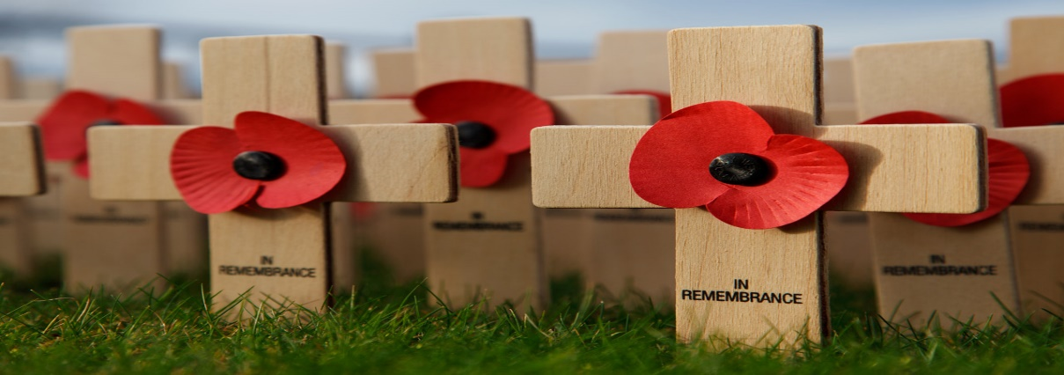
REMEMBER

Slide 2
Lest we forget – 100 years 1914 - 1918

Slide 3
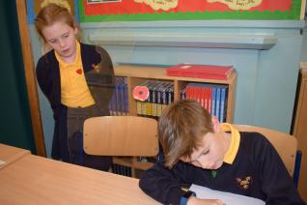
We will remember together

Slide 4
RESPECT
9 out of 10 British Soldiers survived
Total number of casualties 37.5 million ( there are 206 people in this school)
979,498 British and Empire soldiers died
They came from all over and from every family
We know some of those who fought and either died or survived started at Stratford Primary School

Slide 5
We will remember those who once loved and lived our school

Slide 6
House Points

Slide 7
Sing

