Slide 1

Welcome to Year 5
Mr. Argyle and
Mrs. Buchanan

Slide 2
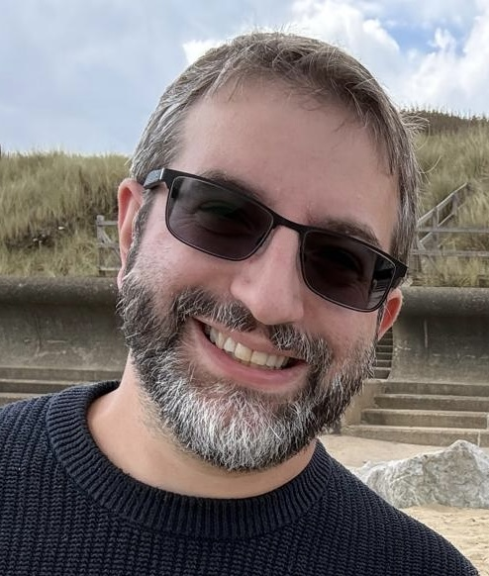
Meet the teacher – Mr. Argyle
My name is Mr. Argyle (sometimes known as ‘the big hairy one at the front’) and I will be your child’s Year 5 teacher.

Slide 3
A typical day in Year 5
When the children arrive, they will put their belongings away in their
lockers, pop to the toilet and then complete a handwriting task.
This is also a great time for them to swap out reading books, catch up with me and share news of anything exciting they did since we last spoke.
After registration, we will have our main Maths lesson followed by a shared reading English lesson. Finally, a short spelling focused activity will complete the pre-break line-up.
After break, it’s time for our English writing sessions. These are lessons that will include a variety of activities to immerse the class in whatever our focus is; it’s not all about pencils to paper!

Slide 4
A typical day in Year 5
After lunch, we will have a Maths mastery short session before we move into the lessons for the wider curriculum. Each day will include a Fluent in 5 Maths activity. These will be quickfire questions and will be moved around the timetable to keep children engaged; they can also be used alongside movement breaks to help promote focus.
The day will conclude with our school assemblies, except on Friday. Before the weekend, this time will be used to tell children what they have to look forward to in the coming week and as time to sing our class song.

Slide 5
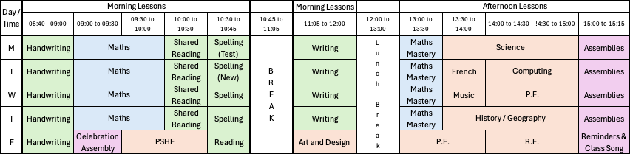
The Timetable

Slide 6
The Timetable
Year 5 will have P.E. lessons on
Wednesday
&
Friday
Our topics for Autumn will be rugby and hockey

Slide 7
English and Mathematics
English – is based on a whole class text that is normally linked to that term’s topic.
The class texts this year are…
The Sleeper and the Spindle by Neil Gaiman
Space Detectives by Mark Powers
Hidden Figures by Margot Lee Shetterly
Adventures of Odysseus by Hugh Lupton
Whole class reading also takes place daily to help children be immersed in a range of texts.
Maths Mastery –is about deepening children’s understanding, use and manipulation of all skills mathematical.
Fluent in 5 – Takes place daily and will help develop speed and accuracy with
arithmetic skills.

Slide 8
Topic Learning
We will also be studying Geography, History, Science, French, Computing, RE, PSHE, Music, Art and Design & Technology.
Learning in these subjects is, where possible, linked to each term’s topics.
This year our topics will be: Stargazers; Dynamic Dynasties; Sow, Grow and Farm; and Groundbreaking Greeks.

Slide 9
Trips and Visits
To broaden engagement and enjoyment of learning, we are building as many experiences into the curriculum as possible.
Bell boating – 23rd September
MAD Museum – 8th October (afternoon)
Heart of England –19th October (Science Forces topic)
Heart of England – Spring Term (afternoon and evening) – Stargazing
Bikeability
Greek Workshop Day – Summer term
El Greco visit – Summer term

Slide 10

The One School Rule

Slide 11

My Classroom Ethos

Slide 12
Assessment
Assessment in KS2 is carried out daily with live marking happening during the lesson and targeted questioning as the children are working. This ensures that children have time to respond to the feedback, make changes and any misconceptions can be addressed immediately.
Children will take part in assessments of reading, writing, spelling, mathematics and science across the year allowing us to monitor progress and, more importantly, offer support if needed. Many of these assessments will now be completed online using the GL assessments. Assessments on paper will still be carried out as preparation for Year 6 SATs.
The Statutory Assessment does not make up the whole picture. We use teacher assessment to make a final judgement on whether children have met the Expected Standard for the end of Year 5.

Slide 13
Home Learning
Children are expected to read at home a minimum of 3 times a week and this should
be recorded in their diaries. They can record this themselves. It would be wonderful if
parents can support their children as much as possible. This could
include helping the children understand unfamiliar vocabulary, asking them to summarise what they have read or listening to them read aloud.
Children will be given a Maths Key Instant Recall Facts (KIRF) for each term, which will give you ideas of things you can do with you children at home to develop and refine fluency. These will be ideas for quick activities that you can do incidentally throughout the day whenever the opportunity arises.
Children should complete 20 minutes of Times Table Rock Stars three times a week, but may do more; continuing to develop their confidence with multiplication has a huge impact on new learning in Upper Key Stage 2.

Slide 14
Home Learning
Children will also have a weekly spelling test. New spellings will be sent home on
Tuesdays with a test the following Monday. Practising these spellings forms part of
their homework each week.
If the Year 5 team notice that particular spellings are repeatedly misspelt, we will make a note of these as a spelling to be sent home for selected individuals.
Home learning is for recall of facts, knowledge and learnt skills.
It will not be marked, but any completed will be rewarded with dojos or stickers.

Slide 15
Expectations
Behaviour – we have the highest expectations of conduct from the children
at all times and in all settings. They should strive to exemplify the school’s
rule of ‘Respect”.
Children should take responsibility for their learning; mistakes are proof that they are trying and asking for help shows strength of character and maturity.
Children should present their work to the best of their ability in all subjects.
All items sent into school should be clearly named
Children should bring a named water bottle to school every day.

Slide 16
Celebrating Success
There will be a celebration assembly each Friday during which certificates for Learner of the Week and the Headteacher’s Award will be given out.
We will celebrate the achievements of a class Well-being Warrior each week.
Excellent work in class will be shared as part of the Class story on Class Dojo and Dojo points awarded too.

Slide 17
Communication
Class Dojo is the primary form of communication between the members of the Year 5 family. Dojo points will be awarded to acknowledge positive behaviours and the children’s successes.
Our Class Story will show you the children’s work and give us a forum to celebrate their successes.
The whole class chat will be used to communicate letters and important information.
The one-to-one chats will be used to communicate privately and are a means for you to talk to me. Please remember that replies can take up to 72 hours.
Messages can be sent via the school office.

Slide 18
Communication
Arbor is now being used for handling payments, consent and attendance.
Accident forms will be given out for any minor injuries, such as cuts and grazes. For any head injuries or more serious injuries we will contact you promptly by telephone.
As a school staff, we are always here to support and listen whatever the topic may be. We are all here working for the best outcomes of the children and communication is key.

Slide 19
Some other important things
Medicines – Only prescribed medicines with child’s name on are allowed. They must be handed
to the office.
Healthy snacks for break time only please. No crisps should be sent for consumption at break time.
Only Year 6 children are permitted to walk to and from school on their own and only Year 6 children are allowed mobiles. All other children must be escorted to and from school.
New statutory guidance in place by the government means that all children must attend school and holidays/ leave of absence can not be granted except in exceptional circumstances. Stratford Primary School’s attendance policy is available on the website.
We are a nut free school; food containing nuts must not be sent in to school or on trips.

Slide 20
Designated Safeguarding Leads
If you have any concerns about your ​
child or need our support you can contact me or you may want to contact the school office and arrange a meeting in private.​
The DSL team are always welcoming and can support you
with your concerns.​
Our safeguarding leads are:
Mrs. G. Humphriss
Mrs. L. Chisholm
Miss T. Parton
Mrs. C. Nailor
Mrs. H. Desai

Slide 21
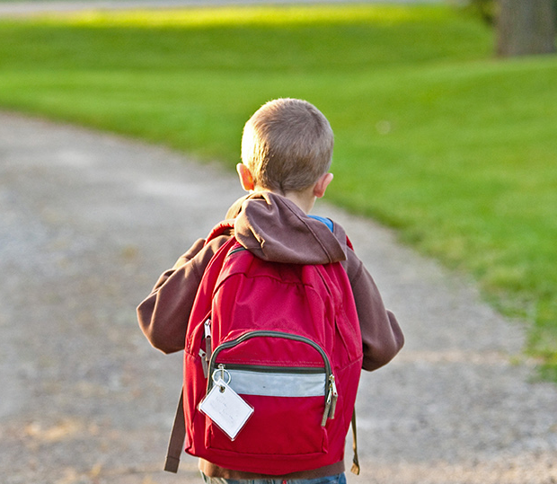
Thank You!
Be Brave!

