Slide 1

Respect
Resilience
This Photo by Unknown Author is licensed under CC BY-ND
Responsibility

Slide 2

Takes place every October
Celebrates all cultures and equality
Seeks to share the impact black people have had on society and changing history

Slide 3

The true story of four black women and the Space Race

Slide 4
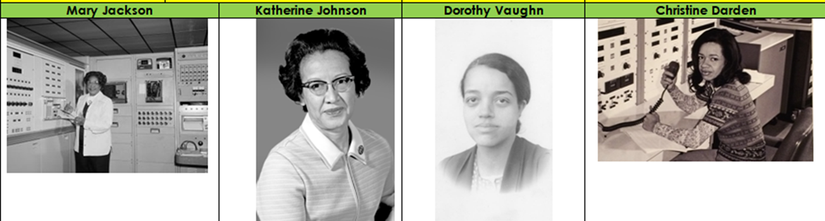
Four incredible women
I am going to share some of their story

Slide 5
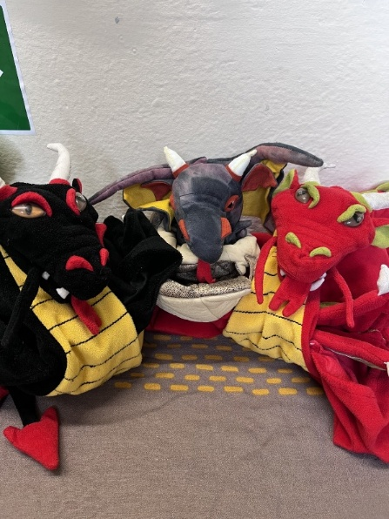

Attendance – week 5 29th Sep – 3rd Oct
Dragons go to Y2, Y4, Y3
Reception 97.7%↑
Year One 97.3%↑
Year Two 99.3%↑
Year Three 97.8%↑
Year Four 98.8%↓
Year Five 97.2%↑
Year Six 97.5%→
Whole School 97.9%↑

Slide 6
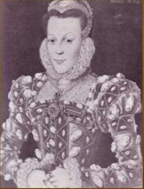
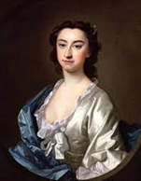

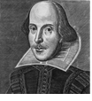
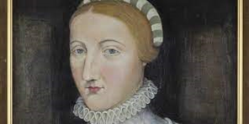
House Points
Arden
1489
Winners
Shakespeare
1606
Hall
1519
Hathaway
1345

Slide 7
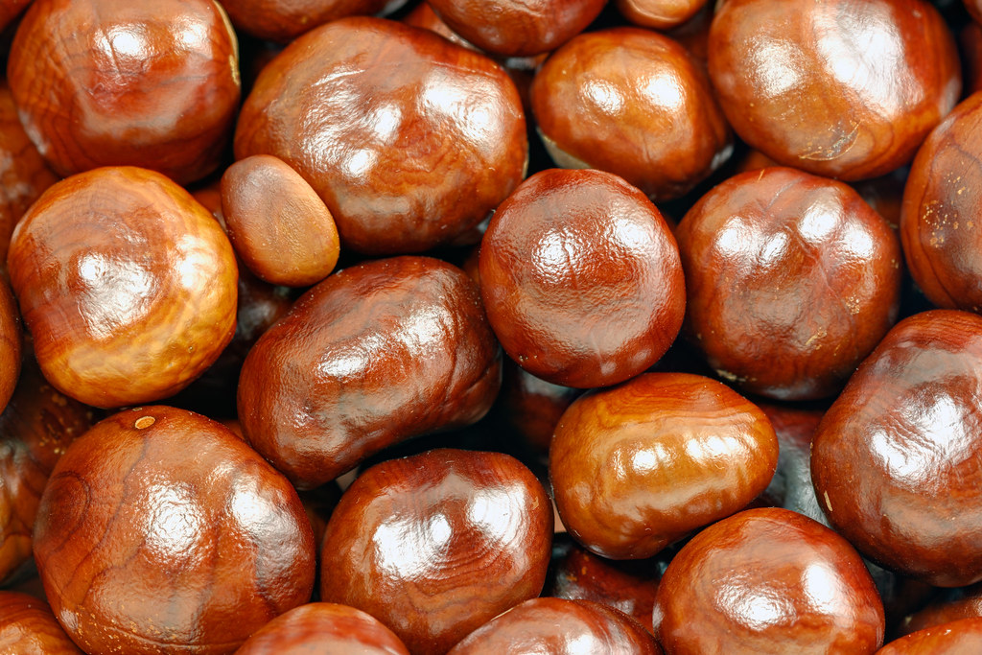
Conkers song

Slide 8
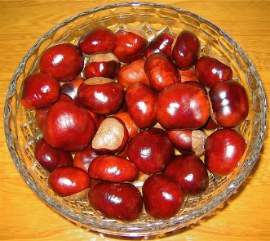
Conkers
Chorus: Conkers, I’m collecting conkers,
I’m trying hard to find the biggest and the best
Conkers, lots of lovely conkers,
I want a conker that is better than the rest! (Repeat)
Verse: Under the chestnut tree, there waits for me,
A sight so marvellous to behold,
Amidst the autumn leaves, it gleams for me,
A conker, beautiful and bold!
(Repeat the chorus)

