Slide 1
How many can you see?

Slide 2
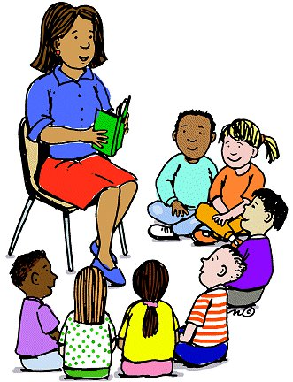
Why Teach?

Slide 3
Education is not the filling of a pail but the lighting of a fire - Yeats

Slide 4
I loved school

Slide 5
What is teaching all about?
You need to be dedicated
Be prepared to work long hours
Be creative and resourceful
Make the classroom safe and welcoming
Do well in your exams – every teacher needs to have passed maths, English , and Science GCSE.
You need a degree from university
You need to like working with people
Right now a teacher starting out can earn £22,917

Slide 6
Are you curious?
What fuels our teachers passion for teaching?
What motivates them to get up and teach everyday?
Let’s ask them!

Slide 7
So if you want to be a teacher REMEMBER
You need to pass exams
You need to want to do it
You need to be patient
It is a fantastic job – think about it.

Slide 8
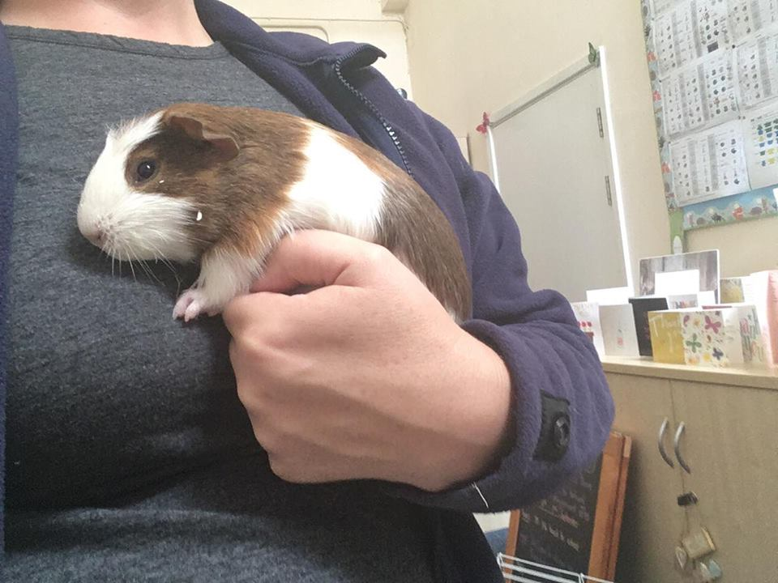
Meet our new friends

Slide 9
Autumn One Competition
Create a picture that makes someone happy
What can you win?
Just for entering you can get 10 house points
One person from each year group will have their picture displayed in Stratford Hospital
Two people (one from KS1 and one from KS2) will have their picture reprinted on canvas and displayed permanently in the school.

Slide 10
Let’s sing

