Slide 1
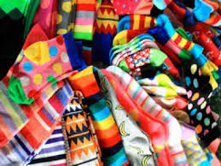
How many can you see?

Slide 2
Anti-bullying week

Slide 3
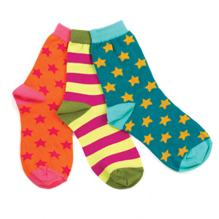
Today is odd sock DAY?
Show the person next to you your socks
Why are we wearing odd socks? Let’s see why.

Slide 4
What is respect?
“have due regard for (someone’s feelings, wishes, or rights).”
Do you know what to do if you are being bullied or are unhappy about how you are being treated?

Slide 5
What is bullying?
Bullying is a continuous deliberate harassment or aggression which causes distress to an individual or a group. This can be either physical or psychological and can be inflicted by either one person or a group of people.

Slide 6
Anti-bullying code
Don’t: Take part in the bullying
Don’t: Get involved, tell an adult
Don’t: Ignore bullying, never be a bystander
Do: Listen if somebody tells you they are being bullied.
Do: Encourage them to tell an adult what has been happening or offer to go with them to talk to a teacher or an adult or offer to tell an adult for them.

Slide 7
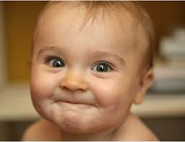
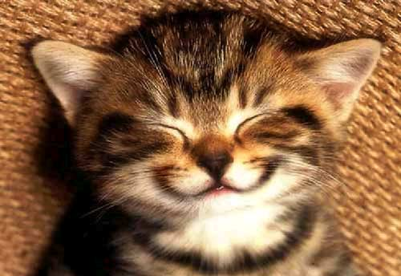
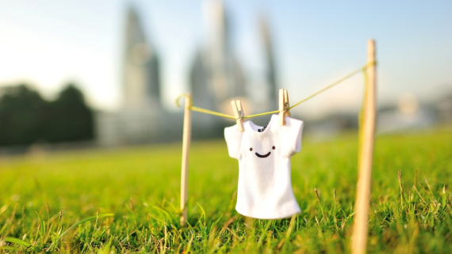
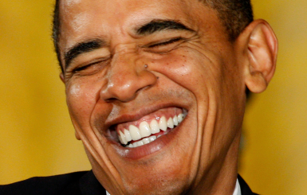
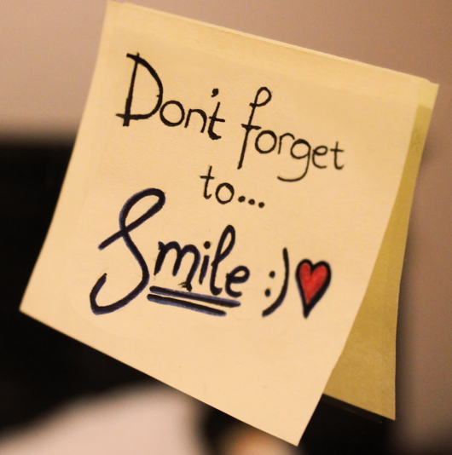
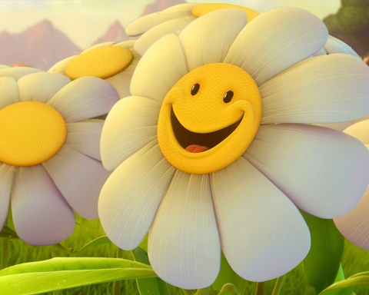
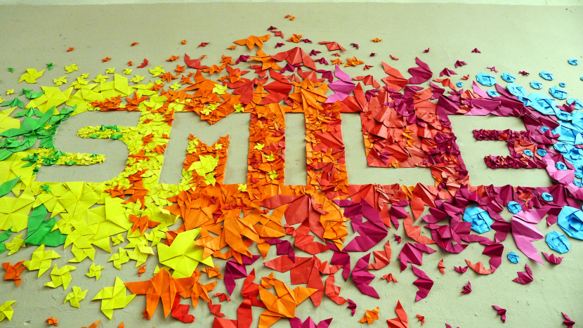
Choose Respect

Slide 8
The chorus
We’re all for one, and one for all Come together and stand up tall Choose respect, do you get it? Respect, can you show it? Respect, wanna have it? Choose respect

Slide 9
Attendance and house points

