Slide 1
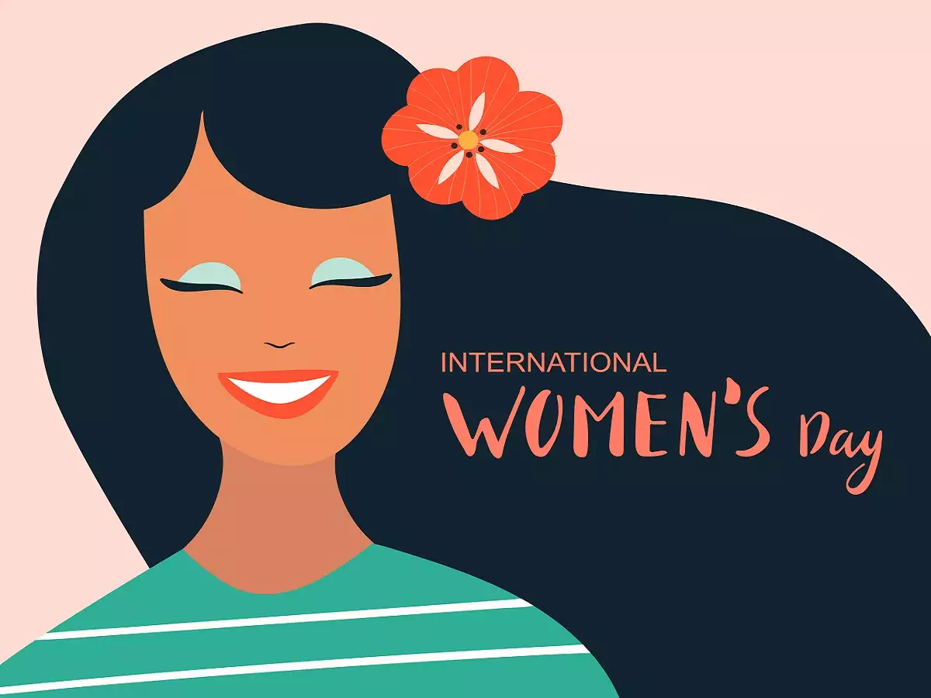
To a woman who is strong, clever, compassionate beautiful and unique.
May you continue to inspire those around you.
8th March

Slide 2
International Women’s Day is held annually on 8th March to celebrate women’s achievements throughout history and across nations.
It is also known as the United Nations Day for Women’s Rights and International Peace.

Slide 3
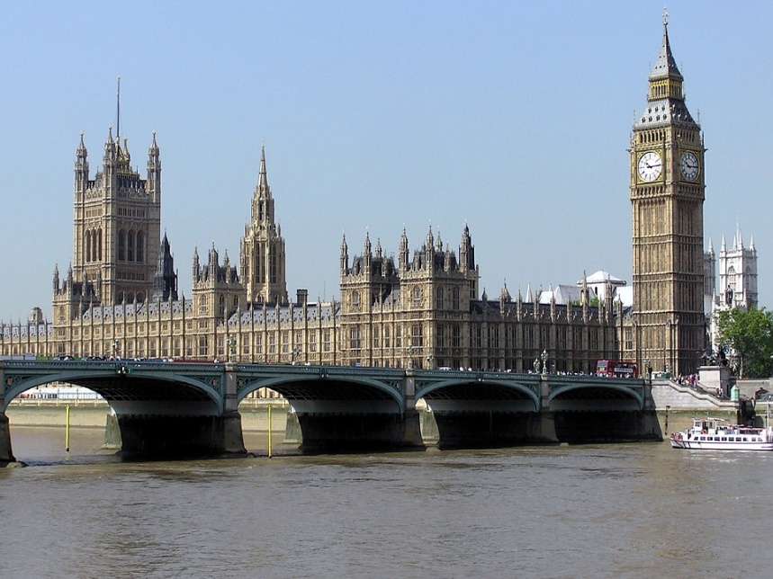
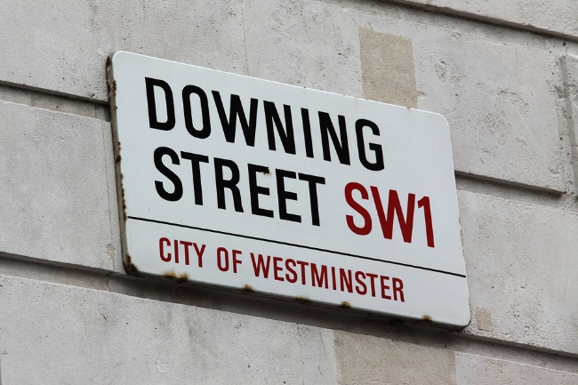
Women’s History
British Prime Ministers - Men
British Prime Ministers - Women
In fact, only about 38% of countries in the world have EVER had a female leader.
David Cameron
Gordon Brown
Tony Blair
John Major
Edward Heath
Howard Wilson
Winston Churchill
Neville Chamberlain
Stanley Baldwin
David Lloyd George……
74 male prime ministers
Theresa May
Margaret Thatcher
2 female prime ministers

Slide 4
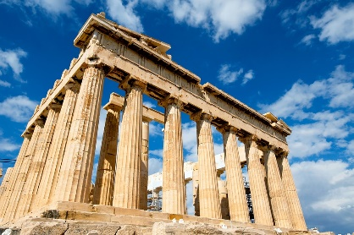
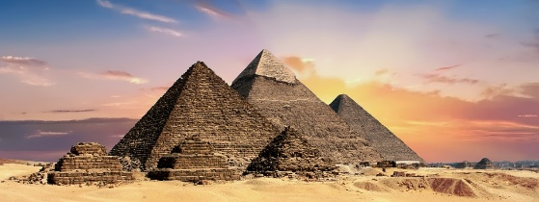
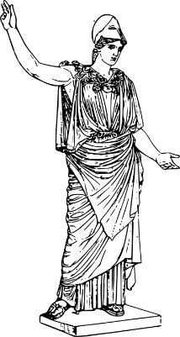
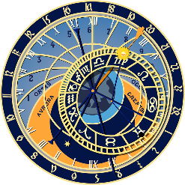
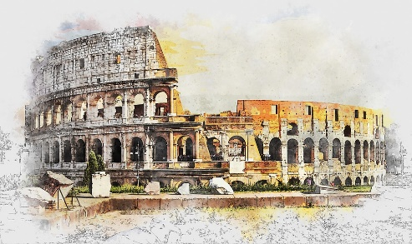
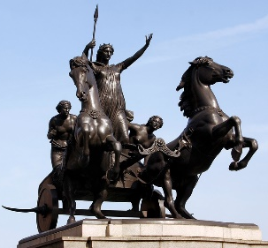
Women in the Ancient World
In the Ancient World women's rights varied from one civilization to another.
In Ancient Egypt, women had lots of freedom. For example, they could own their own houses.
However, in Greece women were kept apart from men in rich families. They were usually confined to the back of the house. Girls were forced to marry men their families arranged for them and their husbands were often much older than them!
But there were lots of famous Greek women. Sappho was a female Greek poet. Theano of Crotona was a great mathematician and Aglaonike was a woman astronomer.
In Rome, women could not vote or rule.
But Celtic (British) women had many more rights. Celtic women, like Boudicca, were even allowed to rule.
Ancient Egypt
Ancient Greece
Ancient Greek Goddess, Athena
The Colosseum, Ancient Rome
Boudicca
3000BC
Ancient times
476AD
2019 AD
0

Slide 5
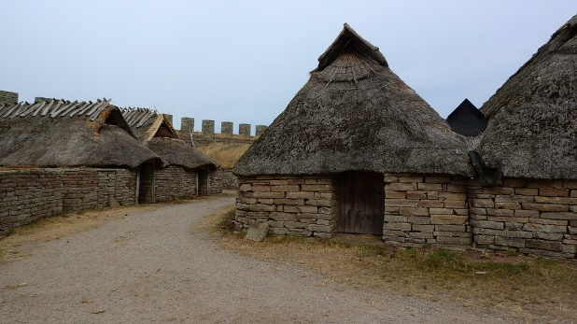
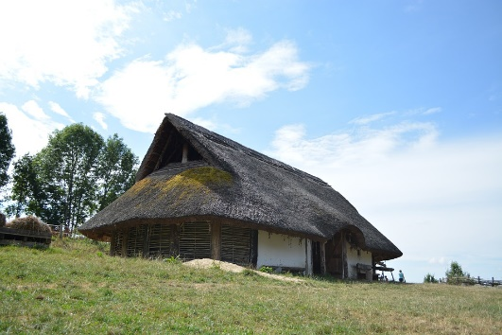
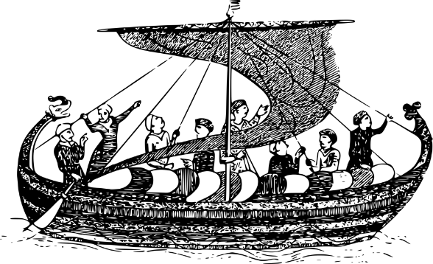
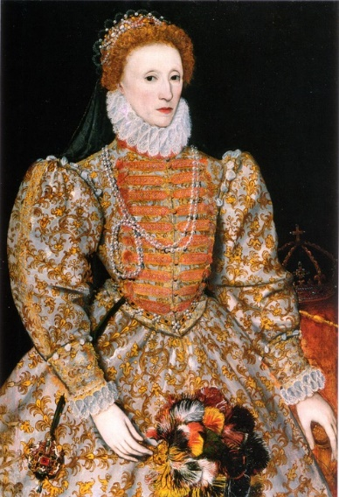
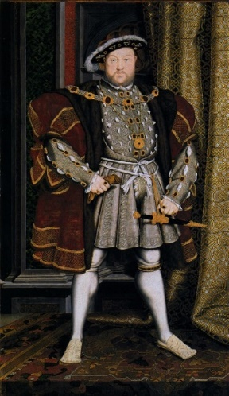
Viking, Saxon and Tudor Women
Both men and women could be slaves in Saxon times and life was tough for most people.
Rich Saxon women were allowed to own and inherit property and to make contracts.
Viking women had similar freedoms, but life was still hard for most, with people struggling to survive.
In the Middle Ages it was not unusual for middle class women to run their own businesses.
In Tudor times, Henry VIII left 2 of his wives to rule the country while he was away at war, then Elizabeth I ruled for 45 years!
A Viking Ship
Henry VIII
Queen Elizabeth I
3000BC
0
476AD
1100AD
1500AD
2019 AD
Ancient times
Saxons and Vikings
Tudors

Slide 6
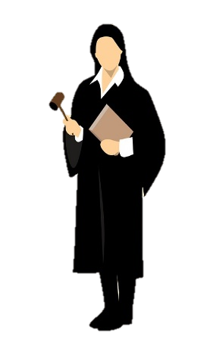
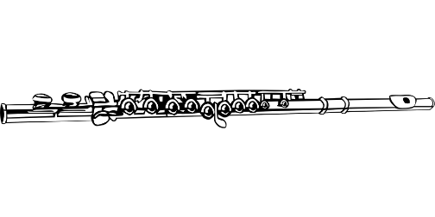
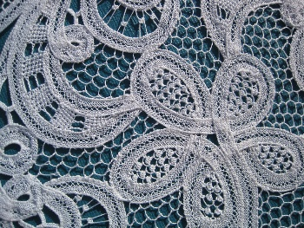
Women in the 16th and 17th Centuries
In the 16th and 17th centuries, women had many different jobs in Europe, like being tailors and shoemakers, or selling food. Many were washerwomen.
But they were not allowed to be teachers, lawyers or doctors.
Most women were housewives and they were kept very busy running the house.
In the 16th century in Britain, girls did not go to school, but rich girls might learn sewing, reading, writing and arithmetic at home. Very rich women would often learn languages.
However, towards the end of the 16th century girls spent less time on academic subjects and more time on skills like music and embroidery.
During the 17th century, boarding schools for girls were founded in many towns. In them, girls were taught subjects like writing, music and needlework.
3000BC
Ancient times
476AD
Saxons and Vikings
1100AD
1500AD
2019 AD
0
Tudors

Slide 7
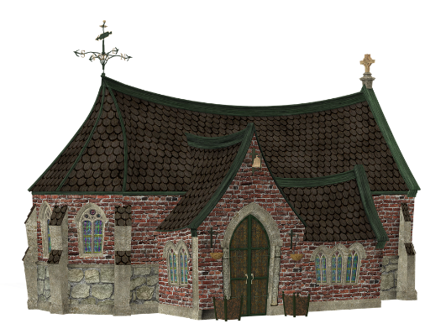
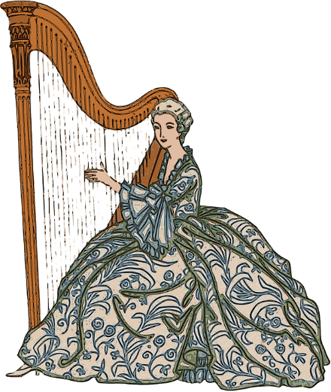
Women in the 18th and 19th centuries
There was little change in women's rights in the 18th century.
Girls from wealthy families went to school, but it was felt that it was important for them to learn 'accomplishments' like embroidery and music rather than academic subjects.
They could not attend most universities.
Women continued to be allowed to do certain jobs, with factory work becoming popular, but were banned from ‘professions.’
Women were not allowed to vote for who would rule the country anywhere in the world until the end of the 19th century.
3000BC
Ancient times
476AD
Saxons and Vikings
1100AD
1500AD
2019 AD
0
Tudors

Slide 8
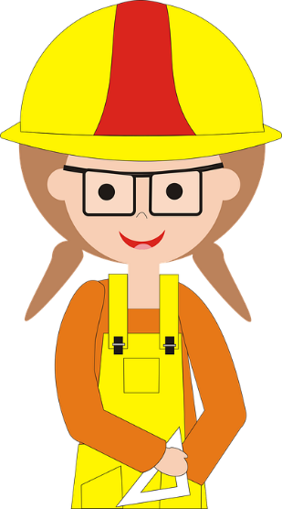
But things started to change…
Votes For Women
In the 19th and 20th century, women fought for suffrage in the UK and across the world.
New Zealand and Australia were the first countries to achieve this and were followed by many countries across the world in the early 20th century!
Women started to be allowed to go to university.
Women fought for equal pay.
Women started working in wide-ranging professions – as doctors, professors, builders, surgeons, politicians, designers….
476AD
Saxons and Vikings
1500AD
2019 AD
Ancient times
1100AD
3000BC
0
Tudors

Slide 9
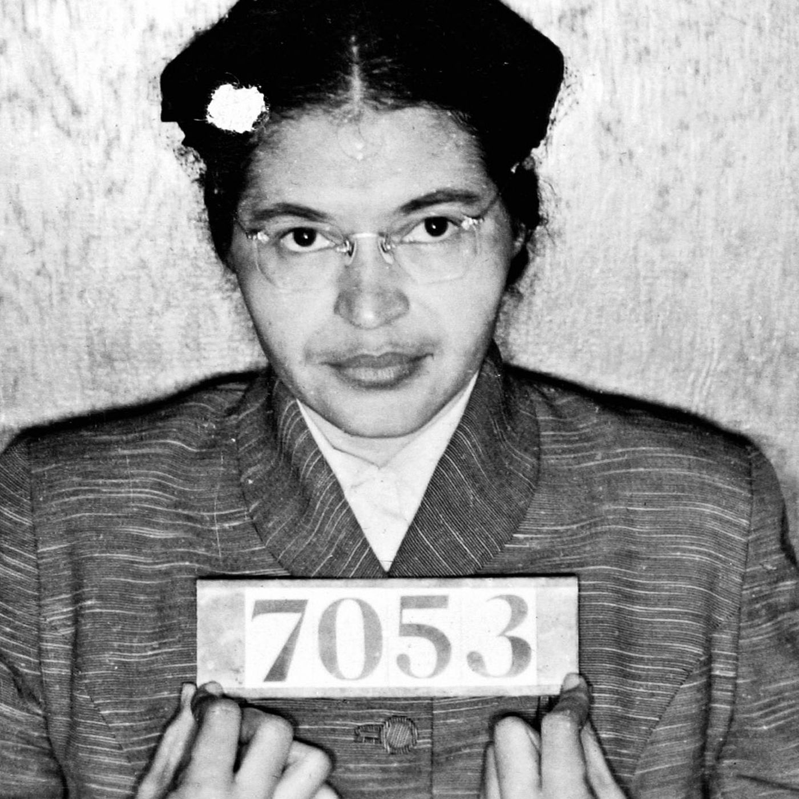
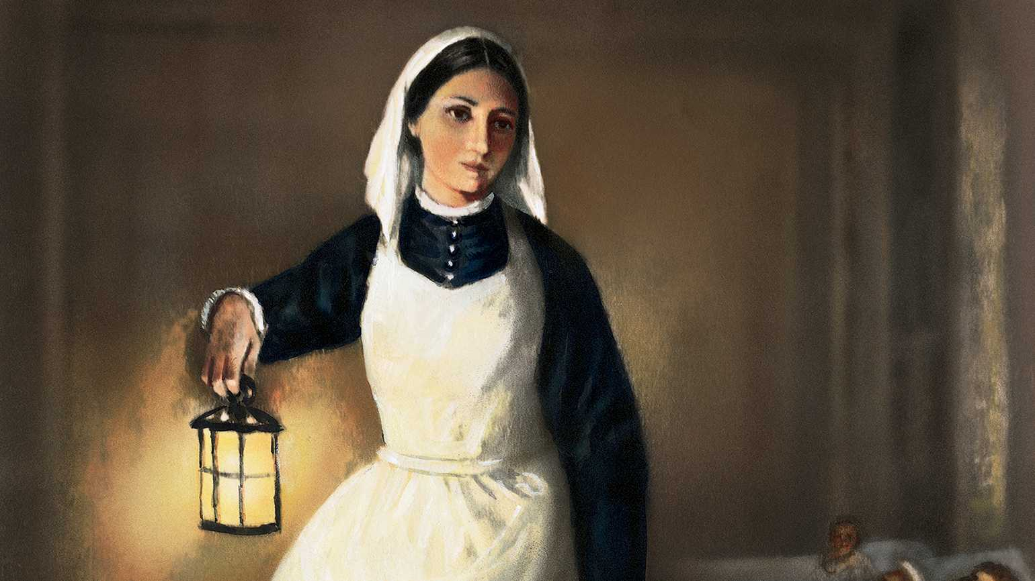
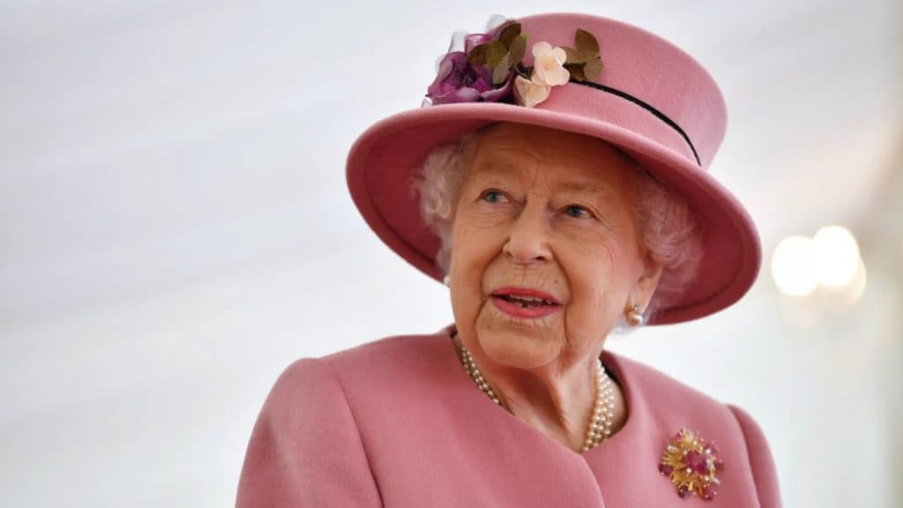
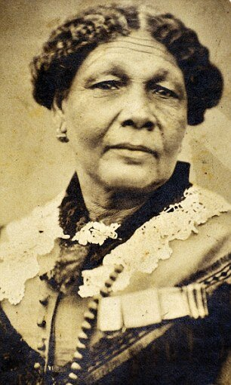
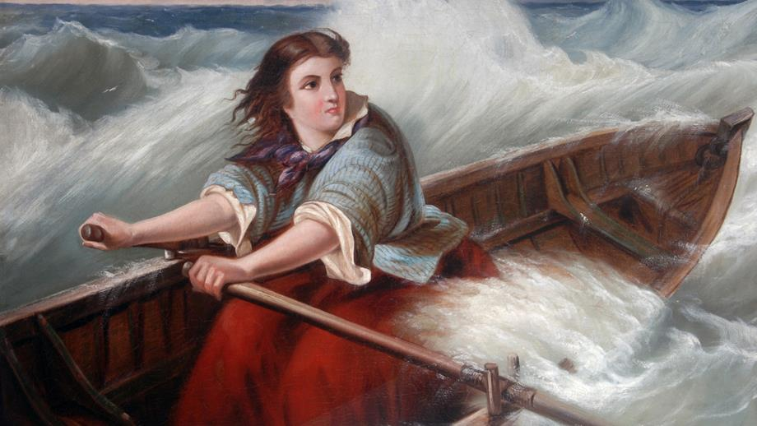
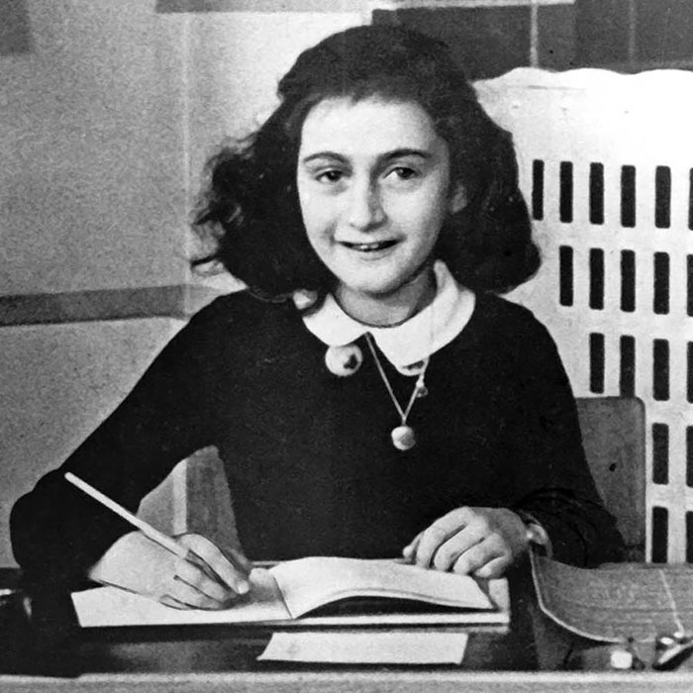
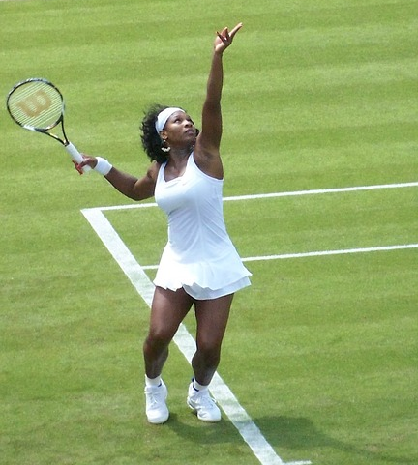
Do you recognise any of these significant women?

Slide 10
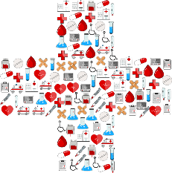
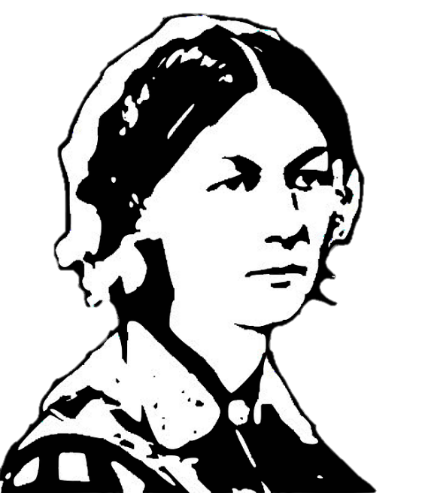
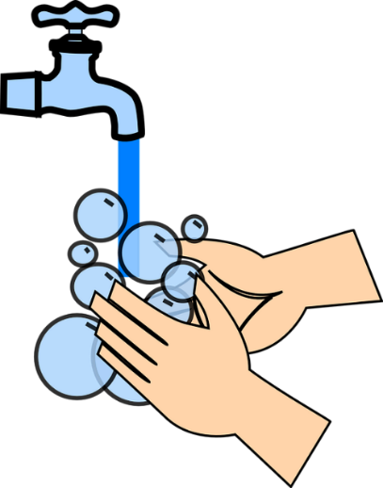
Who was she?
Florence Nightingale was a nurse in the Crimean War.
She saved many lives.
She made big changes to hospitals that meant they were cleaner places for soldiers to recover.
These changes are still being used today.
Florence Nightingale
1820 - 1910
Crimean Peninsula
Hospital

Slide 11
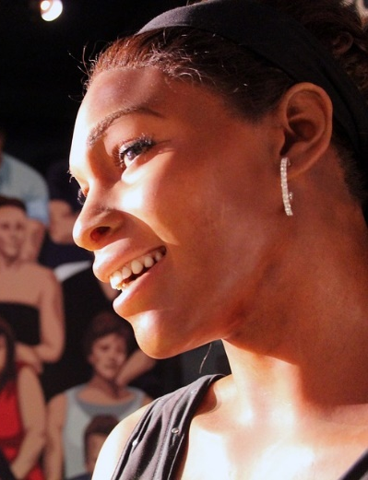
Who is she?
Serena Williams is a highly successful American tennis player.
She is known for her sheer power and athletic ability.
She has been the women’s world number 1 eight times.
Williams holds the most major titles in singles, doubles, and mixed doubles combined amongst active players, male or female.
She has won 23 Grand Slam titles.
She was the highest paid female athlete in 2016 and 2017.
Serena Williams
1981 -
Final Slide

Slide 12
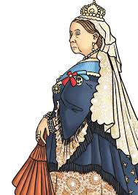
Who was she?
Grace Darling 1815 – 1842
Grace Darling is remembered for the rescue she undertook with her father in the Farne Islands in 1838.
The SS Forfarshire had broken up on rocks within sight of the lighthouse at Longstone, which was home to Grace and her parents.
Grace was determined to undertake a rescue immediately but was persuaded by her father to wait until morning and better light.
Grace and her father then set out through the stormy sea and collected some of the survivors.
They rowed back to Longstone Lighthouse where Grace and her mother looked after the survivors while her father returned to the shipwreck to collect the last of the survivors.
Grace soon found herself celebrated in print... even Queen Victoria wrote to her with a reward.
Today Grace's memorial can be found in the churchyard at Bamburgh, where there is also a museum about her.
Click on the image to watch the short film

Slide 13
Women’s History in the 22nd Century
Women still hold fewer than a third of top jobs in the UK.
Men outnumber women four to one in parliament.
There has still not been a female president in the USA.
In some parts of the world, girls do not have the right to an education up to the age of 16.
The list of inequalities goes on and on…
What can YOU do?
Find more resources at https://www.tes.com/teaching-resources/shop/blossomingminds

Slide 14
To a woman who is strong, clever, compassionate beautiful and unique.
May you continue to inspire those around you.
8th March

