Slide 1

Welcome to Year 3!
Miss White, Mrs McDonald and Miss Campbell

Slide 2
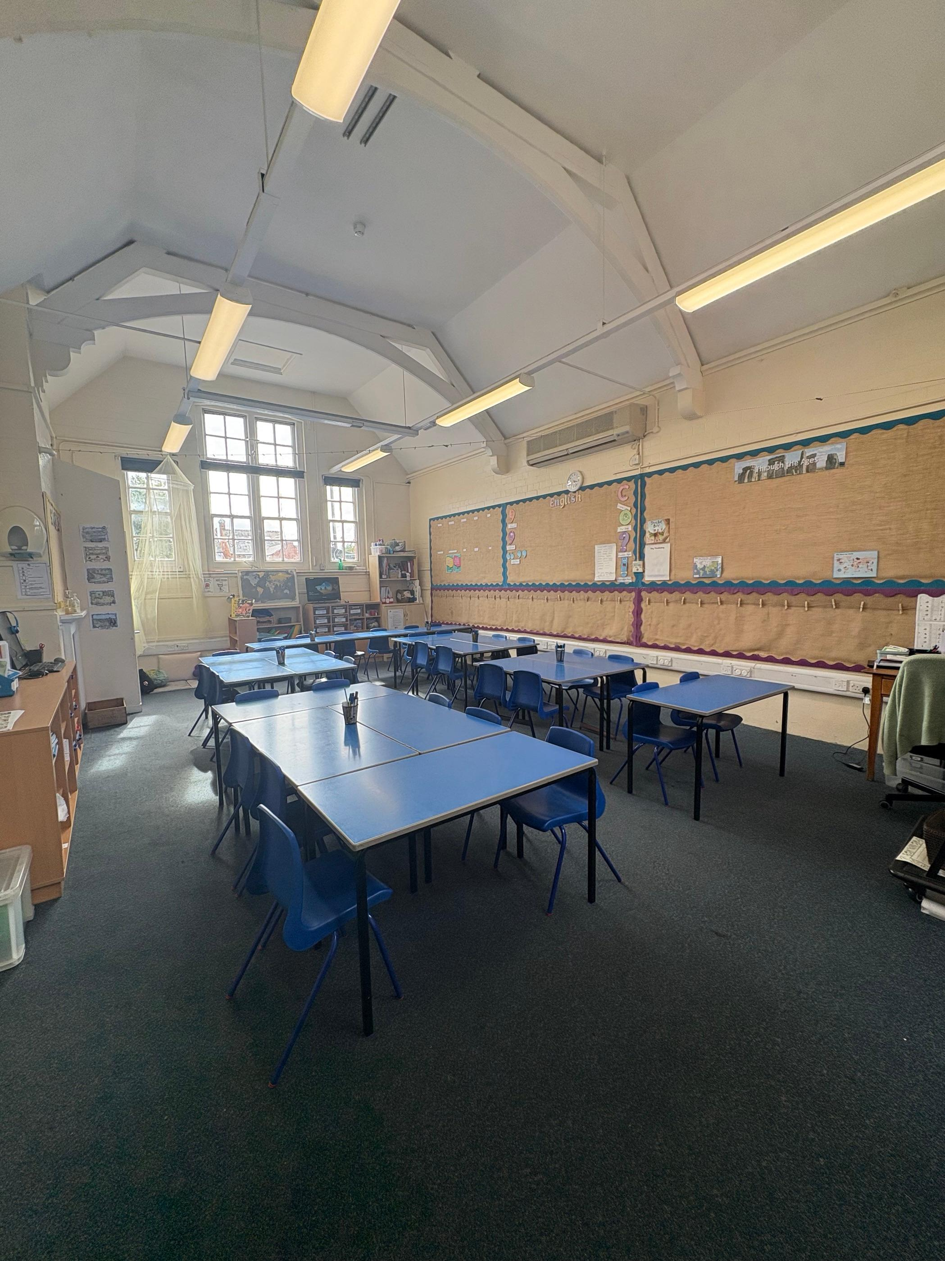
Meet the teacher Miss White
Welcome to Year 3!
Mondays – Miss Campbell
Tuesdays to Fridays – Mrs McDonald
Tuesdays – Mr Kelly

Slide 3
A Typical Day in Year 3…
Year 3 is exciting and action packed with many thrilling learning adventures along the way!
A typical day begins with the gate opening at 8.40am. Children enter school via KS2 door with school officially starting at 8.55 am - all children are expected to be in class for registration.
On arrival belongings are put away in named lockers (pencil cases and daily reading book to be taken into class). The children will quietly complete the early morning activities, during registration time, which include Colour Monster and Fluent in Five.
Morning lessons begin at 9.05am with the core subject – Maths. Break is at 10am - 10.20am. After break the children will have handwriting/TTRS, spelling and then English.
​Lunch at 12pm (KS2 dine at 12.30pm) and children return to classrooms at 1pm ready for the afternoon.
​

Slide 4
Afternoon
The afternoon runs similarly to the morning with topic based learning through the foundation subjects: Art, History, Geography, Science, PSHE, PE, RE, Music and French.
Throughout the week, children have daily reading opportunities. The teaching of reading is executed with whole class text allowing children to become immersed in a quality text, developing reading skills and understanding of inference and vocabulary.
The day ends with either a whole school/KS2/class assembly or whole-class reading.

Slide 5
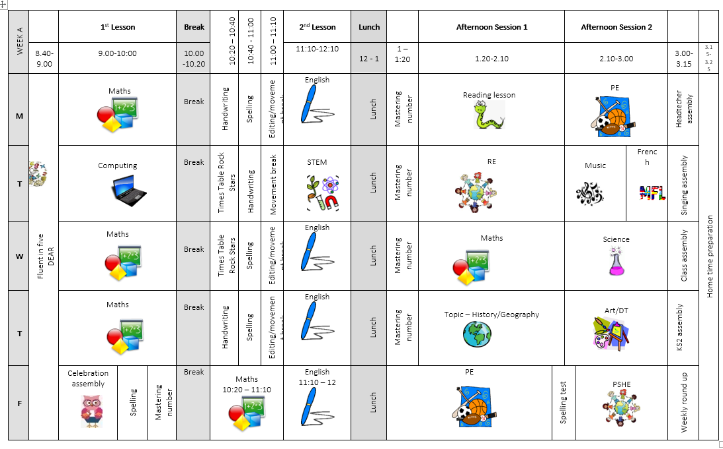
Weekly timetable

Slide 6
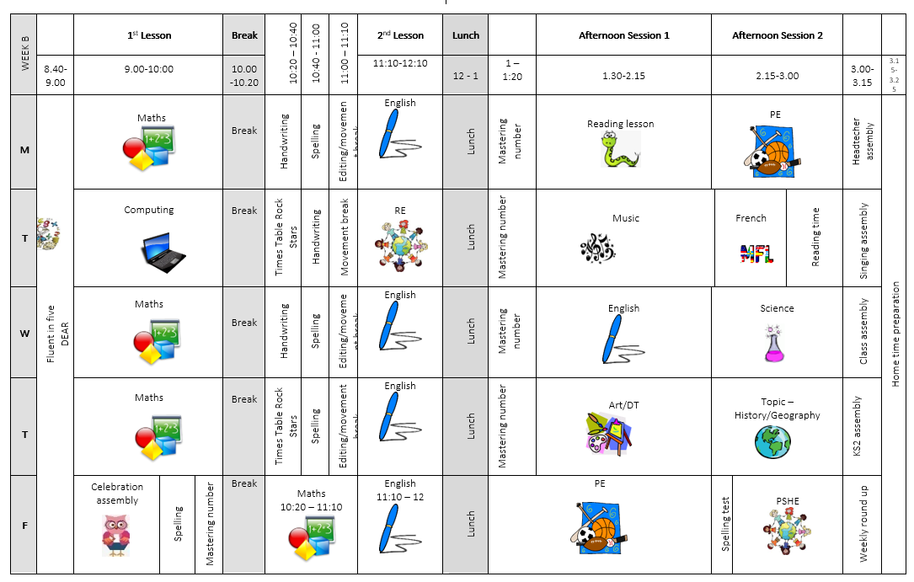
Weekly timetable

Slide 7
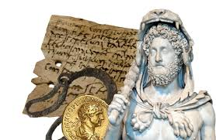

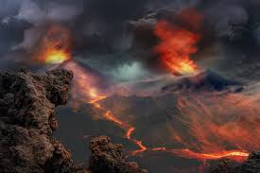
Year 3’s Creative Learning Themes for 2025-2026
Autumn – Through the Ages
Spring – Rocks, Relics and Rumbles
Summer – Emperors and Empires

Slide 8








English Key Texts
English is based on a whole class text that is normally linked to that terms topic.
Autumn – Through the Ages
Stone Age Boy by Satoshi Kitamura
The Lost Spear by Saviour Pirotta
How to Wash a Woolly Mammoth by Michelle Robinson
Summer – Emperors & Empires
The Romans: Gods, Emperors and Dormice! By Marcia Williams
Roman Tales: The Goose Guards by Terry Roman
Julius Zebra – Rumble with the Romans: Colin Northfield
Spring – Rocks, Relics and Rumbles
Firemaker’s Daughter by Philip Pullman
Pebble in my Pocket by Meredith Hooper
Escape from Pompeii by Christina Balit

Slide 9
Maths
Scheme of Learning
Autumn
Place Value
Addition and Subtraction
Multiplication and Division A
Spring
Multiplication & Division B
Length & Perimeter
Fractions A
Mass & Capacity
Summer
Fractions B
Money
Time
Shape
Statistics
Maths is taught every day following the scheme of learning across the year. Importance of multiplication * division is reinforced with continued practice using Time Tables Rockstar after break. Maths Mastery aids with the deepening children’s understanding, use and manipulation of all things maths!

Slide 10
Topic Learning
Where possible the foundation subjects - Geography, History, Science, French, ICT, RE, PSHE, Music and Art/Design – are linked to each term’s theme of learning incorporating cross curriculum teaching where possible.

Slide 11
PE and Outdoor Learning
Year 3 PE lessons are on Monday and Friday. Children will need come into school in their PE kits.
We will also have lots of opportunities for outdoor learning this year, including trips to the Heart of England Forest. You will be sent dates with plenty of notice – waterproofs and wellies/walking boots will be needed!​ We will restart Forest School later on in the year.
Please ensure every item is clearly named!

Slide 12
Trips & Visitors...
To further enhance the curriculum and children’s class based education, we have planned trips and experiences that will captivate and stimulate the intrinsic learning.
The planned and potential trips for the year are…
Stonehenge: 11th September
Heart of England: 21st October & 13th March
Christmas Theatre: Date & Cost TBC
Shakespeare Week Open House: Spring term – no cost
Roman workshop: Summer term & cost TBC

Slide 13
Assessment…
Assessment in KS2 is carried out daily utilising a range of strategies such as: live marking, targeted questioning and quizzes. This is to ensure the teaching team can monitor children’s understanding promptly and enable children have time to respond to the feedback, make changes and address any misconceptions.
Throughout the year, children will take part in assessments in reading, writing and mathematics to show progress and inform us of next steps or gaps in learning.​ Children are not made aware that it is a formal assessment.​
​The Statutory Assessment does not make up the whole picture. We use teacher assessment to make a final judgement on whether children have met the Expected Standard for the end of Year 3.

Slide 14
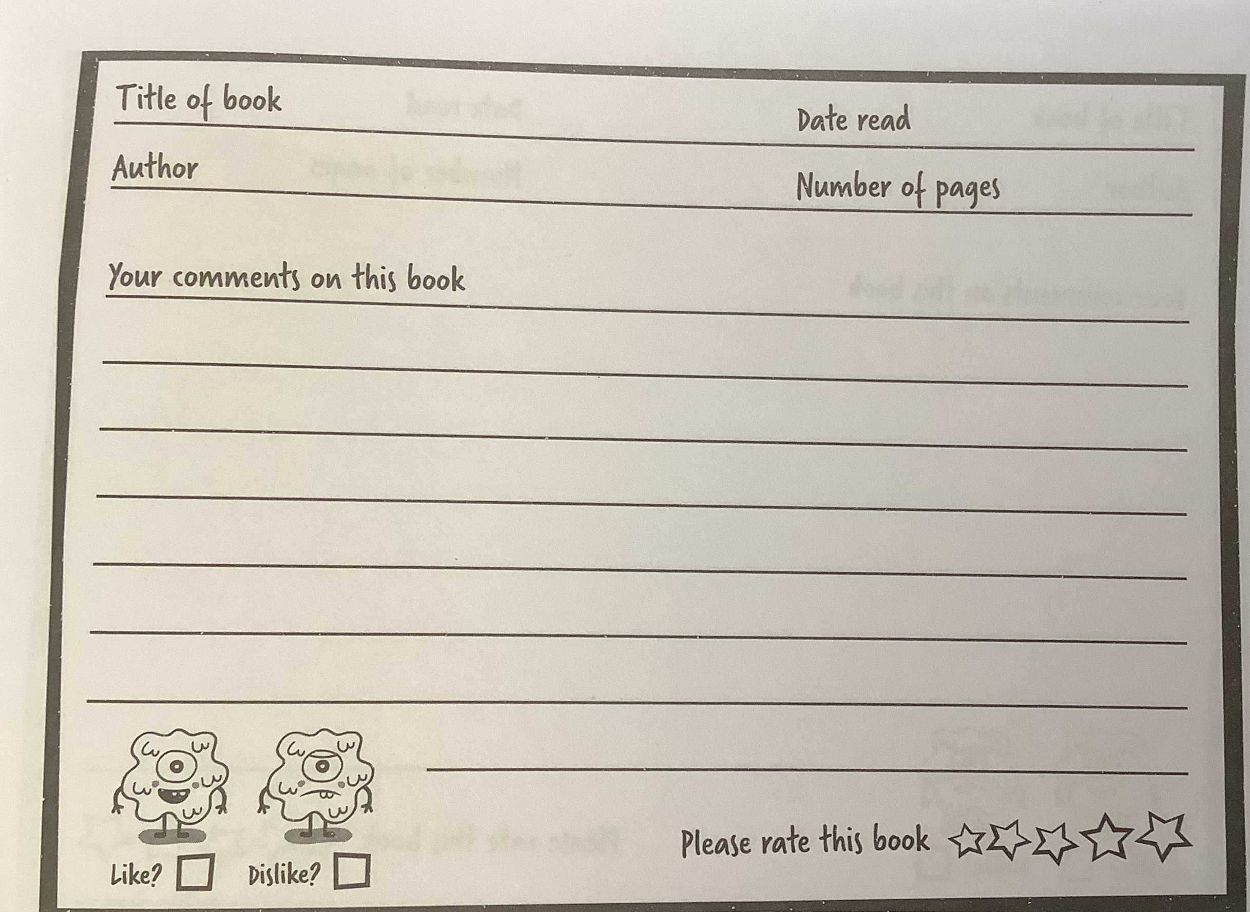
Home Learning…
Home learning is for recall of facts, knowledge and skills learnt. It will not be marked but all completed tasks will be rewarded with dojos.
All children are expected to read at home every day and this should be recorded in their reading diaries.
.

Slide 15
Home Learning…
Children will be given a maths Key Instant Recall Facts (KIRF) for each term. This will help with fluency and provides quick strategies to practice in the car, on the way to school, whilst queuing at the shops, whenever you have a spare five minutes etc.
Children should also complete 3 x 15 minutes of times table rock stars a week.
Children will be given spellings sheets to practice at home every week in readiness of the Friday spellings quiz! . Some children may have individualised spellings of common exception words from previous years or that we have noticed they need to practice from lessons. Please encourage them to focus on these words first.
.

Slide 16
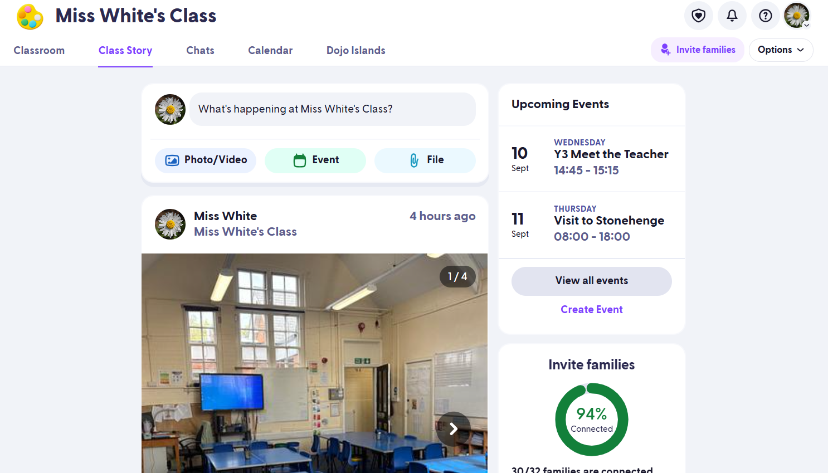

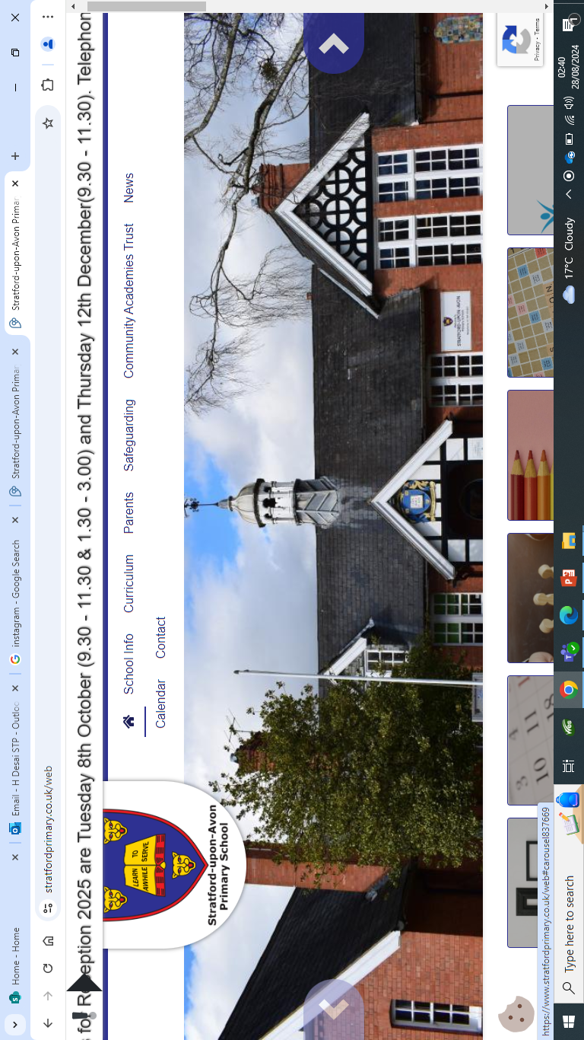
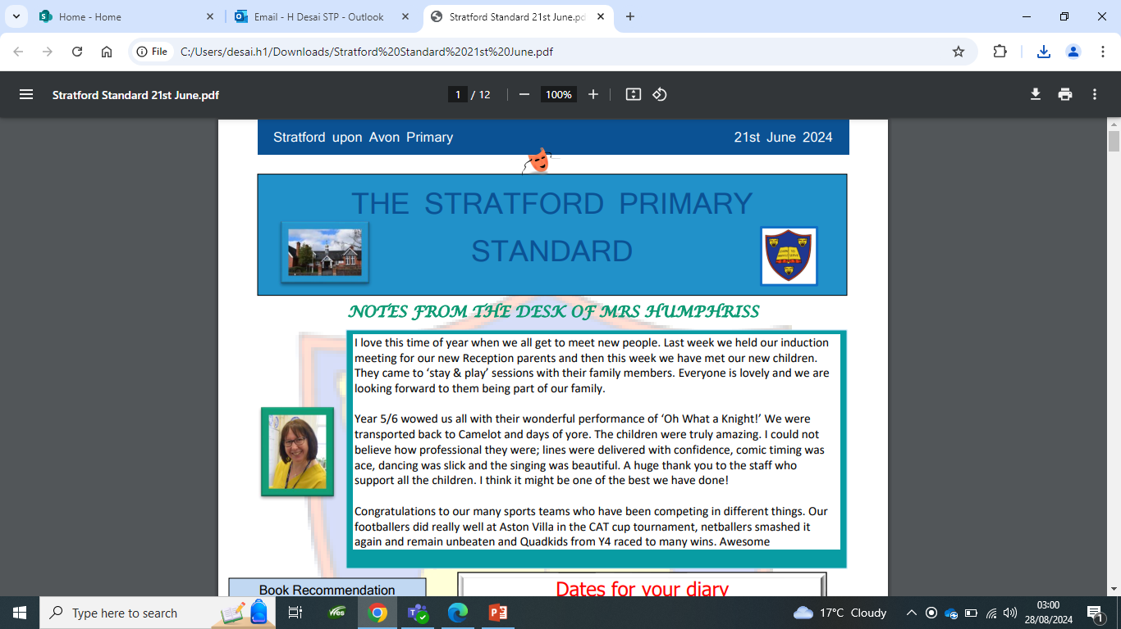
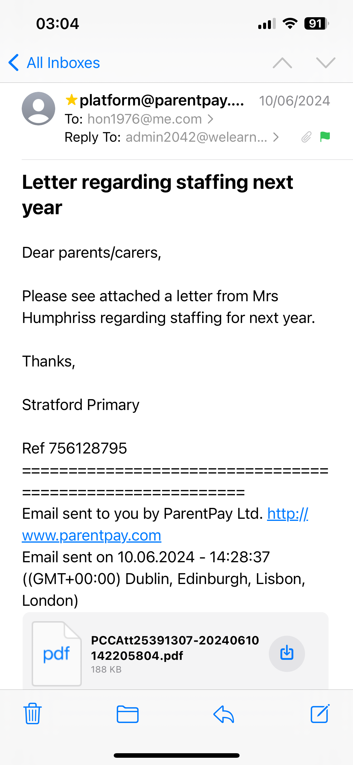
Communication…
Timetable
ClassDojo
Instagram - stratforduponavonprimary
Website
Newsletter
Emails

Slide 17
Communication…
We are always here to support and listen! You will receive communication via parent letters, emails, weekly newsletter, ClassDojo and school website. We will also share Year 3 news via the aforementioned platforms and Instagram!
You can contact me via ClassDojo. If the matter is urgent please email admin2042@welearn365.com and it will be forwarded on to me. Please note staff can only respond to emails/messages between 8am-5pm (and not during direct teaching time). Do regularly check ClassDojo for general class messages.
You can also talk to the member of staff on the gate in the morning about any general enquiries or seek me out at the end of the day (please be mindful that we will be in charge of children during these times). If you require an appointment to speak to me or any other member of staff this can be arranged directly at the end of the day or via the school office.
​​Serious injuries will be either a phone call home or a face-to-face chat. Minor injuries such as cuts and grazes will be communicated via accident forms which are given out at the end of the day.​​​

Slide 18
Expectations…
Behaviour – high expectations are required: in class, in playground, moving around school, on trips, when visitors are in and at after school clubs .
School uniform/PE kit/lunch/snack pots/water bottles(every day)/pencil cases should all be clearly labelled and it is the children's responsibility to look after these.
Presentation: in school and when completing homework.
Encourage independence: encourage children to organise themselves for a successful day; to inform staff when they need a book changed, need to hand in a letter, bring sheets and uniform home, hand homework in.

Slide 19
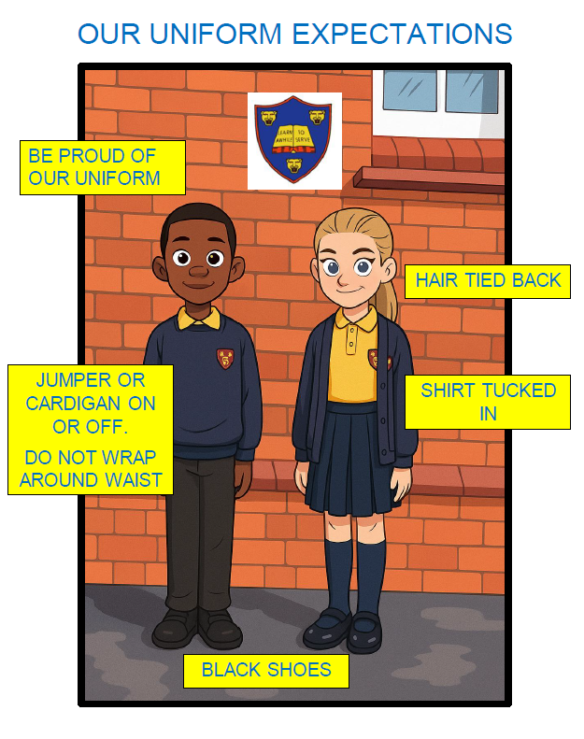
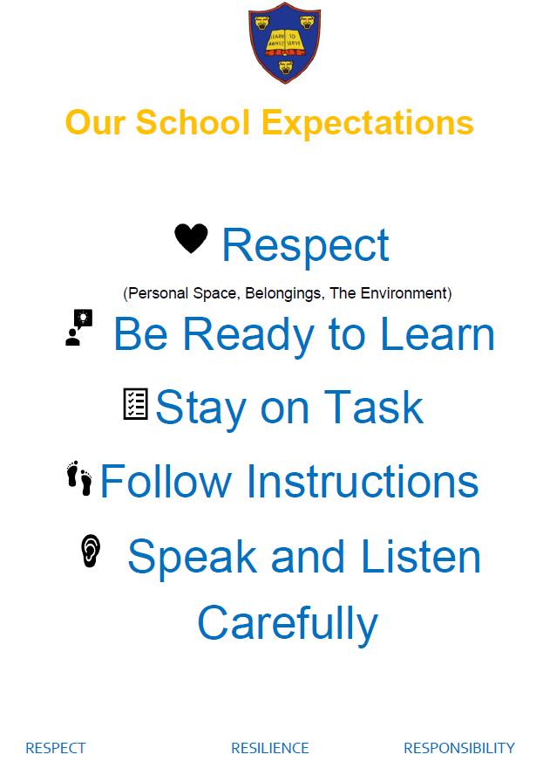
Expectations…

Slide 20

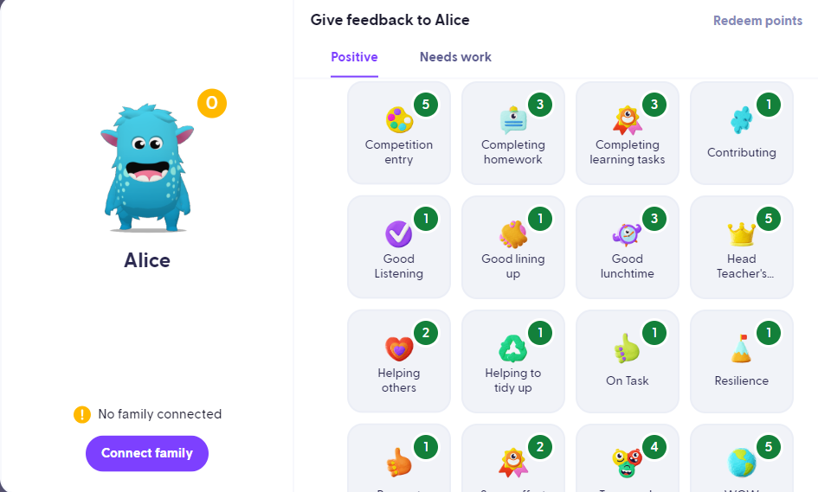
Celebrating Success…
Celebration Assembly: Head Teacher’s Award, Learner of the Week, Well-being Warrior, Respect Certificate.
Daily: Affirmations, stickers, Dojo Points, verbal praise and feedback
Shakespeare Hall Arden Hathaway

Slide 21
AOB…
Please remind children they have a locker in which to store their items, encourage independence.
ParentPay – lunches and trip payments
Medicines – Only prescribed medicines with child’s name are permitted. They must be handed to the office. No medicines should be left in a child’s bag.
Healthy snacks – NUT FREE! No sweets or chocolate. KS2 children are not provided with fruit.
PE days – Mondays and Fridays. Children to come to school in PE kits.
Only Y6 are permitted to walk to school and have mobile phones. All Year 3 children must be escorted to and from school.
In accordance to new statutory guidance holidays/leave of absence will NOT be granted except in exceptional circumstances.

Slide 22
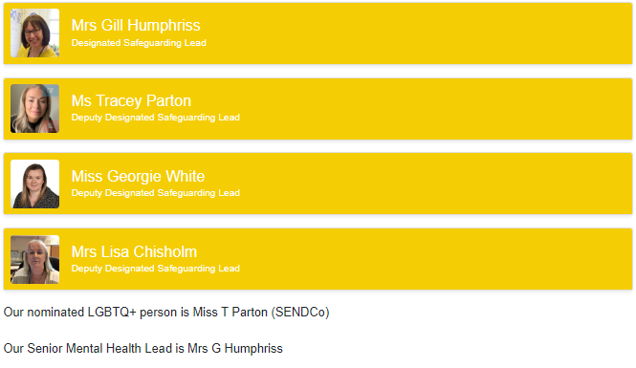
Additional Support/Concerns DSL
The DSL team are always welcoming and can support you with your concerns.​
Please call or email the office to arrange to speak to one of the DSL team

Slide 23
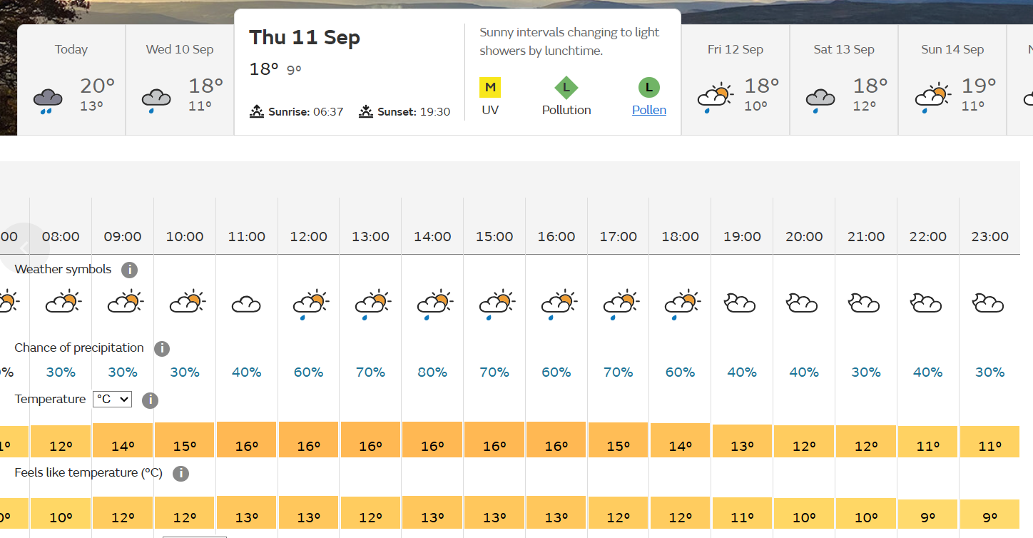
Stonehenge
Please arrive by 7:55 at the very latest. The bus is now arriving at school at 8am.
Packed lunch and snacks.
Wear school uniform.
No electronic devices.
The children can bring £10 in a labelled purse.
Weather is currently mixed – rain coats and layers are needed.
I will update on dojo of our eta in the evening.

Slide 24
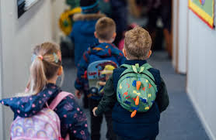
Any Questions?
Thank you!

