Slide 1
Positive attitude matters

Slide 2
Let’s all think positively

Slide 3
Going Bananas

Slide 4
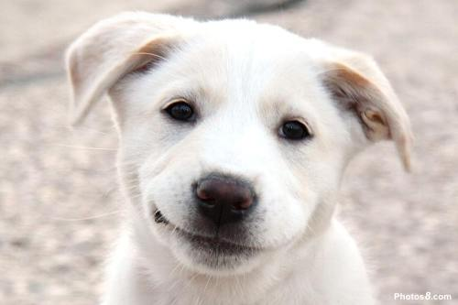
A smiling face and a listening ear

Slide 5
We all learn together

Slide 6
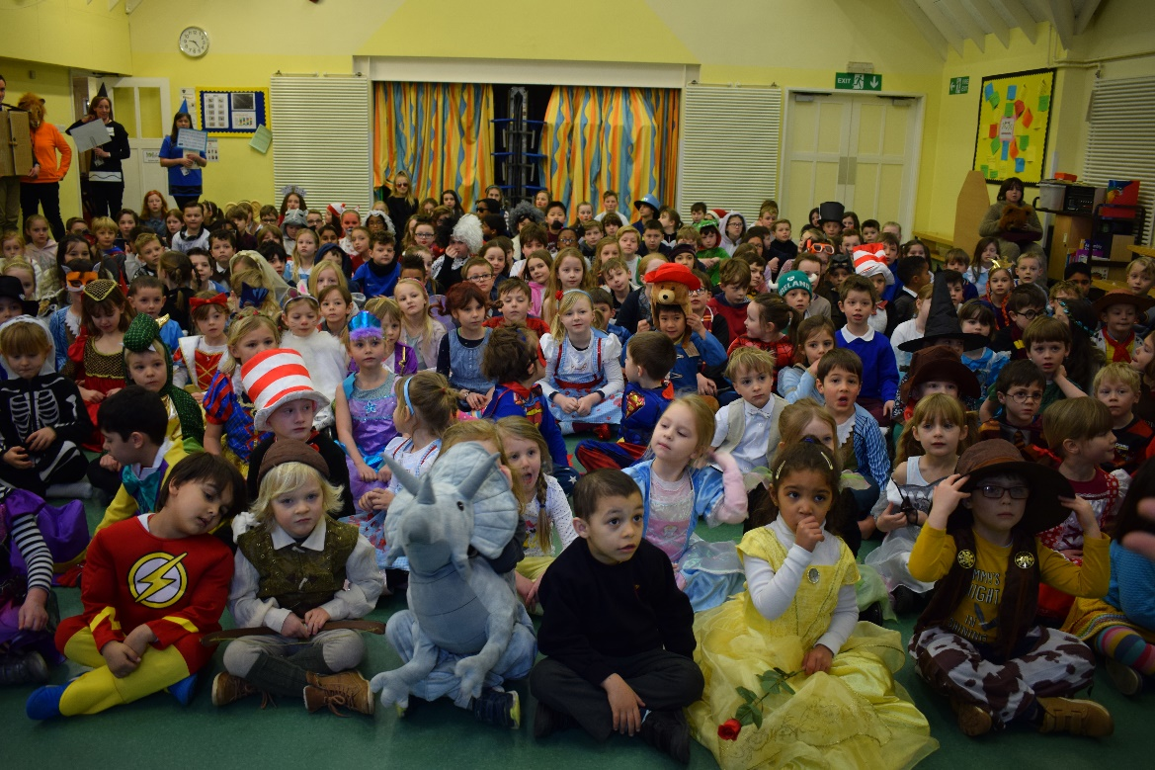
Have a great bananas day

Slide 7
House Points

Slide 8
Sing Happy Birthday to Mrs Ingate

