Slide 1

Welcome to Year 1!
Ms Desai, Mrs Green, Miss Buchanan & Mr Kelly

Slide 2
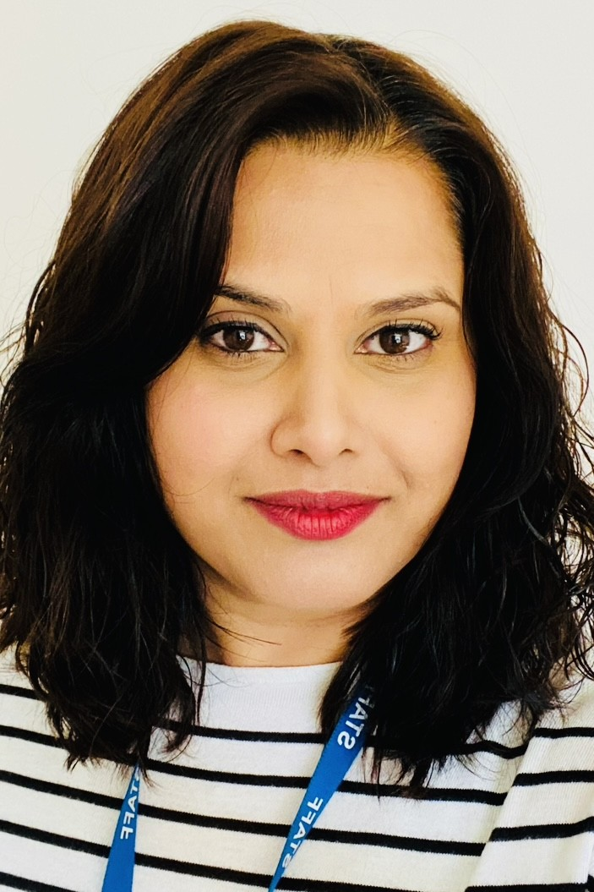
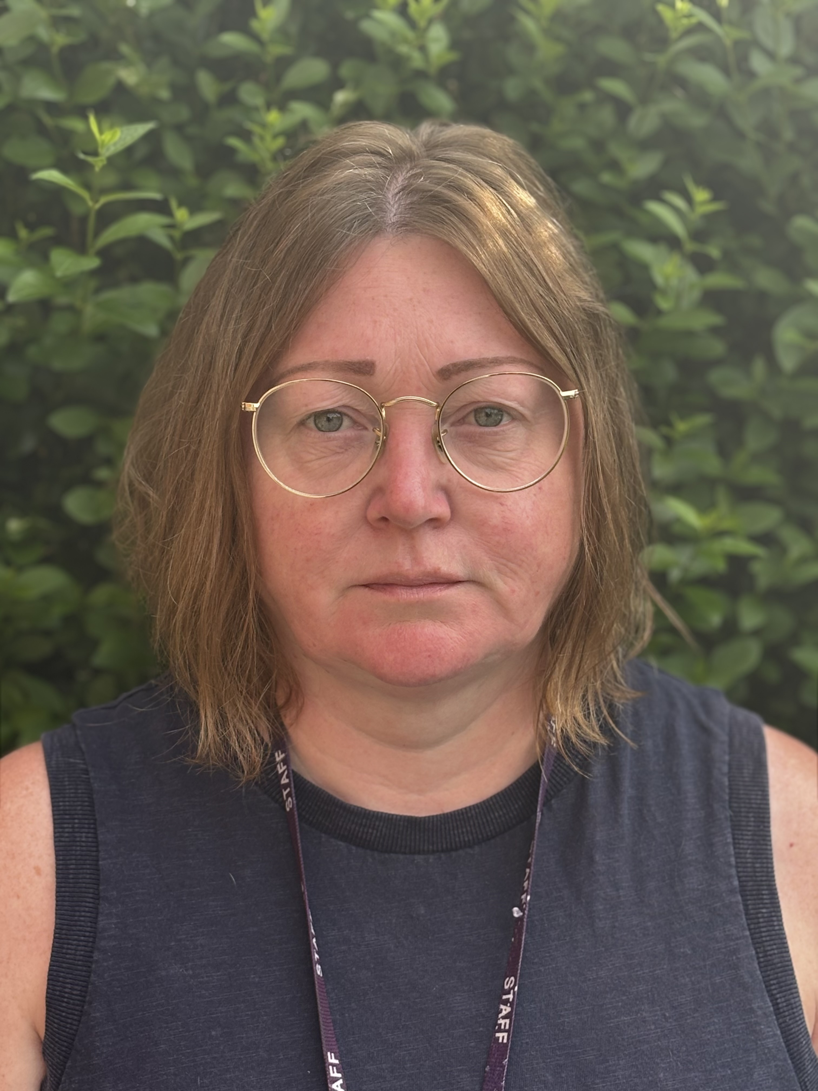
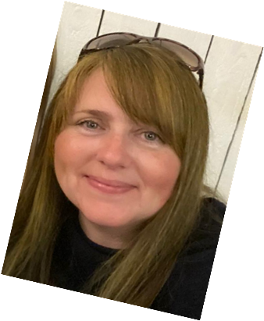
Welcome to Year 1
I am Ms Desai and I am the Year 1 teacher supported by Mrs Green (am) & Mrs Mingins (pm). Mrs Vandenberg will also be teaching one day per fortnight to cover PPA.

Slide 3
A Typical Day in Year 1…
Year 1 is an action-packed year with many thrilling learning adventures along the way!
A typical day begins with the gate opening at 8.40 am. Children enter school via the KS1 door, with school officially starting at 8.55 am - all children are expected to be in class for registration. Upon arrival, book bags are placed in the drawers outside Year 1 and coats on named pegs. The children will begin the day fine motor activity and handwriting. Following registration, focus is on phonics and English. The children will have break and then move on to maths and story time.
Continuous provision will also be in place during these lessons to support and enhance learning. The afternoon runs similarly to the morning, with theme-based learning.

Slide 4
Afternoon
The afternoon starter focus begins with Mastering Maths. Children then move into the foundation subjects, and continuous provision runs alongside teacher-led activities.
Towards the end of the day, we read stories and sing! Throughout the week, the children have daily handwriting practice and whole class/ guided reading.​

Slide 5
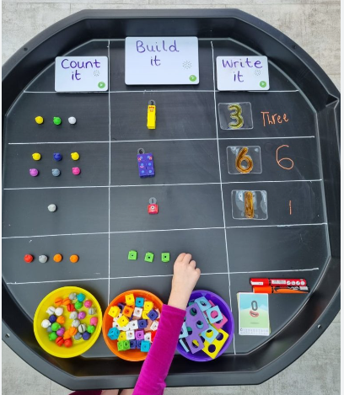
Learning through play
Continuous provision
In Year 1, there is a focus on learning through play. This allows the children to develop their independence, resilience, and determination, whilst covering all areas of the curriculum. The classroom is set up with a variety of resources that the children can access to facilitate their learning.
Each week, the children will complete independent tasks which are linked to teacher-led input and theme. In addition to the challenges, children will also complete learning tasks with adult support.!.

Slide 6
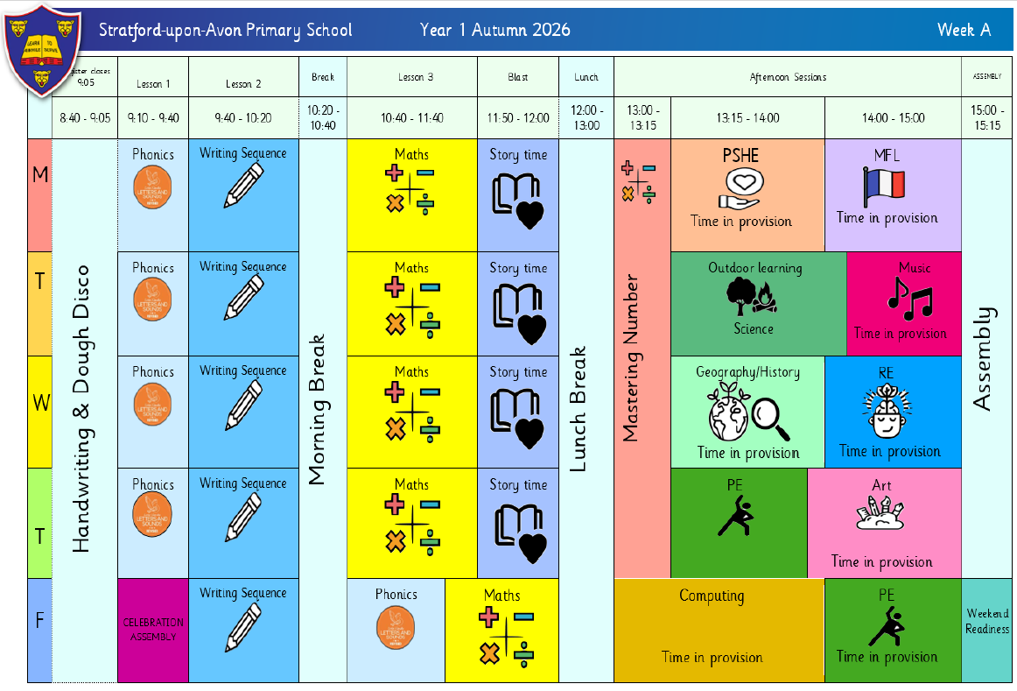
Weekly timetable

Slide 7
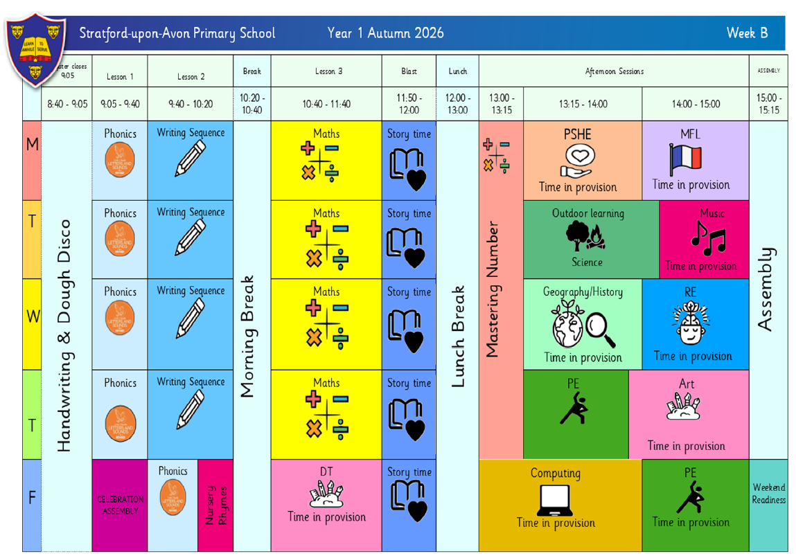
Weekly timetable

Slide 8
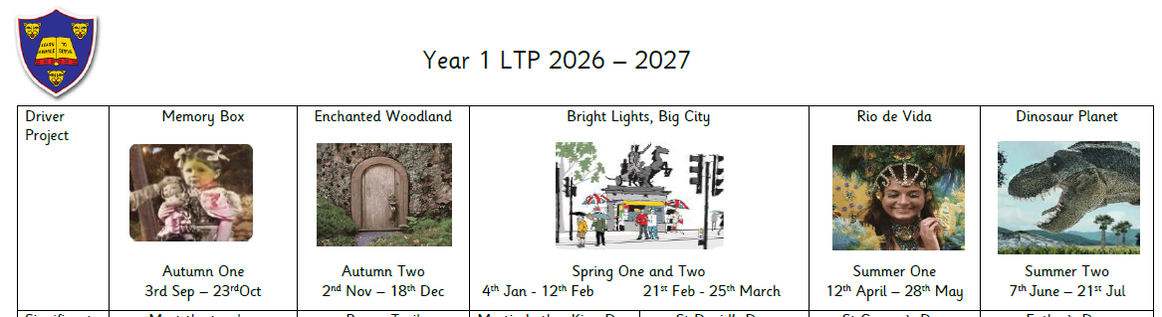
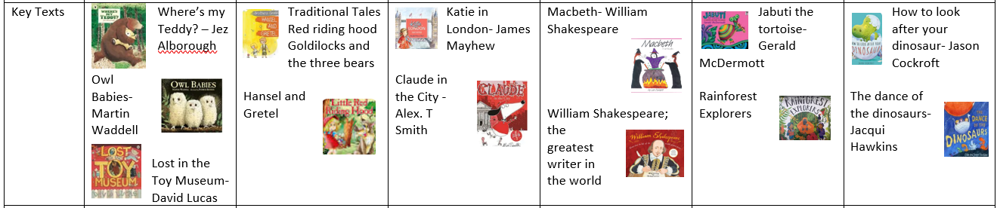
Year 1 Themes and Texts for 2026-2027

Slide 9
Maths – Scheme of learning
Autumn
Place Value
Addition and Subtraction
Shape
Spring
Place Value
Addition and Subtraction
Place Value
Length & Perimeter
Mass & Volume
Summer
Multiplication & Division
Fractions
Position & Direction
Place Value
Money
Time
Mastering Maths deepens children’s mathematical understanding and knowledge, providing meaningful opportunities to apply learnt skills.

Slide 10
Topic Learning
In addition to the morning core subjects, children will learn about science through outdoor learning. The foundation subjects - including geography, history, French, ICT, RE, PSHE, music and art/DT – are linked to each term’s theme of learning, incorporating cross-curriculum teaching wherever possible.

Slide 11
PE and Outdoor Learning
Year 1 PE lessons are on Thursday and Friday afternoons. Please ensure children come to school dressed in PE kits.​ Suitable black trainers will be needed.
​Our outdoor learning sessions will be on Tuesday afternoons, which take place in our garden or paddock. Children will need to bring in suitable clothing i.e. long sleeves and full-legged bottoms (weather dependent) which they will get changed into. They will also need appropriate shoes such as wellies, and waterproof coat and trousers. ​
​
PLEA: Please ensure every item is clearly named!

Slide 12
Trips & Visitors...
To further enhance the curriculum and children’s class-based education, we have planned trips and experiences that will captivate and stimulate intrinsic learning.
The planned events for the year are…
Holy Trinity Harvest Festival – w/c 28th Sep
Year 1/2 Christmas Play – 11th Dec
Poppy Trail – 13th Nov
Fire station visit - TBC
Science Fair – w/c 8th March
Out and about: Shakespeare Week – TBC
Shakespeare Trail – TBC
Carnival Day – TBC
All Things Wild - TBC

Slide 13
Assessment…
Consistent assessment is conducted daily, with live marking and targeted questioning as the children are working. This enables purposeful and effective feedback that addresses any misconceptions or specific knowledge gaps.
Throughout the year, children will undertake termly assessments in reading/phonics, writing and mathematics to inform the teaching team of next steps to support learning.
In June, Children will be assessed in phonics as part of the national screening assessment. This is a check where the children have to read real and nonsense (alien) words, e.g. wup. Whilst it is a statutory assessment, it is delivered in an encouraging and relaxed manner.
The Statutory Assessment does not make up the whole picture. We use teacher assessment to make a final judgement on whether children have met the ‘Expected Standard’ for the end of Year 1.

Slide 14
Home Learning…
Reading- Please read with your child daily, books and reading records need to be in school every day! Books are changed on Fridays. The children will come home with a book linked to phonics sounds and a book for pleasure. Children will read in groups at least three times a week in school with an adult.
Phonics- Delivered via daily whole class practice. Links have been added to the next page to support parents teaching at home.
Maths- White Rose Maths One Minute Maths, KIRFs and number formation.
Spelling- Each week, the children will be given five tricky words to learn. These will come home in small folders. New words will be added once they can read, spell and write the word.
Writing- When completing work with your child at home please help them to form their letters correctly; including starting and ending them in the right place. There is a link to a video to support the correct formation at home. As discussed early, daily letter formation and handwriting practice will take place between 8.40 – 9am.
.

Slide 15
Phase 2 sounds- single sound
https://www.youtube.com/watch_popup?v=-ZtjFIvA_fs
Phase 2 sounds
https://www.youtube.com/watch_popup?v=qDu3JAjf-U0
Phase 3 sounds
https://www.youtube.com/watch_popup?v=DvOuc7cWXxc
Tricky Words
https://www.youtube.com/watch_popup?v=3C1KTDag0ZA
Parent Phonics Page
https://www.littlewandlelettersandsounds.org.uk/resources/for-parents/
Letter formation
https://www.youtube.com/watch_popup?v=2a_e2z78xM4&list=PLGCpNseRUqM4DZKJwKPKmRxTc0lsP0l47
Maths App
https://whiteroseeducation.com/1-minute-maths

Slide 16

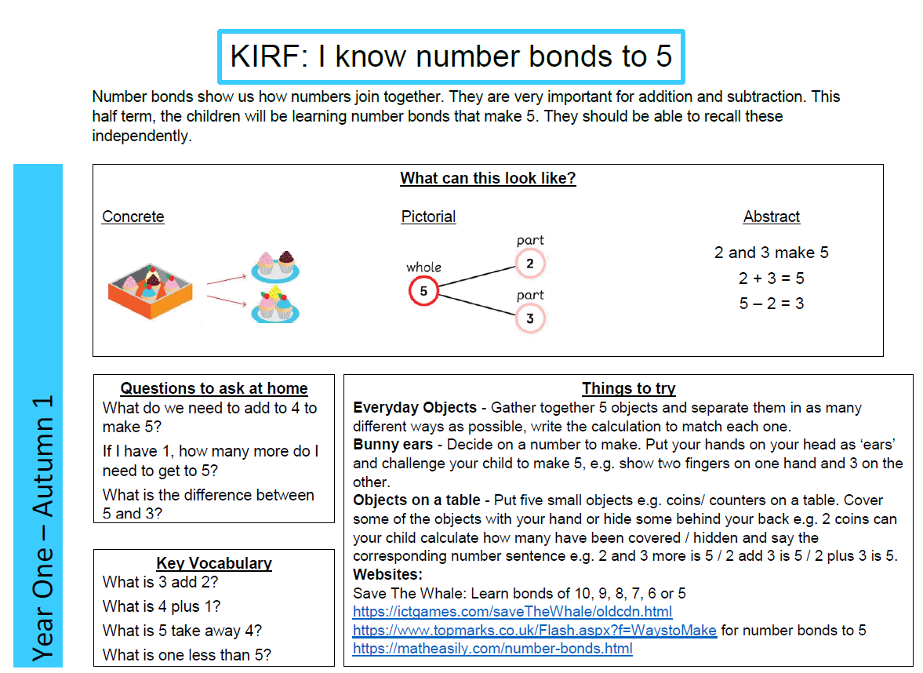
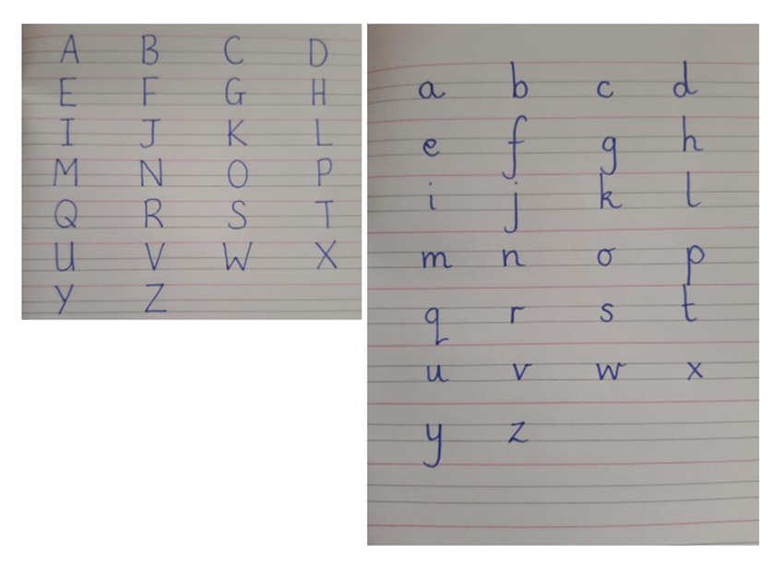
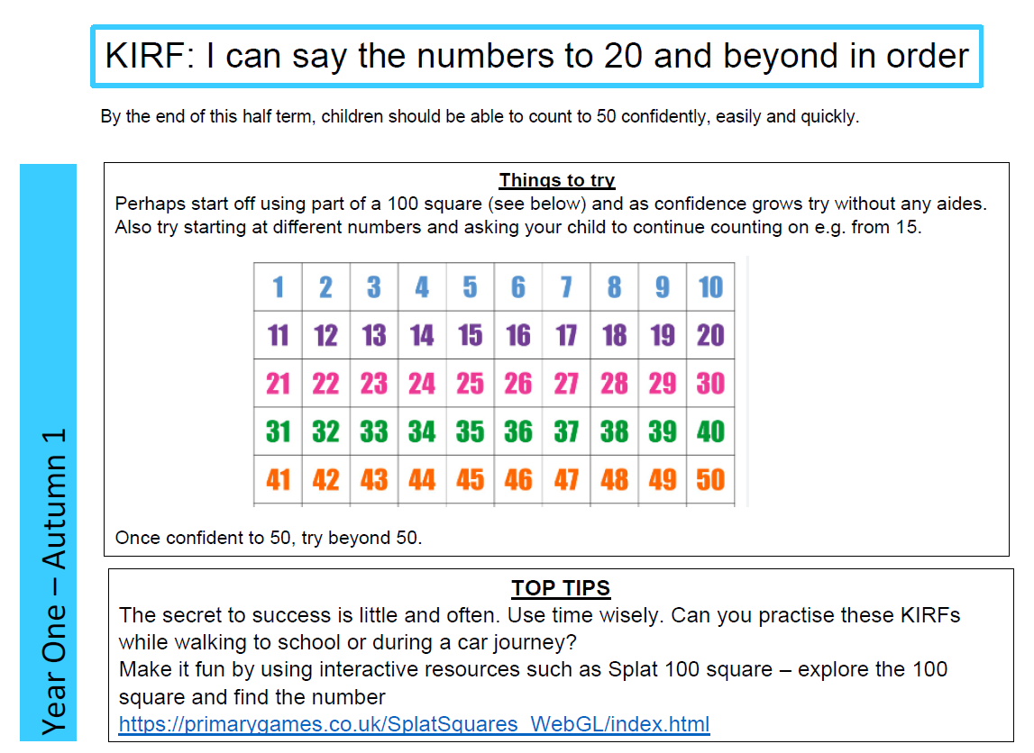
.

Slide 17
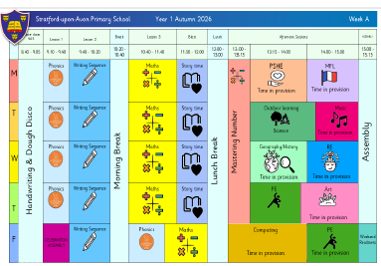
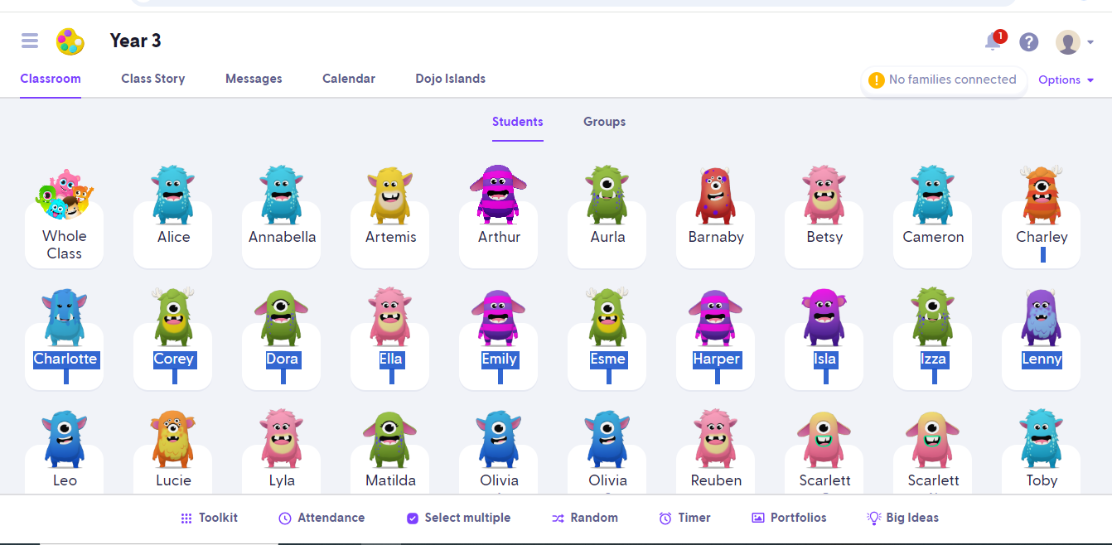

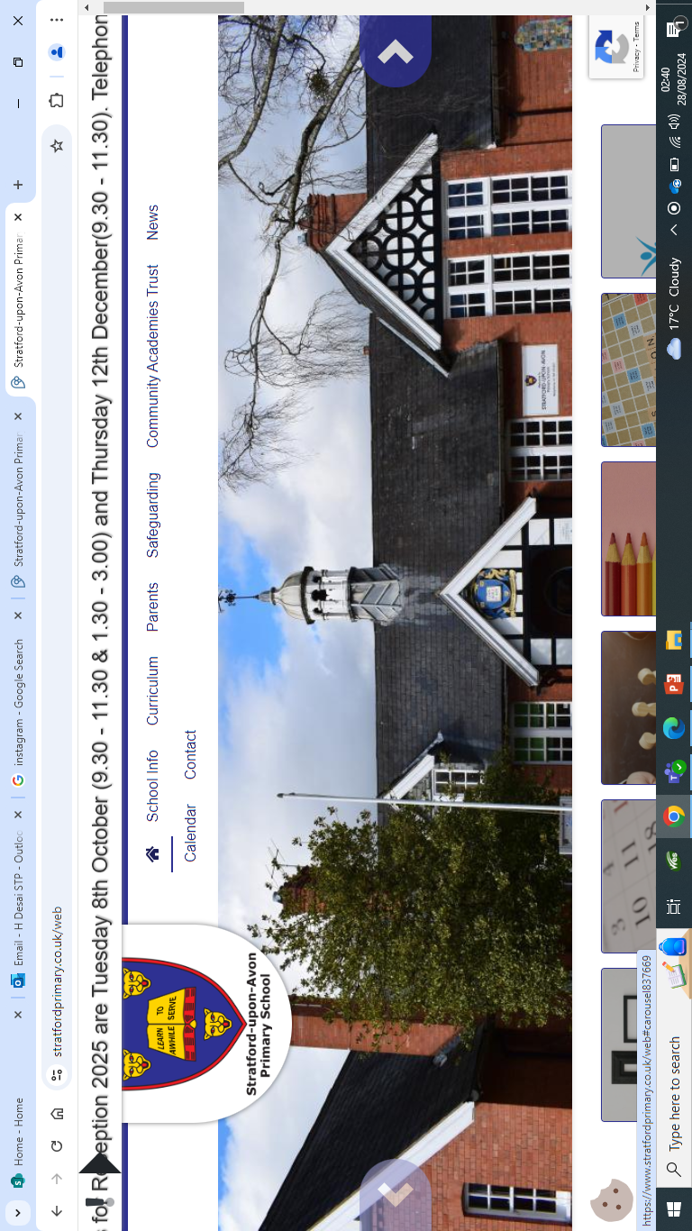
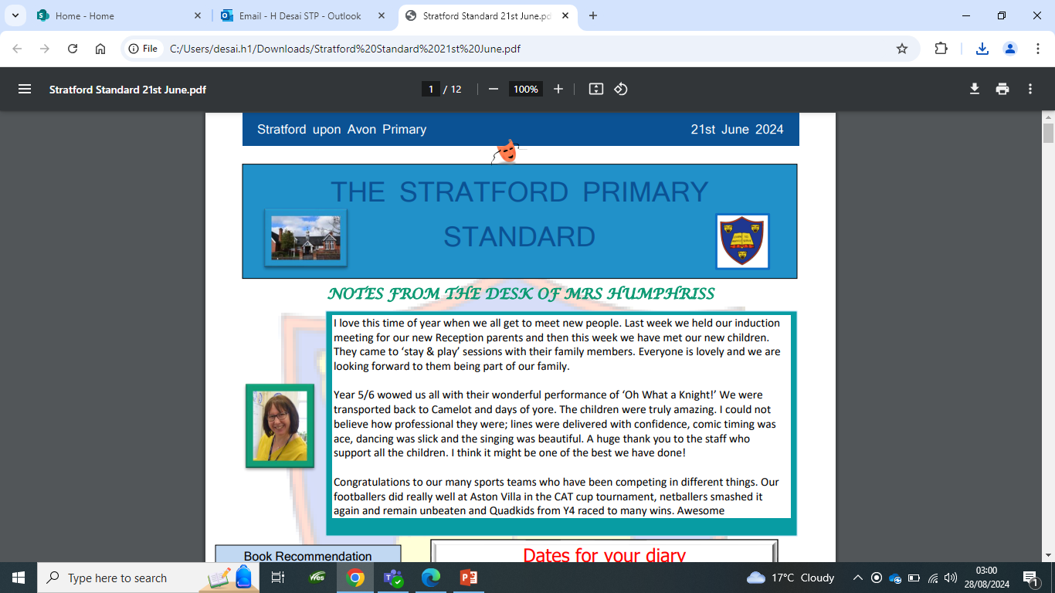
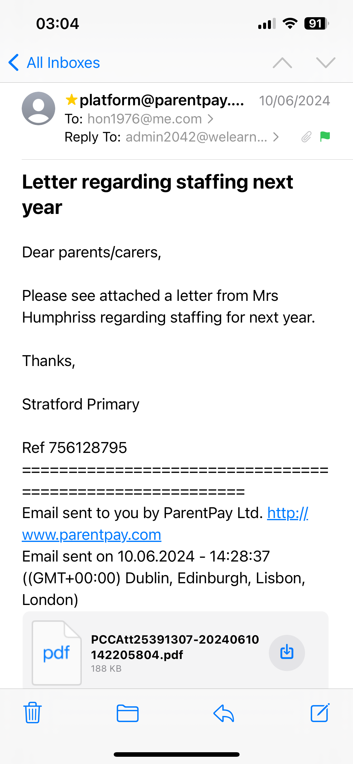
Communication…
Timetable
ClassDojo
Instagram - stratforduponavonprimary
Website
Monthly Newsletter
Emails

Slide 18
Communication…
We are here to support and listen!
You will receive communication via parent letters, emails, monthly newsletter, school website and ClassDojo.
You can contact me via ClassDojo. However, if the matter is urgent please email admin2042@welearn365.com and it will be forwarded on to me. Please note staff can only respond to emails/messages between 8am – 5pm (and not during direct teaching time). Do regularly check ClassDojo for general class messages.
You can also talk to the member of staff on the gate in the morning about any general enquiries or seek me out at the end of the day. If you require an appointment to speak to me or any other member of staff, this can be arranged directly at the end of the day or via the school office.
​​Serious injuries will be either a phone call home or a face-to-face chat. Minor injuries such as cuts and grazes will be communicated via accident forms, which are given out at the end of the day.​​​

Slide 19

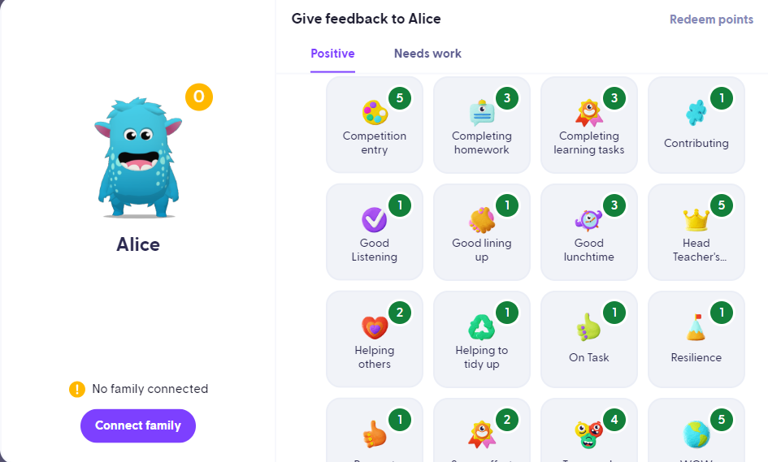
Celebrating Success…
Celebration Assembly: Head Teacher’s Award, Learner of the Week, Well-being Warrior Respect Certificate.
Affirmations, Stickers, Dojo Points, House Points and class favourtie - Friday afternoon Year 1 Celebration
Shakespeare Hall Arden Hathaway

Slide 20
Expectations…
Behaviour – high expectations are required: in class, in playground, moving around school, on trips, when visitors are in and at after school clubs . Class contract and One School Rule of RESPECT!
ClassDojo points and house points.
Please clearly label all uniform and personal items and it is the children's responsibility to look after these.
We are proud of our presentation: in school and when completing homework.
Promoting independence: encourage children to organise themselves for a successful day; to inform staff when they need a book changed, need to hand in a letter, bring sheets and uniform home, hand homework in; taking ownership, building greater self-esteem and sense of achievement.
.

Slide 21
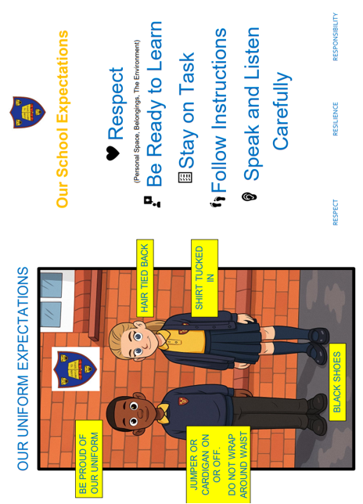

Slide 22
Final points of importance…
ParentPay – lunches and trip payments
Medicines – Only prescribed medicines with child’s name are permitted. They must be handed to the office. No medicines should be left in a child’s bag.
School uniform/PE kit/ snack pots should all be clearly labelled and it is the children's responsibility to look after these.
Healthy snacks – NUT FREE! No sweets or chocolate
In accordance to new statutory guidance holidays/leave of absence will NOT be granted except in exceptional circumstances.
RESPECT – the one school rule

Slide 23
Additional Support/Concerns DSL
The DSL team are always here to listen and support you with your concerns!
Designated Safeguarding Lead:
Mrs Humphriss
Deputy Designated Safeguarding Leads:
Miss Parton
Mrs Chisholm
Ms Desai
Mrs Nailor
Please call or email the office to arrange to speak to one of the DSL team

Slide 24
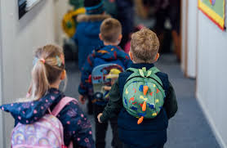
Any Questions?
Thank you!

