Slide 1
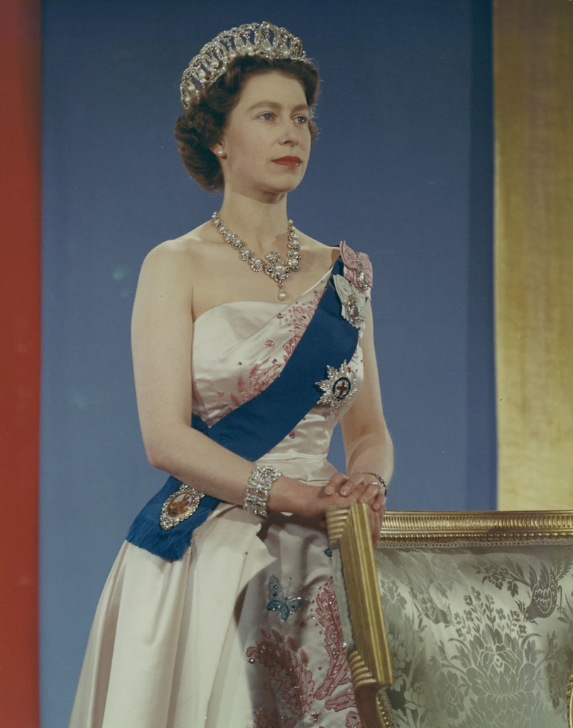
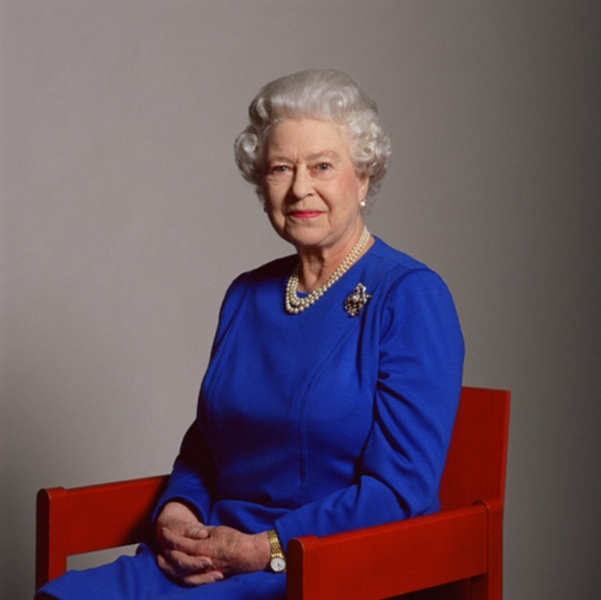
Queen Elizabeth II 1926 - 2022
Notes:
Our nation mourns a mother, a grandmother, a great-grandmother and Our Queen – for many of us in our country and the world we have only known this incredible woman.

Slide 2
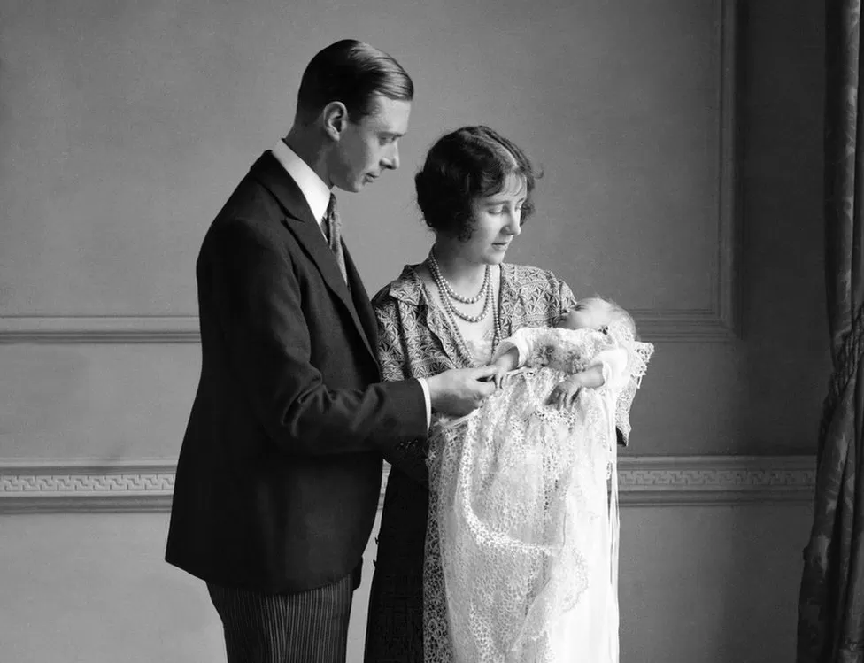
Notes:
Elizabeth Alexandra Mary Windsor was born on 21 April 1926, in a house off Berkeley Square in London. She was the first child of Albert, Duke of York - the second son of George V - and his wife, the former Lady Elizabeth Bowes-Lyon

Slide 3
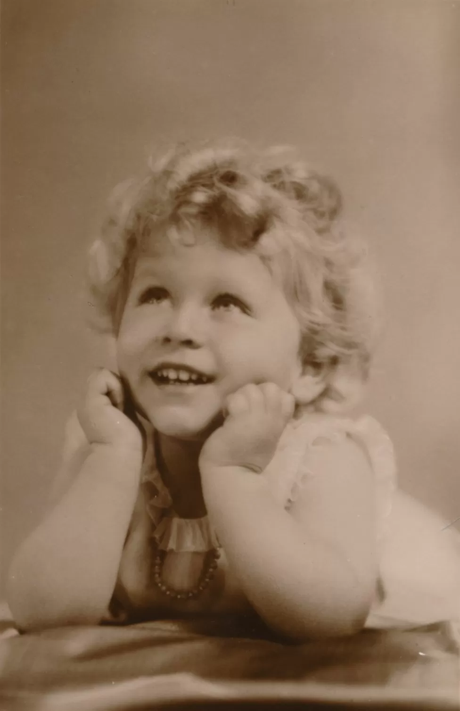
Notes:
In her early years, the throne was not her destiny

Slide 4
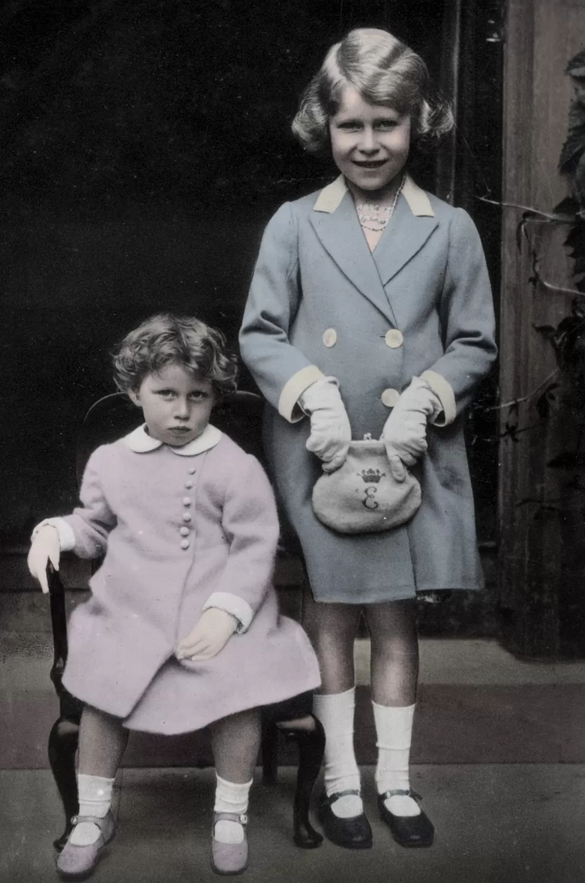
Notes:
She was educated at home with her sister Margaret. Her father was not the king at this point.

Slide 5
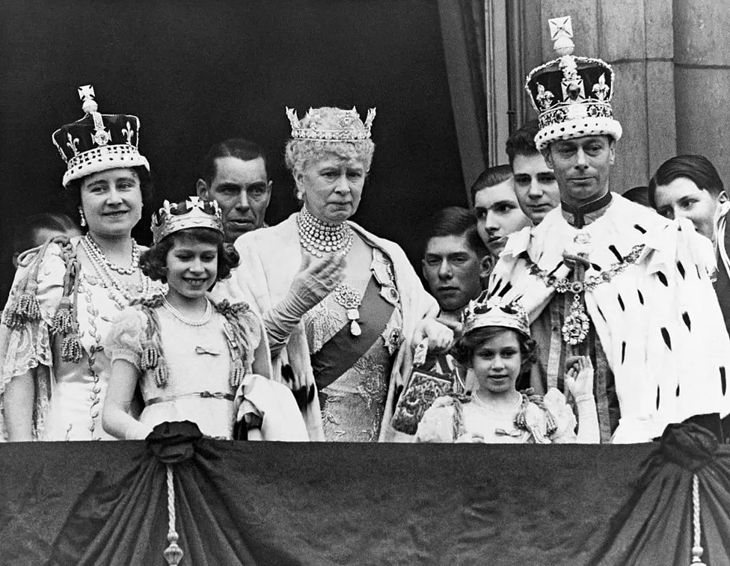
Notes:
Following the abdication of King Edward VIII in 1936, Elizabeth's father became King George VI and she became heir

Slide 6
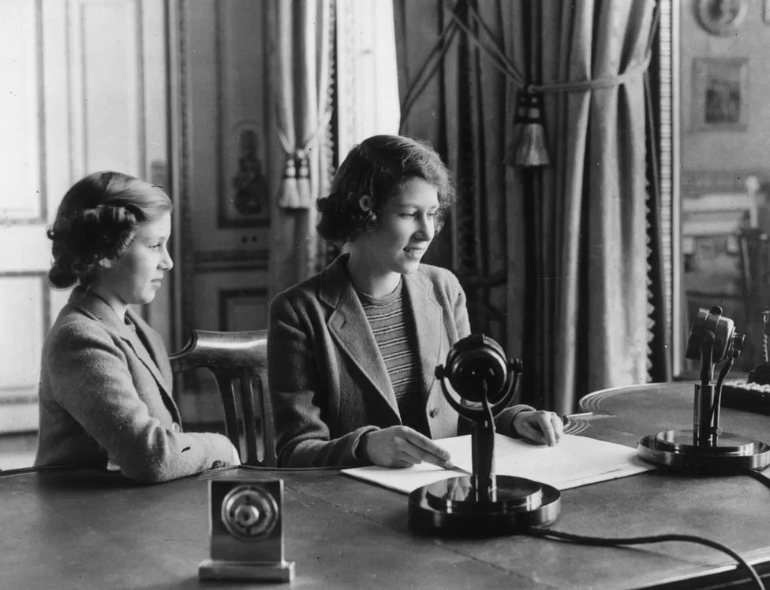
Notes:
During World War Two, Elizabeth and her sister Margaret were evacuated to Windsor. This picture shows them broadcasting to the nation for Children's Hour on the BBC

Slide 7
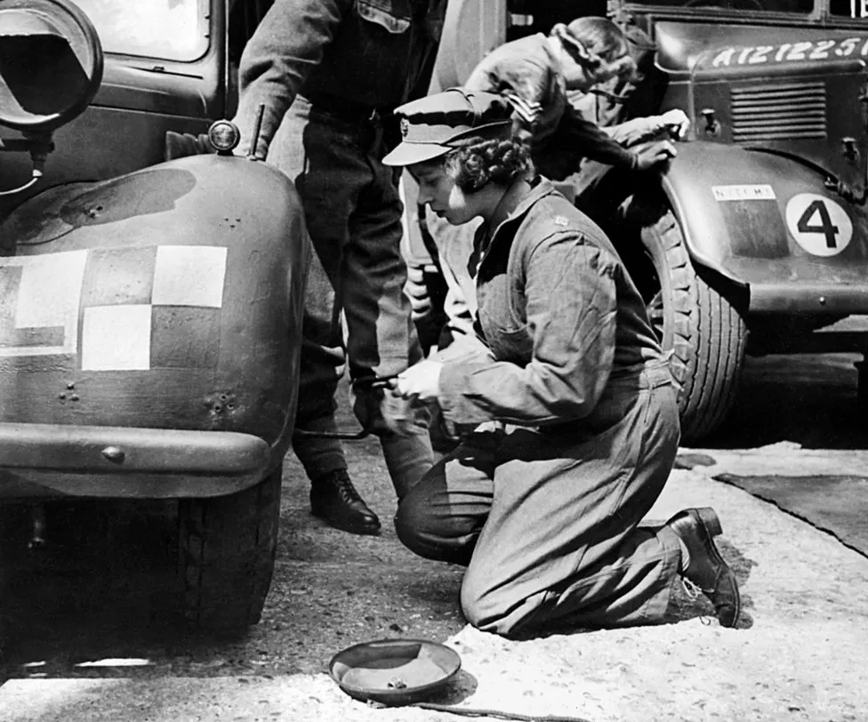
Notes:
The young princess briefly joined the Auxiliary Territorial Service (ATS) towards the end of the war, learning to drive and service a lorry

Slide 8
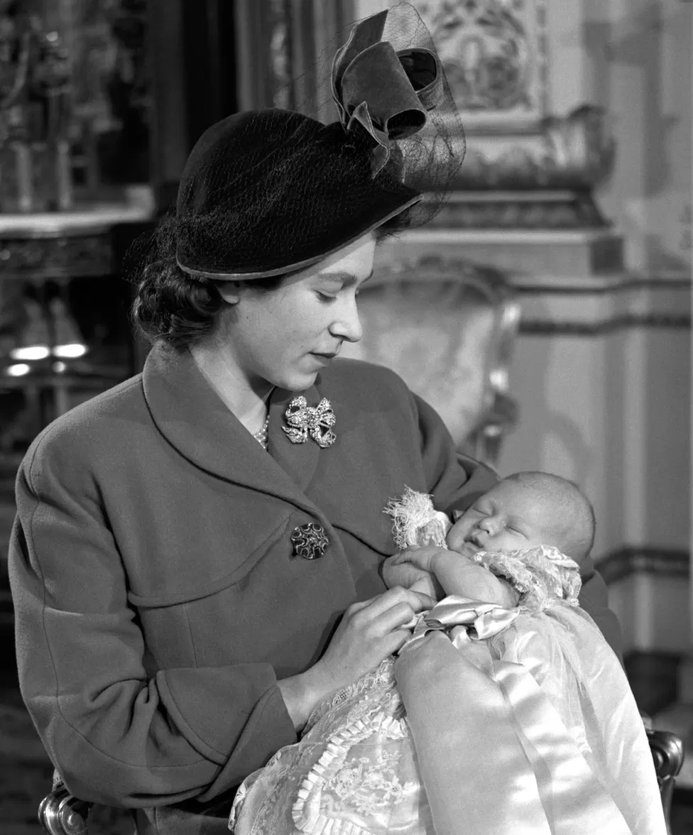
Notes:
In 1947 she married Philip Mountbatten and welcomed their first child Charles in 1948

Slide 9
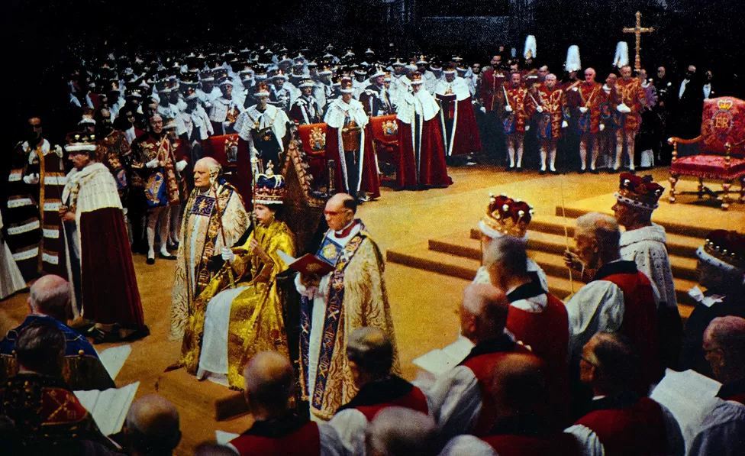
Notes:
Then, in June 1953, Elizabeth was crowned at Westminster Abbey

Slide 10
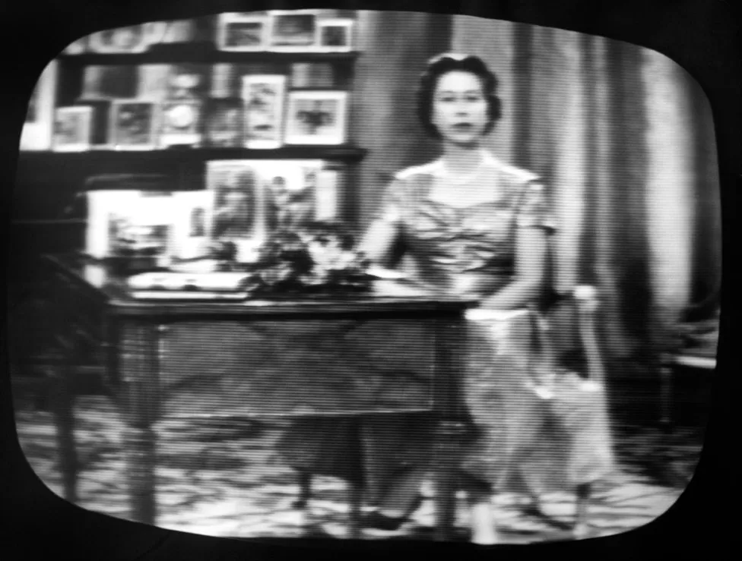
Notes:
In 1957, the Queen made the first of many televised Christmas Day broadcasts to the nation. She embraced all new technology including making zoom calls during the pandemic

Slide 11
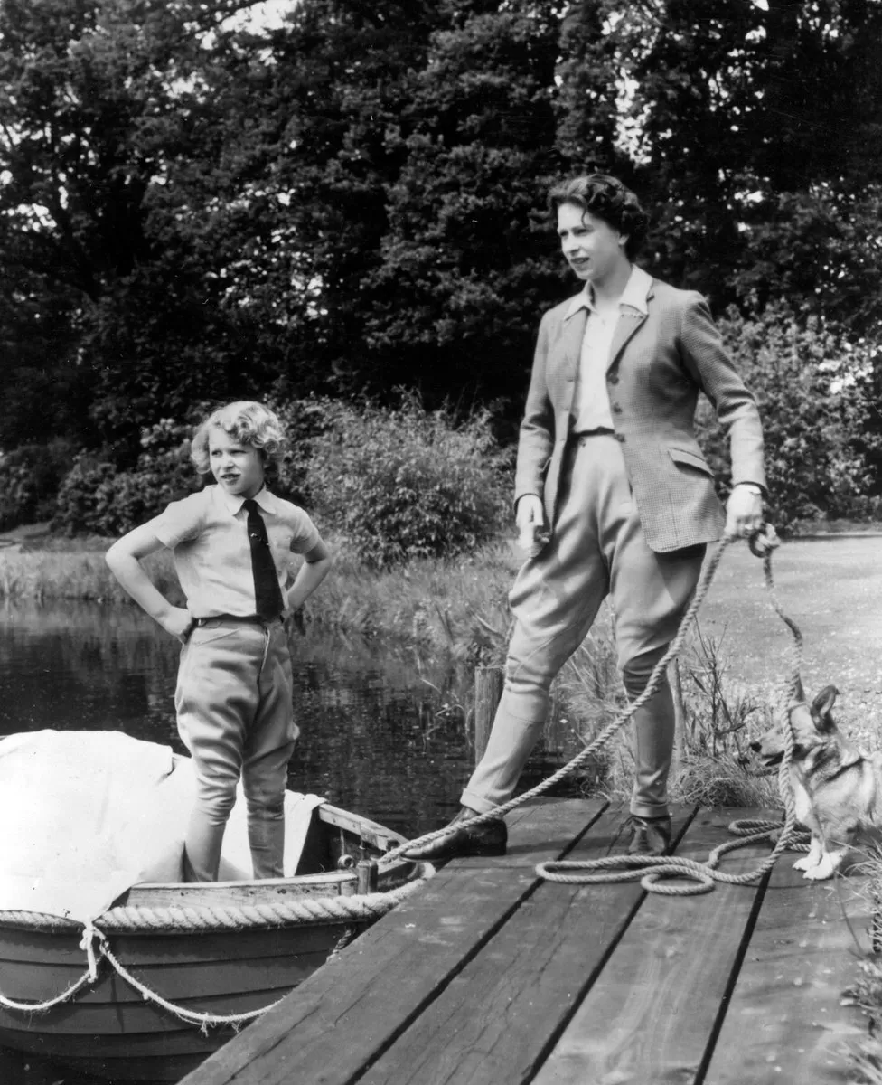
Notes:
Between official engagements Elizabeth spent time with her family - here with her daughter Princess Anne at Frogmore, Windsor Castle

Slide 12
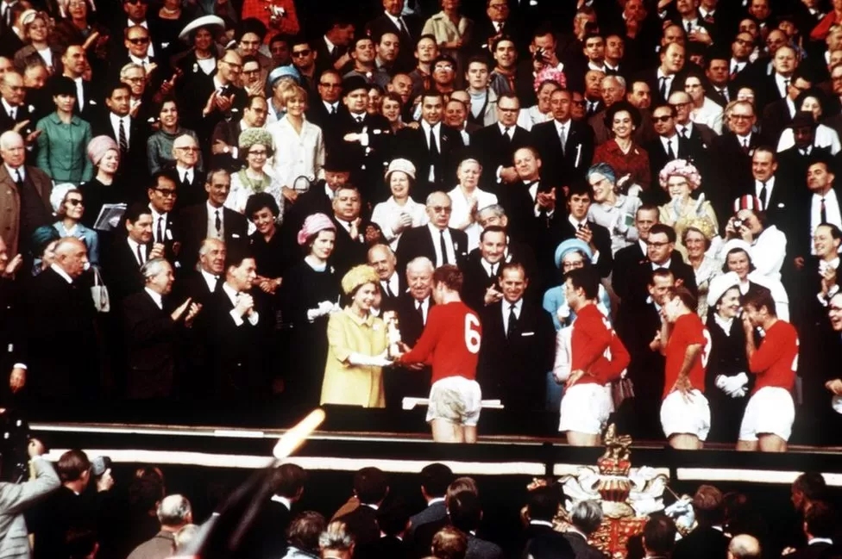
Notes:
In 1966, at Wembley, the Queen presented the Jules Rimet Trophy to England captain Bobby Moore after he led his team to a 4-2 World Cup final victory over West Germany

Slide 13
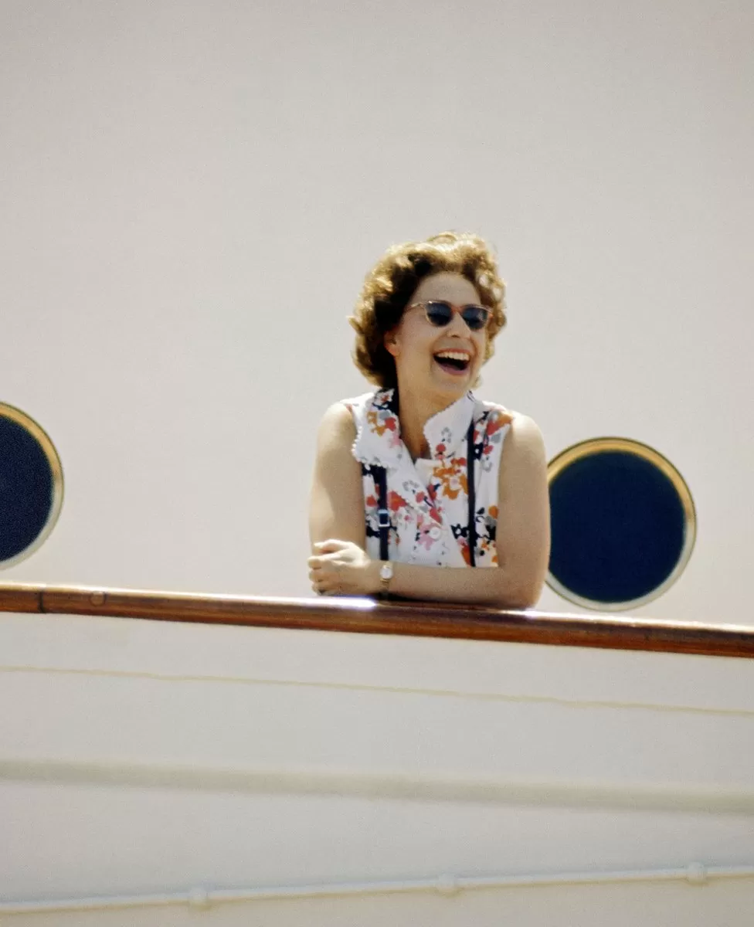
Notes:
In 1972 the Queen was pictured on board HMY Britannia as part of series of photographs taken for use during her Silver Wedding Celebrations.

Slide 14
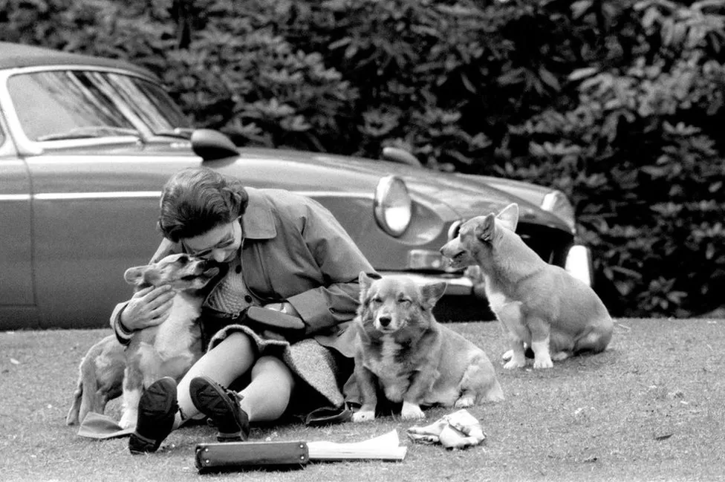
Notes:
Throughout her reign the Queen has been pictured with corgis at her side. The Royal Family's ties with the breed began when the future George VI bought a corgi called Dookie for his daughters in 1933

Slide 15
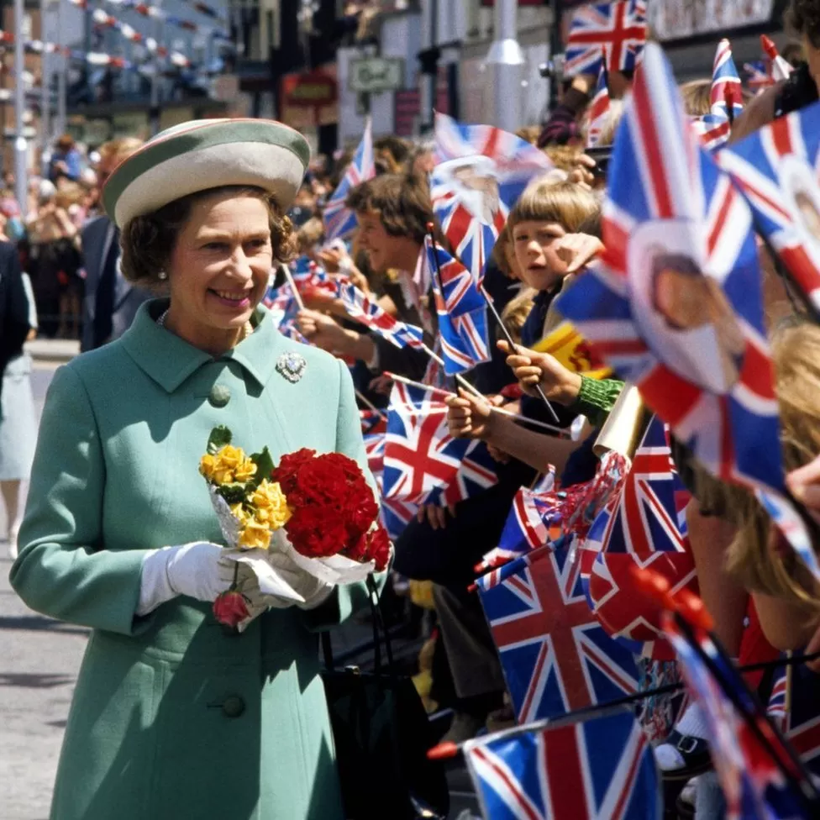
Notes:
In 1977 the country celebrated the Queen's Silver Jubilee, marking 25 years on the throne. The Queen was met by enthusiastic crowds as she toured the country

Slide 16
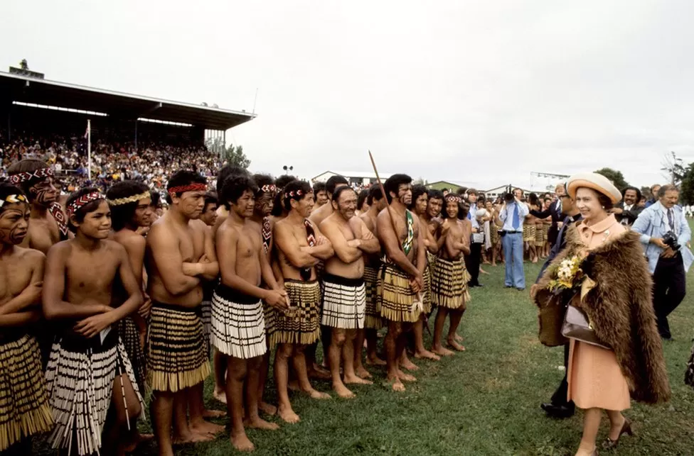
Notes:
Year by year, the Queen's public duties continued. Her Majesty and the Duke of Edinburgh received a New Zealand Maori welcome at the opening of the Royal New Zealand Polynesian Festival

Slide 17
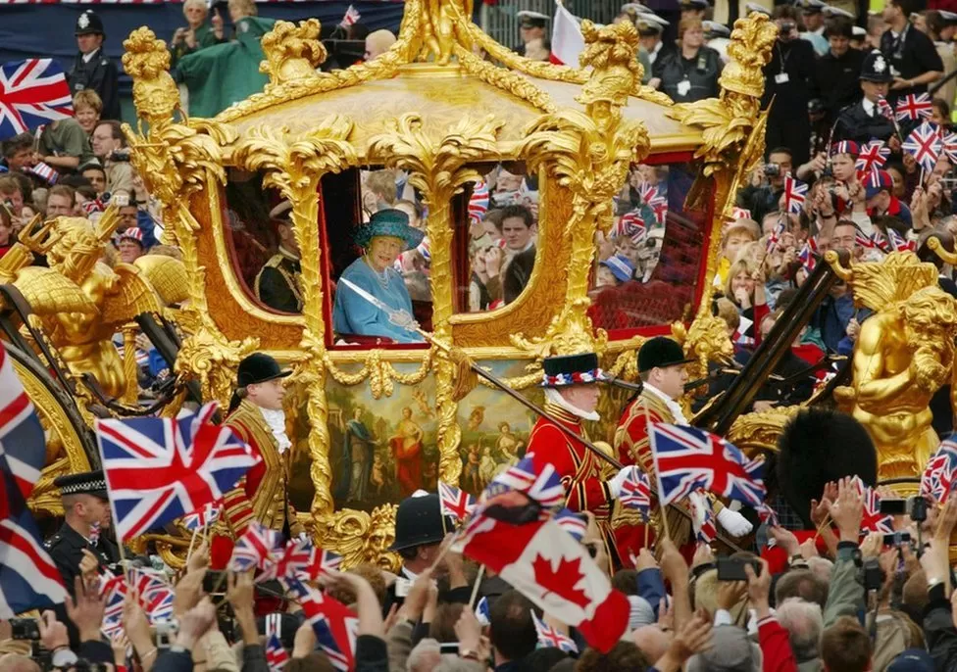
Notes:
The Queen enjoyed a swell of support that summer as she celebrated her Golden Jubilee. Huge numbers turned out for a parade and a million people crowded into The Mall on the evening of the Jubilee on 4 June

Slide 18
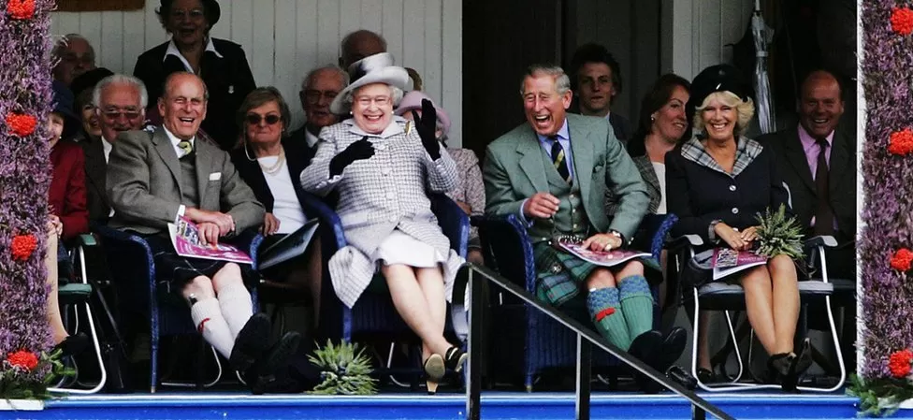

Slide 19
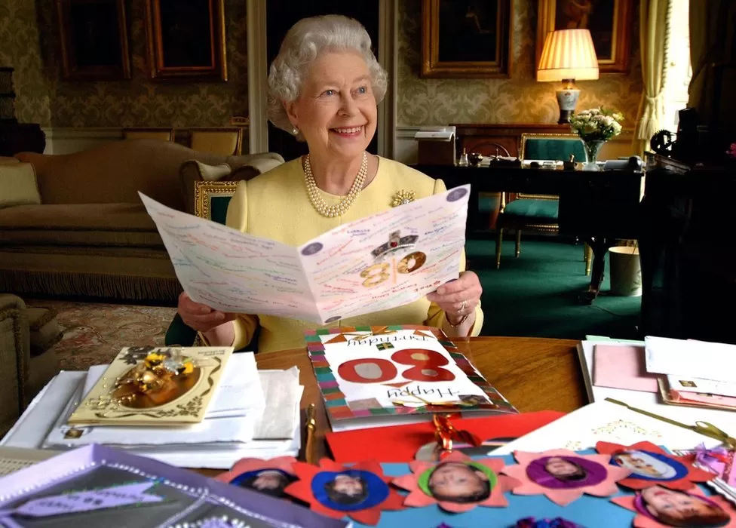
Notes:
The Queen quoted Groucho Marx's dictum on ageing in a speech to celebrate her official 80th birthday saying: "Anyone can get old; all you have to do is to live long enough"

Slide 20
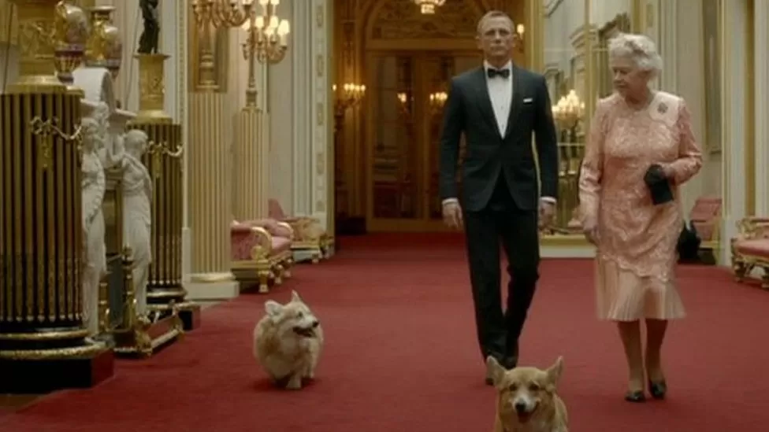
Notes:
Diamond jubilee This was closely followed by an appearance in the opening ceremony of the London Olympics, in a filmed sequence alongside another British icon, James Bond, played by actor Daniel Craig

Slide 21
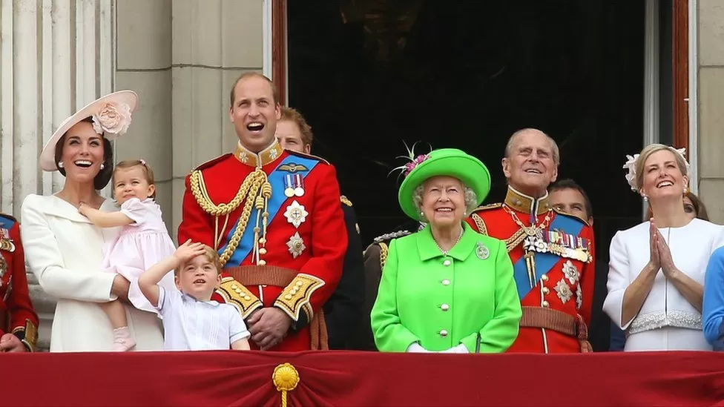
Notes:
The Queen was joined by other members of the Royal Family for her official birthday celebrations in June 2016. She had turned 90 earlier that year

Slide 22
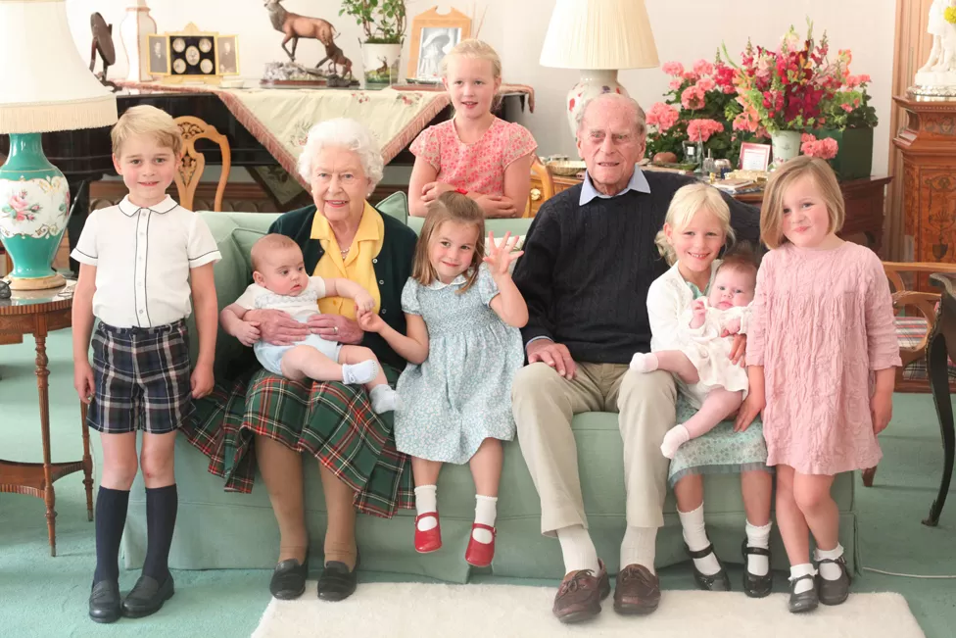
Notes:
The Queen is survived by her four children, eight grandchildren and 12 great-grandchildren

Slide 23
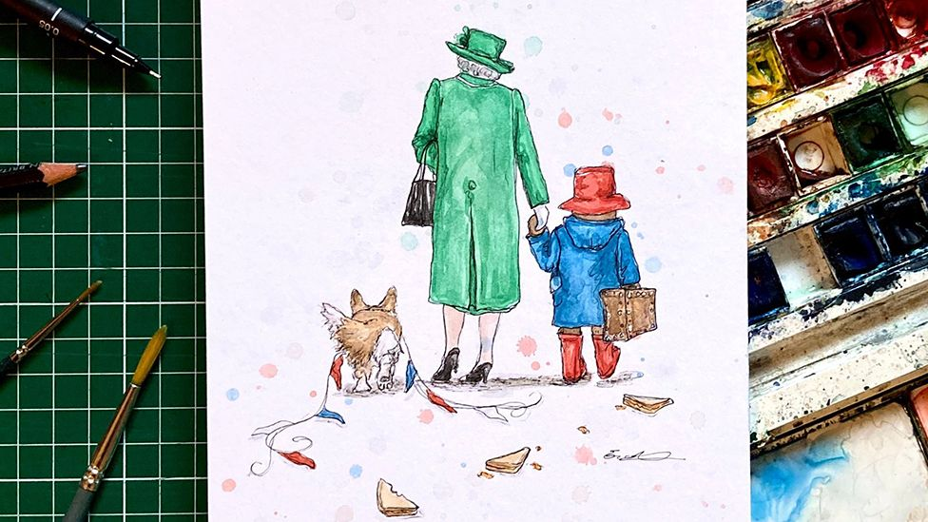
Notes:
Even this year for her platinum celebrations she met with Paddington for tea and made a nation happy . A minute silence.

Slide 24
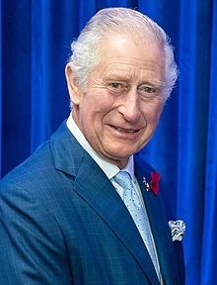
King Charles III

