Slide 1
Welcome back

Slide 2
Feel your Force
Find yourself, your vision, and your path, Don't just think of reading, writing, and math. The educational journey is a winding course, But YOU, my child, are a beautiful force.
.

Slide 4
RESPECT
Respect yourself and others
Walk in school on the left
Smile and stop for adults
Talk quietly in corridors
Listen to each other
Seek help

Slide 5
Class Dojo

Slide 6
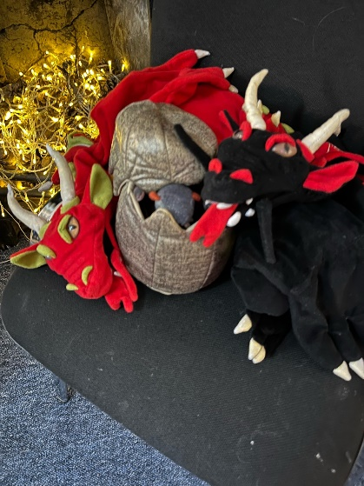
What do we need to remember?

Slide 7
What have we got to look forward to?

Slide 8
Wake up Shake up

